Slide 1




HOW TO USE - NOTES FOR TEACHERS
These resources from Historic Royal Palaces are multi-purpose.
They are ready for you to tweak and use in your lessons.
For the best experience, download and open the
file in the PowerPoint
desktop app.
Answers are found
under the slide. Click
on the notes symbol at
the bottom of the screen.
Delete text and images to make your own worksheets.
Disclaimer and Use Terms
We are the owner or the licensee of all intellectual property rights in these resources which are protected by copyright laws and treaties around the world. All such rights are reserved. These resources, and the content included within them, may be used by you for educational purposes only. This means that you may download the resources and use or share them solely in educational environments (including for home school lessons) or as part of homework. You may not share the resources other than for the above purposes and you must not use the resources, or any part of them, for any commercial purpose.

Slide 2

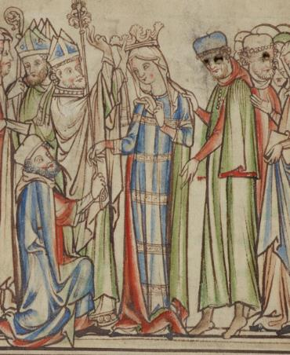
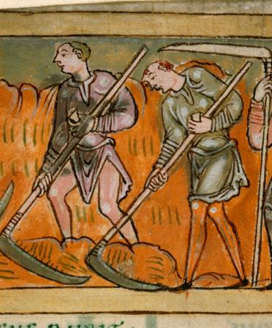


Queen Edith and Saxon Farmer
QUEEN
SAXON
EDITH
FARMER
An intelligent and resilient
Saxon Queen
A free man who worked the land to support himself and his family
Edith was well educated and spoke
several languages.
Edith married King Edward the Confessor in 1045 and was crowned queen.
Became one of his closest advisors.
After he died, Edith’s brother
Harold became king.
She became one of the richest women
in England.
In 1066, her brother King Harold was killed at the Battle of Hastings.
She was one of the very few English landowners to keep all their lands
after the battle.
She later became the patron of a biography of King Edward.
At the time, the walled city of London was surrounded by farmland.
© Cambridge University Library
Courtesy of the British Library
Cotton Tiberius B. V, Part 1
Lived: c.1025 - 1075
Birthplace: England
Reigned: 1045 – 1066
Most Saxons living in England at the time of the Norman Conquest were farmers. They usually paid rent for their land to a lord.
After 1066, the Normans introduced the feudal system to England. All farmers now had to work for a set number of days a week on their lord’s land.
Grew a wide range of crops including einkorn (a type of wheat), barley and oats.
Made and used tools such as scythes, forks and billhooks, and ploughs pulled by oxen.
Kept cows, sheep, pigs, goats, chickens and ducks.
In the biography, Edward and Edith are presented in a saintly light.
Q:
What evidence is there that
Edith was an intelligent and resilient woman?
Q:
Can you describe the tools the farmers in the image are using?
How do you think the feudal system changed their lives?
Notes:
Edith notes: Edith spoke several languages and became one of her husband’s closest advisors. After the Battle of Hastings, she was in a vulnerable position as both her husband and brother were dead. (Her other brothers had also either been killed or taken prisoner.) She still managed to keep all her lands and cleverly strengthened her position through the biography of her husband.
Saxon farmer notes: The farmers are harvesting a tall crop, perhaps einkorn. The farmers are using tools with a long handle and curved blade at the end. They are using these to cut and gather the crops.
After the feudal system was introduced, the farmers were no longer free. They were tied to the land and forced to work for the lord in return for small strips of land to grow crops for themselves.

Slide 3
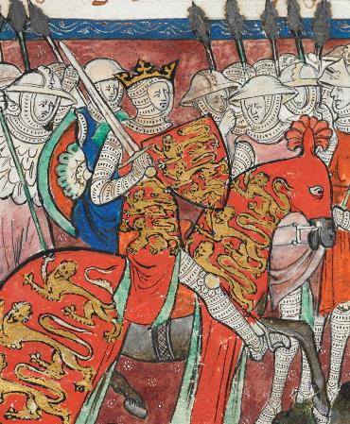
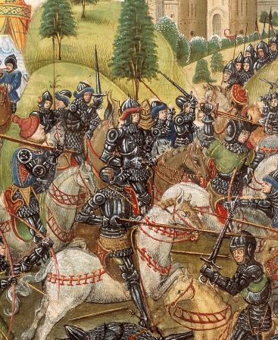


William the Conqueror and Norman Knight
WILLIAM THE
NORMAN
CONQUEROR
KNIGHT
The first Norman King of England
A highly trained warrior who fought
on horseback
William was the son of Robert, Duke of Normandy. William was 8 years old when his father died. At this point William became Duke of Normandy. He grew up to become an experienced and ruthless military commander.
In 1066, he became the king of England after defeating the Saxon King Harold at the Battle of Hastings. After this, he was also known as William the Conqueror.
He knew that the key to controlling England was to control London. He ordered the building of a great stone fortress in London. It took 25 years to complete.
An extremely strong warrior
Liked to hunt and created many new royal forests in England
Some through he was greedy and cruel
Others thought he was generous and fair.
Saxons and Vikings
always fought on foot.
Courtesy of the British Library
Cotton Claudius D.II
Courtesy of the British Library Thompson 33
Lived: c.1027 - 1087
Norman knights were the sons of noblemen. When they were young, they were trained to ride horses and fight with a sword.
At around the age of 18 they were knighted in a ceremony where they were tapped on each shoulder with a sword.
The knights were the Normans’ ‘secret weapon’ at the Battle of Hastings.
Birthplace: Normandy
Reigned: 1066 - 1087
To go into battle, a Norman
knight needed:
a strong warhorse known
as a ‘destrier’
a suit of mail, a helmet and a shield
a sword and a lance.
He was the first king to
be crowned at
Westminster Abbey.
Q:
What items protected Norman knights in battle?
How did the Norman knights help William I to win the battle of Hastings?
Q:
Why do you think William built a huge fortress in London?
Notes:
William the Conqueror notes: William’s main purpose in building the White Tower was as a symbol of power, to control the population of London. The largest of three stone castles he built in the city, it would have dwarfed the small wooden buildings that surrounded it and made a clear statement about who was now in control of the country. It also served as a royal palace and as a garrison for troops.
Norman knight notes: A knight’s helmet was pointed and protected their head. The suit of mail would protect their bodies. Shields were large and would help to protect a large area of their body.
The knights were highly trained soldiers on horseback. This was a great advantage over the Saxon army. The knights were more mobile than foot soldiers and the horses also fought, biting and kicking.

Slide 4
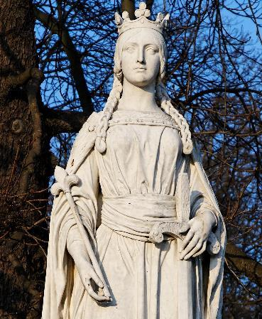
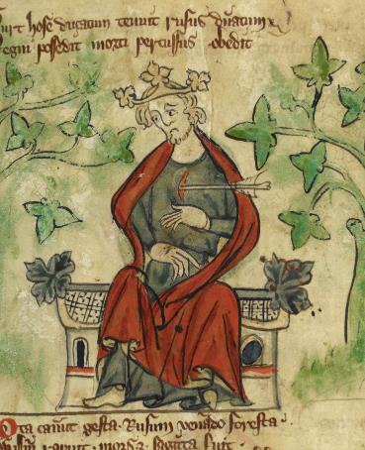
Queen Matilda and William II
QUEEN
WILLIAM II
MATILDA
A powerful Duchess of Normandy and Queen of England
A strong but unpopular king
Matilda’s parents were Count Baldwin of Flanders and Adela of France.
Matilda married William, Duke of Normandy, around 1051.
Served as regent in Normandy when William invaded England.
Crowned Queen of England at Westminster Abbey in 1068.
Matilda and William had four sons and five daughters.
Matilda returned to Normandy after her coronation, and served as regent while William was in England.
She also ruled England as regent when William was in Normandy between 1081 and 1083.
William II was the third son of William I.
His mother was Queen Matilda. He had
an elder brother called Robert who inherited Normandy.
William II was a strong military commander.
Defeated two invasions of England by the Scottish king.
Extended the power of the Normans into areas that had been part of Scotland.
Led invasions against his brother
in Normandy.
William increased taxes to pay for these wars and his expensive lifestyle. He is also known as ‘William Rufus’. Rufus is a Latin word meaning ‘red’.
Jastrow CC BY 3.0
Courtesy of the British Library Royal 20 A. II
Lived: c.1031 - 1083
Lived: c.1057 - 1100
Birthplace: Flanders
Birthplace: Normandy
Reigned: 1066 - 1083
Reigned: 1087 - 1100
Made sure all her children were extremely well educated.
He was killed by an arrow while out hunting, supposedly by accident.
Q:
Can you suggest how William might have got his nickname?
Why do you think he was an unpopular king?
Q:
How did Matilda enable William to rule both Normandy and England?
Notes:
Matilda notes: Matilda enabled William to rule Normandy and England by acting as regent for him when he was away. Without a strong, capable person that he could trust in that role, it would have been extremely difficult for him to maintain his control over both.
William II notes: William may have had red hair or a reddish complexion. He may also have had a fiery temper.
William was unpopular because he taxed people (and the church) heavily. He was also disliked because of his extravagant lifestyle.

Slide 5
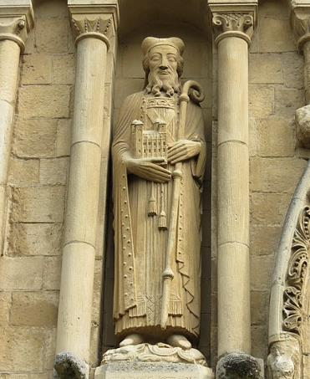
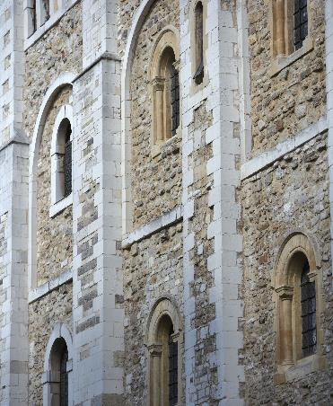


Gundulf of Rochester and Ranulf Flambard
GUNDULF OF
RANULF
ROCHESTER
FLAMBARD
The Norman monk who supervised the building of the White Tower
One of the first prisoners held at the Tower of London and the first to escape
Gundulf was probably born in Normandy and came to England in 1070.
He was a monk and an architect. He was already well known for his skill in designing and building stone castles and churches.
In 1077, William I asked Gundulf to supervise work on a great fortress in London. The work focused on the White Tower at the Tower of London. In exchange, William gave Gundulf the title of Bishop of Rochester and gave him permission to build a new cathedral there.
In 1888, when part of Rochester Cathedral was restored, a statue of Gundulf was added to the building.
Ranulf served King William II and became very unpopular. People blamed Ranulf for new taxes and for trying to make more money for the king.
In 1099, Ranulf became Bishop of Durham. In 1100, William II died and his brother became King Henry I. Ranulf was arrested. He was imprisoned in the White Tower at the Tower of London.
Ranulf’s escape from the Tower is legendary. One story suggests he escaped by:
having a rope smuggled into the Tower in a barrel of wine
giving the wine to his guards, who drank too much and fell asleep
climbing down the rope to where his friends waited with horses.
sailing to Normandy.
Giogo CC BY-SA 4.0
© Historic Royal Palaces
Lived: c.1024 - 1108
Lived: c.1060 - 1128
Birthplace: unknown
Birthplace: unknown
This image shows windows at the White Tower where Ranulf may have been held.
He is also known as the ‘father’ of the
Royal Engineers.
Q:
Gundulf wanted to build churches not fortresses. How did
William persuade him to work on the Tower of London?
What might the statue of Gundulf be holding?
It is said, he paid the king £1000 for his position
as Bishop.
Q:
Can you think of reasons why
Henry I might have wanted to imprison Ranulf?
Notes:
Gundulf of Rochester notes: William offered Gundulf a deal – if he agreed to build the fortress he would be made Bishop of Rochester and could build a new cathedral there.
The statue of Gundulf is holding a model of the White Tower at the Tower of London.
Ranulf Flambard notes: Henry wanted to increase his popularity as a new king. Since Ranulf was unpopular, putting him in prison may have given the King more public support. Ranulf was blamed for Willliam II’s unpopular tax policies.

Slide 6
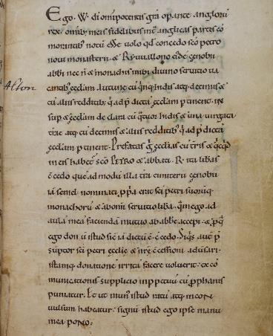
William of Poitiers
WILLIAM
_____________
OF POITIERS
_____________
A Norman priest who wrote a biography of William I
William was born into a wealthy Norman family. He originally trained as a knight. Later, he became a priest and chaplain
to William, Duke of Normandy (who
later became King William I).
William of Poitiers wrote a biography of William I between 1071 and 1077. It tells
the story of how William I planned and achieved the conquest of England. It also includes a detailed description of the Battle of Hastings which is probably based on first-hand oral accounts.
William wrote the biography in Latin. Translated into English, the title is ‘The Deeds of William, Duke of the Normans and King of the English’.
Image credit:
Courtesy of the British Library Stowe 944
Lived: c.1020 - 1090
Lived:
Birthplace: France
Birthplace:
William of Poitiers’ original biography no longer exists. This image shows an example of Latin writing from around the 1070s.
William of Poitiers described William I at the Battle of Hastings:
‘William was a noble general, inspiring courage, sharing
danger, more often commanding men to follow than urging
them on from the rear.’
Q:
Why is William of Poitiers’ description of the Battle of Hastings important as historical evidence? Do you think the biography is likely to be biased?
Q:
Notes:
William of Poitier notes: William of Poitiers’ description of the Battle of Hastings is believed to be based on the accounts of people who took part in the battle. It is therefore an extremely important primary source.
William of Poitiers was a Norman, he was also William I’s chaplain. His biography is therefore likely to be biased and to present William in a very positive way.

Slide 7
TEMPLATE BIOGRAPHY
____________
____________
____________
____________
Image credit:
Image credit:
Lived: _______
Lived: _______
Birthplace: _______
Birthplace: _______
Q:
Q:

Slide 8

VOCABULARY LIST
architect | person who designs buildings and plans and supervises them being built
billhook | tool with a short handle and a wide curved blade used for cutting small branches off trees
biography | story of someone’s life written by someone else
bishop | important and powerful member of the Christian church
chaplain | churchman who provides religious support to a particular person or organisation
crowned | when a crown is placed on the head of someone during a ceremony to recognise them officially as king or queen
engineer | person who designs, builds or maintains engines, machines or structures such as buildings or bridges
feudal system | form of government based on land ownership with the king at the top and farmers or peasants at the bottom
Flanders | large region in northern Europe in the Middle Ages
garrison | group of soldiers defending a town or building, or the buildings that the soldiers live in
government | group of people that have the authority to rule a country
imprisoned | kept in a prison
inherited | given something such as money or a title after the death of the person who had owned or held them before
knight | man who served his king or lord as a soldier on horseback in the Middle Ages
lance | type of long spear
mail | type of armour made up of small metal rings linked together

Slide 9

VOCABULARY LIST 2
VOCABULARY LIST
military | word used in connection with an armed force such as soldiers
minister | someone with a lot of power and responsibility in government
monastery | building or buildings where religious communities of men called monks live and worship
monk | member of a religious community of men
Noblemen | men of high rank in society
oral | spoken rather than written
oxen | a type of cattle often used to pull carts or ploughs
patron | someone who gives financial or other support to a person or organisation
policies | plans for how to do things, usually used by the government or big organisations
regent | person who rules when the king or queen is unable to
Saxon | one of a group of people who lived in Britain from around 410 to 1066; the first Saxons came from what is now Germany
Royal Engineers | military unit which provides engineering support to the British Army.
saintly | someone who is very holy
supervise | tool used for cutting crops with a long-curved blade attached to a long handle at an angle
scythe | type of long spear
taxes | money that you have to pay to the government or ruler; in the past taxes were used to pay for things such as building projects and wars

