Slide 1

Norman England: The White Tower
Resource and source pack
© Historic Royal Palaces

Slide 2
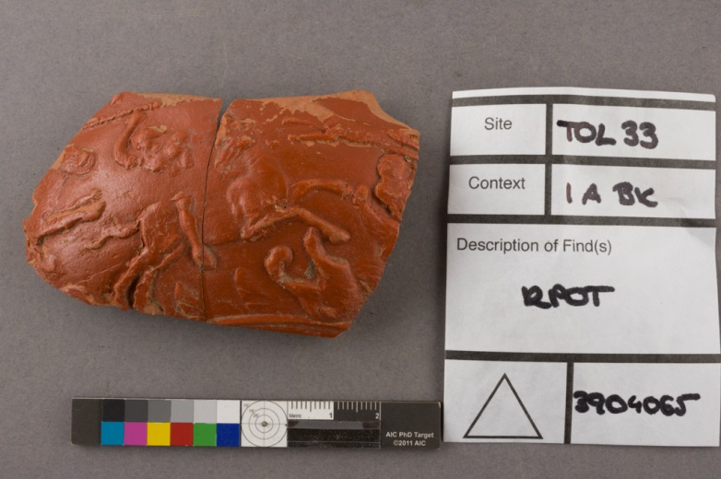
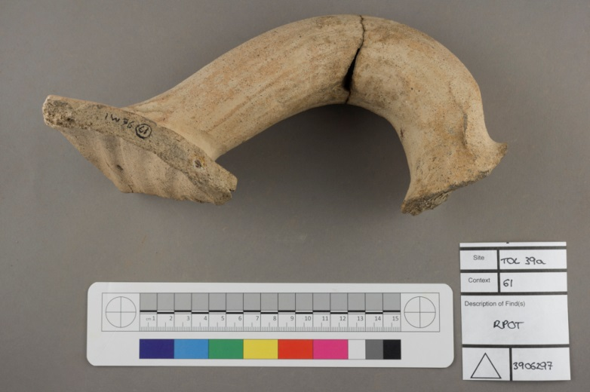
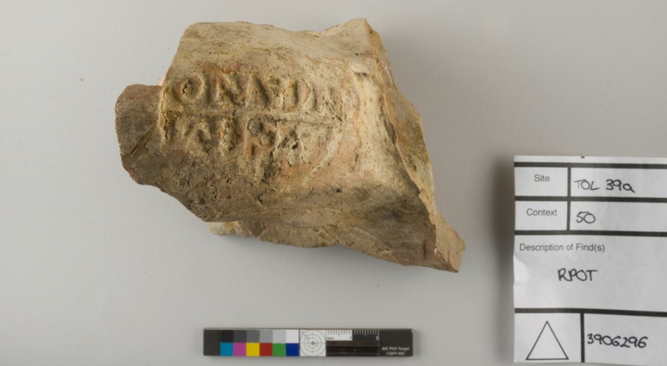
Before the Normans
Evidence of Roman settlement: pottery fragments found during 20th century excavations at the Tower
© Historic Royal Palaces

Slide 3
An artist’s impression of the pre-Roman settlement on what would later become the site of the White Tower, AD 40
© Historic Royal Palaces

Slide 4
An artist’s impression of the Roman city walls on what would later become the site of the White Tower, AD 400
© Historic Royal Palaces

Slide 5
An artist’s impression of the Roman city walls being repaired in the aftermath of Viking invasions, AD 886
© Historic Royal Palaces

Slide 6
The White Tower
An artist’s impression of the Roman city walls being refortified after the Norman Conquest. The White Tower is under construction, AD 1080.
© Historic Royal Palaces

Slide 7
An artist’s impression of the completed White Tower, AD 1100
© Historic Royal Palaces

Slide 8
Nobody is completely sure how the White Tower was configured during the Norman period. This layout was proposed by a Historic Royal Palaces curator studying the White Tower.
© Historic Royal Palaces

Slide 9
Pennies of Harold II (1066) and William I (1068)
Why might these coins look so similar? What does this suggest about William when he became King of England?
The White Tower today, viewed from the South Lawn
The four pairs of small windows (circled) are the only remaining windows in the original Norman style. The wooden staircase has been rebuilt, but it reflects the original Norman design.
© Historic Royal Palaces. Coin images © Classical Numismatic Group (CNG)

Slide 10
Plans of the White Tower
© Historic Royal Palaces

Slide 11
William’s authority over the English
Charter of William I, 1067
‘William the King friendly salutes William the Bishop, and Godfrey the portreve, and all the burgesses within London, both French and English. And I declare, that I grant you to be all law-worthy, as you were in the days of King Edward; and I grant that every child shall be his father’s heir, after his father’s days; and I will not suffer any person to do you wrong. God keep you.’
This is believed to be the earliest guarantee of collective rights of the inhabitants of a town or city by a monarch
William of Poitiers, Deeds of William, Duke of Normandy and King of England, 1070s
‘Many English received by his liberal gift more than they had ever received from their fathers or their former lords. He placed capable castellans with ample forces of horse and foot in his castles, men brought over from France in whose loyalty no less than competence he could trust. He gave them rich fiefs in return for which they willingly endured hardship and danger. But to no Frenchman was anything given unjustly taken from an Englishman.’

Slide 12
Florence of Worcester, The Chronicle, 1068
‘…the king did his utmost to deprive the English of their dignities, that he might appoint persons of his own nation to their preferments, and thus confirm his power in his new kingdom. He also deprived several bishop and abbots, convicted of no open crimes either by the councils or the laws of the realm, and detained them in prison to the end of their lives on mere suspicion, as we have said, of their being dangerous to his newly-acquired power.’
William of Jumièges, Deeds of the Dukes of the Normans, c.1070
‘When the Londoners finally realized they could resist no longer, they gave hostages and surrendered themselves and all they possessed to the most noble conqueror.’

Slide 13
Anglo-Saxon Chronicle, 1085
‘Then sent he [King William I] his men over all England into each shire; commissioning them to find out how many hundreds of hides were in the shire, what land the king himself had, and what stock upon the land; or what dues he ought to have by the year from the shire. Also, he commissioned them to record in writing how much land his archbishops had, and his diocesan bishops, and his abbots, and his earls; … So very narrowly, indeed, did he commission them to trace it out, that there was not one single hide, nor a yard of land, nay, moreover…not even an ox, nor a cow, nor a swine was there left, that was not set down in his writ. And all the recorded particulars were afterwards brought to him.’
William of Malmesbury on King William I, Lives of the Kings of England, 1125
‘The standard of religion, dead everywhere in England, has been raised by their arrival: you may see everywhere churches in villages, in towns and cities monasteries rising in a new style of architecture; and with new devotion our country flourishes… William deposed some of the clergy in their lifetime legally, and in the place of those who died put a competent man of any nationality except English…’

Slide 14
Orderic Vitalis, Historia Ecclesiastica, mid-1100s
‘Nowhere else had William shown such cruelty… In his anger he commanded that all crops and herds, chattels and food of every kind should be brought together and burned to ashes with consuming fire, so that the whole region north of the Humber might be stripped of all means of sustenance. In consequence so serious a scarcity was felt in England, and so terrible a famine fell upon the humble and defenceless populace, that more than 100,000 Christian folk of both sexes, young and old alike, perished of hunger...’
Orderic Vitalis, Historia Ecclesiastica, mid-1100s
‘The king's passion for justice dominated the kingdom, encouraging others to follow his example. He struggled to learn some of the English language, so that he could understand the pleas of the conquered people without an interpreter, and benevolently pronounce fair judgements for each one as required. But advancing age prevented him from acquiring such learning, and the distraction of his many duties forced him to give his attention to other things.’

Slide 15
The building of the White Tower
Anglo-Saxon Chronicles, 1097
‘Many shires whose labour was due at London were hard pressed because of the wall that they built about the Tower, and because of the bridge that was nearly all carried away by a flood, and because of the work on the king’s hall that was being built at Westminster, and many a man was oppressed thereby.’
Anglo-Saxon Chronicles, 1097
‘Also, many shires, whose work pertained to London, were badly afflicted through the wall which they constructed around the Tower.’
Orderic Vitalis, Historia Ecclesiastica, mid-1100s
‘Leaving London [after the coronation] the king spent a few days at Barking nearby, whilst a fortress was being completed in the city as a defence against the numerous and hostile inhabitants.’

Slide 16
Early description of the White Tower
William Fitzstephens’, Descriptio Nobilissimi Civitatis Londoniae (Description of the Noblest City of London), 1174-1183
‘It has on the east the Palatine Castle, very great and strong, of which the ground plan and the walls rise from a very deep foundation, fixed with a mortar tempered by the blood of animals.’

