Slide 1




HOW TO USE - NOTES FOR TEACHERS
These resources from Historic Royal Palaces are multi-purpose.
They are ready for you to tweak and use in your lessons.
For the best experience, download and open the
file in the PowerPoint
desktop app.
Answers are found
under the slide. Click
on the notes symbol at
the bottom of the screen.
Delete text and images to make your own worksheets.
Disclaimer and Use Terms
We are the owner or the licensee of all intellectual property rights in these resources which are protected by copyright laws and treaties around the world. All such rights are reserved. These resources, and the content included within them, may be used by you for educational purposes only. This means that you may download the resources and use or share them solely in educational environments (including for home school lessons) or as part of homework. You may not share the resources other than for the above purposes and you must not use the resources, or any part of them, for any commercial purpose.

Slide 2

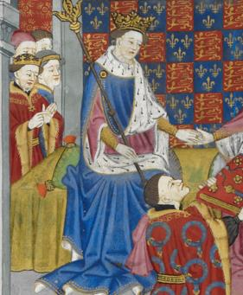
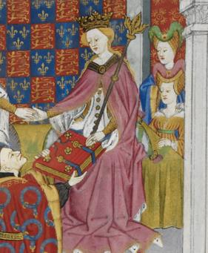

Henry VI and Margaret of Anjou
HENRY VI
MARGARET
OF ANJOU
The Lancastrian King who lost his throne during the Wars of the Roses
Strong-willed Queen Consort who raised armies
Henry VI became king when he was a baby after his father died. He was part of the house of Lancaster. As an adult, he sometimes suffered with mental illness and his wife Margaret would often help to rule.
However, his relative Richard, Duke of York also wanted power and became Lord Protector. These power struggles led to the Wars of the Roses between the Lancastrians and the Yorkists.
In 1461, the Yorkist armies defeated Henry’s Lancastrian armies at the Battle of Towton and Richard’s son Edward IV became King. In 1470, Henry VI briefly became king again, but he was deposed a year later.
Henry VI’s only son and heir was killed in battle. In 1471, Henry was imprisoned in the Tower of London and eventually murdered.
Margaret married Henry VI in 1445, when she was 15. She became Queen Consort and was now part of the house of Lancaster. In 1453 they had their only child, Edward. Margaret was intelligent, determined and had a powerful influence over her husband.
When Henry was unwell, Margaret ruled the kingdom in his place. However, Richard, Duke of York became Lord Protector. This created a power struggle and led to the start of the Wars of the Roses.
Margaret helped to organise Lancastrian armies, but they were defeated, and she fled to France with her son in 1461. In 1471 they returned but their army was defeated again, and her son was killed. Margaret was imprisoned but was later released and went
back to France.
Courtesy of the British Library Royal 15 E. VI
Courtesy of the British Library Royal 15 E. VI
Lived: 1421-1471
Lived: 1430 - 1482
Birthplace: Windsor Castle
Birthplace: Lorraine, France
Reigned: 1422-1461 & 1470-1471
Reigned: 1445-1461 & 1470-1471
In 1455, she was offered a deal to allow Henry VI to keep the throne, if she agreed that after he died, the throne would pass to Richard, the Duke of York. This may have avoided war, but she refused.
Henry founded Eton College and King’s
College at Cambridge.
Q:
Henry VI may have been murdered on the orders of the Yorkist brothers Edward IV or Richard, Duke of Gloucester. What did they have to gain from Henry’s death?
Q:
Why do you think Margaret refused the deal in 1455?
Do you think Margaret’s was brave and courageous to refuse the deal, or do you think she should have compromised?
Notes:
Henry VI notes: Edward and Richard had a lot to gain from Henry VI’s death. Henry’s only son had been killed in battle (The Battle of Tewkesbury). Henry’s death would end the Lancastrian line of succession. Henry’s death would mean that Edward would become the King and Richard would become the brother of the King.
Margaret of Anjou notes: Margaret refused the compromise in 1455 because it would have disinherited her son, Edward. She also probably knew that Richard, Duke of York, would try to rule the country during Henry’s lifetime anyway and he might even break the agreement.
Some may argue that Margaret was brave and courageous in standing up for her son’s right to inherit the throne and being prepared to go to war. Others might argue that she refused to compromise because she wanted to keep her own powerful position as queen and that this led to a war that could have been avoided.

Slide 3
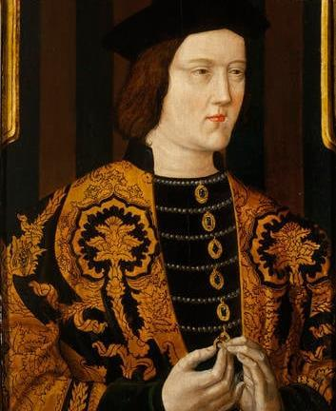
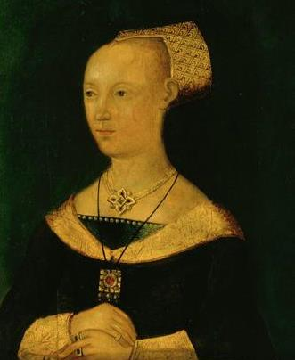
Edward IV and Elizabeth Woodville
EDWARD IV
ELIZABETH
WOODVILLE
The Yorkist King who won the crown twice in battle
The widow of a Lancastrian knight who became a Yorkist Queen
Edward IV was the eldest son of Richard, Duke of York, and Cecily Neville. He grew up fighting on the Yorkist side in the Wars of the Roses. His father was killed in 1460 at the Battle of Wakefield.
He became king after defeating the Lancastrian armies at the Battle of Towton in 1461.
He was deposed in 1470 but became king again a year later.
Edward secretly married Elizabeth Woodville in 1464, but their marriage was later
declared invalid.
He died in 1483, leaving two young sons who became known as the ‘Princes in the Tower’ after they mysteriously disappeared.
Elizabeth was born to a family of low-ranking nobles who were supporters of the Lancastrians.
She married Sir John Grey, a Lancastrian knight, and they had two children. However, he was killed in battle in 1461, fighting for the Lancastrian army.
Elizabeth later married the Yorkist Edward IV in secret, and this caused a public scandal. She was crowned Queen Consort in 1465 and used her position to increase the status and wealth of her family.
After Edward’s death, her sons were taken to the Tower of London. Elizabeth took sanctuary in Westminster Abbey with her other children. Her two sons mysteriously disappeared.
Years later, Elizabeth helped to arrange the marriage of her daughter Elizabeth of York to Henry Tudor, which ended the Wars of the Roses and started the Tudor dynasty.
Royal Collection Trust
© His Majesty King Charles III 2024
Royal Collection Trust
© His Majesty King Charles III 2024
Lived: 1442 - 1483
Lived: c.1437 - 1492
Birthplace: Rouen, France
Birthplace: Northamptonshire
Reigned: 1461-1470 & 1471-1483
Reigned: 1465-1470 & 1471-1483
Q:
Why do you think Elizabeth’s marriage to Edward caused a scandal when it became public?
What evidence is there to explain why Elizabeth was not a popular queen?
Edward was the tallest king of England, at 1.93 metres tall.
Q:
What impression do you have
of Edward from his portrait
and this biography?
Notes:
Edward IV notes: In his portrait, Edward IV appears to be a tall and imposing man, and a successful soldier. This might be based on the fact he won the throne in battle twice during a very turbulent period in English history.
Elizabeth Woodville notes: The marriage between Edward IV and Elizabeth might have caused a scandal because she came from a family of low-ranking nobles. The King was expected to marry someone from high-ranking nobility, or a foreign princess. In addition, her family and first husband were Lancastrian supporters and Edward was part of the York family.
Elizabeth might have been unpopular because she was not considered of high enough status to be Queen. She also used her position to advance her family. (This included the two sons from her previous marriage, and her brothers and sisters.)

Slide 4
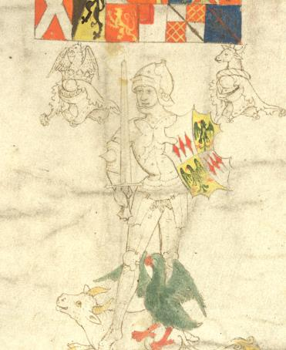
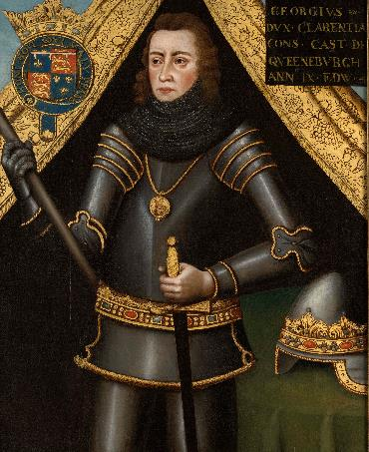

Richard Neville and George Plantagenet
RICHARD
GEORGE
NEVILLE
PLANTAGENET
Known as the ‘Kingmaker’ - changed sides during the Wars of the Roses
A member of the House of York who was executed for treason
Richard became Earl of Warwick when he married Anne, Countess of Warwick, and his life was transformed.
He became one of the wealthiest and most powerful men in England. At first, he fought on the Yorkist side with Richard, Duke of York, and helped the Duke’s son win and to become King Edward IV.
However, Richard did not support
Edward’s marriage to Elizabeth Woodville, and he started to disagree with the King more and more. As a result, Richard began
to lose his power.
In 1470, he made an alliance with the Lancastrians. He helped Margaret of Anjou to put Henry VI back on the throne. Since Henry was unwell, Richard planned to rule through the King, but Richard was killed at the Battle of Barnet in 1471.
Q:
How old was George when his brother made him Duke of Clarence and Lord Lieutenant of Ireland?
What does this tell you about royal titles and positions in the Middle Ages?
Courtesy of the British Library Add. 48976
Philip Mould & Company, London
Lived: 1428 - 1471
Lived: 1449 - 1478
Birthplace: Unknown
Birthplace: Dublin Castle
George was the middle son of Richard, Duke of York. His brother Edward became King Edward IV in 1461 and gave George the title of Duke of Clarence and Lord Lieutenant of Ireland.
He married Isabel Neville, who was the daughter of Richard Neville. This was against his brother, King Edward IV’s wishes. George made an alliance with his father-in-law. Together, they deserted the Yorkists and now supported the Lancastrians. They helped Henry VI return to power in 1470.
However, George soon realised that his father-in-law was more interested in gaining power for himself than in supporting Henry VI, so George changed sides again. He made up with his brother in 1471 and fought with the Yorkist armies to help Edward IV become king again.
Later, George was accused of plotting against Edward IV. He was found guilty of treason and executed at the Tower of London.
As part of the alliance with Margaret of Anjou Richard’s daughter, Anne, would marry Margaret’s son, Edward.
Q:
Using this evidence, how would you describe Richard, the Earl of Warwick?
Notes:
Richard Neville notes: Richard Neville, the Earl of Warwick, could be described as an ambitious, scheming man who was prepared to do anything to keep – and increase – his power. Others might argue that he was justified in changing sides from the Yorkists to the Lancastrians. He had been loyal to the Yorkists, fighting on their behalf, but was displaced by the Woodville family.
George Plantagenet notes: George was 12 years old when he was given titles of Duke of Clarence and Lord Lieutenant of Ireland.
Many royal appointments were a way for the monarch to distribute wealth and prestige to their family or loyal followers, regardless of age or ability.

Slide 5
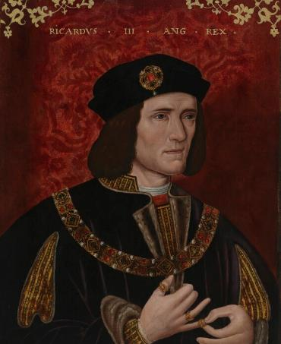
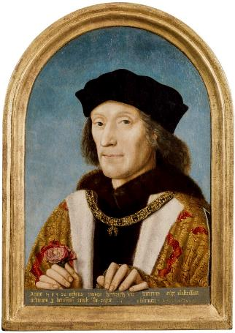
Richard III and Henry VII
RICHARD III
HENRY VII
The last English king to die on the battlefield
Founder of the Tudor dynasty
Richard was the youngest son of Richard, Duke of York, and Cecily Neville. His brother Edward IV became king in 1461 and Richard became the Duke of Gloucester.
Experienced military commander
by age 17.
Later put in charge of northern England.
When his brother Edward IV died,
he became Lord Protector and ruled
on behalf of his 12-year-old nephew Edward V.
Placed his nephews, the two princes (the uncrowned Edward V and his 10-year-old brother Richard) in the Tower of London.
The boys were declared illegitimate and disappeared soon after.
A few weeks after the disappearance of the princes, in July 1483, Richard was crowned King Richard III. Two years later, he was killed at the Battle of Bosworth.
Henry became king after the Battle of Bosworth in 1485.
He was part of the House of Lancaster but did not have a strong claim to the throne. He made his claim stronger by marrying Elizabeth, the eldest daughter of the Yorkist King Edward IV. Together, they united the two royal houses of Lancaster and York.
Defeated two uprisings that were led by people stating they had a stronger claim to the throne than he did.
Strengthened the power of the monarchy.
Reduced the power of nobles.
Increased taxes.
Henry arranged marriages for his children to help him make alliances and keep peace.
He left behind a stable country, a secure throne and a full treasury when he died.
© National Portrait Gallery, London
© National Portrait Gallery, London
Lived: 1452 - 1485
Lived: 1457 - 1509
Birthplace: Northamptonshire
Birthplace: Wales
Reigned: 1483 - 1485
Reigned: 1485 - 1509
Richard III’s skeleton was discovered in a car park in 2012. It was revealed that he had scoliosis.
This was probably painful but hardly visible when he was clothed.
The new Tudor emblem combined the red rose of Lancaster with the white rose of York. It became
known as the Tudor Rose.
Q:
What impression do you get of Richard from his portrait?
Do you think Richard was a popular king?
Q:
How did Henry secure the future of the Tudor dynasty?
Do you think Henry was a popular king?
Notes:
Richard III notes: In his portrait, Richard’s mouth is set in a hard line and turns down at the corners. His eyes are a hard, steely grey. These give the impression that he is mean and cunning. His right shoulder also appears higher than his left. In the past, this type of physical difference was sometimes associated with inner wickedness. (Research suggests that this portrait was altered after it was made to make Richard appear more wicked and unkind).
Richard was not popular with the public. This may have been linked to the fact that his two nephews disappeared at the Tower of London, after he placed them there to await the elder prince’s coronation. Many people believed Richard might have had them murdered so he could take power himself, however this remains a controversial topic today as there were other people who benefited from the two princes' disappearance too.
Henry VII notes:
Henry married Elizabeth of York which added weight to the Tudor claim to the throne. He also planned marriages for his children to form alliances with other countries. He put down uprisings and reduced the power of the nobles.
Some people might think that Henry was popular because he restored peace and stability after the Wars of the Roses. Others might say he was unpopular because he increased taxes.

Slide 6


TEMPLATE BIOGRAPHY
____________
____________
____________
____________
Image credit:
Image credit:
Lived: _______
Lived: _______
Birthplace: _______
Birthplace: _______
Q:
Q:

Slide 7

VOCABULARY LIST
alliance | agreement between people or countries to help each other
emblem | picture of an object used to represent something else, such as membership of a group or an idea
depose | remove someone from power
dynasty | series of leaders from the same family
government | group of people that have the authority to rule a country
heir | person who will become the next king or queen
illegitimate | child whose parents were not legally married to each other when they were born
invalid | not legal
Lancaster | one side of the Plantagenet royal family who fought in the Wars of the Roses; their emblem was the Red Rose
Lancastrians | supporter of the Lancaster side in the Wars of the Roses
Lord Lieutenant | person who represents the king or queen
Lord Protector | title used by someone in charge of a country when the king or queen is unable to rule (if they are unwell or a child, for example)
military | word used in connection with an armed force such as soldiers
nobles | people of high rank in society
Plantagenet | royal family who ruled England from 1154 to 1485

Slide 8
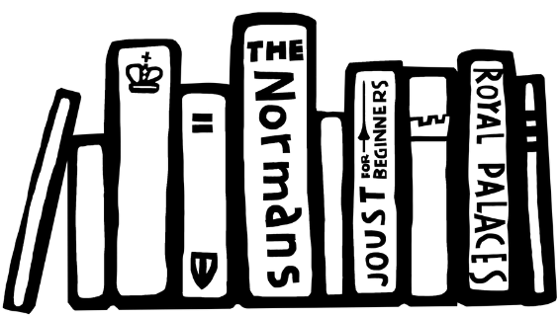

Vocabulary list 2
VOCABULARY LIST
plot/plotting | secretly plan to harm someone, especially a government or ruler
power struggle | a fight for control between two or more people or groups
Queen Consort | wife of a reigning king
scoliosis | condition where a person’s spine twists and curves to the side
treason | the crime of acting against your own country, especially by trying to kill the king or queen, or overthrow the government
Treasury | place or building where money is stored
uprising | protest against the government or ruler by people who are angry and want change; usually in one part of the country and often violent
Wars of the Roses | name given to battles fought in England between 1455 and 1485 between two sides of the Plantagenet royal family
York | one side of the Plantagenet royal family who fought in the Wars of the Roses; their emblem was the White Rose
Yorkists | supporters of the York side in the Wars of the Roses

