Slide 1

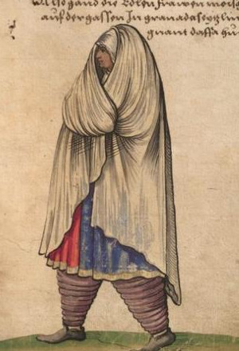
CATALINA OF MOTRIL
A Muslim woman who travelled to England and worked at the Tudor court
Catalina was from Motril. Today this area is part of Spain. However, in the 1400s, when Catalina first lived there, this area was home to a group of people called the Moors. They were Muslim and had North African heritage.
In 1492, a Spanish queen took over Motril. The Moors were forced to flee. Those that didn’t, or couldn’t, were enslaved. Catalina may have been one of those people.
At the time, when people were enslaved, they were sometimes forced to change their religion to Christianity. They were also often given a new name.
This means ‘Catalina’ was probably not this woman’s birth name. She was possibly called ‘Catalina’ after her new mistress, Princess Catalina of Spain.
Princess Catalina was sent to marry an English Prince. Catalina of Motril travelled with her to England.
In 1509, Princess Catalina married King Henry VIII. Today we know her as Katherine of Aragon.
Catalina of Motril would have helped Katherine of Aragon prepare for her wedding and her coronation.
Slavery was not a recognised status in Tudor England. We do not know if Catalina of Motril was paid.
We do know that Catalina of Motril did not stay in England. At some point she returned to Spain. She met a man called Oviedo. He was a crossbow maker. They got married and had two daughters in Malaga.
When her husband died, Catalina and her daughters moved again. They went to live in Motril.
In 1531, a group of Spanish officials went to look for Catalina. They wanted her to reveal secrets only she could know about Katherine of Aragon. There is no record of what happened next.
This image is not of Catalina. However, it is a representation of how women in Motril may have looked at the time.
Q:
Why do you think we don’t know what Catalina of Motril’s birth name was?
Germanisches National Museum
Q:
Why do you think we don’t have an image of Catalina of Motril?
Birth year: unknown
Q:
What does Catalina of Motril’s story tell you about travel and migration in Tudor times?
Birthplace: Motril, Granada, Spain
Notes:
Why do you think we don’t know what Catalina of Motril’s birth name was?
We do not know Catalina’s birth name because records about ordinary people were rarely written down in the past. If Catalina was enslaved, her original name may not have been recorded, or it may have been deliberately changed and lost over time.
Why do you think we don’t have an image of Catalina of Motril?
We do not have an image of Catalina of Motril because portraits were expensive and usually only made of rich or powerful people. Ordinary people, especially women and enslaved people, were rarely painted or drawn.
What does Catalina of Motril’s story tell you about travel and migration in Tudor times?
Catalina of Motril’s story shows that people moved to England from other parts of the world in Tudor times, but travel was not always a free choice. Her life suggests that movement could be forced and shaped by power, religion, and the actions of rulers.

