Slide 1




HOW TO USE - NOTES FOR TEACHERS
These resources from Historic Royal Palaces are multi-purpose.
They are ready for you to tweak and use in your lessons.
For the best experience, download and open the
file in the PowerPoint
desktop app.
Answers are found
under the slide. Click
on the notes symbol at
the bottom of the screen.
Delete text and images to make your own worksheets.
Disclaimer and Use Terms
We are the owner or the licensee of all intellectual property rights in these resources which are protected by copyright laws and treaties around the world. All such rights are reserved. These resources, and the content included within them, may be used by you for educational purposes only. This means that you may download the resources and use or share them solely in educational environments (including for home school lessons) or as part of homework. You may not share the resources other than for the above purposes and you must not use the resources, or any part of them, for any commercial purpose.

Slide 2

WHEN ARE WE?
Empire & Sea Power
1714 – 1837
War & Revolution
1603 – 1714
WWI
1914 – 1918
Maya Civilisation 2000 BCE – 1500 CE
WWII
1939 – 1945
Mughal India 1526 – 1707
Benin 900 – 1300
Cold War
1945 – 1989
Qing Dynasty 1644 – 1912
French Revolution
1789 – 1799
1100 CE
1300 CE
1500 CE
1700 CE
1900 CE
2100 CE
The Silk Roads 130 BCE – 1453 CE
Medieval c.5th century – 1450
Renaissance 1450 – 1750
Industrial Revolution 1750 – 1900
Modern
Normans
Middle Ages 1154 – 1485
Tudors
Stuarts
Georgians
Victorians
House of Windsor
Edwardians

Slide 3

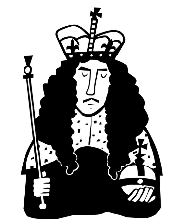
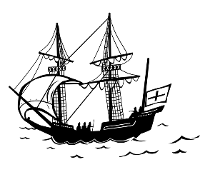

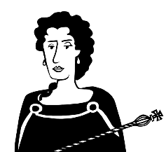
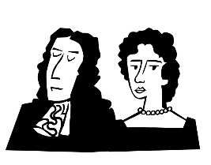


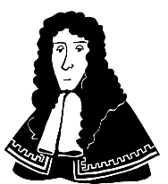
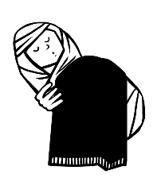
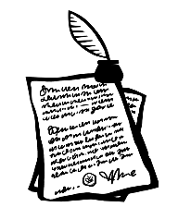
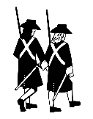
STUARTS AND GLORIOUS REVOLUTION TIMELINE
1660
1687
November 1688
April 1689
1690
1702
Charles II is King
James II creates powerful positions for Catholic friends
William’s army arrives in Devon. Joined by English supporters
William III and
Mary II are crowned joint monarchs
Battle of the Boyne in Ireland
William III dies. Anne I is Queen
1685
June 1688
December 1688
December 1689
Charles II dies. Catholic James II is King
James II’s son born. William and Mary are invited to rule
William brings Army to London. James II flees to France
Bill of Rights approved

Slide 4
STUARTS AND GLORIOUS REVOLUTION TIMELINE
STUARTS AND GLORIOUS REVOLUTION CHRONOLOGY 2
1660
1677
1687
November 1688
April 1689
1690
1702
Charles II is King
William III and Mary II married
James II creates powerful positions for Catholic friends
William’s army arrives in Devon. Joined by English supporters
William III and
Mary II are crowned joint monarchs
Battle of the Boyne in Ireland
William III dies. Anne I is Queen
1673
1685
June 1688
December 1688
December 1689
1694
James II marries Mary of Modena, a Catholic
Charles II dies. Catholic James II is King
James II’s son born. William and Mary are invited to rule
William brings Army to London. James II flees to France
Bill of Rights approved
Mary dies of smallpox

Slide 5

CLASSROOM TASKS
Q1
What was the name of James II’s second wife that he married in 1673?
Q2
When did William’s army arrive in Devon?
Q3
What important Bill was approved in 1689?
Q4
How many years after Mary did William die?
Notes:
Classroom task answers
James II’s second wife was Mary of Modena.
Wiliam landed his fleet in Devon in November 1688.
The Bill of Rights was approved in 1689 which limited the powers of the monarch.
William died 8 years after his wife, Mary.

Slide 6


VOCABULARY LIST
Bill of Rights | a list of rules about people’s rights, which limited the power of kings and queens
Catholic | member of the Roman Catholic Church, a type of Christianity that follows the teachings of the Pope
dynasty | series of leaders from the same family
English Commonwealth | period from 1649-1660 when Britain and Ireland had no King or Queen
monarch | ruler of a kingdom or empire
smallpox | serious and often deadly infectious disease in the past

