Slide 1




HOW TO USE - NOTES FOR TEACHERS
These resources from Historic Royal Palaces are multi-purpose.
They are ready for you to tweak and use in your lessons.
For the best experience, download and open the
file in the PowerPoint
desktop app.
Answers are found
under the slide. Click
on the notes symbol at
the bottom of the screen.
Delete text and images to make your own worksheets.
Disclaimer and Use Terms
We are the owner or the licensee of all intellectual property rights in these resources which are protected by copyright laws and treaties around the world. All such rights are reserved. These resources, and the content included within them, may be used by you for educational purposes only. This means that you may download the resources and use or share them solely in educational environments (including for home school lessons) or as part of homework. You may not share the resources other than for the above purposes and you must not use the resources, or any part of them, for any commercial purpose.

Slide 2

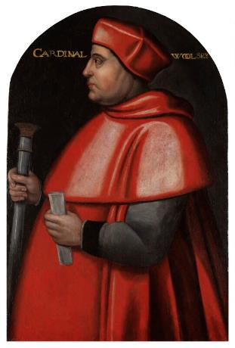
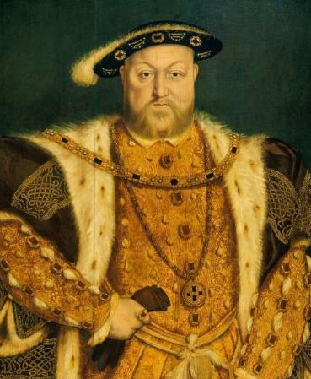
THOMAS WOLSEY AND HENRY VIII
THOMAS
HENRY VIII
WOLSEY
The king who married six times and started the Church of England
The priest who became a Cardinal and Henry VIII’s chief minister
Henry VIII became king aged 17.
Wrote music and poetry.
Graceful dancer and excellent sportsman.
Began spectacular building projects at Hampton Court Palace and the
Tower of London.
During his time as king, he faced many challenges. In particular, he struggled with having a male heir and getting the Pope’s permission for a divorce. This led to the English Reformation.
He famously had six wives, two of which he had executed. He had two daughters, Mary and Elizabeth, and one son, Edward.
In 1536, he had an accident whilst
jousting where he was knocked unconscious for a few hours. When he died, he was buried with his third wife, Jane Seymour,
at Windsor Castle.
Thomas studied at Oxford University. His father was a butcher, and the family were not of high status. Thomas worked hard and eventually became very powerful.
Brilliant, ambitious and hard-working.
Became Archbishop of York in 1514 and Cardinal in 1515.
Also became King Henry VIII’s Lord Chancellor (chief advisor).
Immensely powerful and wealthy.
He rented Hampton Court Palace and transformed it from an ordinary country house into a magnificent palace.
When Henry wanted to end his first marriage, Thomas was not able to get the Pope to agree. As a result, he was eventually accused of treason in 1529, but he died before going on trial.
© National Portrait Gallery, London
CC BY NC ND 3.0
Royal Collection Trust
© His Majesty King Charles III 2024
Lived: c.1470 - 1530
Lived: 1491 - 1547
Birthplace: Ipswich
Birthplace: London
Reigned: 1509 - 1547
‘If I had served my God as diligently as I have done the King, he would not have given me over in my grey hairs.’
Words said to have been spoken by Wolsey before he died.
‘This is like having fun with tamed lions – often it is harmless, but just as often there is fear of harm.’
Sir Thomas More, warning Henry’s courtiers to be careful.
Q:
How does the artist show Henry’s power in the portrait?
Q:
From his portrait, what is your main impression of Thomas Wolsey?
Notes:
Thomas Wolsey notes:
In his portrait, Thomas Wolsey seems to be a large, very powerful man. He used his wealth to display his power, through his palaces and very big household.
Henry VIII notes:
In his portrait, Henry stands in a dominant pose. His expensive, fashionable clothes, encrusted with jewels, emphasise both his immense wealth and his physical size. One hand rests on his sword, which adds to the impression of a powerful ruler.

Slide 3
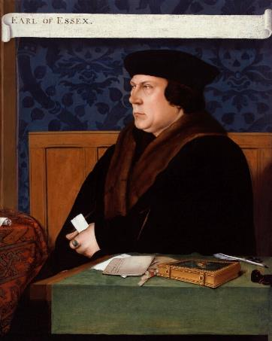
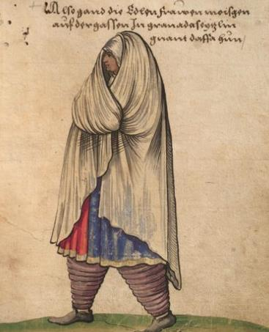

THOMAS CROMWELL AND CATALINA OF MOTRIL
THOMAS
CATALINA
CROMWELL
OF MOTRIL
The son of a blacksmith who became Henry VIII’s chief minister
A Muslim woman at Tudor court
Thomas’ father was a blacksmith. Thomas travelled around Europe, learning several languages. When he returned to England, he became a lawyer and was a loyal servant to Cardinal Wolsey.
When Cardinal Wolsey died, Thomas Cromwell replaced him as Henry VIII’s trusted minister. Thomas was loyal and efficient but also cunning and ruthless.
Became very rich and powerful
Enforced Henry’s new position as head of the Church
Initially supported Henry’s second wife, Anne Boleyn but later plotted against her
Closed catholic monasteries.
Thomas arranged Henry’s fourth marriage to Anne of Cleves. However, this marriage eventually failed, and Henry lost confidence in Thomas. He was imprisoned in the Tower of London and executed for treason.
Catalina was probably born in Motril, Granada and she might have had North African heritage. Granada was a Muslim kingdom, but it was conquered by Spain in 1492 and many Muslim people were enslaved. Catalina may have been one of those people.
She came to England with Katherine of Aragon and was her maid. Slavery was not a recognised status in 16th-century England and it is not clear if Catalina of Motril was still enslaved.
Years later, Catalina returned to Spain. Catalina married a crossbow-maker called Oviedo. They had two daughters.
When Henry was trying to get a divorce from Katherine of Aragon, Catalina was asked to give details of Katherine’s first marriage.
There is no record of her response or what happened to her after this.
© National Portrait Gallery, London
CC BY NC ND 3.0
Germanisches National Museum
Lived: c.1485 - 1540
Lived: unknown
Birthplace: London
Birthplace: Granada, Spain
This image is not of Catalina.
However, it is a representation of how women in Motril, Granada
may have looked at the time.
Henry described him as ‘the most faithful servant’ he had ever had.
Q:
Why do you think we know so little about Catalina’s life after she left the
Tudor court?
Q:
What objects has the painter included on the table in Thomas’s portrait?
What impression do these objects give you about Thomas’s character?
Notes:
Thomas Cromwell notes:
In the portrait, the painter has included documents, a quill pen and a book bound in expensive covers. There is a pair of scissors under the pen, and a small leather pouch in front of it. The book has been identified as a prayer book (Book of Hours) dating from 1527. It demonstrates his religious devotion as well as his status.
The objects in the portrait create the impression that he is a stern, serious, hard-working man.
Catalina of Motril notes:
It is possible that details about Catalina’s life were only recorded because she was associated with the King and Queen. At the time, often only high status and powerful people had details about their lives recorded. Not only that, but it is likely documents about high status people were kept safe and therefore still survive today. After Catalina went back to Spain it is likely that she was not deemed important enough to have much information recorded about her. Additionally, any documents relating to her may not have been kept safe enough for historians to learn more about her today.

Slide 4
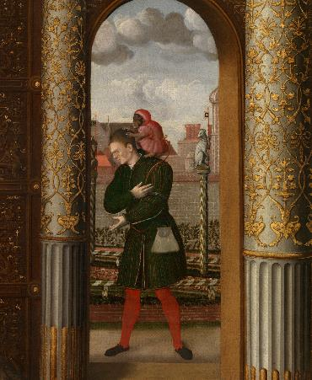
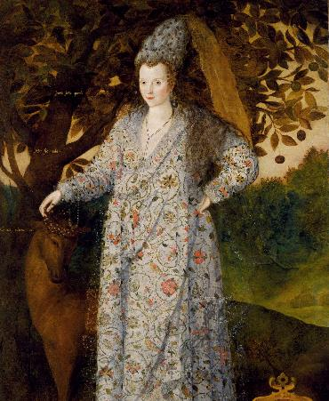
WILL SOMER AND AURA SOLTANA
WILL
AURA
SOMER
SOLTANA
A famous entertain to Henry VIII
A Muslim woman at the
Elizabethan court
“Fools” (or jesters) entertained people at court. This might have included singing songs, telling jokes and playing music. However, some “fools” probably had learning disabilities. These people are sometimes called “natural fools”.
Will Somer started serving Henry VIII around 1535. Will was known for his clever word play. His work was even published by writers at the time. He sometimes joined the king as he travelled around the country.
Some historians think that Will was a “natural fool”. In 1551 a man was paid to help Will. A record states ‘whom his Majesty hath appointed to keape him, and money for men to do his laundry and shave him.’ This might suggest that Will needed someone to take care of him or it might suggest that he was high status.
Will performed for Henry’s son, Edward VI at Christmas time in 1551. Will also was part of Elizabeth I’s coronation in 1559. When Will died he was buried at St Leonard, Shoreditch, London. Many Tudor “fools” and actors were later buried in that church.
Little is known about Aura. More research is needed to understand her role at Tudor court. Aura was described as a 'Tartar girl', meaning she was probably from a Muslim background in North or Central Asia.
When she was young, Aura was enslaved and sold to an English merchant. She was transported to England. She may have been given as a gift to Queen Elizabeth I. She may have become a lady-in-waiting.
Aura's original name is unknown. She was given the name ‘Aura Soltana’ by the people who enslaved her.. She may have also been known as 'Ippolyta the Tartarian'.
Around this time, Queen Elizabeth was making new political alliances with Muslim rulers in North Africa and Asia.
As a result, Muslim ambassadors visited the Tudor court and new trade routes opened up. Items such as silk, sugar and pearls were exchanged and brought to England.
Royal Collection Trust
© His Majesty King Charles III 2024
Royal Collection Trust
© His Majesty King Charles III 2024
Lived: unknown
Lived: unknown
Birthplace: unknown
Birthplace: unknown
This image is a portrait of an unknown woman and could have been painted around 1590. The woman is wearing silk and pearls. Some historians think this portrait is linked to Aura.
Q:
Why do you think a payment was made to someone to ‘keep’ Will?
How long did Will serve Henry and his children (Edward and Elizabeth) and what does this tell you about how he was seen by them?
Q:
What might this portrait tell us about links between the Islamic world and the Tudor court?
Why do you think we know so little about Aura?
Notes:
Will Somer notes:
Will is likely to have had a learning disability. The role of his ‘keeper’ was probably similar to that of a carer today.
Will started working for Henry around 1535 and his last performance was around 1559, 24 years later. This suggests the family had a strong connection to Will and that he was valued by them.
Aura Soltana notes:
This portrait depicts a woman wearing clothes inspired by Persian fashion and made of materials traded from North Africa and Asia to England. It shows the trade links between the Islamic World and the Tudor court.
Aura was an enslaved person and was moved between different countries, probably against her will. Details about Aura’s early life were possibly never recorded, or if they were, may have been lost overtime. The fact that Aura was given a different name by the people who enslaved her shows how little we know about her original identity.

Slide 5
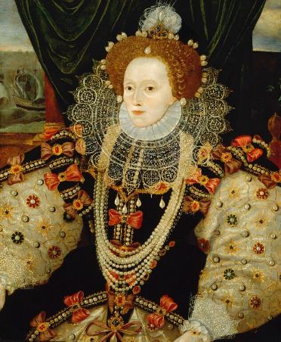
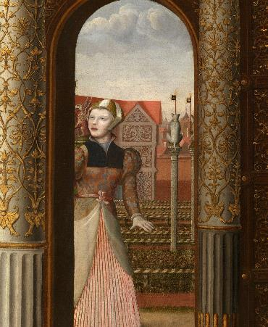

ELIZABETH I AND JANE THE FOOL
ELIZABETH I
JANE
THE FOOL
Last Tudor monarch – a queen who ruled alone
Court entertainer who worked for
many queens
Elizabeth was the daughter of Henry VIII and his second wife, Anne Boleyn.
She was Protestant and was accused of plotting against her half-sister, the Catholic Queen Mary I.
In 1554, Mary imprisoned Elizabeth briefly in the Tower of London.
Mary thought Elizabeth was involved in a Protestant Rebellion.
Elizabeth became queen in 1558, aged 25. In 1588, Philip of Spain planned
an invasion of England and launched the Spanish Armada. The Armada was defeated by Elizabeth’s much smaller
English navy.
She caught smallpox at Hampton Court Palace in 1562 but eventually recovered.
“Fools” (or jesters) entertained people at court. This might have included singing songs, telling jokes and playing music. However, some “fools” probably had learning disabilities. These people are sometimes called “natural fools”.
Jane might have been a “natural fool”. She first served Queen Anne Boleyn and later served Queen Katherine Parr and Queen Mary. Jane took part in activities like riding and sewing and was given her own horse. She was given food and clothing. When she was ill, Queen Mary paid for her care.
However, we do not know if Jane was paid for her work. Like other “fools” her head was shaved once a month. “Fools” were often considered childlike and did not always have the freedom to choose their employers.
Royal Collection Trust
© His Majesty King Charles III 2024
© National Portrait Gallery, London
Lived: 1533 - 1603
Lived: unknown
Birthplace: London
Birthplace: unknown
Reigned: 1558 - 1603
“I know I have the body of a weak and feeble woman;
but I have the heart and stomach of a king, and of a king of
England too.”
Elizabeth’s speech to her
army at the time of the
Spanish Armada.
Mary gave Jane a
large shoe collection.
Q:
Jane may have had a learning disability. What do you think her treatment shows about how learning disability was treated by the court?
Q:
What clues are there that this portrait was painted to celebrate the defeat of the Spanish Armada?
Notes:
Elizabeth I notes:
In the portrait, we can see scenes from the defeat of the Spanish Armada on the wall behind the Queen. This suggests it was painted to celebrate the defeat of the Spanish Armada. (English fireships setting out on the left, and Spanish ships being wrecked in storms on the right.) Also, Elizabeth’s hand rests on a globe, perhaps representing England’s command of the seas.
Jane the Fool notes:
Some people might think that however kindly Jane was treated, it shows that people with learning disabilities were seen as figures of fun. Also, it seems possible that Jane did not have freedom. Others may say it shows that people with learning disabilities were included and valued at court.

Slide 6
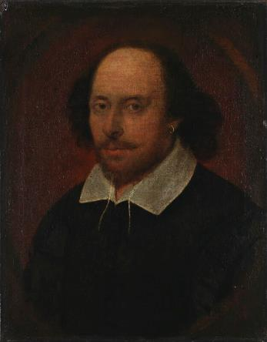
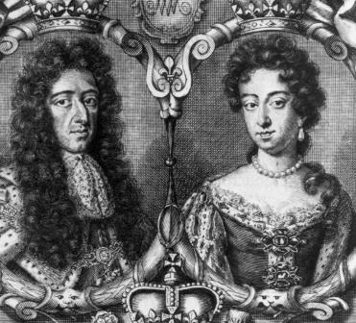


WILLIAM SHAKESPEARE AND WILLIAM AND MARY
WILLIAM
WILLIAM III
SHAKESPEARE
AND MARY II
Known as one of the greatest writers in the English language
The only British monarchs to have ruled together
Mary was the daughter of James II. William was the grandson of Charles I.
They were both Protestants and got married in 1677.
As part of the Glorious Revolution
1688-1689:
Catholic King James II was unpopular
William and Mary were invited to become rulers instead.
They became joint monarchs.
It was called the Glorious Revolution because it did not involve violence in England, however it did lead to violence
in Ireland.
As monarchs, they hired the architect Sir Christopher Wren to transform Nottingham House into Kensington Palace. This included new State Apartments, accommodation for courtiers and kitchens and stables.
Mary died of smallpox and a few years later William died after a riding accident.
Shakespeare is best known for writing at least 37 plays.
© Historic Royal Palaces
© National Portrait Gallery, London
CC BY NC ND 3.0
Lived: 1564 - 1616
William: 1689-1702, Netherlands
Mary: 1689-1694, London
Birthplace: Stratford-Upon-Avon
William’s father was a glover. William married Anne Hathaway and they had three children. Later William moved
to London.
Became an actor and playwright.
Jointly owned a theatre company called ‘The Lord Chamberlain’s Men’.
Based in Globe Theatre from 1599.
Renamed the group ‘The King’s Men’ in 1603 after James I became patron.
They were invited to perform at court more often than any other theatre company. The first performance of ‘Macbeth’ may have been in the Great Hall at Hampton Court Palace in 1606.
Reigned: 1689 – 1694 & 1702
William was devastated when Mary died and did not remarry.
Q:
We know very little about Shakespeare as a man. Can you describe how he is portrayed in his portrait?
Notes:
William Shakespeare notes:
In his portrait, Shakespeare is portrayed as a middle-aged man, with a receding hairline. He wears simple, plain clothes and has one earring visible. (Wearing one earring was a popular fashion for men at the time.) He appears to be half-smiling, as though he is amused by something.

Slide 7
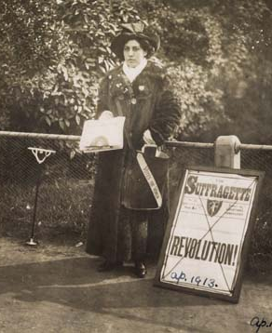
SOPHIA DULEEP SINGH
SOPHIA
____________
DULEEP SINGH
____________
The Indian princess who fought for women’s right to vote
Sophia was daughter of Duleep Singh, last Maharaja of Lahore, and his wife, Bamba. She was also the goddaughter of
Queen Victoria.
Given Faraday House, part of the estate at Hampton Court Palace, by Queen Victoria as a Grace and Favour residence.
Visited India as an adult with her sisters. They were welcomed as famous princesses.
Sophia was deeply affected by her visits to India. She was a passionate supporter of Indian causes for the rest of her life.
She was a key part of the Sikh community in London and helped create a club to support Indian sailors in England. She also raised funds to support the Indian Army and nursed Indian soldiers during World War One.
Sophia was heavily involved in the ‘Votes for Women’ campaign. She sold copies of a suffragette newspaper outside Hampton Court Palace. She also refused to pay tax or fill in the census and took part in marches on Downing Street.
© Museum of London
Image credit:
Lived: 1876 - 1942
Lived: _______
Birthplace: Suffolk
Birthplace: _______
‘No vote, no census. As women
do not count, they refuse to
be counted.’
Written by Sophia Duleep Singh on her census return, 1911.
Q:
Describe Sophia’s character and give evidence to support your opinions.
Q:
Notes:
Sophia Duleep Singh notes:
There is evidence that Sophia was a strong, determined woman who stood up for what she believed in. She sold the suffragette newspaper outside Hampton Court Palace and refused to complete her census return to support the suffragette movement. She also helped support Indian soldiers living in England.

Slide 8
TEMPLATE BIOGRAPHY
____________
____________
____________
____________
Image credit:
Image credit:
Lived: _______
Lived: _______
Birthplace: _______
Birthplace: _______
Q:
Q:

Slide 9

VOCABULARY LIST
archbishop | the highest rank of bishop
apartment | set of rooms for living in
aristocracy | group of people with very high social status
bishop | important and powerful member of the Christian church
blacksmith | person who makes and repairs iron objects such as horseshoes
Cardinal | senior churchman in the Roman Catholic Church, second only to the Pope
Catholic | member of the Roman Catholic Church. A type of Christianity that follows the teachings of the Pope
chief minister | person with the most power and responsibility in government
Church of England | the established Christian church in England based on the Protestant faith with the king or queen as its head
divorce | the legal ending of a marriage
empire | large group of countries or regions that are controlled by one ruler or government
English Reformation | name given to ending the Pope's control of the English Church and the religious changes that followed
enslaved | someone who is forced into slavery
enslaver | someone who forces other people into slavery
Glorious Revolution | events of 1688-89 when the Catholic King James II was replaced by the Protestant William III and Mary II
glover | person who makes gloves

Slide 10

VOCABULARY LIST 2
VOCABULARY LIST
grace and favour | apartments and other residences gifted by the monarch inside a royal property in recognition of service to the country
government | group of people that have the authority to rule a country
heir | person who will become the next king or queen
heritage | something that is handed down from the past, including culture and traditions
house arrest | kept as a prisoner in a house, castle or palace rather than a prison
joust/jousting | sport developed in the Middle Ages as training for soldiers who fought on horseback
lady-in-waiting | one of the queen’s companions who is there to do as the queen wishes
Maharaja | Indian prince
merchant | person who buys and sells things in large amounts
minister | someone with a lot of power and responsibility in government
monarch | ruler of a kingdom or empire, such as a king or queen
monasteries | buildings where religious communities of men called monks live and worship
navy | ships built and maintained to defend a country
patron | someone who gives financial or other support to a person or organisation
playwright | someone who writes (‘makes’) plays
plotted | secretly planned to harm someone, especially a government or ruler

Slide 11
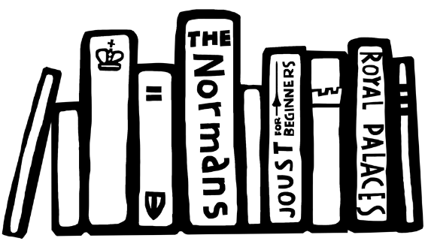

VOCABULARY LIST 3
VOCABULARY LIST
Protestant | a type of Christianity that believes people do not need officials (such as the Pope or Bishops) to communicate with God
rebellion | a fight by a large group of people against the government or ruler
Roman Catholic Church | Christian religion with the Pope as its head
slavery | the practice of one person losing their freedom and being owned by another as property
smallpox | serious and often deadly infectious disease in the past
Spanish Armada | the large fleet of ships sent to invade England by Philip II of Spain in 1588
State Apartments | grand public rooms where official visitors are hosted
suffragette | member of the Women’s Social and Political Union (WSPU) who campaigned for the right of women to vote in the UK
The Glorious Revolution | events of 1688-89 when the Catholic King James II was replaced by the Protestant William III and Mary II
treason | the crime of acting against your own country, especially by trying to kill the king or queen, or overthrow the government
wealth | a large amount of money, property, land or valuable possessions

