Slide 1



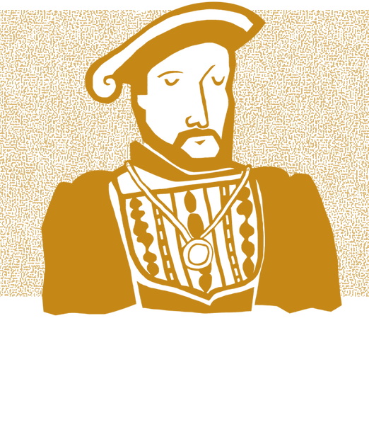
THE
many women were active in family businesses and managing states. They would have had more responsibilities than raising children, although their status was still limited compared to men.
People with learning disabilities were sometimes seen as having an important gift. Some worked at the Tudor Court as entertainers and were often called ‘natural fools’. ‘Natural fools’ held valued positions at court and could speak openly when others could not. However, disabled people also faced discrimination, ridicule and mistreatment.
DAILY LIFE IN TUDOR ENGLAND
TUDORS
Many people in Tudor England lived in the countryside, working on farms or as crafts people. Their diet was simple, mainly consisting of bread, pottage (a thick stew), and ale, while the rich enjoyed meats, exotic spices, and sugar. Childhood was often short, as many children had to work from a young age, and only wealthy boys had access to formal education. Life was harsh, the average life expectancy was roughly 35 years.
A KNOWLEDGE BOOSTER FOR TEACHERS
IN A NUTSHELL
POWER OF THE MONARCH
ELIZABETHAN ENGLAND
The Tudor period was a time of great change in Britain, spanning three generations. Henry VIII transformed the country’s religion by creating the Church of England, with the monarch as its head. Meanwhile, large ships sailed the seas, exploring Europe and beyond. This brought new goods and opportunities to England.
Tudor monarchs had absolute power, and their court was the centre of political and social life. Hampton Court Palace was one of their grand homes, often filled with nobles trying to win royal favour. The king or queen’s mood could decide a person’s fate—Henry VIII, for example, was known for his temper. Life at court included a mix of roles, from jesters (also known as ‘fools’) like Will Somer to musicians like John Blanke, a Black trumpeter.
Elizabeth I’s reign is often called a ‘golden age.’ Theatre flourished, with playwrights like Shakespeare writing comedies, tragedies, and histories. The Globe Theatre and other playhouses became popular entertainment spots. However, it is important to note that many people faced hardships during this time, and it was not a ‘golden age’ for all.
RELIGION IN THE TUDOR ERA
EXPLORATION, TRADE
& EXPLOITATION
Religion changed dramatically under
the Tudors:
Henry VIII – Split from the Roman Catholic Church and created the Church of England. However, he broadly remained a Catholic.
Edward VI – Made England more Protestant.
Mary I – Attempted to restore Catholicism, earning the nickname ‘Bloody Mary’ for her persecution of Protestants.
Elizabeth I – Practised Protestantism but tolerated some Catholic practices. However, tensions remained high.
TUDOR SOCIETY
Under Elizabeth I, England expanded its trade and influence:
The East India Company (founded in 1600) aimed to control trade with India and Asia.
English sailors, backed by the queen, raided Spanish ships for treasure.
The transatlantic slave trade grew, with privateers capturing and enslaving African people. Elizabeth I actively supported this trade.
Tudor England was highly structured. The monarch was at the top, while the poorest people had little power or security. Wealth was based on land ownership, with the richest families living mainly in the South. The gap between rich and poor was large.
Despite two queens ruling in their own right, Tudor society was male dominated. At the time, there was a common idea that women were weaker than men, and Henry VIII’s hoped to have a son who he thought would be a stronger ruler than a daughter. However,
HOW DID THE
TUDOR DYNASTY BEGIN?
Before the Tudors, England was torn by civil wars known as the Wars of the Roses (1455–1485), fought between the rival houses of Lancaster and York. Henry Tudor (from the House of Lancaster) defeated Richard III at the Battle of Bosworth in 1485 and married Elizabeth of York. This helped end the conflict and began the Tudor dynasty.

