Slide 1

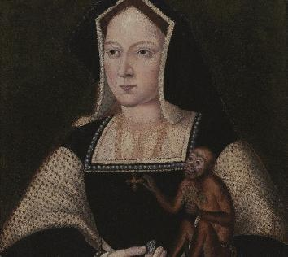
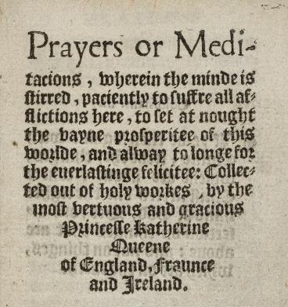
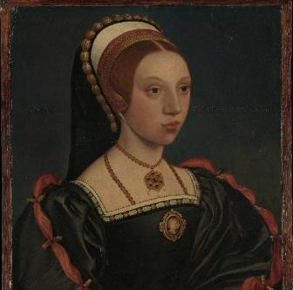
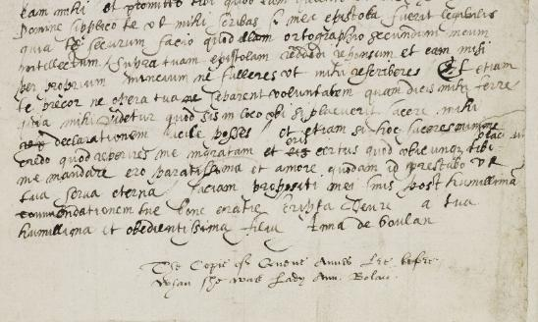
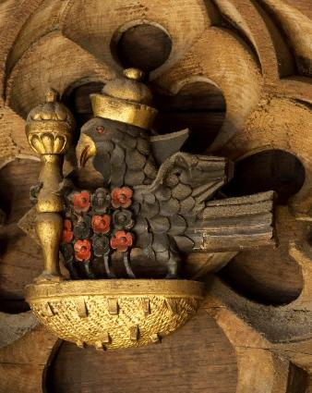
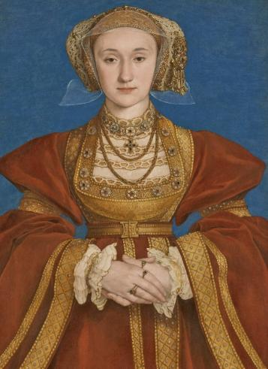
TITLE PAGE
HOW DO
WE KNOW
ABOUT THE SIX
TUDOR QUEENS?
Notes:
Between 1509-1547 six women were married to King Henry VIII. These sources give an insight into the lives of these women as well as themes such as trade, education, religious change and expectations. The sources also highlight the gaps – things we can’t know about these women.
Find more resources on this topic: Teach the Six Queens Differently | Historic Royal Palaces
How to use:
This resource is editable. Teachers can adapt the content for their students. Some teachers may wish to use the sources and audio with their students and use the text-based slides for their own background reading. Other teachers may wish to print off the text-based slides for group activities.
Key vocabulary is highlighted in bold. Definitions are included on the final page.
To use this resource on interactive devices such as Chrome Books, teachers may wish to save this file as a pdf first.
Image credits (from left to right)
Katherine of Aragon © Philip Mould Ltd, London/Bridgeman Images
Katherine Parr’s book From the British Library archive Shelfmark: Royal 7 D. X
Portrait of a young woman The Met CC0
Falcon carving © Historic Royal Palaces
Anne Boleyn's Letter Courtesy of The Parker Library, Corpus Christi College, Cambridge. Licensed under a Creative Commons Attribution-Non Commercial 4.0 International License.
Portrait of Anne of Cleves © 2023 Grand Palais Rmn (Louvre Museum) / Adrien Didierjean

Slide 2
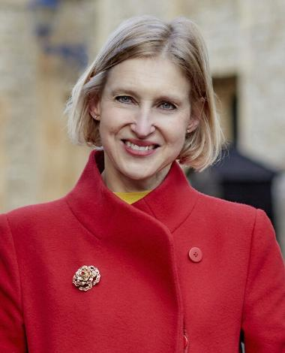


MEET THE HISTORIAN
Tracy is Chief Historian at Historic Royal Palaces.
Hear from Tracy about what historic sources are and how we can learn from them.
Tracy Borman
Notes:
Audio transcript
Speaker: Tracy Borman
I'm Tracy Borman, Chief Historian at Historic Royal Palaces, which means I spend a lot of my time researching the history of the palaces and the people who lived in them. And I am particularly interested in the Tudors. As a historian, I'm always looking at historical sources. These include pictures, documents and objects. It's very important to question these sources. I have to ask myself, who created them? And why? Do the sources reveal the whole story? Do they match what other sources from the time also report? It's only by piecing together the different parts of the story that we can get an accurate idea of that past. In this resource, I'd like to share with you a collection of sources about six Tudor queens, Henry VIII's wives. But these sources reveal more about these queens as people rather than just as wives. We will see glimpses of their personalities, their achievements and their challenges. Let's investigate together and I challenge you to make your own conclusions about what these women might have really been like.

Slide 3
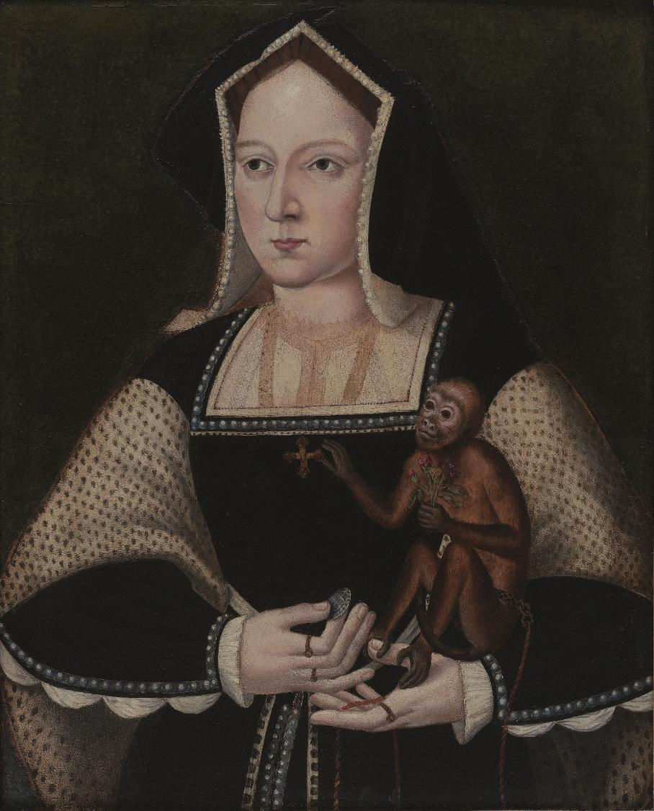
IMAGE PORTRAIT OF KATHERINE OF ARAGON
© Philip Mould Ltd, London/Bridgeman Images

Slide 4
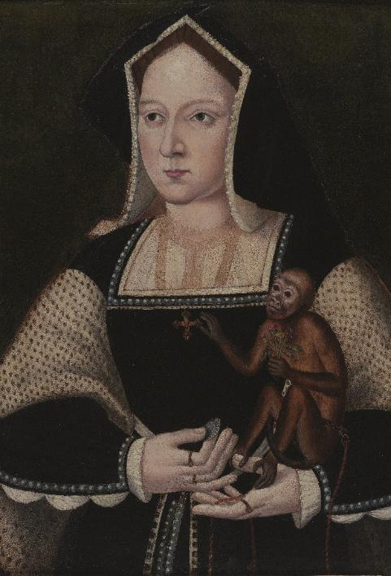
PORTRAIT OF KATHERINE OF ARAGON
A portrait of Katherine of Aragon from the early 1530s
Questions
BACKGROUND NOTES
WHAT CAN WE LEARN FROM
THIS SOURCE?
Q | What clues are there in the painting that suggest Katherine had connections to the wider world, beyond England?
Katherine of Aragon was a Spanish princess, daughter of Queen Isabella of Castile and Ferdinand of Aragon. For many years, Spanish rulers had been fighting to take over areas in Europe and South America.
Katherine came to England in 1501, aged 15. She married Henry VIII in 1509 and became Queen. She had one daughter Mary in 1516. Henry wanted to separate from her, he asked her for an annulment. At first Henry tried to persuade her to go into a convent and told her that she would be given money and property if she agreed. But Katherine refused. Katherine believed their marriage was a holy vow that should not be broken and that God had chosen her to be queen.
Portraits were very expensive, so they were a way of showing off how rich you were. Portraits could also help send certain messages about the person in the painting, perhaps making them look powerful and or to show connections to other places.
This portrait gives us an idea of what Katherine looked like and what she wore.
The portrait also shows Katherine’s pet monkey. Rich people often had unusual pets from far-away places.
Katherine seems to be offering the monkey some coins, which it is ignoring. The monkey is holding a small bunch of flowers and is reaching for Katherine’s cross necklace instead. Some historians believe that this symbolises how Katherine felt about Henry asking for an annulment.
The monkey appears to be a type of monkey from South America.
Q | The monkey is reaching for the cross and ignoring the coins. What might this symbolise?
Q | At what stage in Katherine’s life do you think this painting shows? Before, during or after her marriage?
© Philip Mould Ltd, London/Bridgeman Images
Key dates: Painted around 1530
Notes:
Answers
What clues are there in the painting that suggest Katherine had connections to the wider world, beyond England?
Katherine is holding a monkey from South America in the portrait. This tells us there must have been connections and trade between England and Spain and other parts of the world such as South America.
At what stage in Katherine’s life do you think this painting of her is? Before, during or after her marriage?
This painting is based on originals made around 1530, which is a few years before Katherine’s separation from Henry.
The monkey is reaching for the cross and ignoring the coins. What might this symbolise?
The monkey reaching for the cross might symbolise that Katherine was not interested in the money Henry promised her if she agreed to separate, and that her religion and faith was more important to her.

Slide 5

TRANSCRIPT SPEECH
Alas, Sir, where have I offended you?
Or what occasion have you of displeasure, that you intend to put me from you?
I take God and all the world to witness that I have been to you a true, humble and obedient wife, ever conformable to your will and pleasure.
© Philip Mould Ltd, London/Bridgeman Images
Listen to audio about this source from Chief Historian Tracy Borman.
Notes:
Audio transcript
Speaker: Tracy Borman
Henry VIII wanted his marriage to his first wife, Katherine of Aragon, to be cancelled or annulled. In 1529, there was a trial to decide if this could happen. This source is a record of what Katherine said at the trial. She explained that she had always been a true, humble and obedient wife. She clearly believed she had done nothing wrong. It was a very brave thing to say because she was asking Henry, in public, to give a real reason for ending their marriage. But we have to think carefully about where this source came from. It was written by George Cavendish, who might have been at the trial in 1529, but he didn't write it down until many years later. This means it might not be completely accurate. Also, he wrote it as part of a biography of Cardinal Wolsey. So he might have told the story in a way that overall made certain people look good. Even so, the source is still useful because it was written by someone who lived at the time. And we do know one certain fact. The Pope's court agreed with Katherine and refused to cancel the marriage, which suggests she argued her case very well.

Slide 6
KATHERINE OF ARAGON’S SPEECH
Katharine of Aragon’s speech in court, as recorded by George Cavendish in a book
Questions
BACKGROUND NOTES
Katherine of Aragon and Henry VIII were married for 24 years. However, in 1527 Henry asked for an annulment. Katherine refused to accept this. As a result, in 1529, the case was taken to a special court led by religious leaders linked to the Pope.
At court, Katherine questioned Henry. The court decided not to give Henry the annulment. Because Henry didn’t get what he wanted, he decided to break away from the Pope and the Roman Catholic Church.
Q | Put what you think Katherine is saying into your
own words.
Alas, Sir, where have I offended you?
Or what occasion have you of displeasure, that you intend to put me from you?
I take God and all the world to witness that I have been to you a true, humble and obedient wife, ever conformable to your will and pleasure.
Q | Does this source present Katherine
in a positive or negative way? Explain why you think this.
WHAT CAN WE LEARN FROM THIS SOURCE?
This source suggests that Katherine stood up for herself and tried to stop the annulment. It suggests she was brave to question Henry in front of the court. Based on this source, Katherine claimed she had done nothing wrong and had been loyal and obedient as a wife.
This source has been taken from a book written by George Cavendish. He worked for Thomas Wolsey who was in charge of trying to get Henry the annulment. This might mean that Cavendish was at the court case and knew lots about it. However, this might also mean that he wanted to tell the story in a way that made certain people look good. He didn’t publish the book until 1554–1558, when Katherine’s daughter Mary was Queen.
Q | How useful is this source to understand how Katherine acted at the trial?
Key dates: Original speech 1529. Book written 1554-1558.
Notes:
Answers
Put what you think Katherine is saying into your own words.
Katherine is questioning Henry, asking him to say what she has done wrong and why he wants to separate. She says she has been obedient, loyal wife.
Does this source present Katherine in a positive or negative way?
Some students might think that this source presents Katherine in a positive way as she seems confident and not afraid to question the king to stand up for herself.
How useful is this source to understand how Katherine acted at the trial?
Scaffolded questions: What does this source suggest about how Katherine acted at the trial? How far do you trust the evidence given in this source and why?
The source is somewhat useful to understand how Katherine acted. It was recorded by a person who was alive at the time and worked for Wolsey who was very involved in the trial. However, the source was not written until around 30 years after Katherine’s speech, so it might not be very accurate.
George Cavendish worked for Wolsey who was in charge of getting the annulment. But Wolsey was not successful as the court refused the annulment. Cavendish might have written this report to try to make Wolsey look good. Also, it was written during the time that Katherine’s daughter Mary was queen, so Cavendish might have wanted to please Mary by showing her mother in a brave way.
Overall though, the court did agree with Katherine, so it does seem likely she defended herself well. It also agrees with other sources about her showing her as brave.

Slide 7
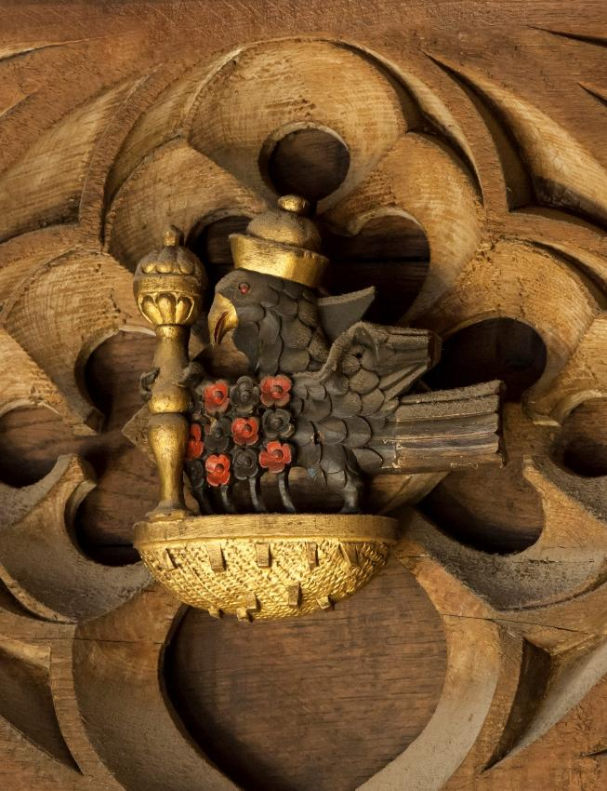
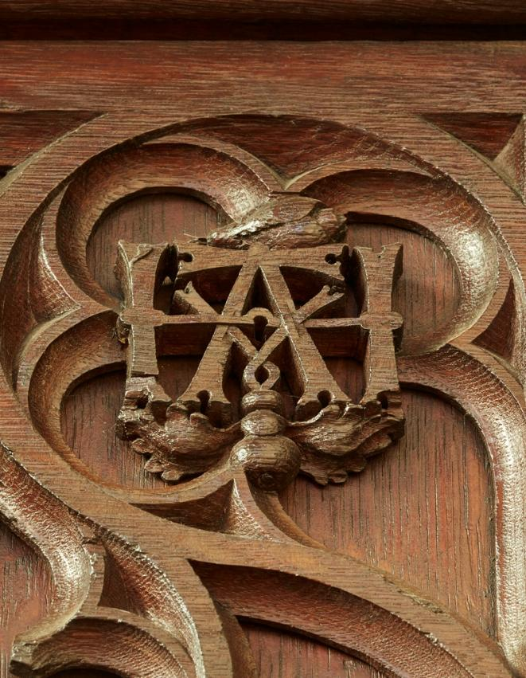
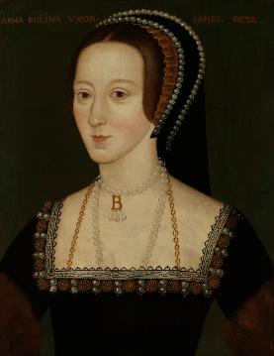
IMAGE WOODEN CARVINGS
© National Portrait Gallery
Listen to audio about this source from Chief Historian Tracy Borman.
Notes:
Audio transcript
Speaker: Tracy Borman
Hampton Court Palace used to belong to Cardinal Wolsey, but Henry VIII took it over. When he married Anne Boleyn, he wanted to redecorate the Great Hall to honour her. These two objects are part of the Great hall. They were carved into the wooden ceiling. One carving is a falcon, which was the Boleyn’s family symbol. Falcons represented majesty, power, and ambition. This falcon is holding a sceptre like the ones kings and queens hold at their coronations. It is also decorated with flowers. The other carving shows the letters H and A for Henry and Anne. There used to be lots of these carvings all around the palace showing how strongly Henry felt about Anne and how important he wanted everyone at court to think she was. But after Anne was executed Henry ordered almost all signs of her to be destroyed. Only a few of these carvings still survive today.

Slide 8


ANNE BOLEYN CARVINGS
BACKGROUND NOTES
Around 1529, Henry took over Hampton Court Palace and began turning it into a magnificent palace. 1533, he married Anne Boleyn, his second wife. Many people supported Katherine of Aragon and as a result did not like Anne Boleyn.
Henry ordered the Great Hall at the palace to be decorated in Anne’s honour. Carpenters carved her family badge, a falcon, and the initials H&A into the wood.
However, Anne was accused of treason and executed in 1536. Afterwards, Henry tried to remove all signs of her from the palace. Even so, a few carvings survived, and you can still see them at Hampton Court Palace today.
Decorative carvings in the Great Hall at Hampton Court Palace
Questions
Q | Describe the falcon badge.
Q | What message do you think Henry wanted these carvings to send about Anne?
WHAT CAN WE LEARN FROM THIS SOURCE?
Q | What can we learn about Anne’s life from these sources?
The Great Hall was designed to impress visitors. By placing Anne’s symbols here Henry showed everyone how important she was to him. Carving symbols into the wood suggests he thought their relationship would last.
The falcon was carved into the ceiling and this animal represented power and majesty. The falcon appears powerful - it has a crown and sceptre like a King or Queen would have at a coronation. The flowers around it may be Tudor roses. Anne also enjoyed hunting with falcons, so the bird could hint at her hobby.
The letters H and A stand for Henry and Anne. They are intertwined to show their close relationship. There used to be many of these carvings decorating the hall, but only two survive today.
Q | How useful are these carvings for understanding how Anne Boleyn was viewed by other people at the time?
Key dates: 1533-1536
Notes:
Answers
Describe the falcon badge.
The falcon is painted gold and has a crown and sceptre. It sits in a gold nest. There are black and red flowers decorating it, which could be Tudor roses.
What message do you think Henry wanted it to send about Anne?
It sends a message that Anne is powerful, important and the rightful queen. The crown and sceptre show her royal status, and the flowers may link her to the Tudor family. This would have been especially important after Henry’s marriage to Katherine of Aragon ended, as Henry may have felt he needed to convince people that Anne truly was their new queen. It could also be a link to Anne’s hobbies.
What can we learn about Anne’s life from these sources?
She liked hunting with falcons
Henry wanted to show her off when they first married and perhaps felt the need to show off that she was the rightful queen
That Henry’s feelings towards her changed dramatically and he wanted to remove all memory of her
However, they do not give us much insight into what Anne’s experiences might have been like from her perspective
How useful are these carvings for understanding how Anne Boleyn was viewed by other people at the time?
Scaffolded questions: What do the carvings suggest about how Anne Boleyn was portrayed at the time? How typical do you think this way of seeing her was?
The carvings are very useful to understand how Henry viewed Anne. He presented her as powerful, important and his rightful queen. This tells us that at least for part of her time at court, Henry wanted others to respect her. They are useful to understand how his view of her changed so quickly and dramatically, since he eventually ordered for the symbols to be destroyed. This suggests he wanted everyone to forget about her.
However, the carvings aren't as useful to understand what everyone else actually thought about Anne. Their opinions aren’t shown in the decorations. The decorations might even suggest that public opinion of Anne was not very positive, since Henry was initially trying so hard to show her in a positive light. So, the carvings are useful for showing Anne’s public image while she was queen, but they don’t tell us the full range of people’s views at the time. They need to be used alongside other evidence.

Slide 9
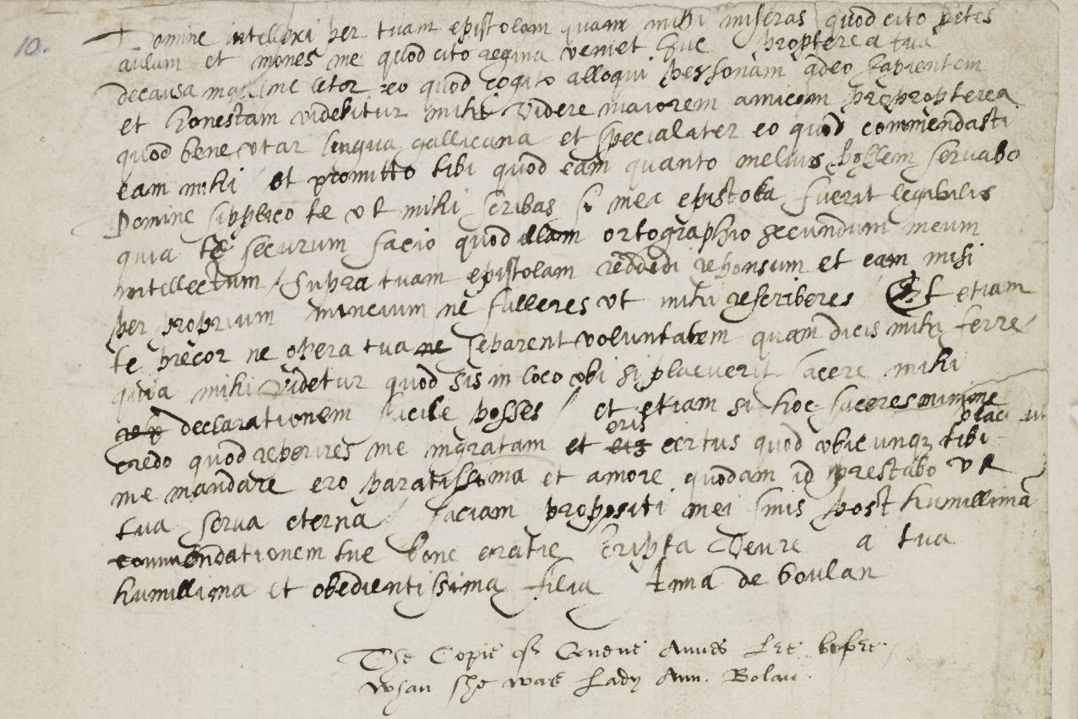
IMAGE ANNE BOLEYN LETTER
Courtesy of The Parker Library, Corpus Christi College, Cambridge
Notes:
Anne Boleyn's Letter Courtesy of The Parker Library, Corpus Christi College, Cambridge. Licensed under a Creative Commons Attribution-Non Commercial 4.0 International License.

Slide 10
TRANSCRIPT ANNE BOLEYN LETTER
Sir, I understand by your letter that you desire that I shall be a worthy woman when I come to the Court and ... that the Queen will take the trouble to converse with me which rejoices me much to think of talking with a person so wise and worthy.
This will make me have greater desire to continue speaking French well and also spell, especially because you have enjoined it on me...
Sir, I beg you to excuse me if my letter is badly written.
© National Portrait Gallery

Slide 11
ANNE BOLEYN’S LETTER
A letter written by Anne Boleyn to her father in 1514
BACKGROUND NOTES
Questions
When Anne Boleyn was around 12 years old, her family sent her abroad to learn how royal courts worked. She went to the Netherlands and France and joined the royal households there. While she was abroad, she learned languages, music, dance and etiquette.
Her father, Thomas Boleyn, believed she should have the same high-quality education as her brother. This was very unusual for the time as girls' education was not usually seen as important.
Sir, I understand by your letter that you desire that I shall be a worthy woman when I come to the Court and ... that the Queen will take the trouble to converse with me which rejoices me much to think of talking with a person so wise and worthy.
This will make me have greater desire to continue speaking French well and also spell, especially because you have enjoined it on me...
Sir, I beg you to excuse me if my letter is badly written.
Q | Is this a contemporary source? Explain your answer.
WHAT CAN WE LEARN FROM THIS SOURCE?
Q | How useful is this letter for finding out what Anne was like when she was young?
This letter was written about a year after Anne arrived in Europe. It is written in French, and there are a few places where she made mistakes and crossed out words as she corrected herself. From the translated lines, we learn about Anne’s life and experiences in 1514.
The first part suggests that Anne’s father wanted her to work hard and gain a good position at court. Anne seems excited about the idea of speaking to the queen one day. The second part shows that Anne was eager to improve her French because her father encouraged her. She clearly cared about doing well.
The last part reveals that she was still learning and worried about making mistakes. She wanted to impress her father.
Q | What kind of source would be useful for finding out what Anne was like as queen?
Key dates: 1514
Notes:
Answers
Is this a contemporary source? Explain your answer.
Yes. This is a contemporary source because it is an original letter written by Anne Boleyn herself in 1514. It was created at the time of the events it describes, making it direct evidence from the past.
How useful is this letter for finding out what she was like when she was young?
Scaffolded questions: What does this letter suggest about what Anne Boleyn was like when she was young? How strong is this source as evidence for what she was like when she was young?
This letter is very useful for helping us understand what Anne Boleyn was like when she was young. It shows that she was eager to learn and wanted to improve her French, especially her speaking and spelling. This suggests she was hardworking and took her education seriously. The way she writes to her father also shows that she wanted to please him and was worried about making mistakes, which tells us she cared about doing things well.
The letter also shows that Anne was ambitious and excited about life at court. She looked forward to talking to the queen one day, which suggests she was confident and hopeful about her future.
However, the letter has some limitations. Anne may have written in a polite and careful way because she was writing to her father, so we do not see everything she really thought or felt. It is also only one letter, so it shows just one moment in her early life.
Overall, the letter is a useful piece of evidence for showing that Anne was hardworking, eager to learn and ambitious when she was young, but it cannot tell us the whole story on its own.
What kind of source would be useful for finding out what Anne was like as queen?
Anne’s diaries and letters from when she was queen might reveal what was important to her and how she treated others
Her household accounts might show how she spent her money
Other people’s letters and diaries that mention her as queen
All of these would have some strengths and limitations depending on who wrote it, why and when.

Slide 12
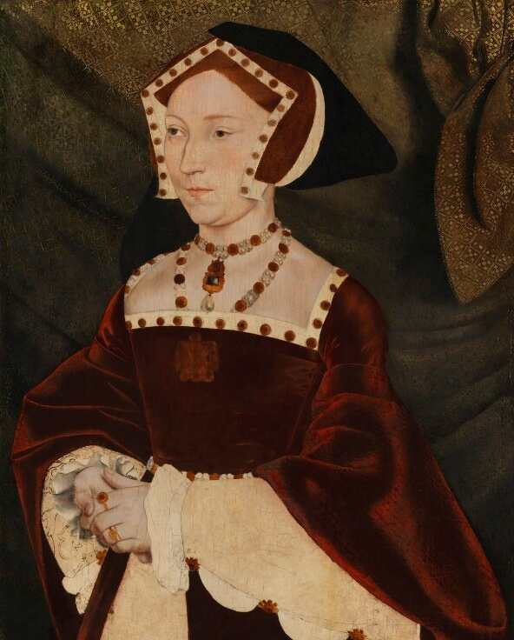
IMAGE PORTRAIT JANE SEYMOUR
© National Portrait Gallery

Slide 13
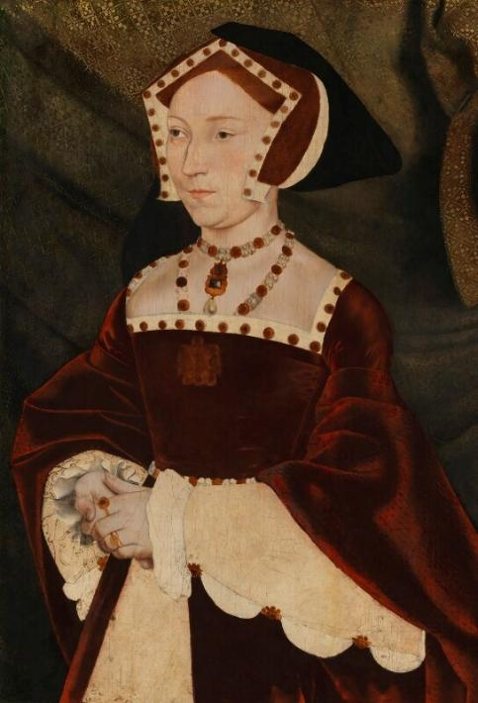
PORTRAIT OF JANE SEYMOUR
A portrait of Jane Seymour from around 1537
Questions
BACKGROUND NOTES
WHAT CAN WE LEARN FROM
THIS SOURCE?
Q | What does Jane’s clothing in this portrait tell us about how she wanted to be seen as queen?
Jane was a lady-in-waiting to Katherine of Aragon and Anne Boleyn. This meant that she knew court life well and saw the events of two queens’ lives unfold. Shortly after Anne Boleyn was executed, Jane Seymour married Henry VIII in 1536.
Jane had a son, Edward, in 1537, but became ill and sadly died shortly afterwards.
There were two main types of Tudor headdresses for women: the French hood and the English gable hood.
The French hood had a rounded shape at the top and you could see the person’s hair underneath. Anne Boleyn made the French hood popular in England when she was queen.
The English gable hood had a pointed, triangular shape on top that covered most of the hair.
In the portrait, Jane wears the pointed English gable hood. When she became queen, she encouraged people at court to wear this style again. This may have been to show that she was different from Anne Boleyn, who had made the French hood popular.
The portrait also shows Jane wearing rich fabrics, gold jewellery and precious stones. These were symbols of power and wealth, helping to present her as a respected queen.
However, the painting seems to be unfinished: the jewels and gold do not have the usual shine that other Tudor portraits have. The sleeves are not fully decorated.
Q | How useful is this portrait in learning what type of queen Jane was?
Q | Think about the year this portrait was made and what else happened at this time. Why might the portrait be unfinished?
© National Portrait Gallery
© National Portrait Gallery
Key dates: Painted around 1537
Notes:
Answers
What does Jane’s clothing in this portrait tell us about how she wanted to be seen as queen?
Jane’s clothing in this portrait shows her wearing rich fabrics and expensive jewellery, which highlights her wealth and status as queen. These items were meant to show that she was powerful and respected at court.
She is also wearing the English gable hood, a traditional pointed headdress. This suggests she wanted people to see her as very different from Anne Boleyn, who was known for wearing the more fashionable French hood. By choosing the English style, Jane may have been trying to show that she was modest, traditional, and proudly English.
How useful is this portrait in learning what type of queen Jane was?
Scaffolded questions: What does this source suggest about what kind of queen Jane was? How strong is this painting as evidence of what Jane was really like as queen?
This painting is somewhat useful because it shows the image Jane wanted to present as queen. Her rich fabrics and jewellery show that she wanted to appear wealthy, important and worthy of her position. The English gable hood suggests she wanted to be seen as a traditional, modest and English queen, especially compared to Anne Boleyn.
However, the painting has limits. Portraits were carefully controlled and designed to show queens in the best possible light, so it may not tell us what Jane was truly like as a queen. It doesn’t tell us much about her actions or what was important to her. We would need to use other sources to help us understand more.
Think about the year this portrait was made and what else happened at this time. Why might the portrait be unfinished?
There are lots of reasons this painting might not have been finished, the artist may have become unwell or the person who ordered it might have run out of money. However, it was painted around the same time that Jane Seymour died, so it is also possible that Henry no longer wanted a painting of Jane as queen.

Slide 14
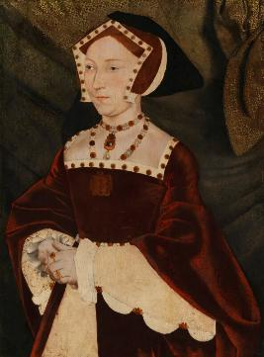
TRANSCRIPT LETTER JANE SEYMOUR
the young damsel... after respectfully kissing the letter, returned it to the messenger without opening it, and then falling on her knees, begged the royal messenger to entreat the King in her name to consider that she was a well-born damsel, the daughter of good and honourable parents without blame or reproach of any kind;
there was no treasure in this world that she valued as much as her honour, and on no account would she lose it, even if she were to die a thousand deaths.
That if the King wished to make her a present of money, she requested him to reserve it for such a time as God would be pleased to send her some advantageous marriage.
© National Portrait Gallery
Listen to audio about this source from Chief Historian Tracy Borman.
Notes:
Audio transcript
Speaker: Tracy Borman
We don't have many sources about Jane Seymour and almost none of it comes from Jane herself, so we have to rely on what other people said about her. One of those people was Eustace Chapuys. He was an ambassador who passed on news and sometimes gossip about the English court to Europe. This source is something he wrote about when Henry VIII sent Jane a letter and a filled with gold. Chapuys said that Jane replied there was no treasure in the world that she valued as much as her honour. But we always have to question our sources. This source shows what people in Europe were being told about Jane and what stories were spreading around the court. It suggests Jane was acting carefully and sensibly with Henry VIII. However, it may not tell the full story. Because we don't have Jane's own words. It's hard to know more about what she was like. She really is a mystery.

Slide 15
LETTER ABOUT JANE SEYMOUR
A letter written about Jane Seymour
Questions
BACKGROUND NOTES
By 1536, Henry VIII’s marriage to Anne Boleyn was no longer happy. Jane Seymour was one of Anne’s ladies‑in‑waiting and would have been at court often. At some point, Henry began to show an interest in Jane. He sent her gifts to impress and charm her.
At that time, ambassadors from other countries spent time at court and wrote letters home about what was happening. One of these was Eustace Chapuys. Chapuys reported all sorts of news from the English court back to Rome. He wrote many letters describing things he saw or heard. However, he was known for repeating gossip and sharing stories that were not always reliable.
the young damsel... after respectfully kissing the letter, returned it to the messenger without opening it, and then falling on her knees, begged the royal messenger to entreat the King in her name to consider that she was a well-born damsel, the daughter of good and honourable parents…
there was no treasure in this world that she valued as much as her honour, and on no account would she lose it, even if she were to die a thousand deaths.
That if the King wished to make her a present of money, she requested him to reserve it for such a time as God would be pleased to send her some advantageous marriage.
Q | Why do you think Jane refused Henry’s letters and gifts?
Q | How useful is this source for understanding what Jane was like as a person?
WHAT CAN WE LEARN FROM THIS SOURCE?
This is part of a letter written by Chapuys to Charles V, the Holy Roman Emperor (and Katherine of Aragon’s nephew). They all disliked Anne Boleyn. The letter talks about problems at court, including the fact that Anne was making enemies and Henry wanted a new wife.
A small part of the letter is about how Henry sent Jane a purse of gold coins and a letter, but that Jane refused the gift. She kissed the King’s letter politely but sent it back without opening it. She told the messenger that she cared about her honour and would not accept money.
The source tells us that people were interested in Henry’s marriage and Jane’s behaviour. It suggests that Jane acted politely and respectfully towards the King but did not want to accept gifts from him at that time.
Q | How reliable is Chapuys’ version of events? What might make it trustworthy or untrustworthy?
Key dates: March/April 1536
Notes:
Answers
Why do you think Jane refused Henry’s letters and gifts?
Jane declined Henry’s letters and gifts because she wanted to protect her reputation. Henry was still married to Anne Boleyn, and Jane did not want people to think she was behaving like a mistress or acting improperly at court.
Her refusal may also have been a clever strategy. By insisting she would only accept gifts as part of a proper marriage proposal, Jane showed that she valued her honour and would not give in easily. This may have made Henry even more interested in her.
How useful is this source for understanding what Jane was like as a person?
Scaffolded questions:
What does this source suggest about what Jane was like as a person? How strong is this letter as evidence for what Jane was actually like as a person?
This source is somewhat useful for understanding Jane’s personality. It suggests she wanted to appear modest, polite, and respectful, and that she cared about her honour. Her refusal of the King’s gift shows that she did not want to be seen as acting in the wrong way.
However, we should be careful. Chapuys may not have witnessed the event himself, and he often repeated court gossip, so his report might not be completely accurate. Also, the letter only shows how other people described Jane — it does not tell us what she truly thought or felt. So, while the source gives us some clues, it cannot give us a full picture of her personality.
How reliable is Chapuys’ version of events? What might make it trustworthy or untrustworthy?
Chapuys’ version of events is helpful but not fully reliable. He was an ambassador who wrote detailed reports about what was happening at Henry VIII’s court, so he often heard important news quickly. However, Chapuys did not always see events himself and often repeated court gossip. He and Charles V also supported Katherine of Aragon, and disliked Anne Boleyn, which could make him biased. Because of this, the letter gives useful clues but may not be completely accurate on its own.

Slide 16
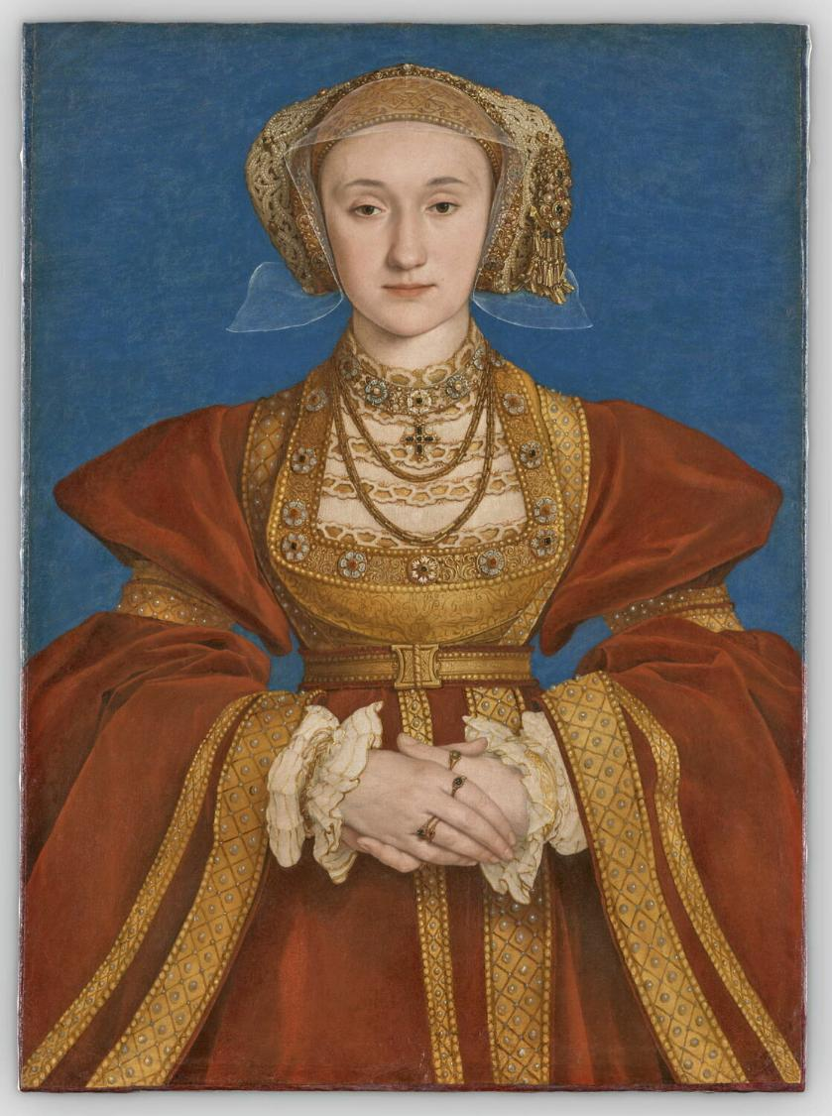
IMAGE PORTRAIT ANNE OF CLEVES
© 2023 GrandPalaisRmn (Louvre Museum) / Adrien Didierjean

Slide 17
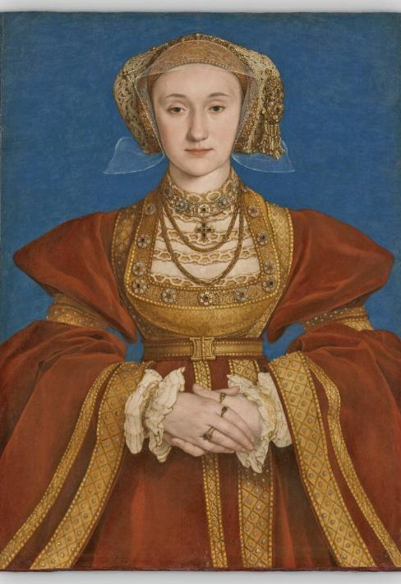
PORTRAIT OF ANNE OF CLEVES
A portrait of Anne of Cleves possibly by Hans Holbein the Younger
Questions
BACKGROUND NOTES
WHAT CAN WE LEARN FROM
THIS SOURCE?
Q | How useful is this portrait for finding out what Anne of Cleves looked like?
By 1539, Jane Seymour had died, and Henry VIII had separated England from the Pope and the Roman Catholic Church. Henry was now looking for new allies in Europe, as well as a new wife. The area of Cleves, in what is now Germany, was also moving away from the Catholic Church.
Anne of Cleves was the daughter of the Duke of Cleves, and Henry hoped marrying her would make an alliance between their two countries. Before agreeing, he sent his painter, Hans Holbein, to paint Anne so he could see what she looked like. Holbein was very well known for making paintings that looked very much like the real person.
When Anne and Henry first met, things did not go well. He famously reported that she did not look like the painting and that he was disappointed. Even so, they got married in January 1540. The marriage ended a few months later in July.
This portrait is thought to be the one that Hans Holbein made to show Henry what Anne looked like. It is painted on vellum, a material that could be rolled up and transported.
The painting shows Anne wearing expensive clothes and lots of jewellery. She has a square shaped headdress with a see-through linen cap underneath. This was a German fashion at the time.
Most portraits of women in the Tudor period were painted so they were looking down or to the side. This often made them look quiet or obedient. This painting of Anne is unusual as she is looking directly forward. This might have been to give her a confident look or to help Henry understand exactly what she looked like before they met.
Q | Why do you think Tudor women were usually painted looking down or to the side?
Q | Name some examples of images created today that are designed or edited to create a particular impression?
© 2023 GrandPalaisRmn (Louvre Museum)
/ Adrien Didierjean
Key dates: Painted around 1539
Notes:
Answers
How useful is this portrait for finding out what Anne of Cleves looked like?
Scaffolded questions: What does this source suggest Anne of Cleves looked like? Is this a trustworthy source for finding out what she looked like?
This portrait is partly useful for learning what Anne of Cleves looked like. If Hans Holbein really created it, he was known for painting people very accurately, so in that case it could be very useful.
But, we also need to be careful. The portrait was made as part of marriage plans, so it may have been designed to show Anne in the best possible light. There are reports that Henry later said she did not look like the portrait, but this only tells us about Henry’s opinion, not necessarily about the accuracy of the painting.
We must remember that portraits are not photographs. They can only show what the artist chose to include and are limited by their skill.
Why do you think Tudor women were usually painted looking down or to the side?
Women were not expected to be bold or confident in public at this time. They were expected to do as they were told by men. Painting them to look down or to the side made them look quiet or obedient.
Name some examples of images created today that are designed or edited to create a particular impression?
There are lots of examples such as photoshopped images of famous people, filters on social media or even AI generated images.

Slide 18

TRANSCRIPT LETTER ANNE OF CLEVES
Madame la Cleve has a more joyous countenance than ever.
She wears a great variety of dresses, and passes all her time in sports and recreations.
Listen to audio about this source from Chief Historian Tracy Borman.
Notes:
Audio transcript
Speaker: Tracy Borman
This source comes from the French ambassador. As an ambassador, his job was to represent the French king in England and to report back about what was happening at the English court. He wrote that Anne of Cleves agreed to end her marriage to Henry VIII. He also reported that she told her brother she was happy to stay in England. The ambassador then sent reports to France describing Anne's life after the marriage ended. He writes that Anne spends all her time in sports and recreations, which means she spends all the time having fun. And, as always, we need to question our sources. In this case, the ambassador probably had no real reason to lie about Anne or her life. What he wrote matches what other sources say about how she spent her time too. Suggesting it is an accurate account.

Slide 19
LETTER ABOUT ANNE OF CLEVES
Letter from the French Ambassador in 1540
Questions
BACKGROUND NOTES
Anne of Cleves and Henry’s marriage ended in 1540 when Henry requested an annulment. Anne agreed to this. In return for her agreeing to end the marriage, Henry gave her the title “The King’s Sister.” He also gave her £500 a year and several homes, including Richmond Palace and Hever Castle. She became a femme sole, which means she was an independent woman who could own her own property and business. This was very unusual at the time because most women had to rely on male relatives for support.
Q | What does this source tell us about Anne’s life after her separation from Henry VIII?
Madame la Cleve has a more joyous countenance than ever.
She wears a great variety of dresses, and passes all her time in sports and recreations.
Q | How useful is this source for finding out about Anne’s life after her separation from Henry VIII?
WHAT CAN WE LEARN FROM THIS SOURCE?
This source is from a letter written by Charles de Marillac, the French ambassador. He worked at the English court between 1538 and 1543. His job was to report back to the French king about what was happening in England, including news about Henry VIII and his wives.
In this letter, Marillac briefly mentions Anne of Cleves. His words suggest that she seems happier than ever and spends her time enjoying “sports and recreations,” which could mean activities like hunting, games, or gambling. This suggests that she had free time and money to enjoy herself.
Q | What does this source suggest might have been the benefits of being a femme sole in the Tudor period?
Key dates: 1540
Notes:
Answers
What does this source tell us about Anne’s life after her separation from Henry VIII?
The source tells us that Anne seemed happy after her separation. Marillac says she is “joyous”. She also wore lots of different dresses, showing that she had money. She spent her time doing enjoyable activities, which suggests she was living a comfortable and pleasant life.
How useful is this source for finding out about Anne’s life after her separation from Henry VIII?
Prompt: Think about whether Marillac would have access to information? Is he likely to tell the truth? Is he able to give a full account of Anne’s life?
This source is quite useful for finding out about Anne’s life. Marillac was at the English court, so he may have seen Anne himself or heard reliable information about her. His job was to report truthfully to the King of France, so he would have had little reason to lie about her. However, the letter is brief, so it only tells us a small part of what Anne’s life was like and does not give Anne’s own opinions, only what others thought about her.
What does this source suggest might have been the benefits of being a femme sole in the Tudor period?
This source suggests Anne had much more freedom as a femme sole. She could choose how to live her life and spend her money. She could do her own hobbies and pastimes.

Slide 20
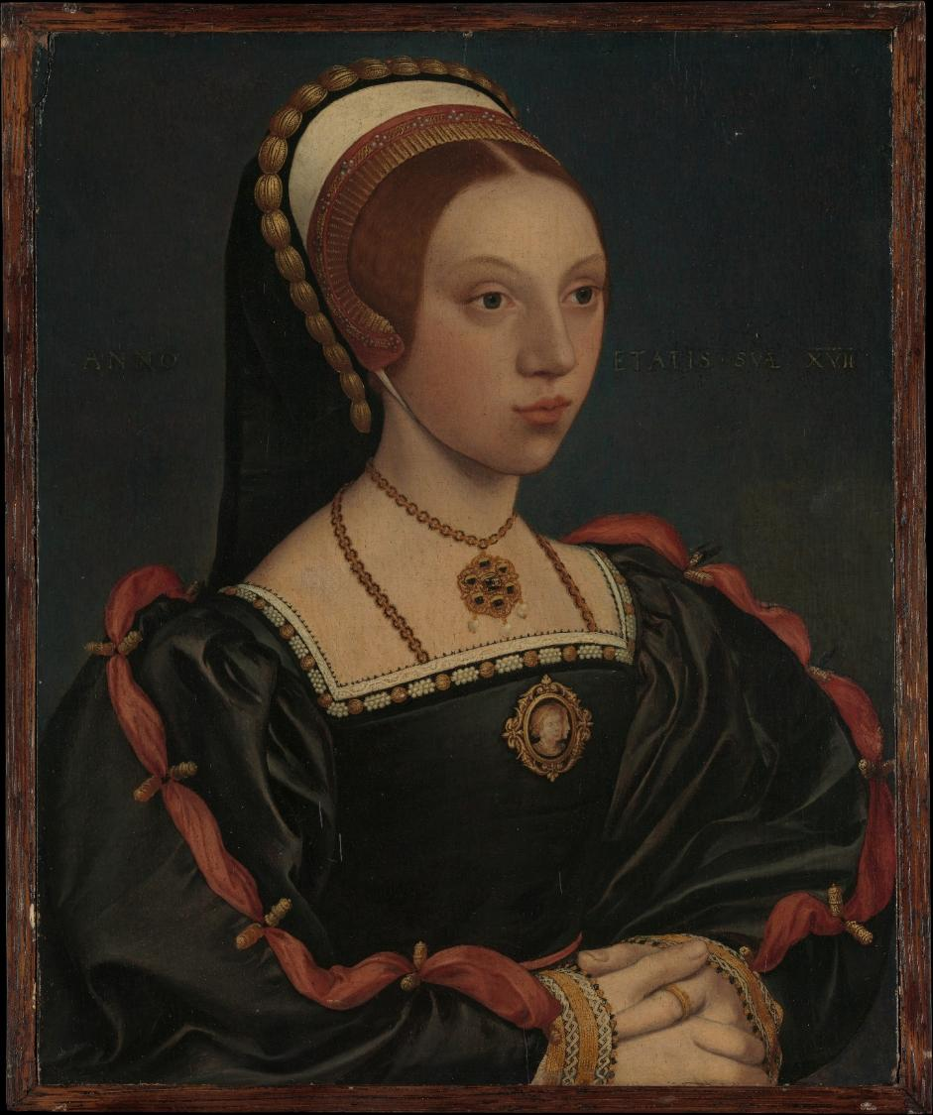
IMAGE PORTRAIT YOUNG WOMAN
The Met CC0
Notes:
Audio transcript
Speaker: Tracy

Slide 21
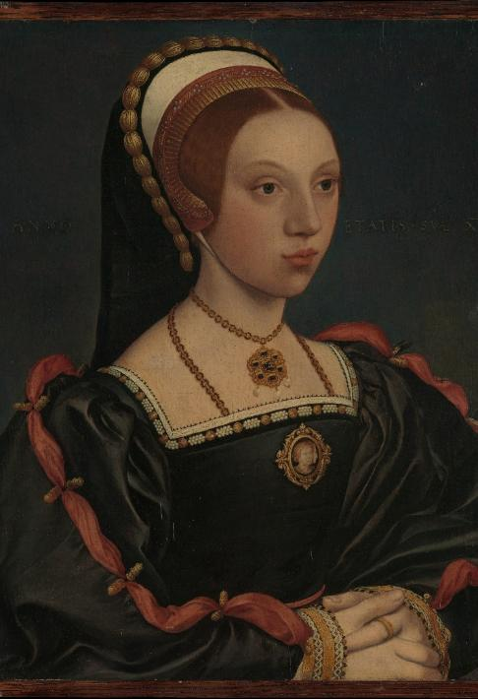
PORTRAIT OF A YOUNG WOMAN
A portrait of a young woman who might be Catherine Howard
Questions
BACKGROUND NOTES
WHAT CAN WE LEARN FROM
THIS SOURCE?
Q | How certain can you be that this portrait shows what Catherine Howard looked like? Explain your answer
Catherine Howard worked at court as a lady‑in‑waiting to Anne of Cleves. After Henry and Anne ended their marriage in 1540, Catherine married Henry VIII and became his fifth wife.
Catherine was about 17 years old, and Henry was 49. Sadly, Catherine was executed for treason just a few years later.
In Tudor times, portraits were to show how people wanted to be seen. Today it can be hard to learn from them because some portraits have been lost, destroyed or damaged. This means important details may be missing, and we can’t always be sure who or what the painting shows.
This portrait shows us what a wealthy young woman at the English royal court looked like around 1540–1545. Her clothing is very rich and detailed, which tells us she was linked closely to the royal household. Her dress, jewellery, French hood and decorated sleeves all match the fashions worn by
women around the time Catherine Howard was queen.
Even though we don’t know who the woman in the painting is, there is a note on the painting that suggests this person was 17 years old when the portrait was made.
Historians have tried to work out who she is, and some have suggested she might be Catherine Howard. This is because Catherine was a similar age and status to the person in this portrait. But we don’t have any other portraits that we know for sure are of Catherine Howard. This means we can’t compare this painting with others of her to check if looks like her.
Q | What can we learn from this portrait?
Q | Why do you think there are no portraits left today that we can be sure are of Catherine Howard?
The Met CC0
Key dates: 1540-1545
Notes:
Answers
How certain can you be that this portrait shows what Catherine Howard looked like? Explain your answer
This portrait is of limited use to understand what Catherine looked like. There are no details to confirm who the woman is. Even though she is the right age and status to be Catherine Howard, we cannot be sure.
What can we learn from this portrait?
This portrait is still useful because it teaches us about Tudor court life, even without knowing the woman's name. Her rich clothing, jewellery and French hood show what high‑status young women at court wore in the early 1540s. New research might also reveal more about the painting one day so that we can know for sure who it is.
It also shows the challenges historians face when working with old paintings: portraits can become damaged, mis‑labelled, or separated from their original records.
Why do you think there are no portraits left today that we can be sure are of Catherine Howard?
There are lots of reasons there aren’t any portraits today that we can be sure are Catherine Howard. They may have been lost or damaged over time. Also, she was queen short time so perhaps not long enough for many portraits of her to be made. Importantly, though, we know she was executed and considered a traitor by Henry. We know that after Anne Boleyn was executed Henry wanted all memories of her to be destroyed, so maybe he also wanted any portraits of Catherine to be destroyed too.

Slide 22
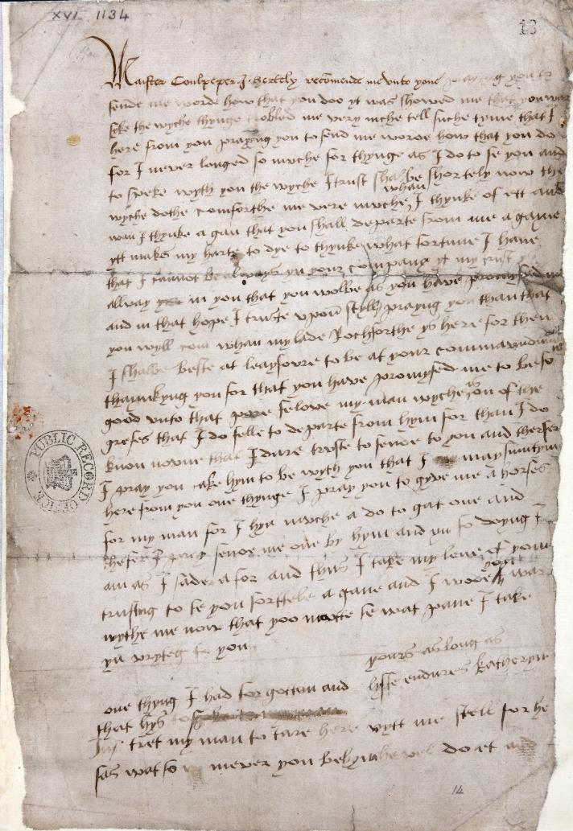
IMAGE LETTER CATHERINE HOWARD
The National Archives, ref: SP 1/167 (14)
Listen to audio about this source from Chief Historian Tracy Borman.
Notes:
Audio transcript
Speaker: Tracy Borman
This letter was written by Queen Catherine Howard to Thomas Culpepper in the summer of 1541. Catherine was accused of having an affair with Culpeper. The letter seems to be a love letter to him. Near the bottom, there is a crease, and on the right-hand side, you can just about make out the words, yours as long as life endures. This letter, was used as evidence against Catherine, and she was eventually executed. It certainly does seem to suggest she was guilty of having an affair. But, as always, we have to question our sources and compare them with other reports from the time. We must remember that Catherine was a young and vulnerable girl. It's also important to know that there is evidence that might suggest Culpeper was an aggressive person. Some historians think he may have threatened Catherine. And that she might not have had much choice about their relationship. Is it possible she wrote this letter just to keep him happy and to keep herself safe? Without more evidence, we may never know.

Slide 23

TRANSCRIPT LETTER CATHERINE HOWARD
'It makes my heart die to think I cannot be always in your company.’
Catherine signed the letter:
'Yours as long as life endures.'
The Met CC0

Slide 24
LETTER FROM CATHERINE HOWARD
A letter written by Catherine Howard to Thomas Culpepper
Questions
BACKGROUND NOTES
Catherine’s time as queen was difficult. People around her tried to use her position as queen to make themselves more powerful. One of these people may have been Thomas Culpepper, a man who worked close to the king. In 1541, Catherine was accused of having a romantic relationship with Culpepper. Around this time Henry also learned that Catherine had been in relationships with other men before their marriage. Because of these accusations, Catherine was charged with treason and executed. She was around 20 years old.
Q | What does this letter suggest about the relationship between Catherine Howard and Thomas Culpepper?
'It makes my heart die to think I cannot be always in your company.’
Catherine signed the letter:
'Yours as long as life endures.'
WHAT CAN WE LEARN FROM THIS SOURCE?
Q | How strong is this letter as evidence that Catherine was having a relationship with Culpepper?
This is part of a letter written by Catherine Howard to Thomas Culpepper. In the letter, Catherine writes about Culpepper being unwell, their secret meetings, and wanting to see him again. Much of what she writes suggest they had a romantic relationship.
Henry’s staff found this letter, and it was used as evidence that Catherine had betrayed the king and to find her guilty of treason. However, around this time Henry deliberately changed the treason laws so that Catherine’s past relationships were now seen as illegal.
Historians today question what this letter really means. Some recent research suggests that Thomas Culpepper may have been a forceful or frightening person. Catherine was young, isolated and may have written the letter to try to please him. However, we cannot know for sure.
Q | Why might historians disagree about what this letter means?
Key dates: Summer 1541
Notes:
Answers
What does this letter suggest about the relationship between Catherine Howard and Thomas Culpepper?
The letter suggests that Catherine Howard loved Thomas Culpepper. She says she wants to always be in his company, implying she misses him when they are apart. She seems devoted to him as she says “yours as long as life endures”. We do not know how he felt about her, so we only get a view of one side of the relationship.
How strong is this letter as evidence that Catherine was having a relationship with Culpepper?
This letter was used as evidence against Catherine as proof of her affair with Culpepper. It proves that she wrote to Culpepper and it seems like they had a romantic relationship. But we cannot be completely certain. She may have written the letter for other reasons, for example, trying to please Culpepper if she felt threatened by him.
Why might historians disagree about what this letter means?
Some historians might think this letter incriminates Catherine and is evidence of her guilt. Other historians may think she was afraid or felt pressured to write this letter and therefore may doubt that is is proof she was having a romantic relationship with Culpepper.

Slide 25
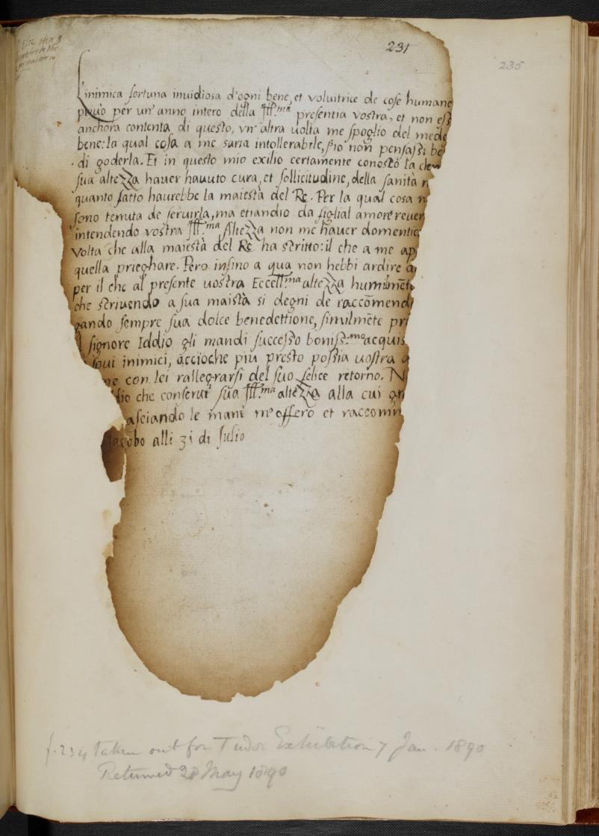
IMAGE LETTER ELIZABETH KATHERINE
Courtesy British Library Shelfmark: Cotton Otho C. X

Slide 26
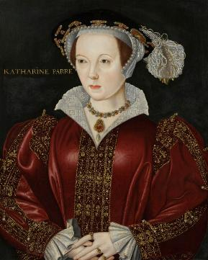
TRANSCRIPT LETTER ELIZABETH KATHERINE
Your Highness has had much care and solicitude for my health.
I am bound to serve you and revere you with a daughter’s love.
© National Portrait Gallery
Notes:
Audio transcript
Speaker: Tracy Borman

Slide 27
LETTER TO KATHERINE PARR
A letter from Princess Elizabeth, the future Elizabeth I, to Katherine Parr
BACKGROUND NOTES
Questions
Katherine Parr married Henry in 1543 and became his 6th wife. Katherine was 30 and Henry was 52. At that time, Henry’s daughter Elizabeth was only 10 years old.
Elizabeth did not have a close or easy relationship with her father. Katherine, however, took an interest in Elizabeth. They both enjoyed learning and shared an interest in the new Protestant religion. Katherine realised that Elizabeth was extremely clever and arranged for her to have her own tutor so she could continue her education.
In 1544, Elizabeth visited Hampton Court Palace where Katherine was ruling as regent. This would have been the first time that Elizabeth would have seen a queen in charge, rather than a king.
Q | What does this letter suggest about the relationship between Elizabeth and Katherine?
Your Highness has had much care and solicitude for my health.
I am bound to serve you and revere you with a daughter’s love.
Q | How trustworthy is this letter for learning about the relationship between Elizabeth and Katherine?
WHAT CAN WE LEARN FROM THIS SOURCE?
This source is part of a letter that 11-year-old Princess Elizabeth wrote to Katherine Parr. In the letter, she thanks Katherine for organising a tutor for her.
Only five letters from Elizabeth’s childhood survive today, and four of them were to Katherine. This suggests that Katherine was an important adult in Elizabeth’s life. In this letter, Elizabeth refers to ‘a daughter’s love’ so perhaps saw her as a mother figure. However, some of the rest of the letter appears to be asking Katherine to help Elizabeth get back into Henry’s good books.
Q | Read the full letter in the notes. What does it reveal about Katherine’s influence over Henry?
Key dates: 1544
Notes:
Answers
What does this suggest about the relationship between Elizabeth and Katherine?
This letter suggests that Elizabeth and Katherine had a warm and caring relationship. Elizabeth writes that she loves Katherine “with a daughter’s love,” which shows she felt close to her and trusted her. It also suggests that Katherine was a kind and supportive stepmother who encouraged Elizabeth’s learning and acted as a positive role model.
How trustworthy is this for learning about the relationship between Elizabeth and Katherine?
This is a fairly trustworthy source because it is a private letter written by an 11‑year‑old Elizabeth, not something meant for the public. She was thanking Katherine for helping her, so her words likely reflect genuine feelings. However, we should remember that children in Tudor times were taught to be very polite and respectful, especially when writing to important adults. Elizabeth may have wanted to impress Katherine or show good manners. Also, Elizabeth is asking for Katherine’s help to make up with her father, so may have tried flattering Katherine. So while the letter is helpful, it might not show absolutely everything about their relationship.
Read the full letter in the notes. What does it reveal about Katherine’s influence over Henry?
The letter shows us that Elizabeth believes that Katherine might be able to influence Henry to make up with his daughter. We know that Katherine did succeed in helping Henry accept his daughters again, so it seems she did have some influence over him.
The full letter
“And in this exile I well know that the clemency of Your Highness has had much care and solicitude for my health as the King’s majesty himself. By which thing I am not only bound to serve you, but also revere you with filial love, since I understand that your most illustrious Highness has not forgotten me every time you requested from you. For heretofore I have not dared to write to him. Wherefore I now humbly pray your most excellent Highness, that, when you write to His Majesty, you will condescend to recommend me to him, praying ever for his sweet benediction, and similarly entreating our Lord God to send him best success, and the obtaining of victory over his enemies, so that Your Highness and I may, as soon as possible, rejoice together with him on his happy return. No less pray I to God, that He would preserve your most illustrious Highness; to whose grace, humbly kissing your hands, I offer and recommend myself.”

Slide 28
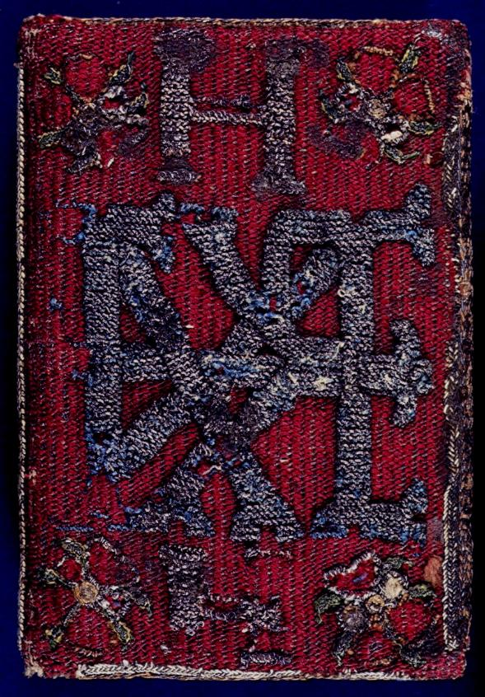
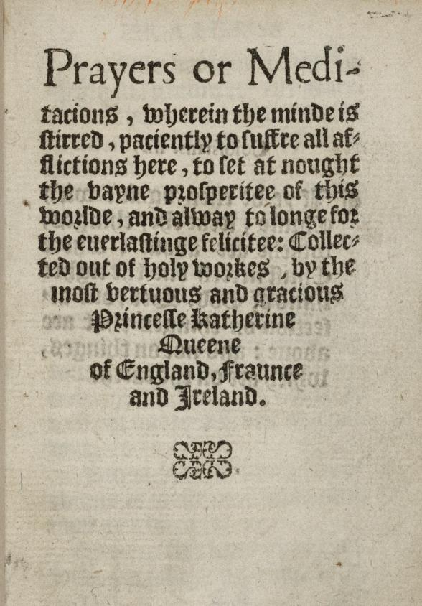
IMAGES KATHERINE PARR BOOK
From the British Library archive Shelfmark: Royal 7 D. X
Folger Imaging Department CC0 1.0
© National Portrait Gallery
Listen to audio about this source from Chief Historian Tracy Borman.
Notes:
Audio transcript
Speaker: Tracy Borman
This is a book published by Katherine Parr in 1545, when she was queen. You can see the front cover and one of the inside pages. It was extremely rare for a woman to publish a book at that time. Katherine Parr was very well educated. She spoke several languages and was interested in medicine. She was also strongly interested in the new Protestant faith. Katherine published three books all about religion. This one is called Prayers or Meditations. It included five original prayers and was the first book ever published in the name of an English queen. On the front cover, you can see Tudor roses. These show her link to Henry VIII and the Tudor family. So, this is a useful source for learning more about Katherine. It is strong evidence that she was well-educated, interested in religion, and confident enough to become one of the first English women to publish a book.

Slide 29
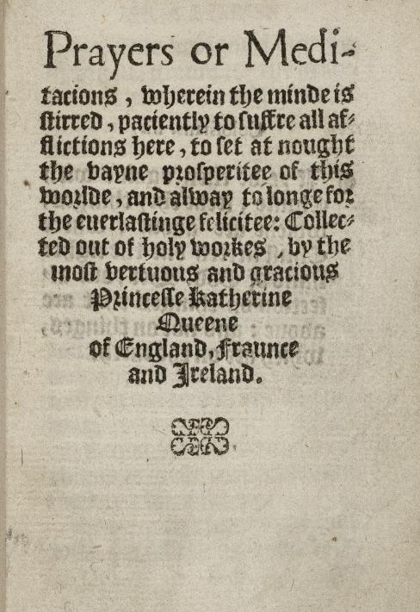
A BOOK WRITTEN BY KATHERINE PARR
The title page of a book written by Katherine Parr called Prayers or Meditations
Questions
BACKGROUND NOTES
WHAT CAN WE LEARN FROM
THIS SOURCE?
Q | What does this source tell us about Katherine Parr as a person?
Katherine was very well educated. She could speak several languages and was interested in medicine. She encouraged Henry’s children Mary, Elizabeth and Edward to study and read. She was also interested in the new Protestant faith.
Katherine published three books which was very unusual for a woman at this time. The first book was published anonymously. The next two books were published in 1545 and 1547 and were printed using her own name.
These were the first books to be written and published by an English Queen.
Later, when Elizabeth became queen, she admired Katherine’s work and translated this book into French, Italian and Latin.
This is the title page of the first book Katherine Parr published using her own name. The book is called Prayers or Meditations. It included five original prayers written from a Protestant point of view.
From this source, we learn that Katherine was highly intelligent, confident and determined. Writing and publishing a book was extremely rare for a woman in Tudor England. This shows that learning and ideas mattered to her.
Because the book contains prayers and reflections, it also shows that religion was very important to her, especially the new Protestant faith. By publishing her prayers, Katherine was sharing her beliefs and encouraging others to think and pray in a similar way.
The book reveals Katherine as a strong, thoughtful and independent person who used her position as queen to influence and encourage others.
Q | Why was it unusual for a woman to publish a book at this time?
Q | How does this source suggest that Katherine influenced people in the Tudor period?
Folger Imaging Department CC0 1.0
Key dates: 1545
Notes:
Answers
What does this source tell us about Katherine Parr as a person?
This tells us Katherine was well educated. She was able to publish a book, a very rare thing for a woman at the time. It also tells us that she was interested in religious ideas. It also suggests she was confident and determined. This was the second book she had published, but this one was in her own name so shows us she was dedicated.
Why was it unusual for a woman to publish a book at this time?
Many women were not educated and in 1600 less than 10% could not read or write, compared with 30% of men. Not only that but women were not usually expected to have their own opinions or to have much of a role in public.
How does this source suggest that Katherine influenced people in the Tudor period?
This source suggests that Katherine influenced others by sharing her ideas through writing. Her book contained Protestant prayers, showing that religion was important to her and that she wanted to encourage others to follow similar ideas. Katherine also influenced Henry’s children, especially Elizabeth, through her interest in education and learning. We know that Elizabeth even translated Katherine’s writing when she became queen showing that the queen influenced her positively. Overall, the source suggests that Katherine used her knowledge, writing and position as queen to shape the ideas of other people.

Slide 30


VOCABULARY LIST
alliance | agreement between people or countries to help each other
ally | a country or person that supports another country or person.
annulment | a legal decision that a marriage was never valid.
ambassador | the official representative of a foreign ruler at the royal court
Catholic | member of the Roman Catholic Church - a type of Christianity that follows the teachings of the Pope
coronation | a ceremony where a king or queen is officially crowned
countenance | a person’s face or expression
convent | buildings where religious communities of women called nuns live and worship
English gable hood | headwear with a pointy shape that covers most of the hair underneath
enjoined | ordered or instructed to do something
etiquette | the rules for polite behaviour in society that people were expected to follow
femme sole | a single woman who can act independently
French hood | headwear with a rounded shape where you can see some of the hair underneath
lady-in-waiting | one of the queen’s companions who is there to do as the queen wishes
obedient | willing to do what someone tells you to do
Pope | the head of the Roman Catholic Church

Slide 31
VOCABULARY LIST
Protestant | A type of Christianity that believes people do not need officials (such as the Pope or Bishops) to communicate with God
regent | person who rules when the king or queen is unable to
Roman Catholic Church | Christian religion with the Pope as its head
treason | the crime of acting against your own country, especially by trying to kill the king or queen, or overthrow the government
wealthy | having a large amount of money, property, land and valuable possessions

