Slide 1



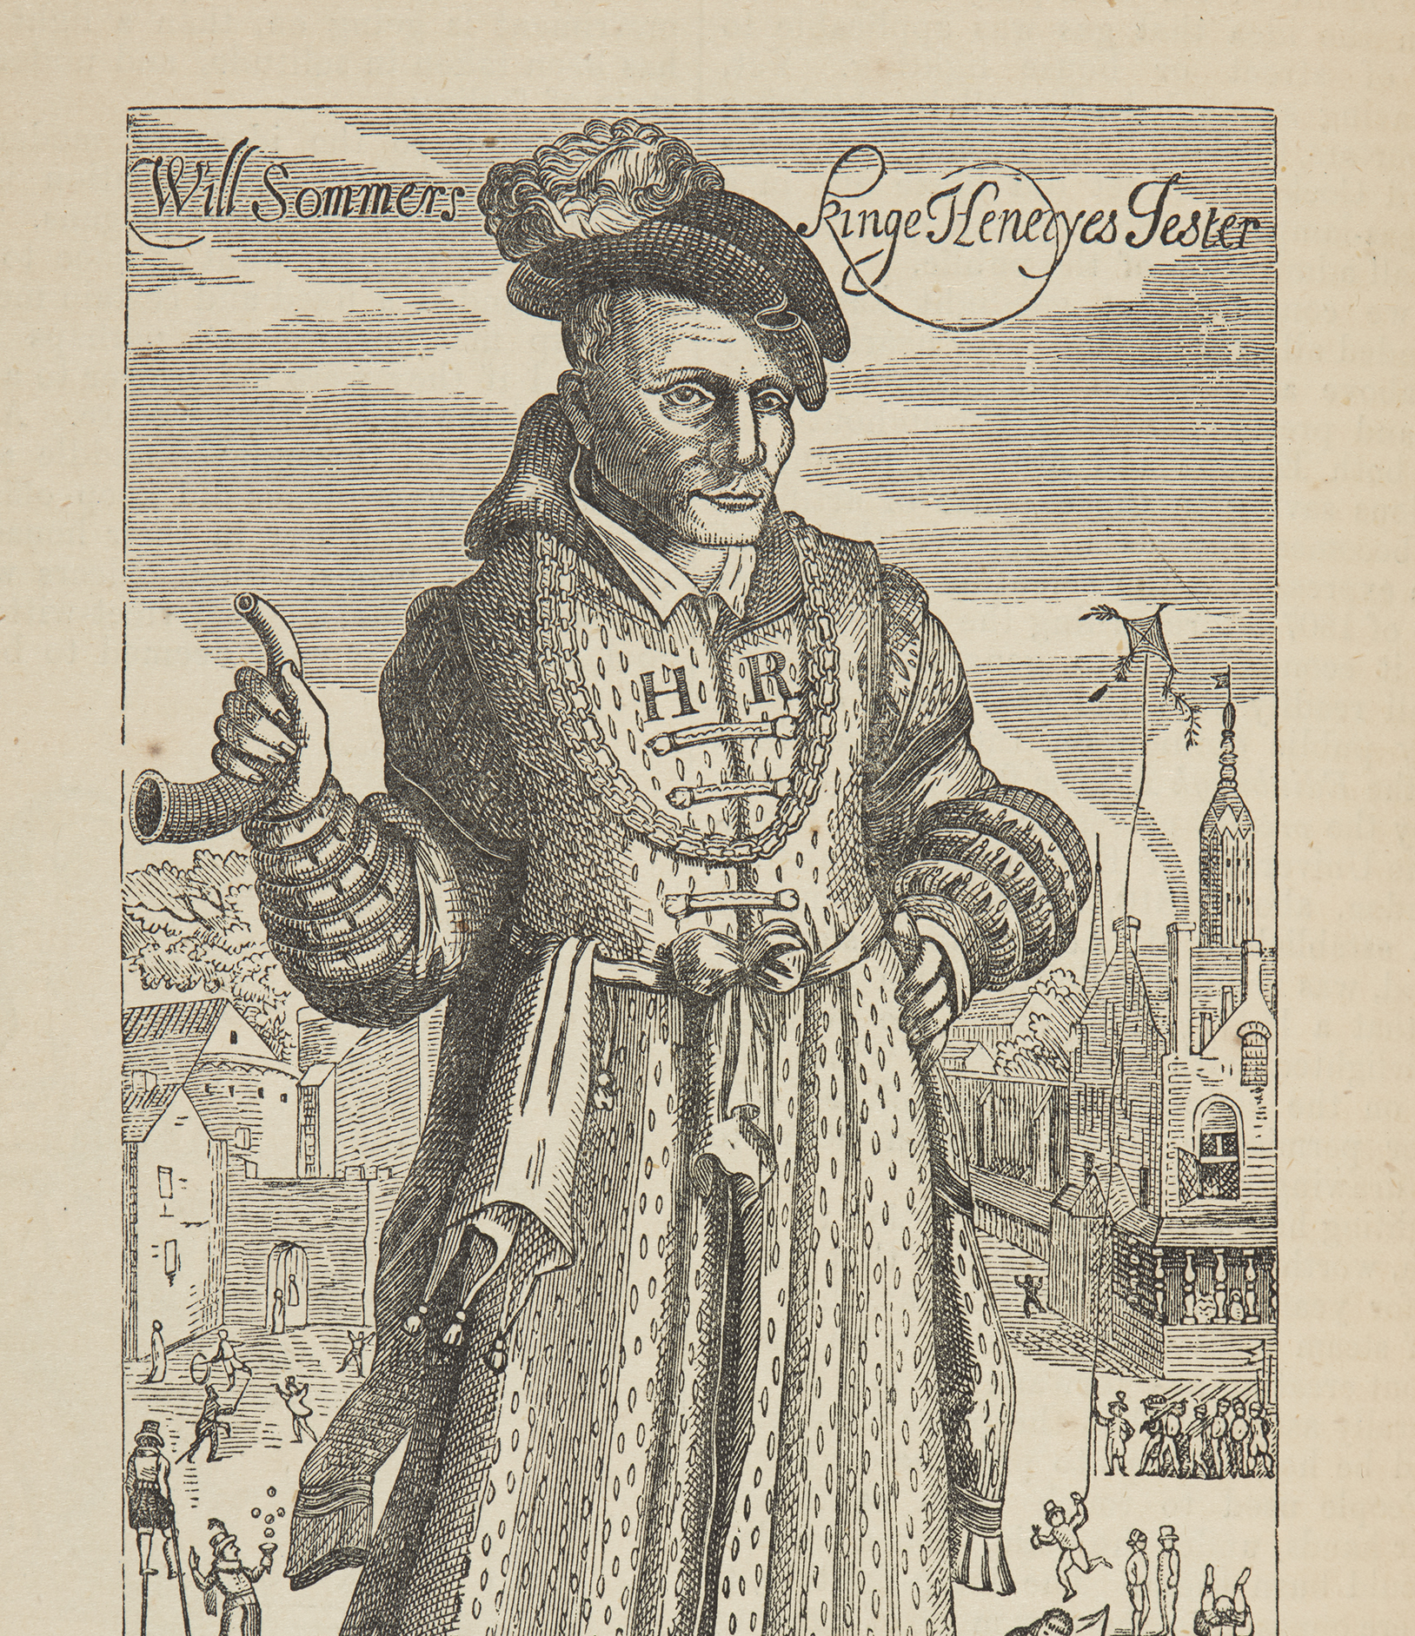

WATCH-ALONG GUIDE
BEFORE WATCHING
KEY THEMES
WIDER HISTORICAL THEMES
Will Somer is a significant individual because he had a fun and important job at the Tudor court. He worked as an entertainer for the royal family for many years and was even included in a painting with them.
There is also some evidence that Will had a learning disability. This video can be used to explore how people with disabilities were viewed during the
Tudor period.
Students may be curious about how the actor portraying Will Somer speaks. It may be helpful to discuss learning disabilities before watching the video to answer any questions in advance.
You could also explain that people with learning disabilities might speak differently than others, which is part of who they are.
Society | People with learning disabilities were sometimes seen as having
an important gift. Some worked at the Tudor Court as entertainers and were often called ‘natural fools’. ‘Natural fools’ held valued positions at court and could speak openly when others could not. However, disabled people also faced discrimination, ridicule and mistreatment.
There is some evidence that Will Somer had a learning disability, but we cannot be sure. While Will seems to have been treated well by the royal family, there is also some evidence to suggest that other peoples may have treated him unkindly. In the video, Will says, “Some people can be a bit mean to me,”.
The idea of a “natural fool” would not be acceptable today. It is important to help students understand that people’s beliefs and how they treat others have changed over time. Read more about disability in the Tudor Court “Fools” and disability in the Tudor court.
Exploration | The Tudor period was a time of exploration. Explorers brought back new and unusual things from faraway places. In the video, Will talks about his pet monkey, which likely came to England as part of these discoveries.
Entertainer
A person whose job is to make people happy by singing, dancing, telling jokes, or performing.
Jester
A person whose job was to make people laugh by telling jokes or acting silly. They often worked for kings and queens.
Learning disability
A condition that makes learning new things harder. People with learning disabilities might need extra help to understand or do things.
WILL SOMER
SOURCES USED IN THE VIDEO
Portraits | Several images
of Will are featured in the video, including a royal family portrait. Will
was included in this image, which suggests they valued him and his role.

Slide 2

WHILE WATCHING
00:38
00:59
2:27
3:02
4:32
END
FINDING WILL
LEARNING
DISABILITIES
GIFTS FROM THE ROYAL FAMILY
EXPLORATION AND DISCOVERY
THE MONKEY
REMEMBERING WILL SOMER
Can you spot Will? What do you notice about him?
He is standing through the doorway on the right and has a monkey on his shoulder! Only two people outside the Tudor family are included in the painting, showing Will’s special place at court.
How does this object help tell Will’s story?
The monkey reminds us that Will’s job was fun and playful. It shows that he was liked and valued at the royal court.
This moment introduces the idea that some people in the Tudor period believed people with learning disabilities had a gift.
What did the royal family give Will as gifts?
They gave him green clothing (a “joyful colour”) and fun disguises.
Where did Will’s monkey come from?
It came from the new lands that Tudor explorers visited. Ships brought back items that were rare to England, like exotic animals.
Will had an important
job as an entertainer and was respected by the royal family. His story shows
us that people in the past enjoyed fun and laughter.
It also helps us understand how people with learning disabilities were treated in the past. Finding out more about Will’s life reminds us that all kinds of people have shaped history.
AFTER WATCHING
HOW DO WE KNOW?
KNOWLEDGE SUMMARY
Introduce the idea of a historical source—something historians use to study the past. Explain that evidence is the information we get from these sources to understand and explain history.
A supporting PowerPoint is available to help students study sources from the video, including the engraving and the royal family portrait.
These activities help students explore how sources shape what we know about historical figures.
Will Somer is a significant individual.
As the king’s entertainer Will had an important job entertaining the royal family at the Tudor court.
Will was well liked by the royal family, included in their portraits, and given many gifts.
There is some evidence that Will had a learning disability.
Some people with learning disabilities had important roles at Tudor court and were seen as being closer to God.
Image credit: © Historic Royal Palaces

