Slide 1




HOW TO USE - NOTES FOR TEACHERS
These resources from Historic Royal Palaces are multi-purpose.
They are ready for you to tweak and use in your lessons.
For the best experience, download and open the
file in the PowerPoint
desktop app.
Answers are found
under the slide. Click
on the notes symbol at
the bottom of the screen.
Delete text and images to make your own worksheets.
Disclaimer and Use Terms
We are the owner or the licensee of all intellectual property rights in these resources which are protected by copyright laws and treaties around the world. All such rights are reserved. These resources, and the content included within them, may be used by you for educational purposes only. This means that you may download the resources and use or share them solely in educational environments (including for home school lessons) or as part of homework. You may not share the resources other than for the above purposes and you must not use the resources, or any part of them, for any commercial purpose.

Slide 2

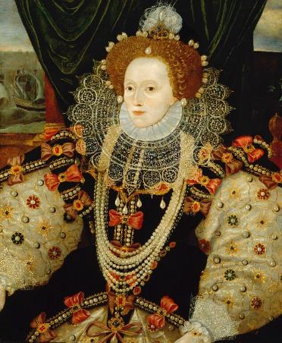
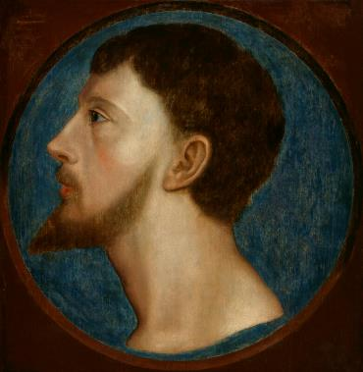

ELIZABETH I AND THOMAS WYATT
ELIZABETH I
THOMAS
WYATT
Last Tudor monarch – a queen who ruled alone
One of the leaders of a rebellion
against Mary I
Elizabeth was the daughter of Henry VIII and his second wife, Anne Boleyn.
She was Protestant and was accused of plotting against her half-sister, the Catholic Queen Mary I.
In 1554, Mary imprisoned Elizabeth briefly in the Tower of London.
Mary thought Elizabeth was involved in a Protestant Rebellion.
Elizabeth became queen in 1558, aged 25. In 1588, Philip of Spain planned an invasion of England and launched the Spanish Armada. The Armada was defeated by Elizabeth’s much smaller
English navy.
She was worried there might be more Catholic rebellions against her as well as other threats. Elizabeth used the Tower of London as a prison and imprisoned many people over several decades.
Wyatt’s Rebellion led
to Elizabeth’s imprisonment in the Tower.
© National Portrait Gallery, London
© National Portrait Gallery, London
CC BY NC ND 3.0
Lived: 1533 - 1603
Lived: 1521 - 1554
Birthplace: London
Birthplace: Kent
Reigned: 1558 - 1603
Thomas was a soldier when he
was young, later he became a Member
of Parliament.
His father was the poet, Sir Thomas Wyatt the Elder.
In 1554, he was a leader in the Wyatt Rebellion. The rebels were angry about Queen Mary I’s marriage to
Philip of Spain.
They were worried that England would become ruled by Spain.
The rebels marched from Kent to London but were not successful.
Thomas was finally arrested and imprisoned in the Tower of London.
He was executed for treason.
“I know I have the body of a weak and feeble woman; but I have the heart and stomach of
a king, and of a king of
England too.”
Elizabeth’s speech to her
army at the time of the
Spanish Armada.
Q:
What was the main cause of Wyatt’s Rebellion?
Q:
What clues are there that this portrait was painted to celebrate the defeat of the Spanish Armada?
Notes:
Elizabeth I notes:
In the portrait, we can see scenes from the defeat of the Spanish Armada on the wall behind the Queen. This suggests it was painted to celebrate the defeat of the Spanish Armada. (English fireships setting out on the left, and Spanish ships being wrecked in storms on the right.) Also, Elizabeth’s hand rests on a globe, perhaps representing England’s command of the seas.
Thomas Wyatt notes:
The main cause of the rebellion was the proposed marriage of Mary I to King Philip of Spain. People did not want England to be subject to foreign rule.

Slide 3
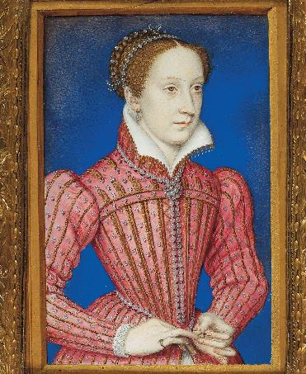
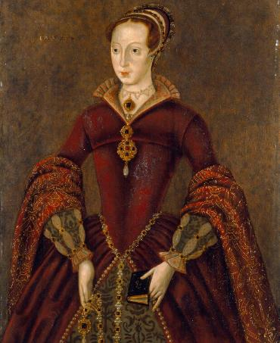

MARY QUEEN OF SCOTS AND LADY LAND GREY
MARY QUEEN
LADY JANE
OF SCOTS
GREY
The Catholic queen who was a threat to Elizabeth I’s reign
The ‘Nine Day Queen’
Mary inherited the Scottish throne as baby when her father, James V of Scotland, died. She was Catholic and had a claim to the English throne. She was the great-granddaughter of Henry VII.
She was forced to abdicate in 1567 after the suspicious death of her second husband Lord Darnley. She was imprisoned in Scotland.
In 1568 she escaped from prison and fled.
Elizabeth saw Mary as a threat and kept her under house-arrest.
Between 1569 and 1586 there were several Catholic plots to put Mary on the throne of England and to make England Catholic again.
Mary was charged with treason and executed at Fotheringhay Castle in 1587.
Jane was the great-granddaughter of
Henry VII and grandniece of Henry VIII. She married Lord Guildford Dudley in 1553.
Dudley’s father was King Edward VI’s chief minister and may have suggested that Jane should be the next queen, as she was Protestant just like him.
Edward died and Jane was declared Queen of England.
She was reportedly surprised and
upset by this.
However, support was growing for Mary to become queen. Mary was Edward VI’s half-sister and Jane’s cousin. Mary was also Catholic. Jane was queen for only nine
days before Mary was proclaimed queen. Jane and her husband became high-status prisoners and were held separately in the Tower of London.
In 1554, Jane and her husband were sentenced to death for treason. Guildford was beheaded on Tower Hill. Jane saw his body brought back to the Tower of London before her own execution.
Royal Collection Trust
© His Majesty King Charles III 2024
© National Portrait Gallery, London
Lived 1542 - 1587
Lived: 1537 - 1554
Birthplace West Lothian, Scotland
Birthplace: Leicestershire
Reigned Scotland 1542 - 1567
Reigned: 1553
She was held as prisoner
for 19 years.
She was given a comfortable place to stay whilst imprisoned.
Q:
Why was Mary a threat to Elizabeth?
Elizabeth was worried about signing Mary’s death warrant. Why do you think that was?
Notes:
Mary Queen of Scots notes:
Mary was a threat because she was a Catholic and had a claim to the throne. She became the focus of Catholic plots to overthrow Elizabeth and make her queen instead.
Elizabeth may have been worried about signing Mary’s death warrant because she was signing the death warrant of a relative and fellow queen, which could set a dangerous precedent. She might also have been worried that it would lead to conflict with Catholic monarchs in Europe. (Philip of Spain did indeed launch the Spanish Armada the following year – a failed Catholic invasion of England.)

Slide 4
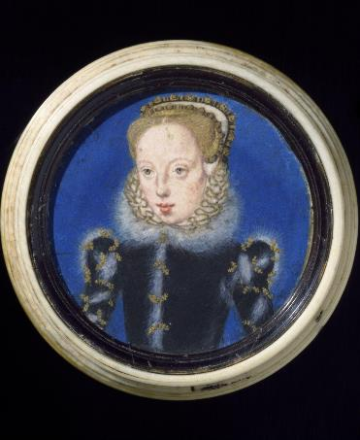
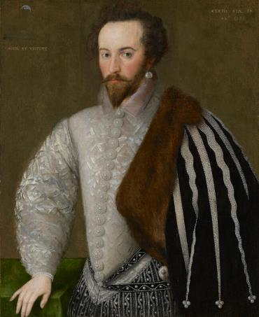

KATHERINE GREY AND SIR WALTER RALEIGH
KATHERINE
SIR WALTER
GREY
RALEIGH
A lady who got married without the Queen’s permission
Famous explorer and one of Queen Elizabeth I’s favourites
Katherine was Lady Jane Grey’s younger sister. In 1560, she married Edward Seymour. He was the son of the Duke of Somerset, and a cousin of Edward VI. However, they did not ask Queen Elizabeth’s permission to get married and this was
an act of treason.
In 1561 Katherine gave birth to a baby boy. When Elizabeth found out she was furious. She thought the baby would be a threat to her as queen. Katherine and Edward were imprisoned separately at the Tower of London and their marriage was declared invalid. The guards must have allowed them to spend time together because in 1563 Katherine had another baby boy.
Elizabeth ordered Katherine and Edward to be permanently separated and Katherine died, heartbroken, in 1568.
Walter was a soldier as a young man.
In the 1580s he led voyages to North America, helped suppress rebellions in Ireland and defend England against the Spanish Armada.
He was one of Elizabeth I’s favourite people at court and became a Knight in 1584. He secretly married Bess Throckmorton and they had a baby but in 1592, Elizabeth found out. Walter, Bess and the baby were imprisoned in the Tower of London. Sadly, their baby did not survive an outbreak of the plague. Bess was released shortly after. Walter was released a few months later and was banned from court for five years.
In 1603, he was accused of plotting against James I. He was imprisoned in the Tower of London again. He was held for 13 years. During this time, he created a garden and used plants to make herbal remedies.
In 1616, he led an expedition to South America which went badly. Because of this, he was executed in 1618.
© Victoria and Albert Museum, London
© National Portrait Gallery, London
CC BY NC ND 3.0
Lived: 1540 - 1568
Lived: 1554 - 1618
Birthplace: Leicestershire
Birthplace: Devon
‘Strike, man, strike.’ Walter’s final words to his executioner.
Her two sons were born at the Tower of London.
During his imprisonment he wrote a book called ‘The History of the World.’
Q:
Why do you think Elizabeth was angry about Katherine and Edward Seymour’s marriage?
Notes:
Katherine Grey notes:
Elizabeth might have been angry about Katherine and Edward’s marriage because it was a threat to her own reign. Katherine had a son and heir and this could make her a focus of rebellions against Elizabeth. (By declaring the marriage invalid, the boys became illegitimate and could not inherit the throne.)

Slide 5
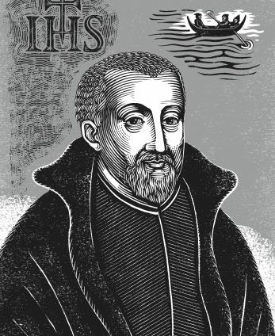
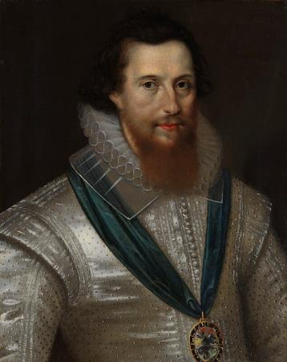
JOHN GERARD AND ROBERT DEVEREUX
JOHN
ROBERT
GERARD
DEVEREUX
Catholic priest famous for escaping from the Tower of London
The last person to be beheaded in
the Tower of London
John was a Jesuit and in 1597 he was imprisoned in Salt Tower at the Tower of London.
He was suspected of being part of a plot to take power away from Elizabeth I. He was severely tortured on three occasions but refused to name his co-conspirators.
Later that year, John escaped from the
Tower of London. His escape involved using orange juice as invisible ink and writing secret messages to friends, which were
hid in baskets of laundry. He planned to escape with another Catholic prisoner, Father John Arden.
They both escaped one night, they used a rope to swing across the moat, into a boat.
He fled to Europe and died in Rome aged 72.
As well as a nobleman
and politician, he was
also a poet.
© Historic Royal Palaces
© National Portrait Gallery, London
CC BY NC ND 3.0
Lived: 1564 - 1637
Lived: 1565 - 1601
Birthplace: Lancashire
Birthplace: Herefordshire
Robert was one of Queen Elizabeth I’s favourite people at court. He was given many important positions and was said to be handsome, arrogant and ambitious.
Became Lord Lieutenant of Ireland.
Went to Ireland with his army to fight a rebellion but instead made peace.
Because he failed to follow the queen’s orders, she was furious.
Robert was put under house arrest and banned from court.
His positions were taken away.
In 1601, Robert led a plot against Elizabeth. He wanted Elizabeth to declare James VI of Scotland as the next monarch. The rebellion failed and Robert was imprisoned in
the Tower of London and executed
for treason.
After his escape he was never recaptured.
Q:
Why do you think Robert planned the rebellion?
Q:
Why do you think the story of John Gerard’s escape has become famous?
Notes:
John Gerard notes:
The story of John Gerald’s escape might be famous because it has all the elements of an adventure story: writing messages in invisible ink and swinging across the moat under cover of darkness.
Robert Devereux notes:
Robert may have planned the rebellion because he was angry at his loss of positions, and the wealth and power that went with them. He thought he could regain power through James VI and, in his arrogance, thought others would support him.

Slide 6
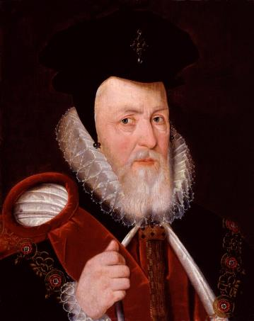
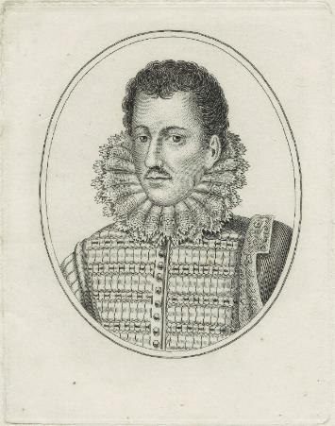

WILLIAM CECIL AND PHILIP HOWARD
WILLIAM
PHILIP
CECIL
HOWARD
Queen Elizabeth’s chief minister and trusted advisor
A Catholic Earl who was imprisoned for his faith
William began his career by serving Edward Seymour. Edward Seymour was Lord Protector to King Edward VI.
William was briefly imprisoned in the Tower of London when the King lost his power in 1549.
In 1558, when Elizabeth became Queen, on the first day of her reign she made William her Secretary of State.
Although he was the youngest member of Elizabeth’s council, Cecil was her most influential minister.
He was involved in almost every area of Elizabethan politics until his death.
Philip was born into a noble family. The Queen made him Earl of Arundel in 1580 and he was one of her favourite people at court.
He was baptised as a Catholic but raised as a Protestant, but in 1581 he decided to
live a fully Catholic life. This was a dangerous move. He tried to hide his faith but eventually Elizabeth found out and in 1585 Philip was sent to the Tower of
London as a prisoner.
His wife gave birth to his son whilst he
was in prison, and he desperately wanted
to see them. He was offered his freedom if he agreed to go to Protestant Church.
He refused.
He carved graffiti into the walls of the Beauchamp Tower, which can still be seen today. He was in prison for 10 years and eventually died there in 1595.
© National Portrait Gallery, London
CC BY NC ND 3.0
© National Portrait Gallery, London
CC BY NC ND 3.0
Lived: 1520 - 1598
Lived: 1557 - 1595
Birthplace: Lincolnshire
Birthplace: London
‘The more affliction we endure for Christ in this world,
the more glory we shall get with Christ in the world to come.’
Philip’s carving in the Tower.
The Queen nicknamed
him her ‘Spirit’ and
relied on his advice.
Q:
What clues are there in the portrait that William is a very important government minister and loyal to the Tudor Queen Elizabeth?
Q:
What do you think Philip meant by the words in his carving?
How might they explain his actions?
Notes:
William Cecil notes:
In his portrait, William is richly dressed in expensive fabrics. His clothes make him look grand and stately, rather than fashionable or showy. He wears a chain around his neck with the Tudor red and white rose. These suggest he was important and loyal to Queen Elizabeth.
Philip Howard notes:
Philip’s words suggest he believes that the more suffering someone has for Christ before they die, the more ‘glory’ they will get after death. This may explain why he decided to remain a prisoner and not change his religion.

Slide 7

TEMPLATE BIOGRAPHY
____________
____________
____________
____________
Image credit:
Image credit:
Lived: _______
Lived: _______
Birthplace: _______
Birthplace: _______
Q:
Q:

Slide 8

VOCABULARY LIST
abdicate | give up the position of being king or queen
Catholic | member of the Roman Catholic Church. A type of Christianity that follows the teachings of the Pope
chief minister | the king or queen’s main advisor who holds a lot of power in government
co-conspirator | someone who plots to commit an illegal act with another person
expedition | a long journey or voyage for a specific purpose such as exploration
government | group of people that have the authority to rule a country
house arrest | kept as a prisoner in a house, castle or palace rather than a prison
imprisoned | kept in a prison
inherited | given something such as money or a title after the death of the person who had owned or held them before
invalid | not legal
Jesuit | Catholic priest whose mission was to restore the Catholic faith to England
Knight | title awarded to a man for services to the king or queen; he can then use the title ‘Sir’ before his name
lady-in-waiting | one of the queen’s companions who is there to do as the queen wishes
Lord Lieutenant | person who represents the king or queen
Lord Protector | title used by someone in charge of a country, when the king or queen is unable to rule (if they are unwell or a child, for example)
minister | someone with a lot of power and responsibility in government

Slide 9
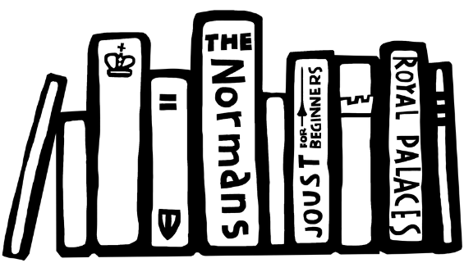

VOCABULARY LIST 2
VOCABULARY LIST
navy | ships built and maintained to defend a country
noble | someone of high rank in society
Parliament | the group of people elected to make and change laws in a country; in the past only very rich and powerful people were Members of Parliament
plot/plotting | secretly plan to harm someone, especially a government or ruler
Protestant | a type of Christianity that believes people do not need officials (such as the Pope or Bishops) to communicate with God.
rebel | person who joins a rebellion
rebellion | a fight by a large group of people against the government or ruler
Roman Catholic Church | Christian religion with the Pope as its head
Secretary of State | senior minister in charge of a government department
Spanish Armada | the large fleet of ships sent to invade England by Philip II of Spain in 1588
state prison | in the past, a prison used for political or religious prisoners or people charged with very serious crimes
treason | the crime of acting against your own country, especially by trying to kill the king or queen, or overthrow the government

