Slide 1



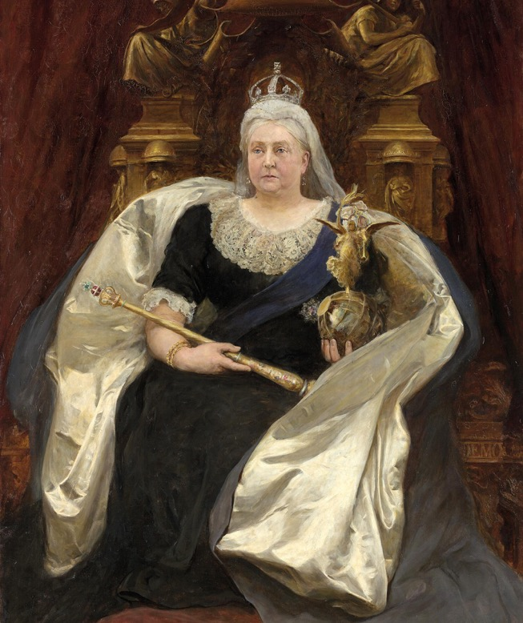

WATCH-ALONG GUIDE
BEFORE WATCHING
KEY THEMES
WIDER HISTORICAL THEMES
Monarch
A king or queen who leads a country and makes important decisions.
(British) Empire
A group of countries ruled by one king, queen, or government. During Queen Victoria’s time, Britain ruled many countries around the world.
Voyage
A long journey, usually by ship, but it can also be by land or air.
Godchildren
Children who have godparents. A godparent is a special adult chosen to guide and support a child as they grow up, especially in their faith.
Queen Victoria is a significant individual because she was the longest-reigning monarch of her time, ruling for 63 years. Her record was later surpassed by Elizabeth II. Her leadership improved the image of the royal family, which had been damaged by her uncles’ reckless spending. She ruled during a time of major changes in society, politics, and daily life.
This video can be used to introduce the British Empire. It shows how the empire brought wealth to Britain but also explains how people in colonised areas were often treated unfairly. The video also highlights the differences between rich and poor people during Queen Victoria’s reign.
Society | Although Britain was very wealthy during the Victorian period, this wealth was not shared equally. Many people in Britain and in the colonies lived in poverty. In the video, Queen Victoria says, “But not all people in the Empire have such luxuries.”
Power of the Monarch | Queen Victoria held great symbolic power as the head of the British Empire, but her political power decreased during her reign. Parliament made more and more decisions about how the country was run.
Technological change | During Queen Victoria’s reign, many new inventions changed how people lived. The video mentions railways, lightbulbs, steamships, and telephones. However, not everyone benefited from these advances, especially poor people.
QUEEN
VICTORIA
SOURCES USED IN THE VIDEO
Portraits | Several portraits of Victoria are featured, offering insight into how she chose to present herself as a ruler. They include photographs, which were new inventions at the time.
Documents | Queen Victoria’s journals are wonderful sources to allow us to learn about life during this period. She began writing a diary as a teenager and continued until shortly before her death.

Slide 2

WHILE WATCHING
00:38
00:51
1:30
2:14
4:08
END
EXPLORATION
AND EMPIRE
DIFFERENCES BETWEEN SOCIAL CLASSES
TECHNOLOGICAL CHANGE
SOCIETY
THE COMMEMORATE PLATE
REMEMBERING QUEEN VICTORIA
Discuss how unusual it was for a young woman to hold so much power and responsibility at that time.
Discuss how Britain expanded its empire by invading other countries. This made Britain richer and more powerful, but people in these areas
were often treated
unfairly and harshly.
Talk about how public services like free healthcare did not exist in Victorian times. People had to pay to see a doctor, and there was no financial support if they lost their jobs.
How would your life be different without cars, trains, or airplanes?
Railways, which were developed during Queen Victoria’s reign, allowed people to travel long distances more easily.
How does this object help tell Queen Victoria’s story?
Pause the video to read the different place names to students. The plate shows the countries that were part of the British Empire during Queen Victoria’s reign, including Canada, India, Cape Colony (South Africa), and Australia.
It was designed to show Britain’s power and importance.
Why should we remember Queen Victoria today?
We remember Queen Victoria because of the important changes during her reign. These include new technologies like railways and telephones, the expansion of the British Empire. She is also remembered as a strong and independent queen who left behind personal diaries, giving us valuable insights into life during the Victorian period.
AFTER WATCHING
HOW DO WE KNOW?
KNOWLEDGE SUMMARY
Introduce the idea of a historical source—something historians use to study the past. Explain that evidence is the information we get from these sources to understand and explain history.
A supporting PowerPoint presentation is available to help students study the sources shown in the video, including a photograph of Victoria in the latter part of her reign, a portrait of Victoria in Australia, and images from her diaries.
These activities help students explore how sources shape what we know about historical figures.
Queen Victoria is a significant individual.
During her reign, Britain controlled an enormous empire.
This empire brought wealth to Britain but exploited people and resources in many different countries.
Life was challenging for many working people in Britain.
Many new technologies developed during the Victorian period, such as railways, telephones, and lightbulbs, still influence our lives today.
Image credit: Queen Victoria, 1891. By Hubert Herkomer © National Gallery of Victoria, Melbourne

