Slide 1
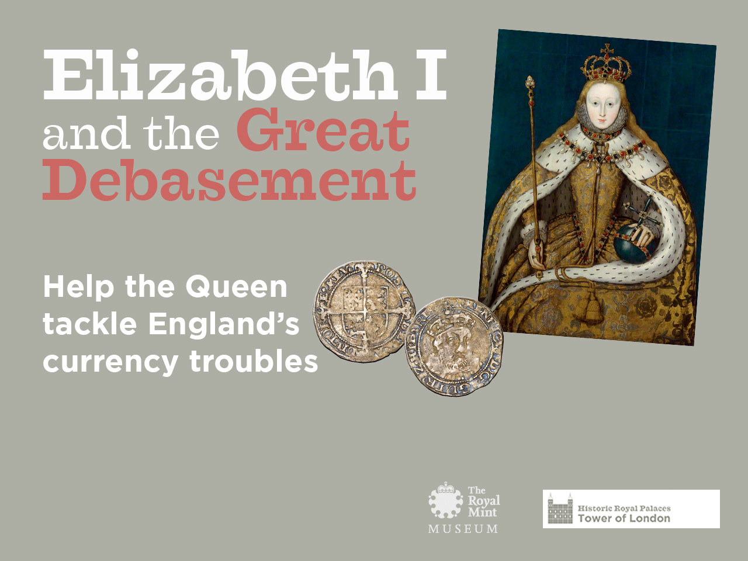
Title page
Notes:
Elizabeth I and the Great Debasement: Help the Queen tackle England’s currency troubles
This activity is designed to follow:
-- A visit to the Coins & Kings exhibition at the Tower of London.
-- The Key Stage 3 introductory resource – Monarchs and the Mint: Making the nations’ coins at the Tower of London (download it here: http://www.hrp.org.uk/coins)
Coins & Kings was produced in partnership between Historic Royal Palaces and the Royal Mint Museum.
Coins & Kings exhibition: http://www.hrp.org.uk/coins
Coins & Kings teaching resources: http://www.hrp.org.uk/towerlearning
Acknowledgements:
© Historic Royal Palaces and the Royal Mint Museum
All coin images © The Royal Mint Museum
© National Portrait Gallery, London
Queen Elizabeth I, unknown artist
King Edward I (‘Longshanks’) by Louis Phillipe Boitard
King Charles II, unknown artist
King Henry VIII, after Hans Holbein the Younger
These National Portrait Gallery works are licensed under the Creative Commons Attribution-NonCommercial-NoDerivs 3.0 Unported License. To view a copy of this license, visit http://creativecommons.org/licenses/by-nc-nd/3.0/

Slide 2
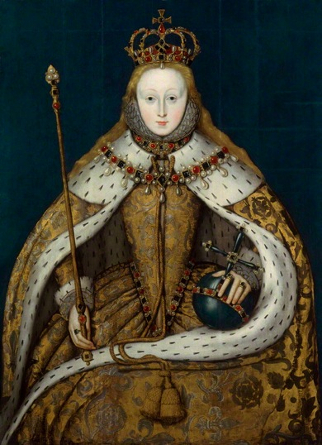
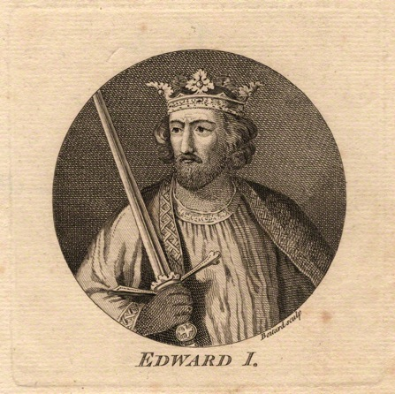
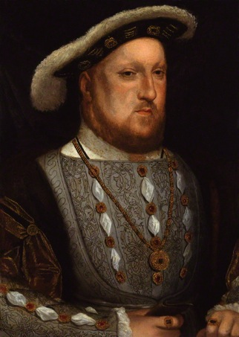
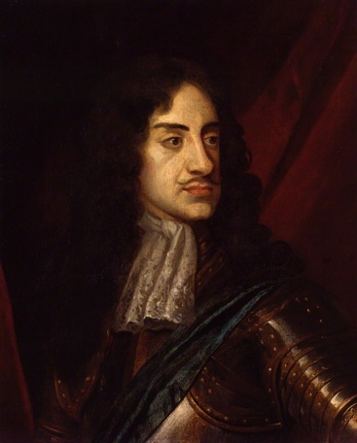
Think of 3 important qualities a good monarch should have
Notes:
Discussion: qualities or responsibilities of a monarch
Ask pupils to consider the responsibilities of a monarch or the qualities a successful monarch would need.
Responsibilities:
-- economy
-- military
-- foreign relations
-- maintaining domestic support
-- government administration
-- religious policy
Qualities:
-- vain
-- angry
-- greedy
-- honest
-- wise
-- clever
-- noble
-- fair
-- weak
-- warrior
-- cruel
-- sensible
-- patient
-- impatient
-- brave
Image notes:
© National Portrait Gallery, London
Queen Elizabeth I, unknown artist
King Edward I (‘Longshanks’) by Louis Phillipe Boitard
King Charles II, unknown artist
King Henry VIII, after Hans Holbein the Younger
These National Portrait Gallery works are licensed under the Creative Commons Attribution-NonCommercial-NoDerivs 3.0 Unported License. To view a copy of this license, visit http://creativecommons.org/licenses/by-nc-nd/3.0/

Slide 3
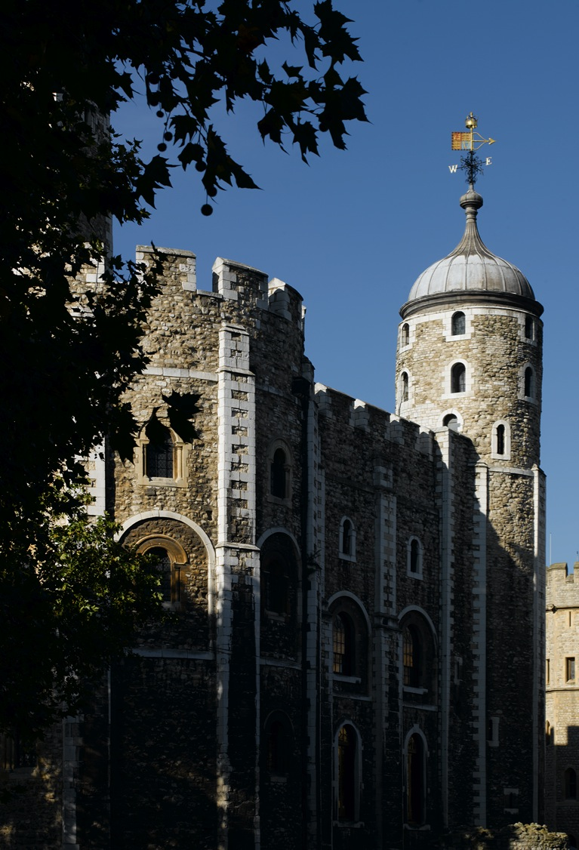

Elizabeth I’s coinage crisis
People have lost confidence in England’s coins.
Everyday business has ground to a halt.
Complaints have even reached Queen Elizabeth I herself.
London,
1560
Notes:
Elizabeth I’s coinage crisis
Set up the task by revealing only a certain amount of information about the coinage problems facing Elizabeth I.

Slide 4


Your task
You are an adviser to Elizabeth I.
The Queen knows there are problems with the country’s coins. She would like you to investigate further.
Your report should give the Queen:
A description of the problem and your analysis of what has caused it
Notes:
Card sort activity
(Print off cards included with teachers’ notes)
-- In this activity pupils consider various factors to do with the crisis.
-- Pupils must analyse and communicate different types of motives and causal factors. They will also prioritise important information and judge its significance.
-- Responses could be written or spoken.
-- This activity could be done in pairs or trios.
Prompts:
-- Suggest pupils begin by placing information on continuum: ‘Serious ←---→ Not serious’.
-- Is this problem getting worse or getting better?
-- Emphasise how busy Elizabeth I is by brainstorming all the problems she had at the start of her reign.
Tips for students
-- The Queen will need to consider whether action is needed to improve the situation.
-- What are some of the risks of not dealing with the coinage problems? What might be the opportunities of tackling them?
-- Use the information and evidence provided to advise Elizabeth I.
-- Present your case persuasively.
-- Remember: you are living in the year 1560.
Image notes:
Queen Elizabeth I, unknown artist © National Portrait Gallery, London

Slide 5
Money, mints & the monarch
People value coins because they are made of precious metal. A coin made of a mix of silver and cheaper metals is less valuable as it contains less precious silver.
Taxes are raised by Parliament only when they are needed for something specific, such as a war.
The monarch pays for the expense of running the country.
The monarch decides how pure the country’s coins should be.
Notes:
Some facts about Tudor England
Key background to review before advising the Queen. (This background aims to help pupils understand the context in which Henry VIII debased England’s coinage.)
The monarch’s treasury
-- In the 16th century the monarch paid for state business.
-- His or her personal fortune and revenue raised from crown lands and customs duties were the main sources of funds.
-- Taxation as we know it was not common. Parliament only raised taxes in specific circumstances.
-- If monarchs wanted to spend more than they had, they needed to find the money somewhere.
The purity of a country’s coins
-- Some countries had ‘debased’ their countries’ coins – this meant a Mint made coins by mixing gold or silver with more and more base (cheaper) metals, such as copper.
-- The coin was then circulated as if they were the same as coins made of pure precious metal.
-- The difference could be kept by the monarch as a way of raising money.
Teachers’ notes:
-- For a good overview and more about Elizabeth’s currency crisis see the National Maritime Museum’s website: http://www.rmg.co.uk/explore/sea-and-ships/in-depth/elizabeth/elizabeth's-england/restoring-the-english-currency

Slide 6
Make your case to the Queen
By September 1560, Elizabeth I decided faith in England’s coins was entirely lost.
It was time to act.
Notes:
Presentation or Q&A
-- Ask pupils to present their ideas and arguments or conduct a Q&A.
-- Some possible response prompts are included below.
The problem
-- People had lost faith in England’s coins. People did not believe coins were made of pure precious metal and so were worth less than their face value indicated.
Factors that can be highlighted:
-- A badly debased currency was one of many problems Elizabeth I inherited.
-- Her father, Henry VIII, had reduced the purity of English silver and gold coins to fund foreign wars and an extravagant lifestyle.
-- His debasement of the currency had negative long-term effects contributing to huge price rises and people losing faith in England’s currency.
-- Previous efforts by Edward VI and Mary I to deal with the problem had either been partially successful or unsuccessful or probably helped make things worse.
-- It was a tricky problem to solve. There was a lot of ‘bad’ money around, which meant any pure coinage put into circulation was likely going to be hoarded.
-- The monarchy’s reputation had been damaged.
-- People were unhappy and confused over the wide range of different coins and values. Prices were high and wages were unstable.
-- Business was suffering. Normal transactions were difficult. Foreign merchants didn’t want English coins.
-- Tackling the problem was going to have its difficulties. It would be a large expense for the Queen if a recoinage were to be enacted. It would also be painful for the public if the government lowered the value of any debased coins.
Teachers’ notes:
-- If the decision-making task is not being done, you may wish to summarise how Elizabeth I dealt with the problems here.

Slide 7
Your second task
You are an adviser to Elizabeth I.
The Queen wants to tackle the problem of England’s debased currency.
Your job:
Advise Elizabeth I on how to deal with each of the following problems…
Notes:
Decision-making activity
-- Ask pupils to consider the dilemmas faced by Elizabeth I. Each problem offers a multiple choice response for pupils to choose the correct answer from.
-- Pupils could work in pairs or trios. Points could be added to make a game of it.
-- After decisions are discussed, Elizabeth I’s actions can be revealed.
-- A follow-up discussion might focus on the qualities needed by a monarch.
Tips for students
-- Consider each possible action, what are some of the potential problems? What might be the advantages?
-- Make your decision. Be prepared to justify your choice.
Image notes:
Queen Elizabeth I, unknown artist © National Portrait Gallery, London

Slide 8
Problem 1
A debased currency
People have lost faith in England’s currency.
Debased coins circulating in England have led to high prices and damaged the monarchy’s reputation.
Making new coins will be expensive and the queen is short of money.
In the past, people have hoarded newly minted coins and continued to spend the ‘bad’ ones.
Which plan might best fix the problem:
What Elizabeth I decided:
A Get a loan from Antwerp to make new coins of pure gold and silver and put them into circulation.
B Call in all old, debased coins and melt them down. Re-make them into new, purer coins.
C Make the spending of debased coins illegal.
Notes:
What Elizabeth I did:
In September 1560 the queen decided she would call in the entire currency and supply in its place new coins of a pure and uniform standard.
She hoped prices would adjust as a result of this action.
She also hoped the recoinage could be paid for out of the debased currency, though this was uncertain.

Slide 9
Problem 2
What percentage of the currency is debased?
To plan for a recoinage, the queen must estimate the proportion of the country’s coins that need melting down.
The decision to call in all the old, debased coins is likely to cause widespread anxiety with the public.
People will worry a government proclamation may cause the money in their possession to lose value overnight.
Action is required urgently.
The queen should:
What Elizabeth I did:
A Order clerks to go through the Mint’s records to estimate the total amount of debased coins produced since Henry VIII.
B Risk upsetting people with a quick and open public inquiry.
C Quietly send someone to examine the range of different coins encountered by a butcher, or a similar tradesmen, who deal with a wide range of people.
Notes:
What Elizabeth I did:
The government quietly investigated the country’s coins. Elizabeth I was not keen to start a panic.

Slide 10
Problem 3
Persuading people to turn in their old coins
Estimates suggest a quarter of the nation’s coins are debased, worth around £1.2 million.
To replace them with new, purer coins, all old coins need to be called into the Mint to be melted down.
People will be reluctant to trade in their debased coins for new coins as they are expecting to lose money.
What Elizabeth I did:
The queen should:
A Ensure people don’t lose money. Give them a new pure coin in exchange for the same coin in debased condition.
B Expect people to take a loss on their coins, but offer to pay the costs of minting the new coins.
C Expect people to take a loss on their debased coins, and also cover the minting costs of their new coins.
Notes:
What Elizabeth I did:
On 27 September 1560 Elizabeth I issued a proclamation which explained the terms of a recoinage. The people would be expected to take a loss, but the Queen committed to bear the cost of refining and making the new coins.
The Queen’s proclamation urged people to cope without complaint, as if they were purchasing a return to security and order.
While Elizabeth I committed to pay for the costs of minting, there was no way of being entirely sure what these would turn out to be.
Quote from Elizabeth I’s proclamation:
“And, finally, the treasure of this realm to be of silver and gold, as was wont in our forefathers’ time, and not of brass and copper, besides many other great commodities that hereof must needs ensue, which but for length might be declared, and for all the same, no loss to any, otherwise but in opinion at the beginning not much unlike to them that being sick receive a medicine, and in the taking feel some bitterness, but yet thereby recover health and strength, and save their lives.” (1)
Quoted in A letter of advice to a friend about the currency of clipt-money wherein all the material clauses contain'd in the several acts made in these two last sessions of Parliament, for the cure of that evil, are Recited. by R.J (London: Castle, 1696)

Slide 11
Problem 4
The price of bulk silver
The queen should:
What Elizabeth I did:
Instead of bringing their old coins to the Mint to exchange them, some people are melting down the debased coins or taking them abroad.
People can get a higher price for the coins as bulk silver than they can from Elizabeth I at the Mint.
A Make it a felony to melt coins down or carry them out of the country.
B Offer rewards that lead to the arrest of people who are melting down coins for the silver.
C Raise the price offered at the Mint for old coins so it is more than the rate for bulk silver.
Notes:
What Elizabeth I did:
She did both A and B.
Elizabeth I was losing out financially and the continued existence of debased English coins were a threat to restoring the currency.
The Queen declared it a felony to willingly batter, break, or melt, any one piece of money, or to carry any manner of sum of monies out of the realm, except according to the license of the laws. Offenders would go to jail to be punished according to the laws.
If people suspected others of melting down the coinage and informed the authorities, they would receive half of any money found.

Slide 12
Problem 5
Minting new coins for an entire country
The queen should:
The Queen’s decision and proclamation means a great deal of work for the Mint at the Tower.
The longer the work takes, the less willing people will be to accept the losses that come with exchanging their debased currency.
What Elizabeth I did:
A Hire extra workers, build more workshops and expand the Mint within the Tower.
B Visit the Mint personally to monitor progress.
C As new coins are made at the Tower, send some to different areas of the country to be distributed.
Notes:
What Elizabeth I did:
She did all of these.
Workers were brought in from Germany, much to the chagrin of some English labourers.
Extra workers were hired and buildings constructed or repaired to cope with the additional work needed to finish the recoinage.
Elizabeth I also took a personal interest in the work of the Mint: visiting on 10 July 1561. Records show the Mint brought in bags of gravel to cover the muddy street so that she did not get her dress and shoes dirty. Rumour has it she even struck some gold coins herself.
In a proclamation of October 1560, Elizabeth stated her intention to make things easier for people by sending ‘quantities of fine monies’ to the different areas of the kingdom so they could easily be exchanged for the ‘bad’ money.
The recoinage was completed within a year. Given the monetary risk involved, it also turned also turned out to be a profitable venture for Elizabeth I.
Historians believe that the estimate of how much debased coinage was in circulation must have been exaggerated or a good deal of the base coins were not brought in.
One historian calculates the net profits from the Mint at around £45,000, which was a nice profit considering how the recoinage helped to ease England’s foreign debts by delivering a marked improvement in foreign exchange.

Slide 13

Problem 6
Protecting the future
Elizabeth I and her Mint have successfully withdrawn England’s badly debased coins and replaced them with newly minted coins of precious metal.
Faith has been restored in England’s coins both at home and abroad. Business is beginning to expand and the economy is improving thanks in part to the Queen’s efforts.
Elizabeth I is considering taking further action to ensure her hard work isn’t reversed in future.
The queen should:
What Elizabeth I did:
A Open more mints around the country to make it easier for people to get coins.
B Make penalties more severe for anyone convicted of tampering with coins.
C Require merchants to have special permission before they are allowed to take coins out of the country.
Notes:
Prompts:
-- Ask pupils to think of other possible policies and justify their ideas.
What Elizabeth I did:
In 1562-3 Parliament passed an Act to prevent the diminishing of coins.
It had always been a crime to clip or debase the country’s coinage, but Elizabeth raised it once again to the status of treason. Such crimes could carry the most severe penalties, including execution.
Evaluating Elizabeth’s response to the coinage crisis
Elizabeth received much praise from her contemporaries for restoring faith in England’s currency.
Historians have also characterised Elizabeth I’s actions as decisive and effective:
‘The restoration of the coinage improved the dealings of English merchants abroad and secured the trust and respect of the City for Elizabeth and her government. The success of the initiative and the maintenance of the integrity of the coinage throughout her reign led to an economic recovery. The confidence that it bred allowed for the expansion in trade and industry that followed. The boldness of the venture and the skill and efficiency with which it was executed boosted Elizabeth's reputation at home and abroad.’
-- Amy Dempsey, ‘Elizabeth I: Restoring the English currency’
http://www.rmg.co.uk/explore/sea-and-ships/in-depth/elizabeth/elizabeth's-england/restoring-the-english-currency
‘Elizabeth’s “notable convercion of the base monyes to the prestinat state of sterlings” has rightly been regarded from her own day to this as an important achievement…’
-- CE Challis (ed.) The New History of the Royal Mint (Cambridge: Cambridge University Press, 1992), 248.

Slide 14
Discussion
Give Elizabeth I marks out of 10 on her handling of the currency crisis.
Explain the grade you have given her.
Notes:
Discussion or PMI
Re-consider the qualities and responsibilities of a Tudor monarch.
-- What important qualities did Elizabeth I display? (e.g., to appear strong and powerful)
-- How successful was Elizabeth I in gaining control of the currency situation?
-- What aspects of the situation or crisis posed her the biggest challenge?
-- What were some of the risks and rewards of her decisions? Are there any common themes?
-- Why did Henry VIII debase England’s currency? Contrast his actions with Elizabeth I’s.

