Slide 1
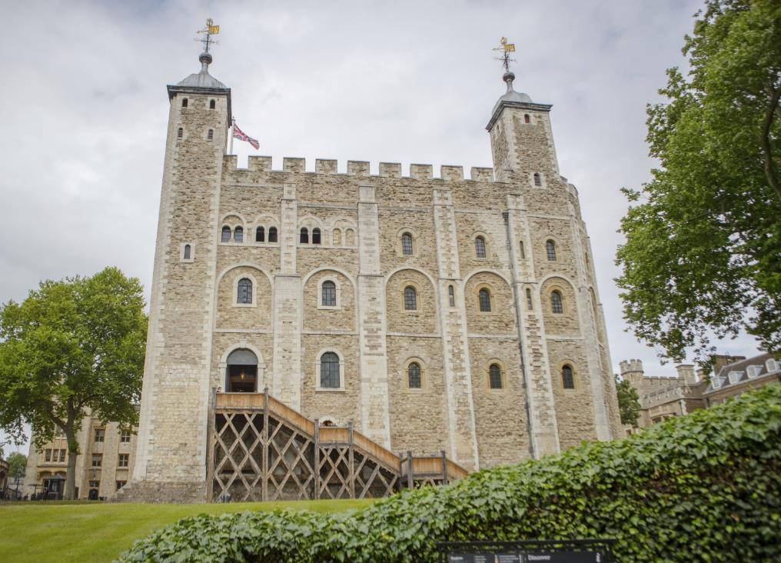

White Tower
© Historic Royal Palaces
Find more details and full image credits in the ‘Notes’ section below the slide.
Notes:
Disclaimer and Use Terms
We are the owner or the licensee of all intellectual property rights in these resources which are protected by copyright laws and treaties around the world. All such rights are reserved. These resources, and the content included within them, may be used by you for educational purposes only. This means that you may download the resources and use or share them solely in educational environments (including for home school lessons) or as part of homework. You may not share the resources other than for the above purposes and you must not use the resources, or any part of them, for any commercial purpose.
These images support an educational video series:
https://youtube.com/playlist?list=PLmQztN3936tKG0dQYWl7k4f4c_p-bzAYM&feature=shared
The White Tower at the Tower of London

Slide 2
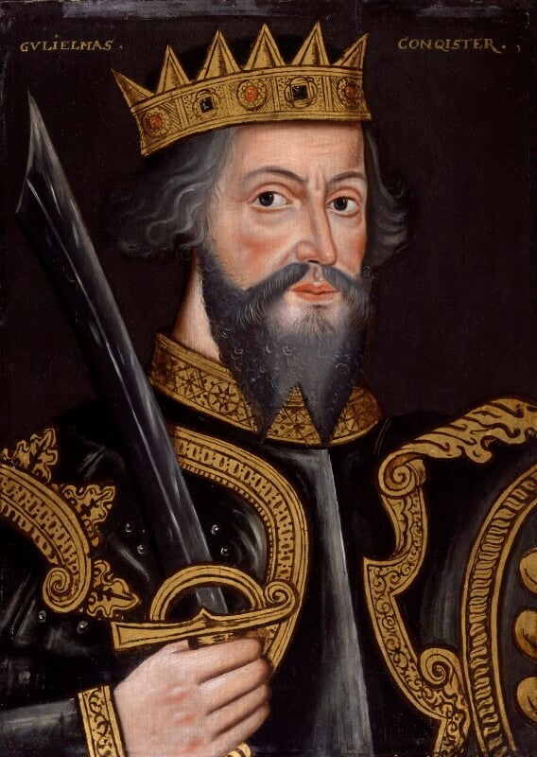
William the Conqueror
© National Portrait Gallery, London CC BY-NC-ND 3.0
Notes:
William the Conqueror
Read more about this portrait: NPG 4980(1); King William I ('The Conqueror') - Portrait - National Portrait Gallery

Slide 3
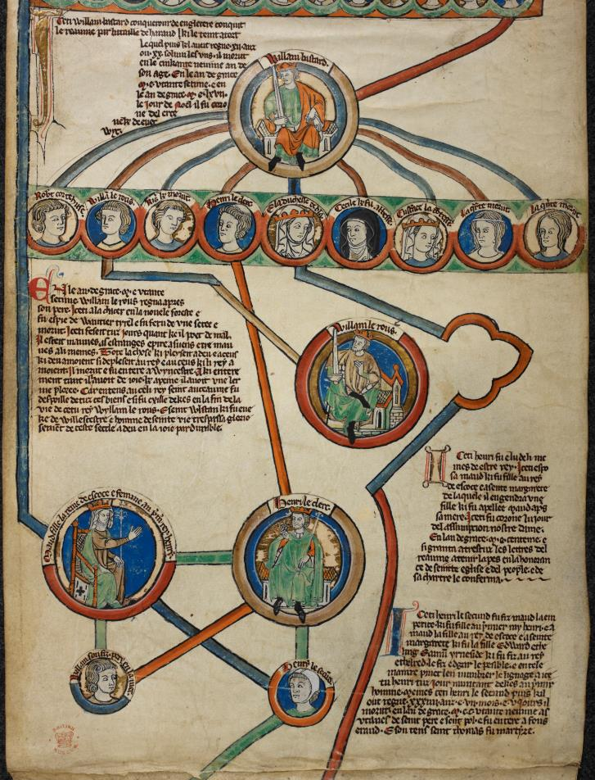
Family Tree
British Library Shelfmark: Royal 14 B. VI
Notes:
Genealogical roll of the Kings of England
View more: K90048-11 - British Library Images

Slide 4
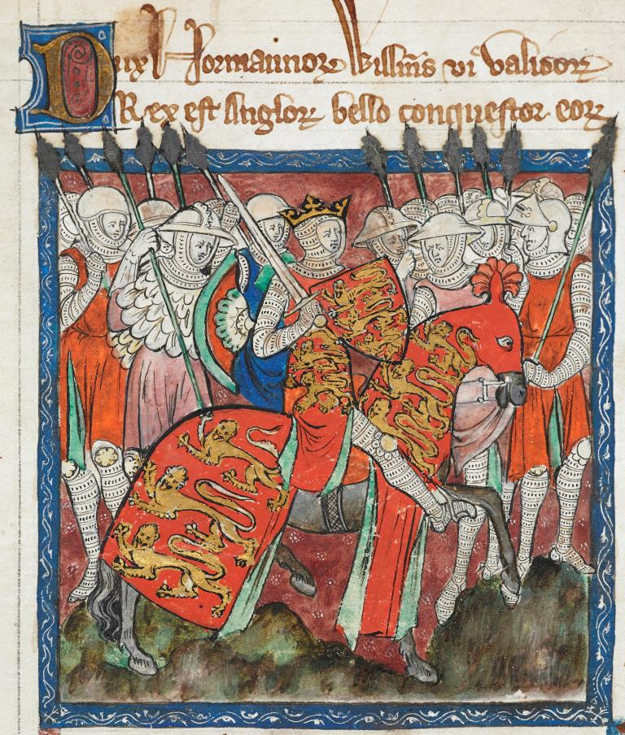
William I
British Library Shelfmark: Cotton Claudius D. II
Notes:
William I
View more: A80109-62 - British Library Images

Slide 5
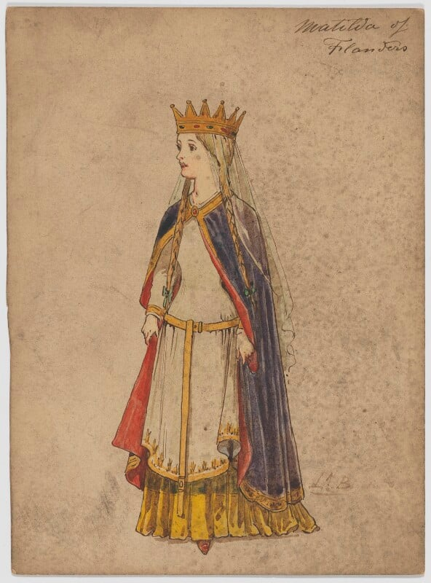
Matilda of Flanders
© National Portrait Gallery, London CC BY-NC-ND 3.0
Notes:
Matilda of Flanders
Read more about this artwork: NPG D6692; Matilda of Flanders - Portrait - National Portrait Gallery

Slide 6
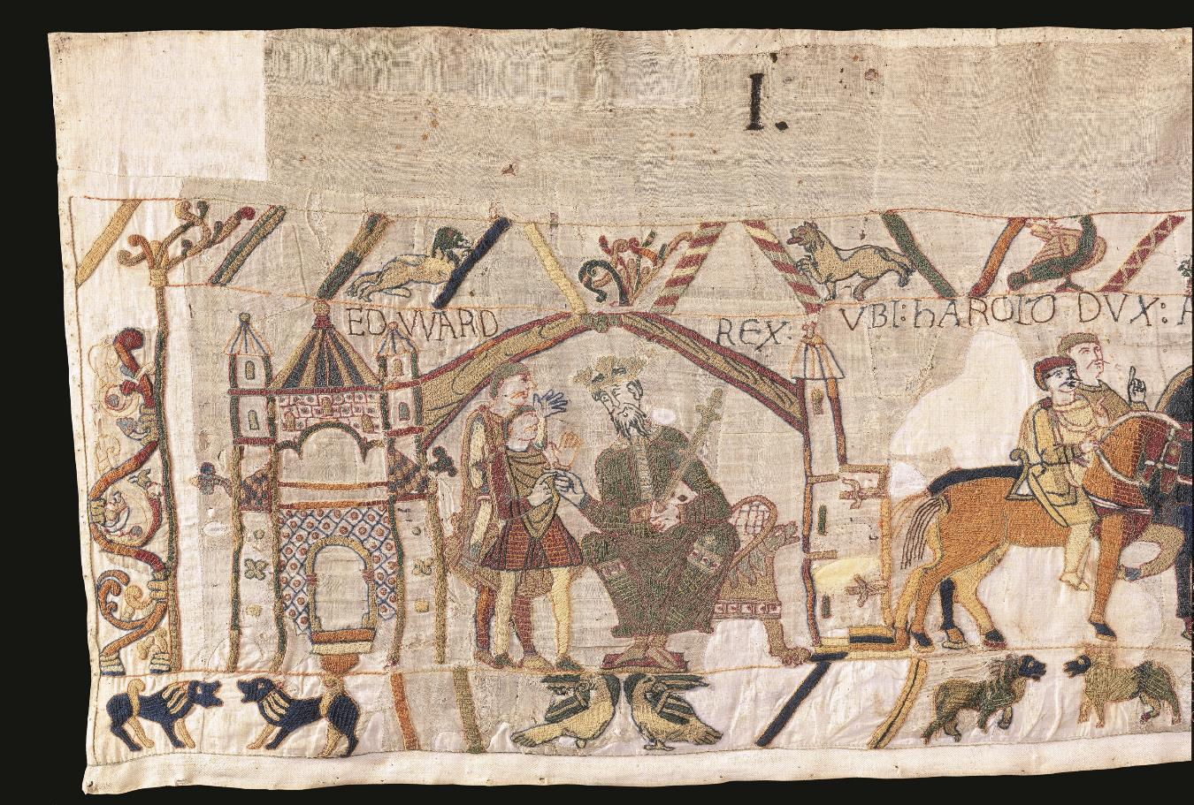
Edward the Confessor
Details of the Bayeux Tapestry, 11th Century. © City of Bayeux
Notes:
Edward the Confessor

Slide 7
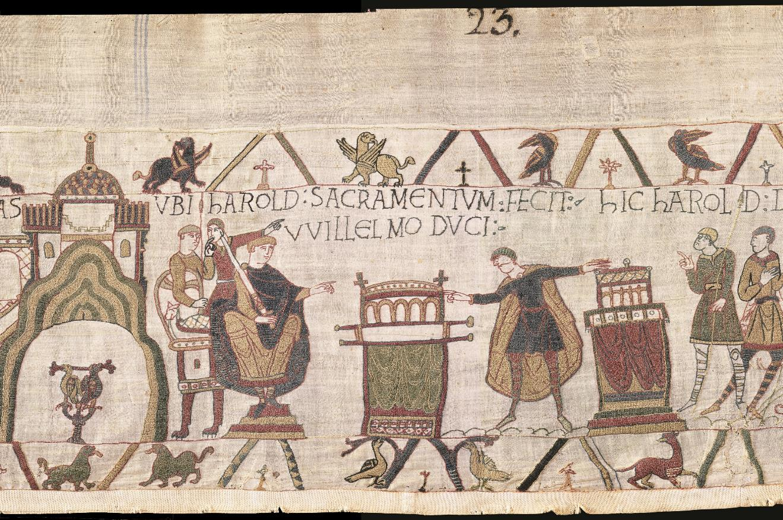
William and Harold
Details of the Bayeux Tapestry, 11th Century. © City of Bayeux
Notes:
William and Harold

Slide 8
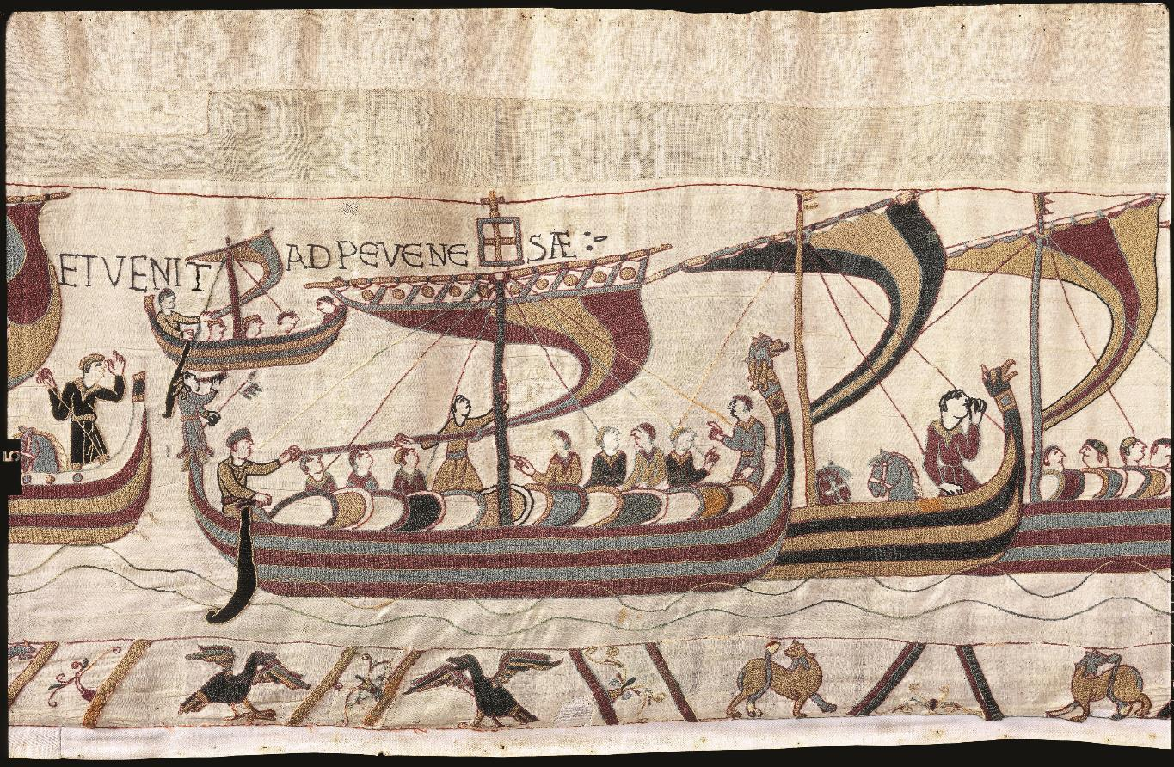
The Mora ship
Details of the Bayeux Tapestry, 11th Century. © City of Bayeux
Notes:
The Mora

Slide 9
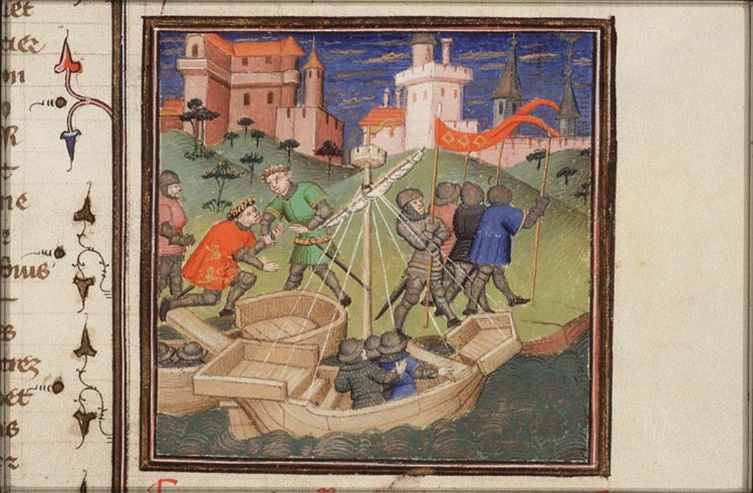
William arrives in England
Huis van het Boek & National Library of the Netherlands, The Hague. Source: manuscripts.kb.nl
Notes:
William arrives in England.
See more of this source: https://manuscripts.kb.nl/zoom/BYVANCKB%3Amimi_72a24%3A020r_min

Slide 10
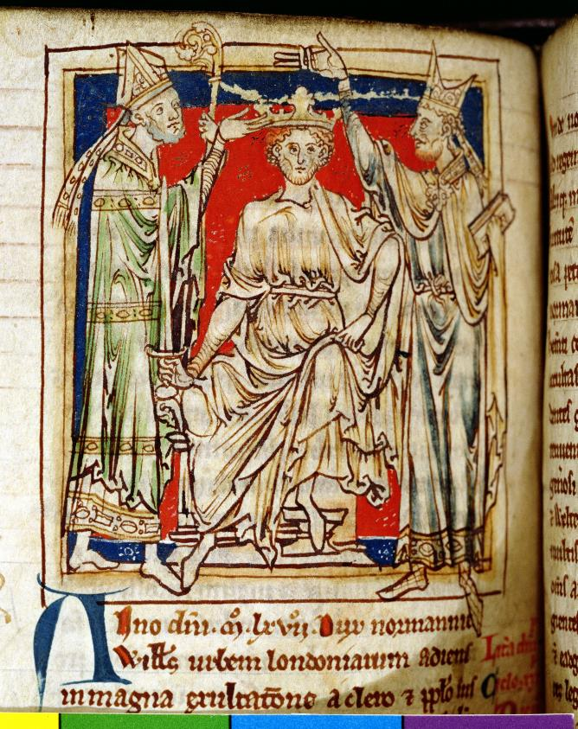
William’s coronation
© Chetham's Library / Bridgeman Images
Notes:
William I’s coronation
William I (1028-87) the Conqueror, miniature from 'Flores Historiarum', by Matthew Paris, 1250-52 (vellum)

Slide 11
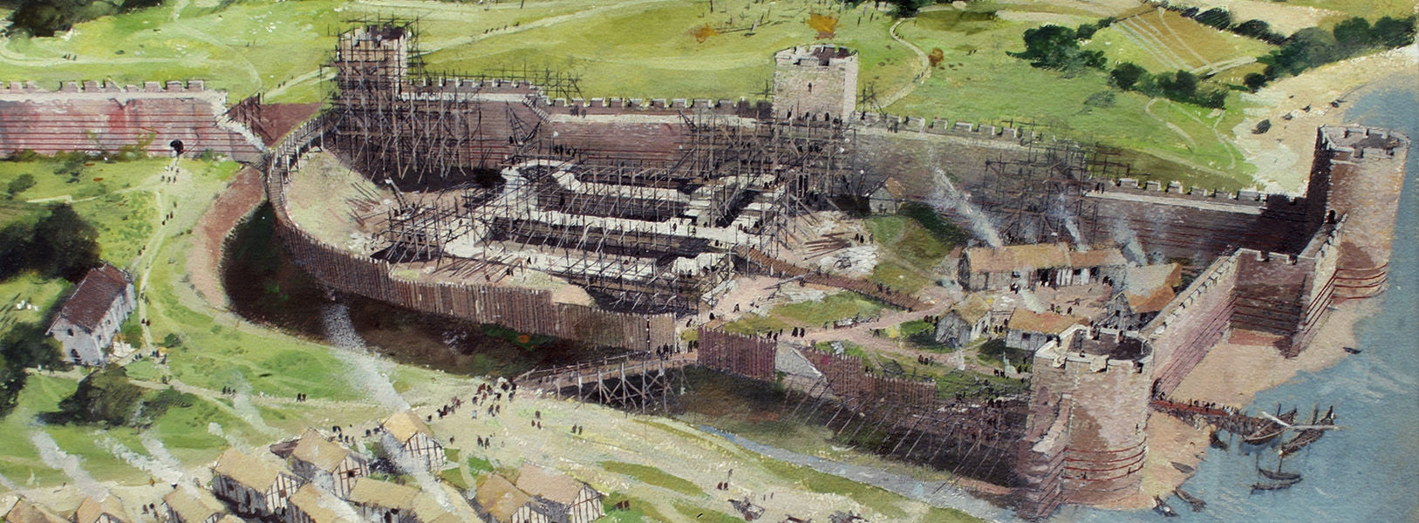
Building of the Great Tower
© Historic Royal Palaces
Notes:
Building of the Great Tower

Slide 12
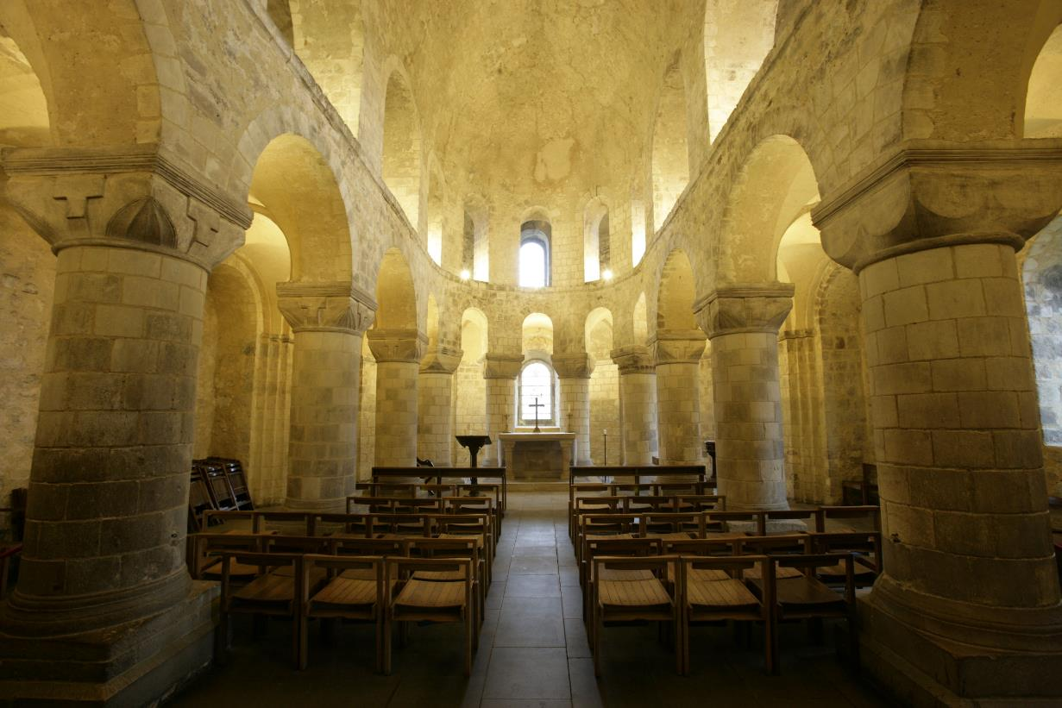
Norman Chapel
© Historic Royal Palaces
Notes:
Norman Chapel in the White Tower

