Slide 1
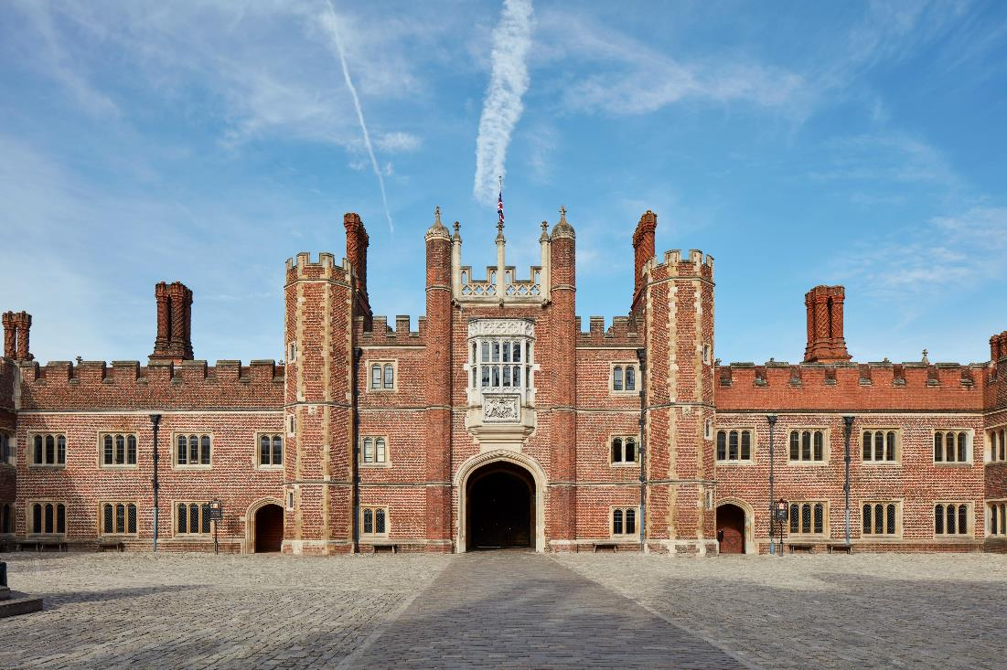

Hampton Court Palace
© Historic Royal Palaces
Find more details and full image credits in the ‘Notes’ section below the slide.
Notes:
Disclaimer and Use Terms
We are the owner or the licensee of all intellectual property rights in these resources which are protected by copyright laws and treaties around the world. All such rights are reserved. These resources, and the content included within them, may be used by you for educational purposes only. This means that you may download the resources and use or share them solely in educational environments (including for home school lessons) or as part of homework. You may not share the resources other than for the above purposes and you must not use the resources, or any part of them, for any commercial purpose.
Hampton Court Palace

Slide 2
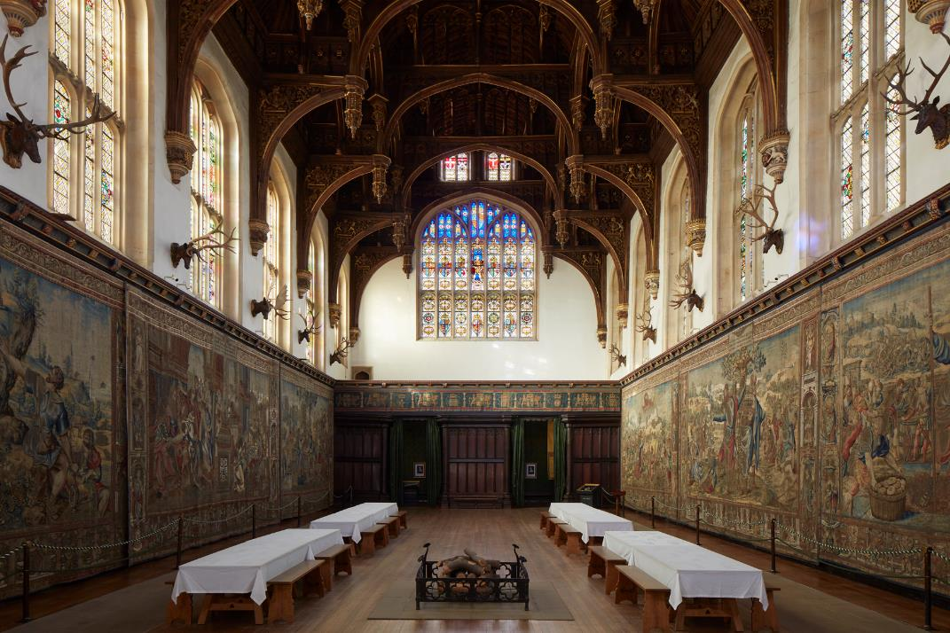
The Great Hall
© Historic Royal Palaces
Notes:
The Great Hall sits at the very heart of the Tudor palace at Hampton Court, towering over the surrounding buildings. It was designed to impress and to proclaim Henry VIII’s power and magnificence.

Slide 3
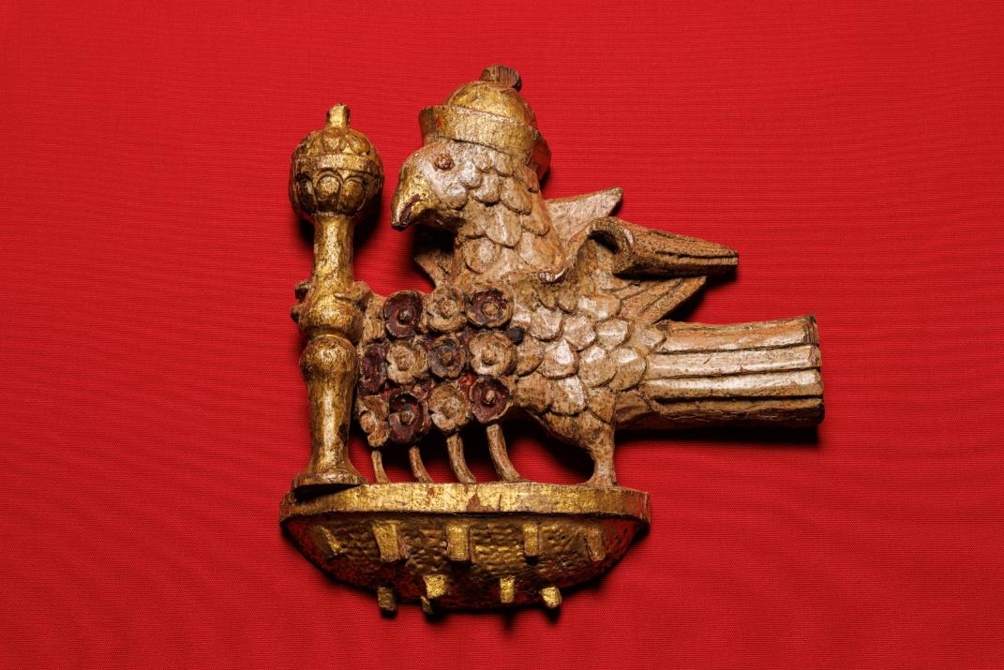
Falcon
© Historic Royal Palaces
Notes:
A rare architectural survival believed to be part of the original Tudor scheme in the Great Hall. The falcon is Anne Boleyn’s emblem.

Slide 4
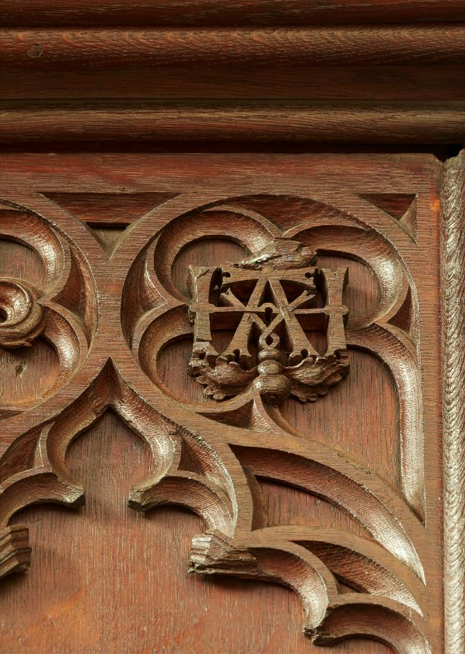
Anne Boleyn Symbol
© Historic Royal Palaces
Notes:
To celebrate Henry VIII and Anne Boleyn’s marriage, the carpenters added Anne's coat-of-arms to the roof and carved the entwined letters H and A on the wooden screen at the end of the Great Hall. These poignant reminders of Anne's time as Queen can still be seen today.

Slide 5
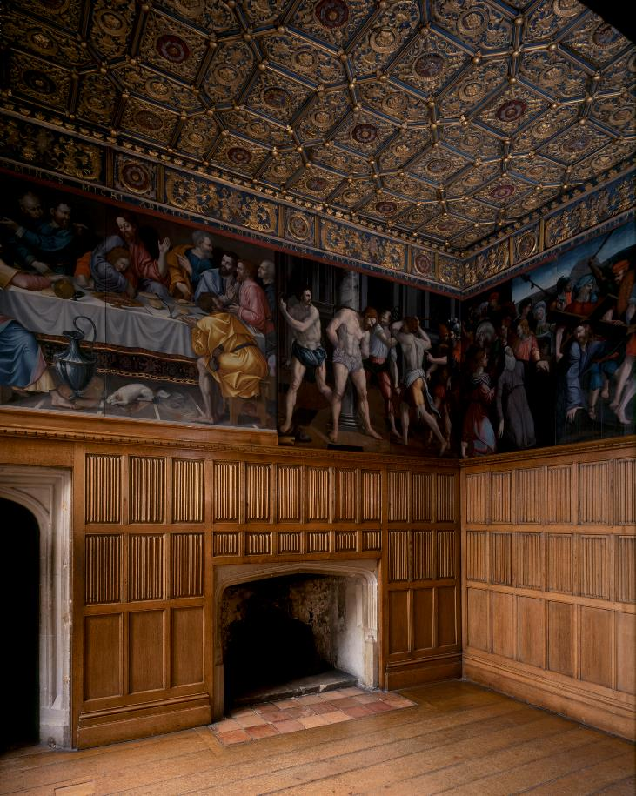
Wolsey Closet
© Historic Royal Palaces
Notes:
The Wolsey Closet is one of the best surviving fragments of Henry VIII's privy (private) apartments at Hampton Court Palace. The Wolsey Closet contains an original Tudor fireplace and ceiling, 16th-century wooden panelling, a series of painted panels, and a portrait of Henry VIII.

Slide 6
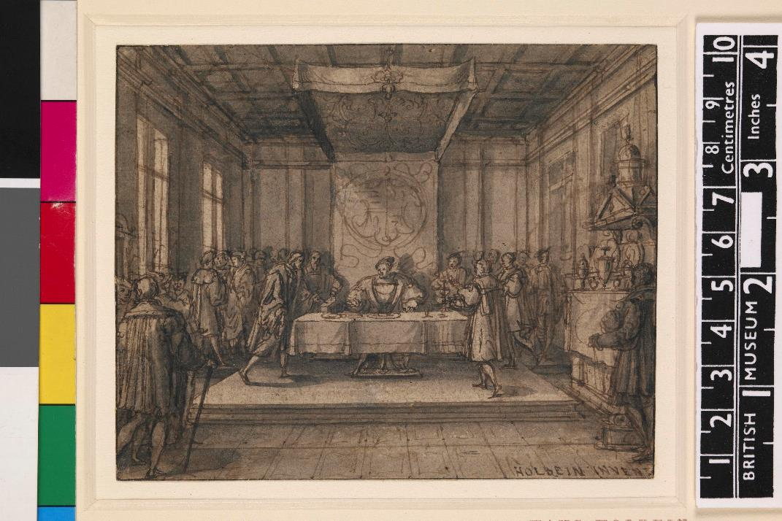
Henry dining in private
© The Trustees of the British Museum
Notes:
Henry VIII dining in his privy chamber
Find more information from the British Museum: drawing | British Museum
© The Trustees of the British Museum. Shared under a Creative Commons Attribution-NonCommercial-ShareAlike 4.0 International (CC BY-NC-SA 4.0) licence.

Slide 7
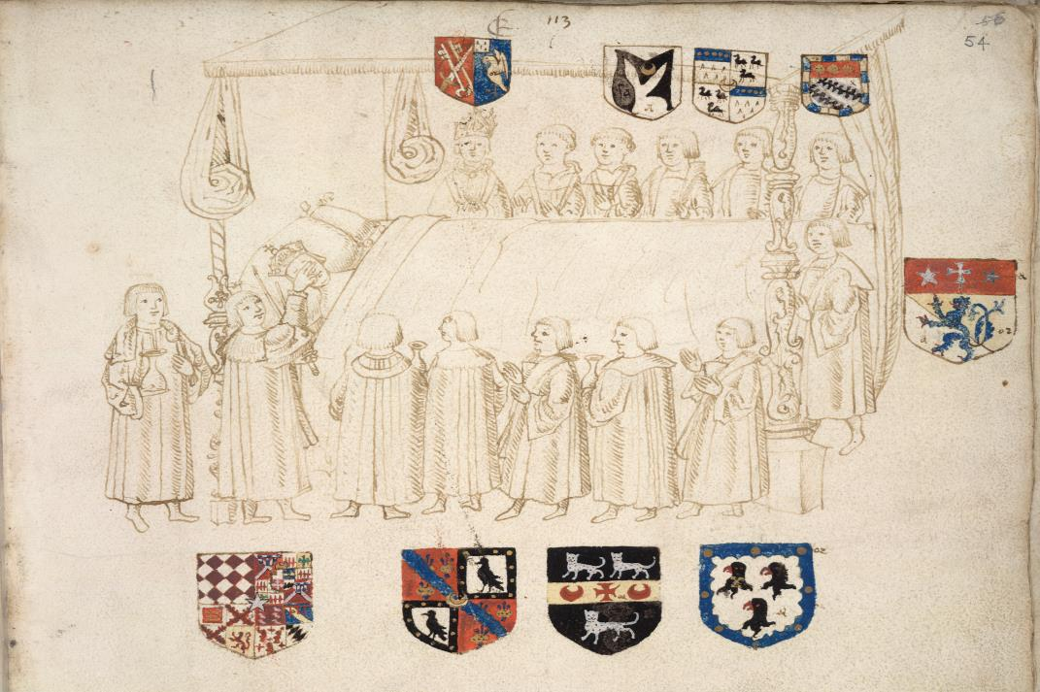
Henry VII deathbed
From the British Library archive Shelfmark: Add. 45131
Notes:
Henry VII on his deathbed
Find more information from the British Library: 067729 - British Library Images

Slide 8
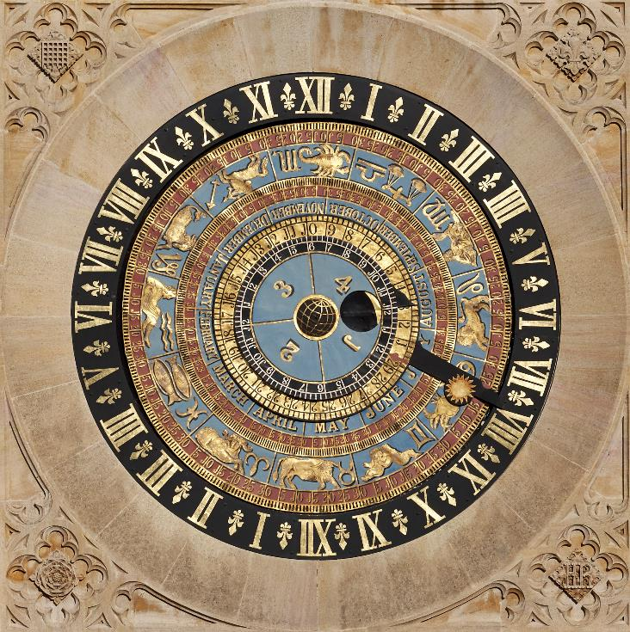
Astronomical clock
© Historic Royal Palaces
Notes:
The astronomical clock at Hampton Court Palace. Henry VIII was fascinated by science and astronomy. The dials rotate around the Earth – it was made three years before Copernicus presented his theory that the planets rotate around the sun.

Slide 9
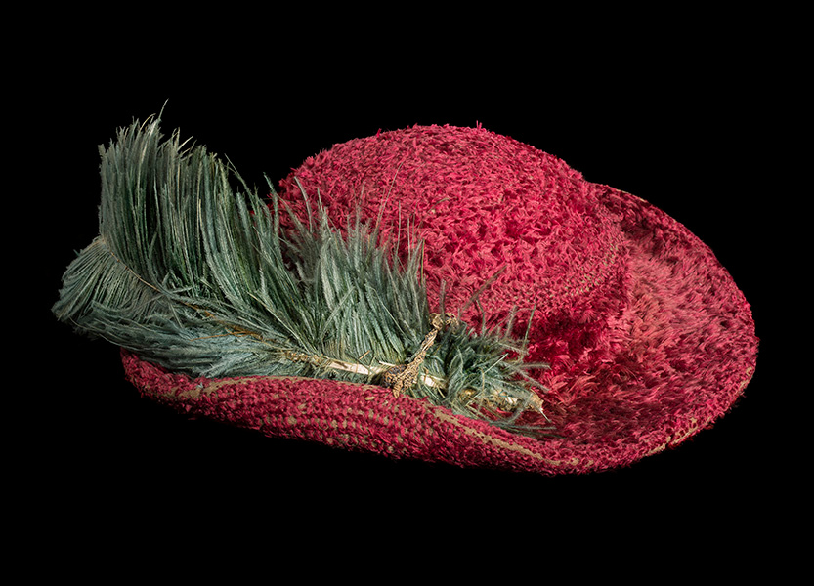
Bristowe hat
© Historic Royal Palaces
Notes:
The Bristowe Hat is a very rare example of Tudor or very early Stuart fashion. It has always been in the possession of the Bristowe family, who trace their genealogy to important Tudor courtiers. Family tradition has it that this was Henry VIII's hat.
Find out more about the origins of the hat: https://youtu.be/LX4wVbRYcV4

Slide 10
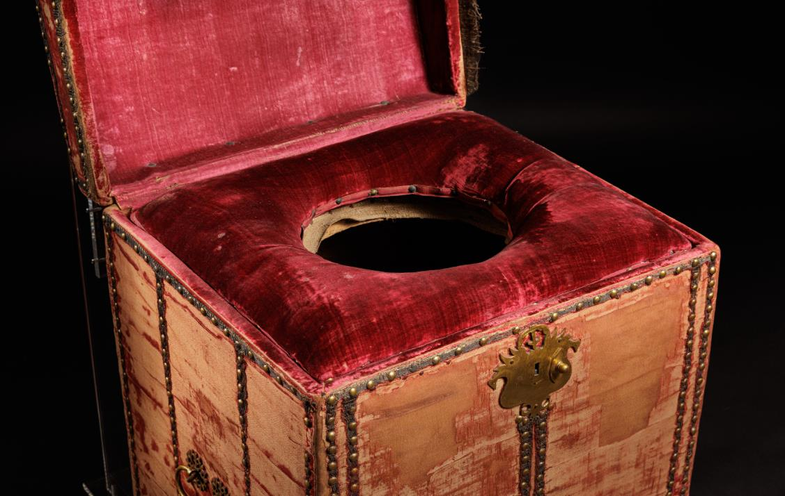
Stool
© Royal Collection Enterprises Ltd 2025 | Royal Collection Trust; Photograph: Historic Royal Palaces
Notes:
Close stool, probably made for William III at Hampton Court c1699.
Henry VIII would have had the most luxurious toilet of all. His close stools were covered in sheepskin, black velvet and ribbons!

Slide 11
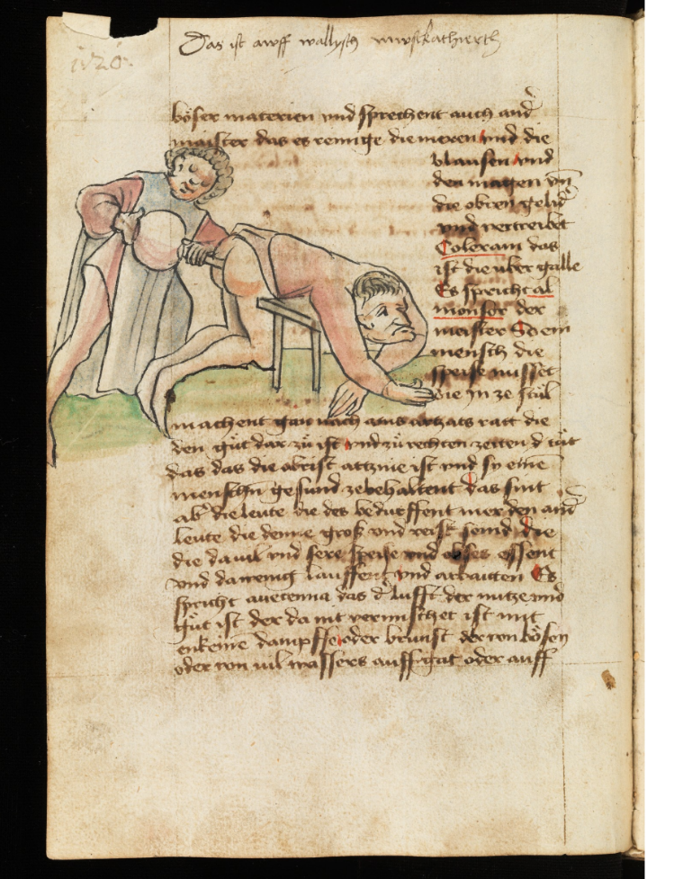
Depiction of an enema
Latromathematical housebook
Notes:
Latromathematical housebook from the Southern German/Swiss region St. Gallen, Stiftsbibliothek, Cod. Sang. 760, p.120 (www.e-codices.ch).
A depiction of an enema in the Tudor period.
Find more information from the e-codices: e-codices – Virtual Manuscript Library of Switzerland

Slide 12
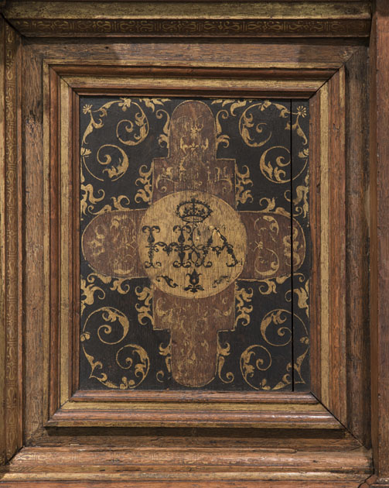
Royal bedhead
Bedhead Burrell Collection
Notes:
Bedhead Burrell Collection: Furniture Gifted by Sir William and Lady Burrell to the City of Glasgow, 1944
The bedhead that King Henry VIII had made for his fourth wife Anne of Cleeves.

Slide 13
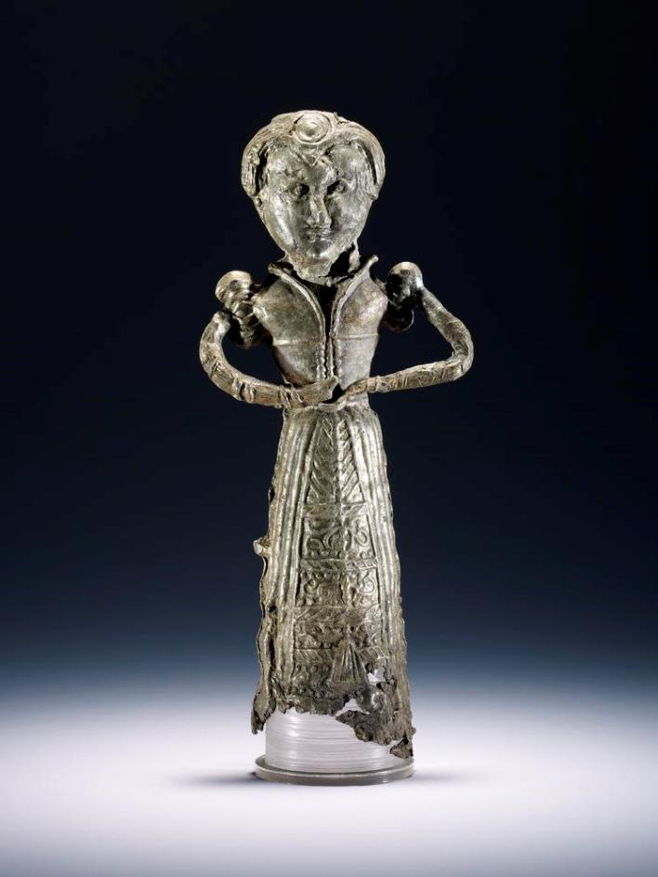
Pewter doll
© The Trustees of the British Museum.
Notes:
Tudor toy (pewter doll).
Find more information from the British Museum: doll | British Museum
© The Trustees of the British Museum. Shared under a Creative Commons Attribution-NonCommercial-ShareAlike 4.0 International (CC BY-NC-SA 4.0) licence.

Slide 14
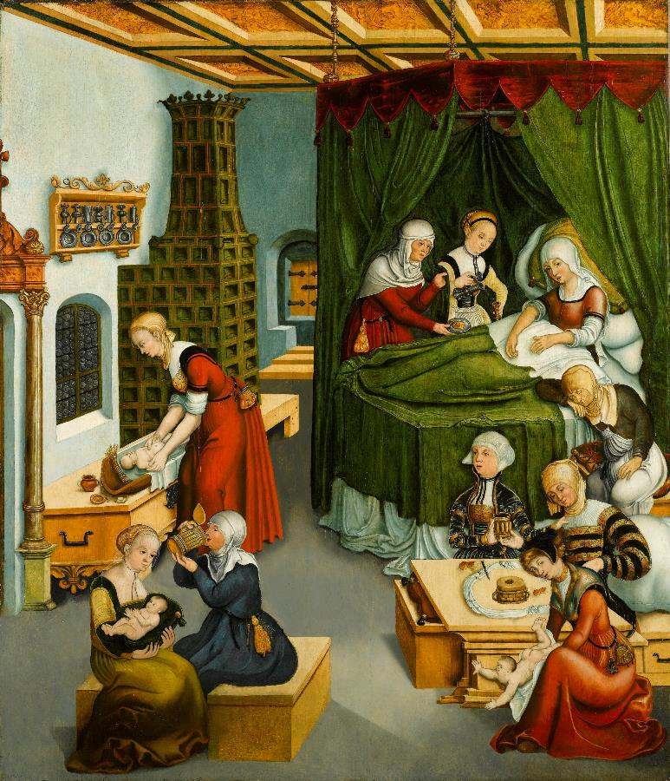
Confinement
© Sphinx FineArt/Bridgeman Images.
Notes:
A scene depicting ‘confinement’ and childbirth during the Tudor period.

Slide 15
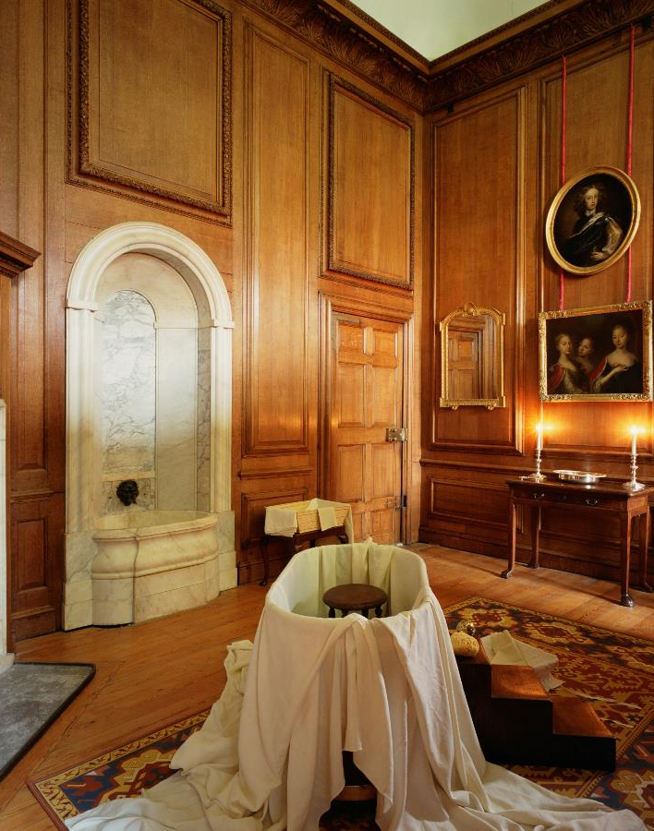
Tudor bathroom
© Historic Royal Palaces
Notes:
Contrary to popular belief, Tudors washed their bodies, if not their outer garments frequently.

Slide 16
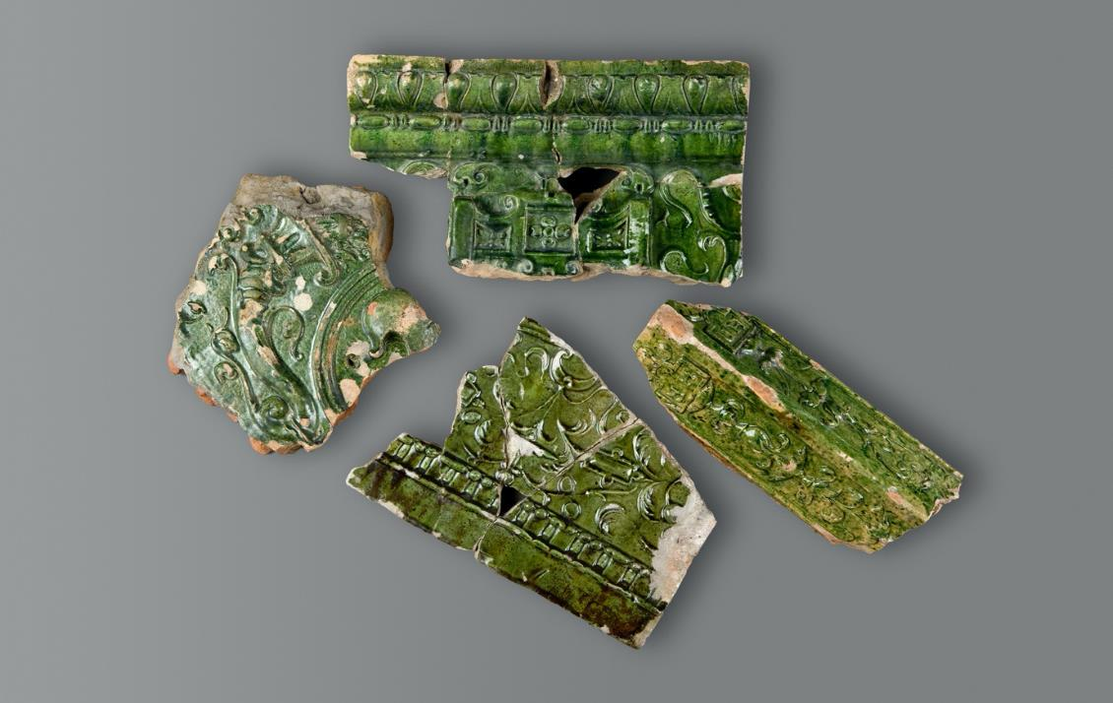
Ceramics
© Historic Royal Palaces
Notes:
Ceramics which may have been part of Queen Elizabeth I’s luxurious bathroom.
Monarchs often had their own bath, with hot and cold running water, and a luxurious tiled bathroom. The air may have been perfumed with fragrant herbs.

Slide 17
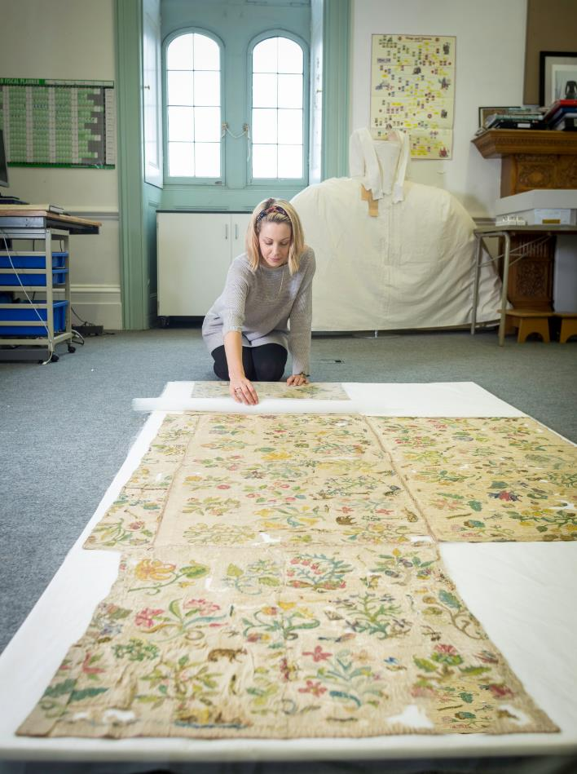
Bacton Alter Cloth
© Historic Royal Palaces
Notes:
A richly embroidered altar cloth, preserved for centuries in a small rural church in Bacton, Herefordshire, was recently identified by experts as a piece of a sixteenth century dress, which may even have belonged to Queen Elizabeth I herself.
Find out more about the Bacton Alter Cloth: The Bacton Altar Cloth

Slide 18
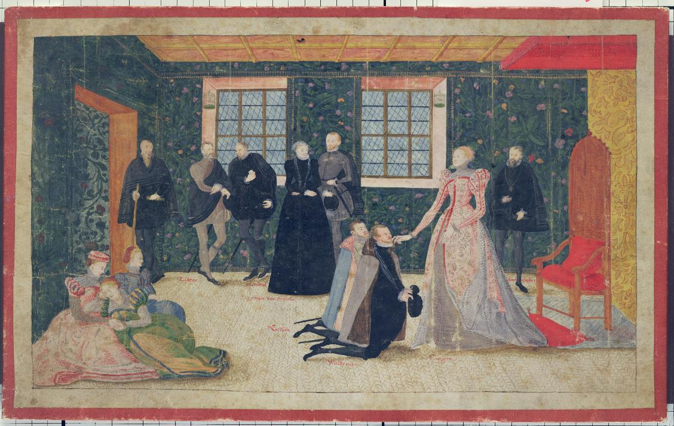
Meeting the queen
© Hessen Kassel Heritage / Bridgeman Images
Notes:
Queen Elizabeth I receives Dutch Ambassadors.

