Slide 1


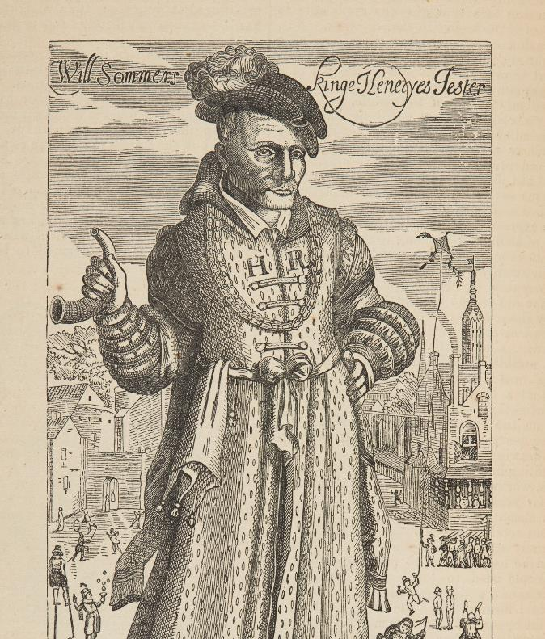
Will Somer – source task
Will Somer
– Source Task –
Notes:
Image Credit:
Historic Royal Palaces

Slide 2



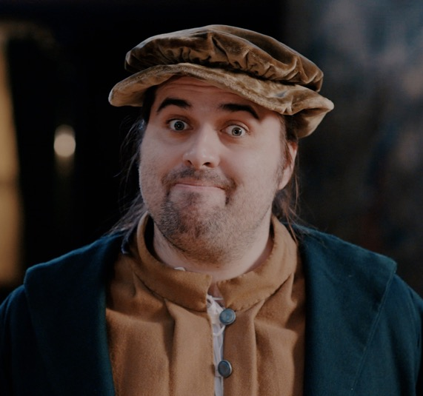
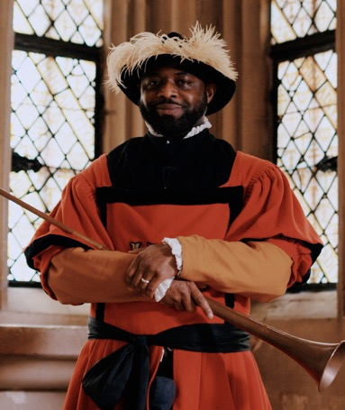
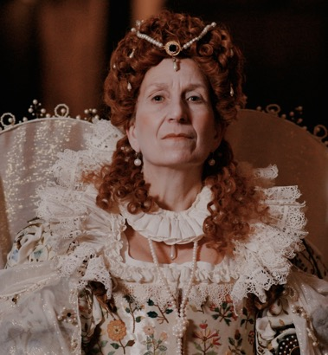
Have you watched me tell my story?
Have you watched me tell my story?
Elizabeth I
John Blanke
Will Somer
Notes:
Watch the videos: https://youtube.com/playlist?list=PLmQztN3936tL1ZgIHlfwlsKaRAqEDNQf1&feature=shared

Slide 3


Vocabulary
history | Learning about people, places and events from a long time ago to understand what life was like in the past.
source | Items from the past that help us learn about what happened. These might be portraits or documents.
evidence | Clues that help us understand and explain what life was like in the past.
portrait | A picture or artwork of a person. It can be a painting, a photograph or even a sculpture.
jester | A person whose job was to make people laugh and feel happy. They often worked for a king or queen and were sometimes called a ‘fool’.
monarch | A king or queen who leads a country and makes important decisions.
dynasty | A family of kings and queens. When one monarch dies, their child usually becomes the next ruler.
court | The household of the monarch, including people who live and work with the king or queen, like their family and helpers.
Notes:
Teacher notes:
These terms are used in the video and this source task. It would be useful for students to be aware of them. However students do not need to memorise or discuss all of them.

Slide 4


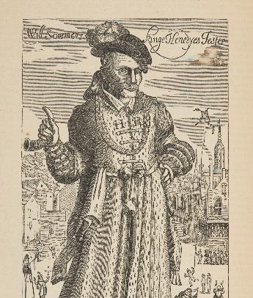

When did Will live?
When did
Will live?
Will worked at court around 500 years ago!
TUDOR PERIOD
Henry VII
Henry VIII
Edward VI
Mary I
Elizabeth I
Further into the past
Now
Notes:
Teacher notes:
The purpose of this slide is for children to understand that this period of history is a long time in the past which is why life is so different to what they know.
Ask children to find 'now'. Explain this is where we are today.
Move finger back to the end of the bright blue section. This is how far the oldest people alive today can remember. The Tudors are further in the past than that.
Say the word Tudor and explain this was the family who ruled over England and who we will learn more about.
We don’t know when Will Somer was born, but there is evidence that he worked for the royal family around 1535.

Slide 5


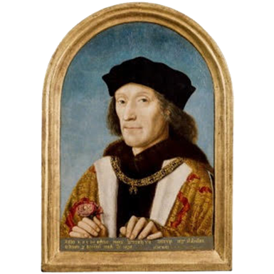


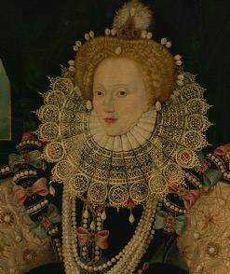
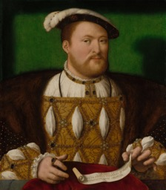
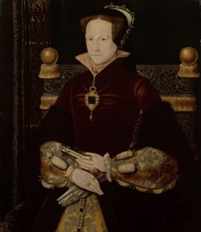
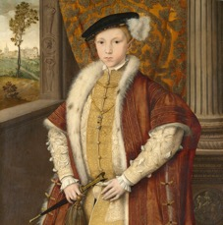
Tudor Dynasty timeline
Timeline of the Tudor Dynasty
Henry VII
Henry VIII
Edward VI
Mary I
Elizabeth I
Will Somer was a court jester in the reign of King Henry VIII.
Notes:
Image Credit:
Henry VII © National Portrait Gallery, London
Henry VIII © Royal Collection Enterprises Limited 2025 | Royal Collection Trust
Edward VI © Royal Collection Enterprises Limited 2025 | Royal Collection Trust
Mary I © Royal Collection Enterprises Limited 2025 | Royal Collection Trust
Elizabeth I Elizabeth 1, 1533 – 1603 (the Armada Portrait) © National Maritime Museum, Greenwich, London

Slide 6

Do you remember this source?
Do you
remember
this source?
Notes:
About this source:
This source is an engraving made by Francis Delaram (1590-1627). It shows Will at court, wearing a hat with feathers and a spotted gown. Will died in 1560, which means this source was created some time after his death.
In the background we can see scenes such as a man on slits, kites being flown and children playing games.
Will was close to King Henry VIII and his family and was popular at the royal court. His role was to entertain people and well thought of by many people.
Learn more about this source with Historic Royal Palaces:
Search - Historic Royal Palaces

Slide 7

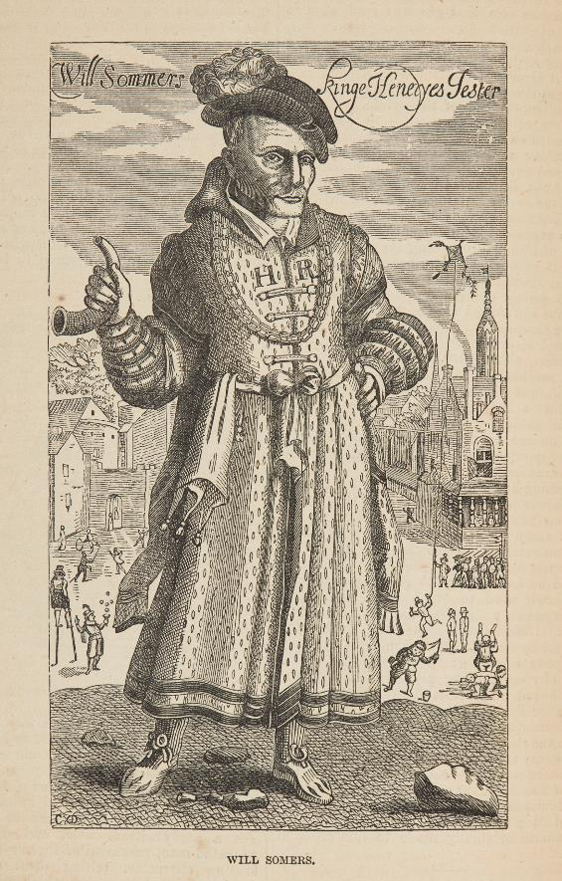
How does this source help tell Will’s story?
How does this source help tell Will’s story?
Notes:
Task:
Ask the students to look closely at this source.
Questions to ask:
The video mentioned Will had green clothes, but his clothes aren’t green here. Does this mean this source is wrong?
No, not everything is made in colour. Also, Will might have worn different colours on different days. Other sources can help us add more to our understanding.
What different types of entertainment can you see in this source?
We can see lots of different activities in the background, such as a man on slits, kites being flown and children playing games. This tells us that entertainment was very important in the Tudor period.
I can’t see a monkey, can you?
No, but other sources and paintings show Will with a monkey, so we know he had one.
This portrait was made a long time after Will had died. The artist who made the portrait never met Will. How did they know what he looked like?
There were other images of Will made whilst he was still alive. Plus, there would have been descriptions of what he looked like. But there were no cameras so the artist would not know for sure what he looked like. This might mean it is not a very accurate image.
Themes to explore:
It is thought that Will may have had a learning disability, but we don’t know for sure. People with learning disabilities were sometimes seen as having an important gift. Some worked at the Tudor Court as entertainers and were often called ‘natural fools’. ‘Natural fools’ held valued positions at court and could speak openly when others could not. However, disabled people also faced discrimination, ridicule and mistreatment.
Will was known for falling asleep in odd places and possibly getting his words confused (although this may have been part of his act). He was able to say things to the king that other people would have been punished severely for.
While he was popular with many at court, there is evidence that he experienced both kindness from some people, and what we would describe as bullying from others.
Learn more about disability in the Tudor Period with Historic Royal Palaces on Future Learn:
“Fools” and disability in the Tudor court

Slide 8
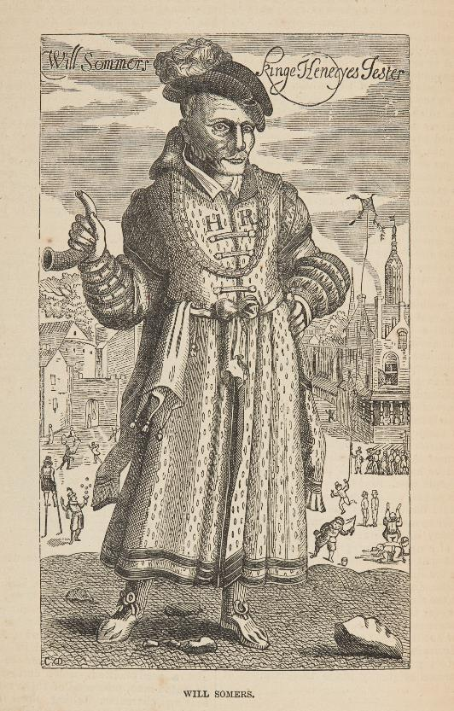
Look closer
Look closer at this source…
How can we tell Will was connected to Henry?
How might he have entertained people?
Look closely at his chest. There are two letters H and R. This is a symbol of Henry VIII and his right to be king.
He is carrying a small horn and has feathers in his cap. These might have been a way to entertain people at court. Will was sometimes seen with a monkey on his shoulder too.
Notes:
Teacher notes:
Ask the students to look closely at this source.
Use the source as evidence to answer the questions on the slide.

Slide 9
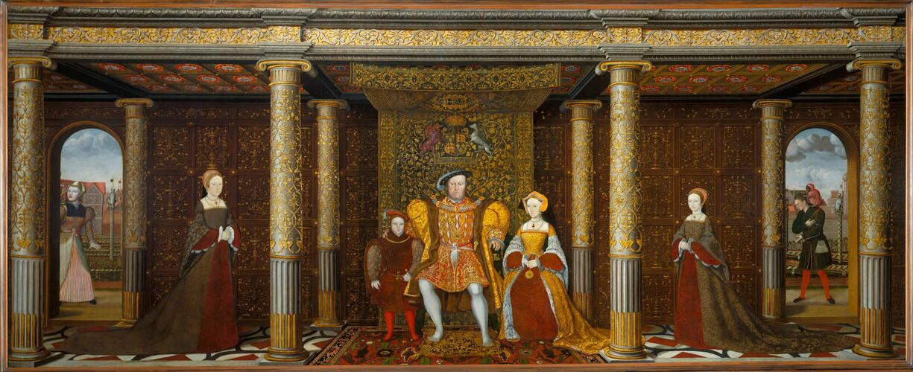
Other sources
Other sources about Will Somer
Notes:
Teacher notes:
Remind students that paintings such as this are carefully created. They may not be factual or accurate. In this image, we see Henry VIII's family. However, Henry's wife Jane Seymour (on his right) died shortly after their son Edward was born. Despite this, we can see Edward as a young man, on Henry's left. This scenario would not have happened in real life.
Can you spot Will Somer?
Will is on the far right hand side, standing in an archway. He is standing close by a young Elizabeth, who would later become queen.
How do we know that is Will?
He has a monkey on his shoulder, and he is wearing green.
This painting shows that the royal family liked and respected Will because they chose to include him in their family portrait.
Learn more about this source with the Royal Collection Trust:
https://www.rct.uk/collection/405796/the-family-of-Henry-viii
Image Credit:
© Royal Collection Enterprises Limited 2025 | Royal Collection Trust

