Slide 1


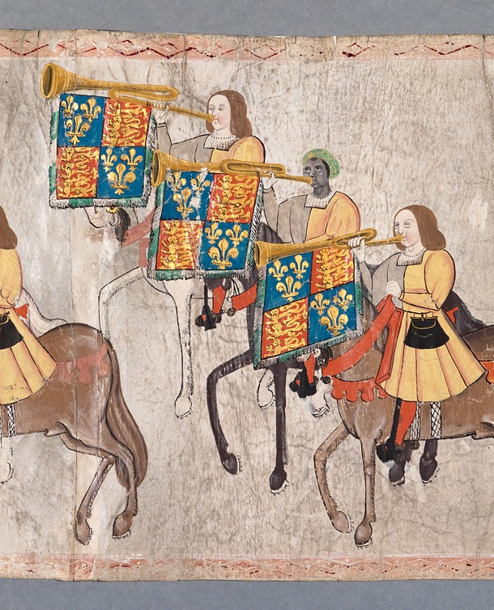
John Blanke
– Source Task –
Notes:
Image Credit:
College of Arms MS Westminster Tournament Roll, 1511, membrane 28. Reproduced by permission of the Kings, Heralds and Pursuivants of Arms.

Slide 2



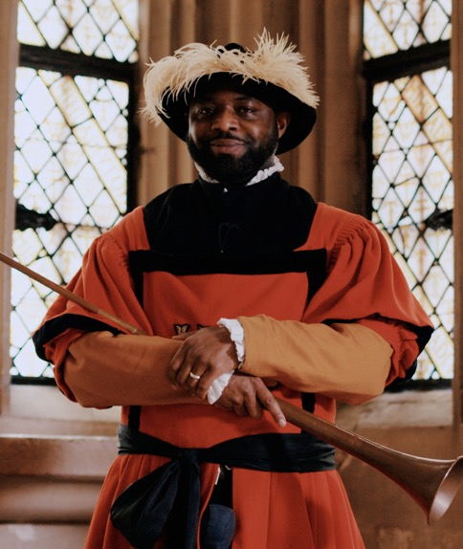
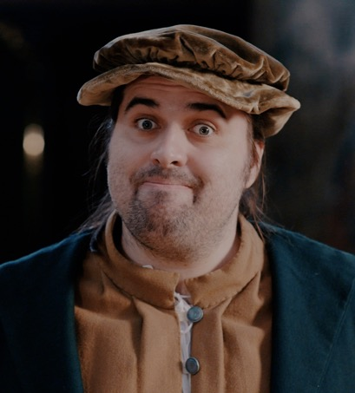
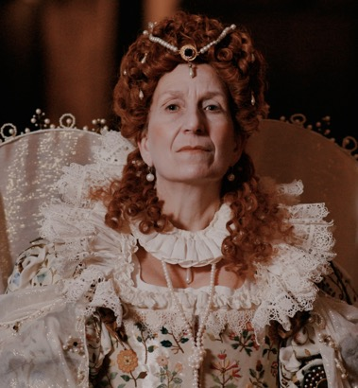
Have you watched me tell my story?
Elizabeth I
Will Somer
John Blanke
Notes:
Watch the videos: https://youtube.com/playlist?list=PLmQztN3936tL1ZgIHlfwlsKaRAqEDNQf1&feature=shared

Slide 3


Vocabulary
history | Learning about people, places and events from a long time ago to understand what life was like in the past.
source | Items from the past that help us learn about what happened. These might be portraits or documents.
evidence | Clues that help us understand and explain what life was like in the past.
trumpeter | A person that plays the trumpet.
joust | A sport where two opponents ride horses and fight with weapons called lances.
monarch | A king or queen who leads a country and makes important decisions.
dynasty | A family of kings and queens. When one monarch dies, their child usually becomes the next ruler.
court | The household of the monarch, including people who live and work with the king or queen, like their family and helpers.
Notes:
Teacher notes:
These terms are used in the video and this source task. It would be useful for students to be aware of them. However students do not need to memorise or discuss all of them.

Slide 4




When did
John live?
John was a trumpeteer
over 500 years ago!
TUDOR PERIOD
Henry VII
Henry VIII
Edward VI
Mary I
Elizabeth I
Further into the past
Now
Notes:
Teacher notes:
The purpose of this slide is for children to understand that this period of history is a long time in the past which is why life is so different to what they know.
Ask children to find 'now'. Explain this is where we are today.
Move finger back to the end of the bright blue section. This is how far the oldest people alive today can remember. The Tudors are further in the past than that.
Say the word Tudor and explain this was the family who ruled over England and who we will learn more about.
We don’t know when John Blanke was born, but we do have evidence that he wrote a letter to the king around 1512.

Slide 5


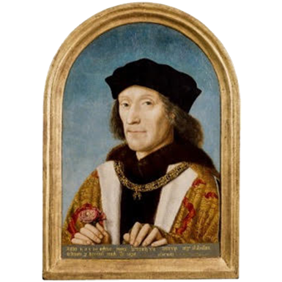


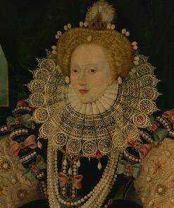
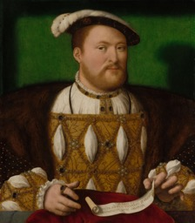
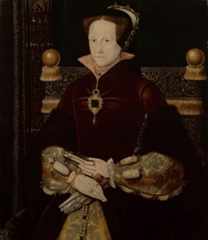
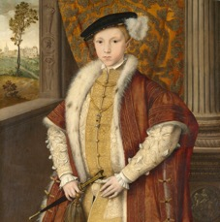
Tudor Dynasty timeline
Timeline of the Tudor Dynasty
Henry VII
Henry VIII
Edward VI
Mary I
Elizabeth I
John Blanke was a trumpeter in the royal court of Henry VII and Henry VIII.
Notes:
Image Credit:
Henry VII © National Portrait Gallery, London
Henry VIII © Royal Collection Enterprises Limited 2025 | Royal Collection Trust
Edward VI © Royal Collection Enterprises Limited 2025 | Royal Collection Trust
Mary I © Royal Collection Enterprises Limited 2025 | Royal Collection Trust
Elizabeth I Elizabeth 1, 1533 – 1603 (the Armada Portrait) © National Maritime Museum, Greenwich, London

Slide 6

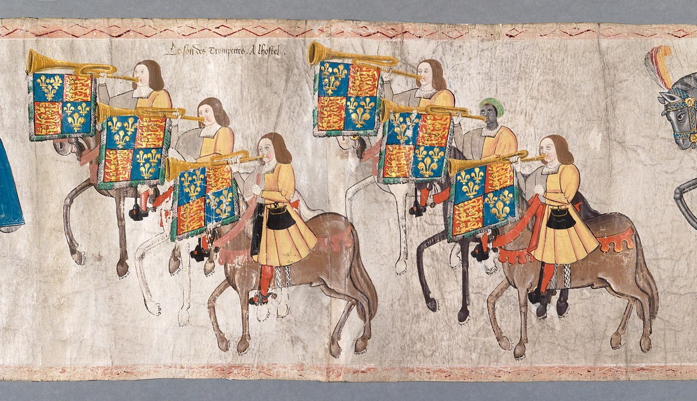
Do you remember this source?
Do you
remember
this source?
Notes:
About this source:
This is the Westminster Tournament Roll from 1511 that was shown in the video. It was made of 36 pieces of vellum (animal skin commonly used for writing on called membranes) sewn together and measures around 60 ft long which is just over 18 metres.
It was made to celebrate the birth of Henry’s first son (named Henry) who sadly died a few weeks later. It is a little like a comic strip and the images show the celebratory joust in the baby’s honour. It could be compared to the opening ceremony of the Olympics/Commonwealth games today.
The Tournament Roll gives us a glimpse into the lives of people that worked at the Tudor Court. This includes John Blanke.
Learn more about the Westminster Tournament Roll with the National Portrait Gallery
John Blanke and the Westminster Tournament Roll - National Portrait Gallery
More details of the Westminster Tournament Roll:
Across the 36 pieces, it tells the story of the day:
Membrane 1 – Henry’s heraldry to show the unity of Henry VIII and Catherine of Aragon (his first wife)
Membrane 2 to 23 – a procession of 6 trumpeters (including John Blanke) and other important people.
Membrane 24 to 27 – the joust itself. It shows King Henry scoring maximum points and being watched over by his Queen, Catherine.
Membrane 28 to 35 – returning from the joust.
Membrane 36 – the conclusion
A poem praising the king.

Slide 7

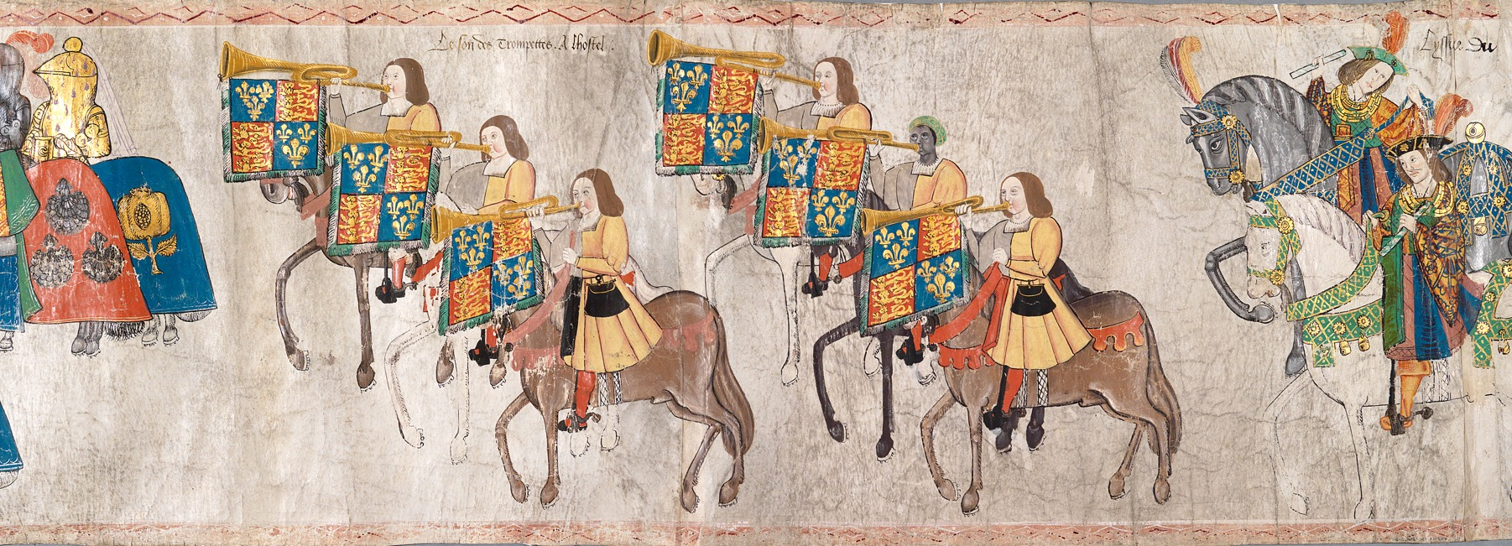
How does this source help tell John’s story?
How does this source help tell John’s story?
Notes:
Task:​
Ask the students to look closely at this source.​
​
Questions to ask:​
What different types of people/jobs can you see?​
Left to right: King’s armourer and his mace-bearer (look like knights) 6 trumpeters including John, and noble men.​
​
Can you locate John Blanke? ​
Second row of trumpeters in the middle.​
​
What makes him stand out from the other trumpeters? ​
John is the only Black trumpeter shown here, he also wears green hat (or perhaps a turban).​
​
Do you think he was the only Black person in England at this time?​
No, there were other Black people in England at this time. John is unique because we have a both picture of him and his name was recorded. We have other records about him too, such as when he asked the king for a pay rise. John had a high-status job at the royal court, other Black people may have been working more 'ordinary’ jobs. ​
​
How does this source show that the trumpeters were important to the King? ​
Their trumpets have the royal flag hanging from them. ​
​
Themes to explore:​
This was a time of discovery and exploration. Lots of people were moving around the globe in large ships, going to new places and trading in new goods. In particular, people from Africa and Asia were arriving in England, finding work and having families. ​
It is important to note that slavery was not a recognised status in England at this time. However, there may still have been prejudice and discrimination towards people arriving from other countries. ​
​
This source is evidence that John was a skilled musician and had a well-respected role at court. ​

Slide 8

Source close-up
How does this source help tell John’s story?

Slide 9
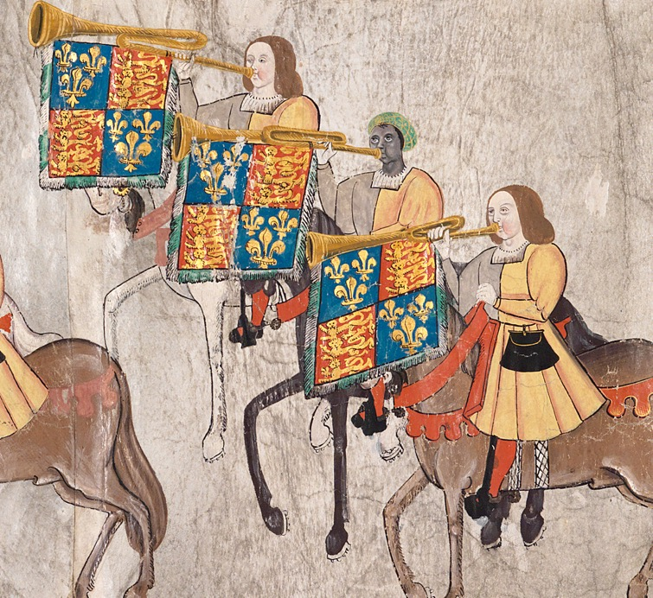
Look closer
Look closer at this source…
How do we know John had an important job?
What skills did
John have?
He’s part of a huge important event.
The royal flag hangs underneath John’s trumpet.
He could ride a horse and play trumpet at
the same time.
Notes:
Teacher notes:
Ask the students to look closely at this section of the source.
Use the source as evidence to answer the questions on the slide.
Remind students that we are lucky to have an image of John Blanke. It is very rare to have pictures of people in the past apart from the very richest (including kings and queens). In history, we often only have a few clues about people's lives which means we don't know very much, including things like where they were born, or if they had children.
There were other Black people in Tudor England that we know little to nothing about.

Slide 10
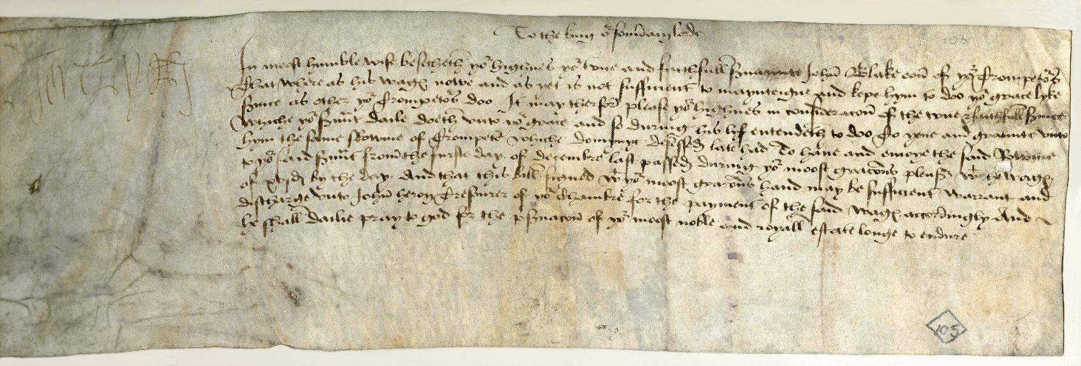
Other sources
Other sources about John Blanke
Notes:
Teacher notes:
This document is an original letter, written (or dictated) by John. In it, he asks King Henry VIII for a pay rise.
John wrote that he wanted a pay rise from 8p per day to 16p per day. This is similar to what other trumpeters were paid. He even suggested that the king might wish to promote him. This evidence shows John was confident and that the King liked him. There are other sources that show John received the pay rise. The king also gave John a gift of £9 for his wedding.
Learn more about this source with the National Archives:
https://images.nationalarchives.gov.uk/search/?searchQuery=john+blanke
Image Credit:
The National Archives

