Slide 1
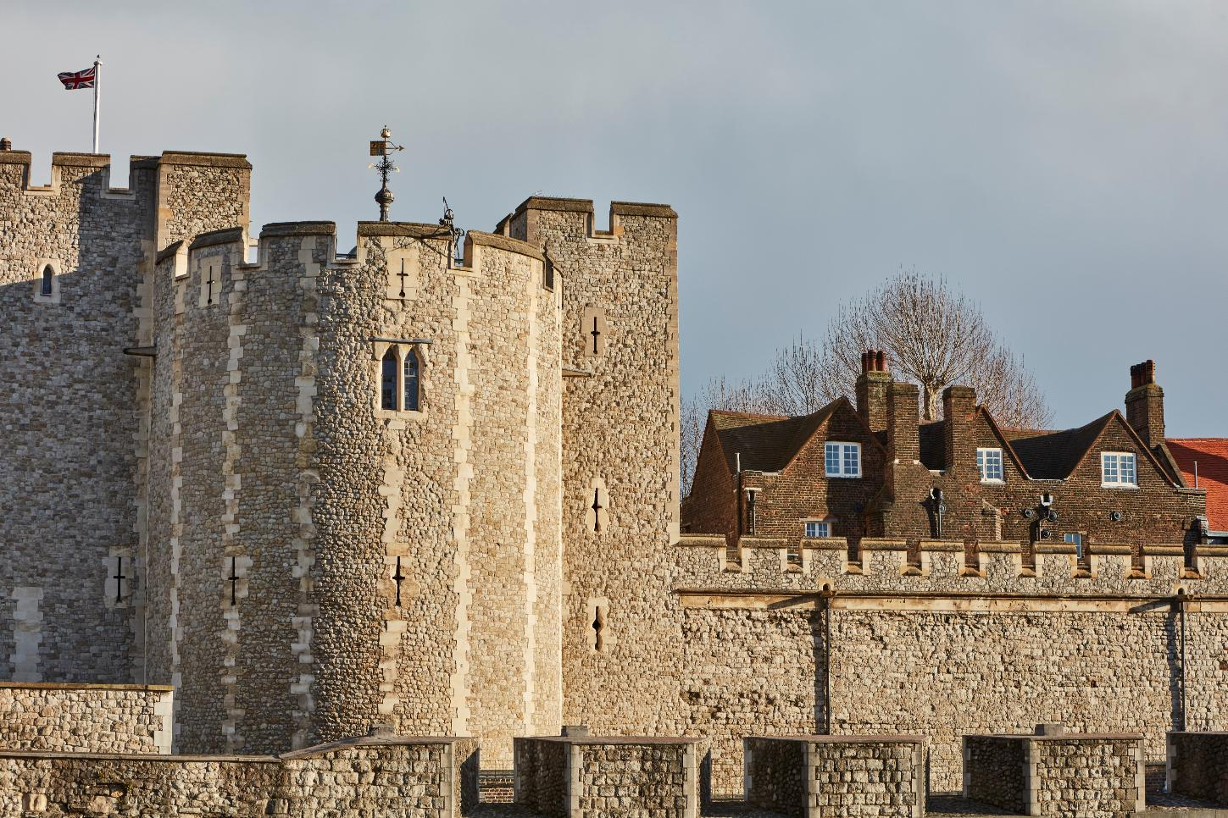

Exterior west
© Historic Royal Palaces
Find more details and full image credits in the ‘Notes’ section below the slide.
Notes:
Disclaimer and Use Terms
We are the owner or the licensee of all intellectual property rights in these resources which are protected by copyright laws and treaties around the world. All such rights are reserved. These resources, and the content included within them, may be used by you for educational purposes only. This means that you may download the resources and use or share them solely in educational environments (including for home school lessons) or as part of homework. You may not share the resources other than for the above purposes and you must not use the resources, or any part of them, for any commercial purpose.
Beauchamp Tower facing west
This side of the building looks over the City of London. From this view you can clearly see that the Beauchamp Tower was built as part of one of the defensive walls. You can see two turrets, crenellations and arrow loops. There is even a model of a soldier on top of the tower giving you an idea of how this building would have been defended when it was built around 1281.

Slide 2
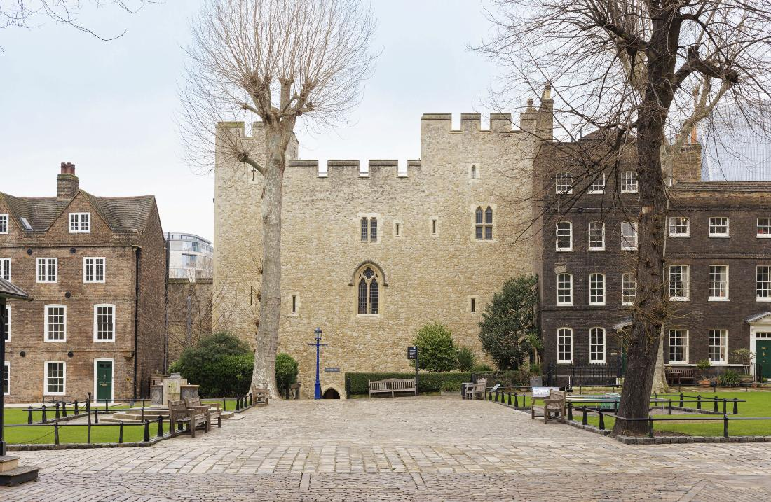
Exterior east
© Historic Royal Palaces
Notes:
Beauchamp Tower facing east
This side of the building looks over the grounds inside the Tower of London. You can see Tower Green to the right of the image, near this site several high-status people were executed in the Tudor period. From this view you can see crenellations and windows. You can also see newer buildings that have been built on either side of the Beauchamp Tower. To the left is a Stuart building and to the right is a Georgian building.
Note that there are not many arrow loops on this side of the building.

Slide 3
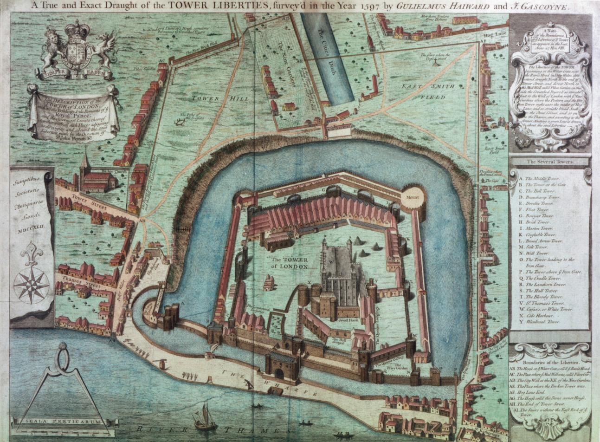
Map from 1597
© Historic Royal Palaces
Notes:
A map of the Tower of London from 1597
This map shows the Beauchamp Tower’s position on the west inner defensive wall.

Slide 4
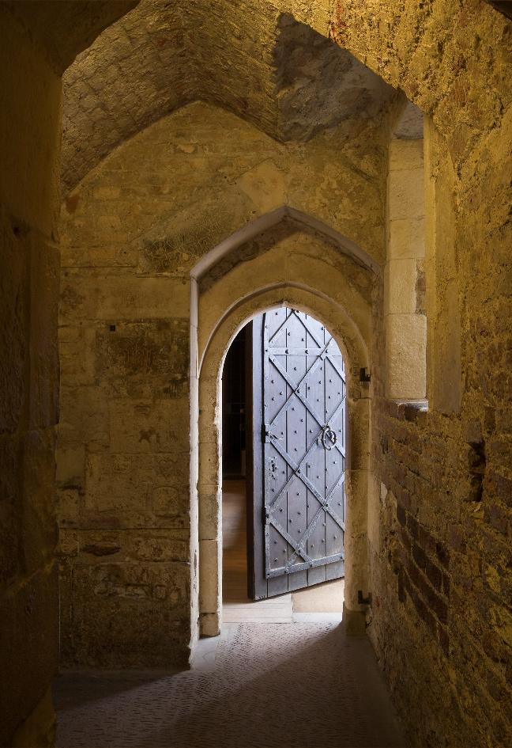
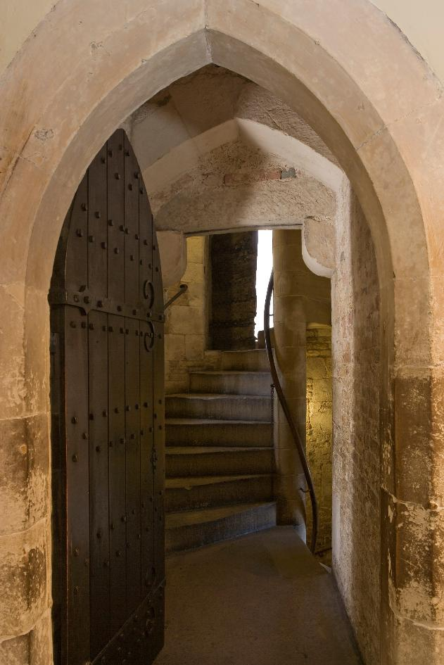
Interior
© Historic Royal Palaces
Notes:
Inside the Beauchamp Tower
These images show thick sturdy stone used to build the Tower, the narrow corridors and the spiral staircase. These are all defensive features.

Slide 5
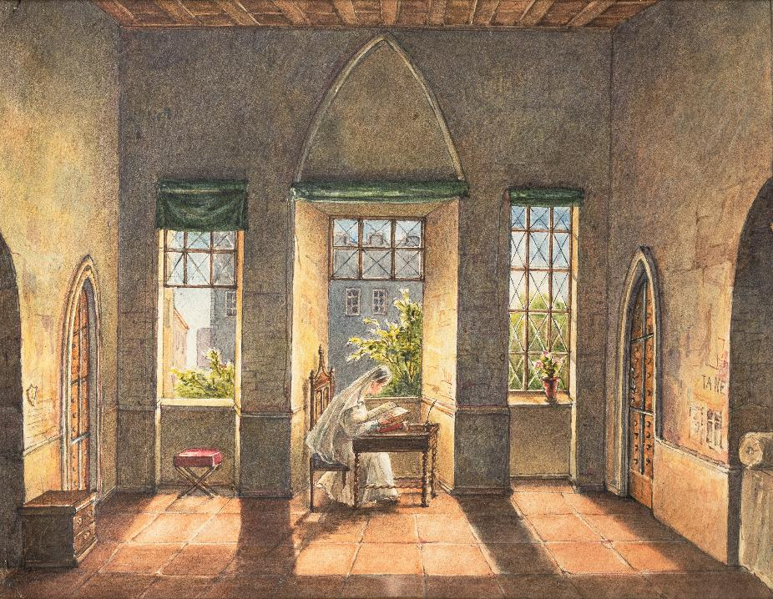
Painting of life in the Tower
© Historic Royal Palaces
Notes:
Life as a prisoner
This drawing shows what life might have been like inside the Beauchamp Tower for the high-status prisoners that were held there.

Slide 6
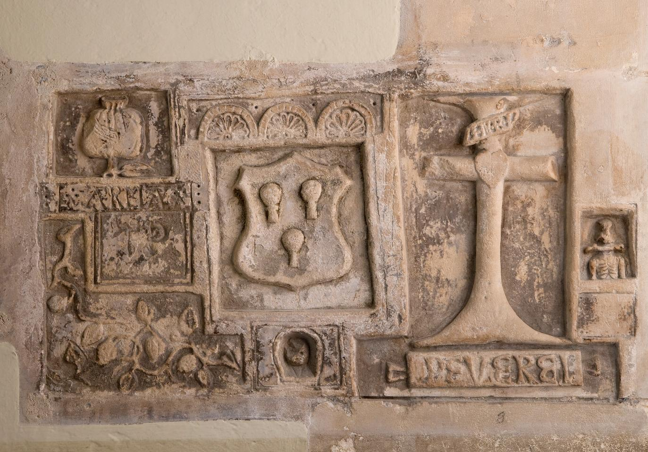
Peverel Carving
© Historic Royal Palaces
Notes:
Peverel carving
This is one of the many elaborate and skilfully carved inscriptions in the Beauchamp Tower. We do not know any firm details about Thomas Peverel, other than that he was imprisoned in around 1570. This collection of carvings also includes a skeleton, which is a symbol of death.
Using the year of his imprisonment as evidence, we might assume he was imprisoned for taking part in the Rebellion of the Northern Earls, an unsuccessful attempt by Catholic nobles from Northern England to replace Elizabeth I with Mary, Queen of Scots.

Slide 7
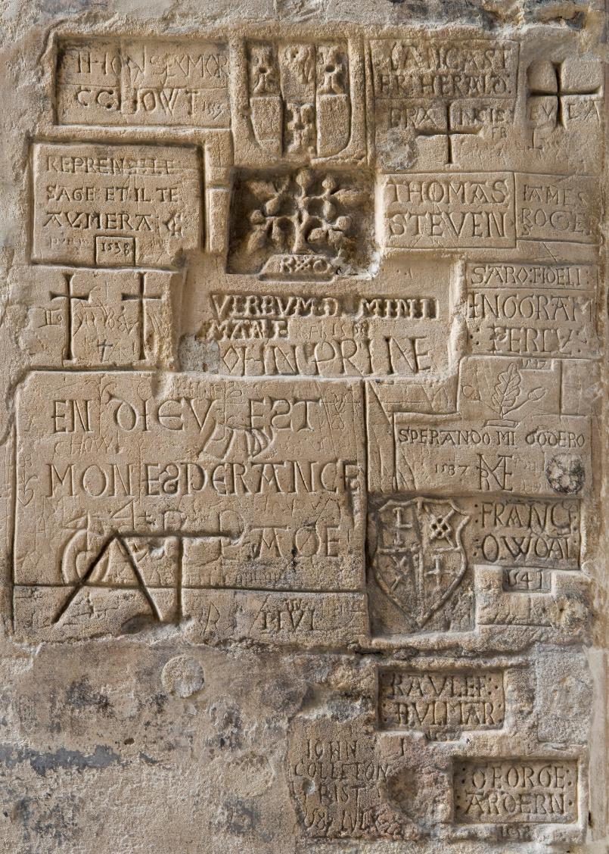
Assortment of carvings
© Historic Royal Palaces
Notes:
Assorted carvings
Many of these carvings near the window include people's names, coats of arms and religious symbols.

Slide 8
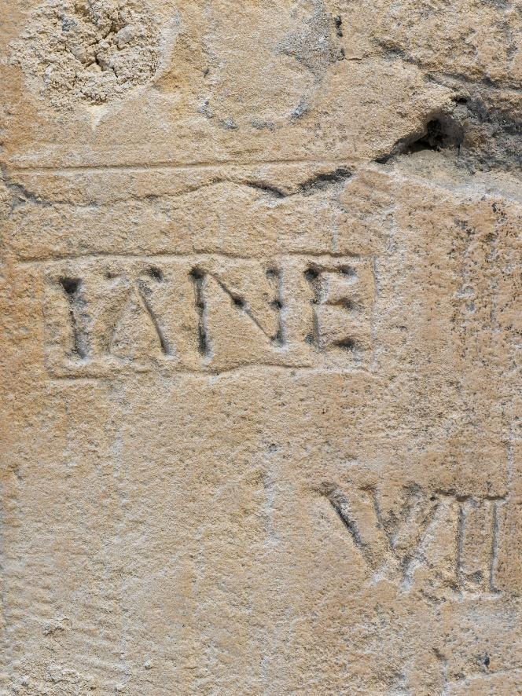
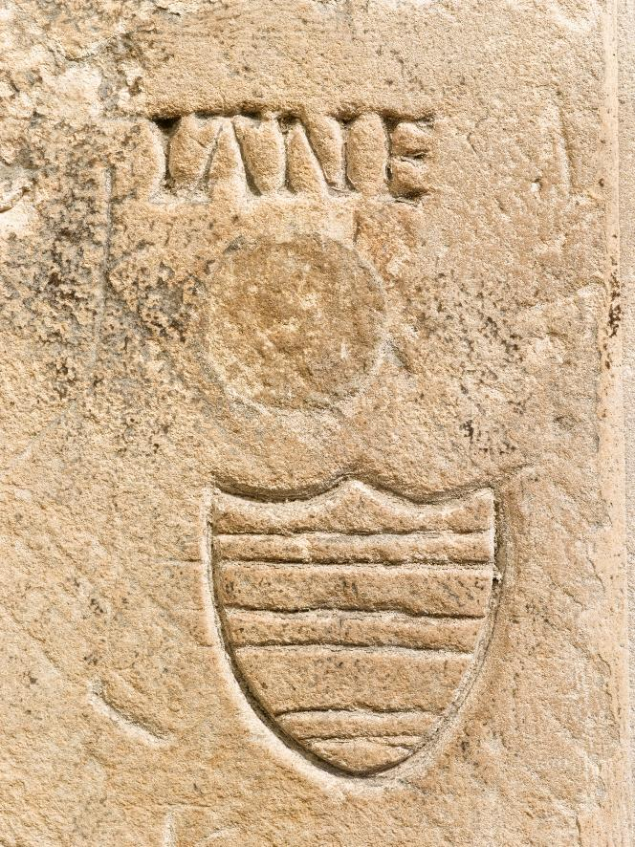
Jane carvings
© Historic Royal Palaces
Notes:
Jane carvings
This carving is anonymous. Some people think that the person who carved it wanted to remember Lady Jane Grey who was executed on Tower Green, the area of grass that can be seen from this window. There are several carvings dedicated to 'Jane' nearby.

Slide 9
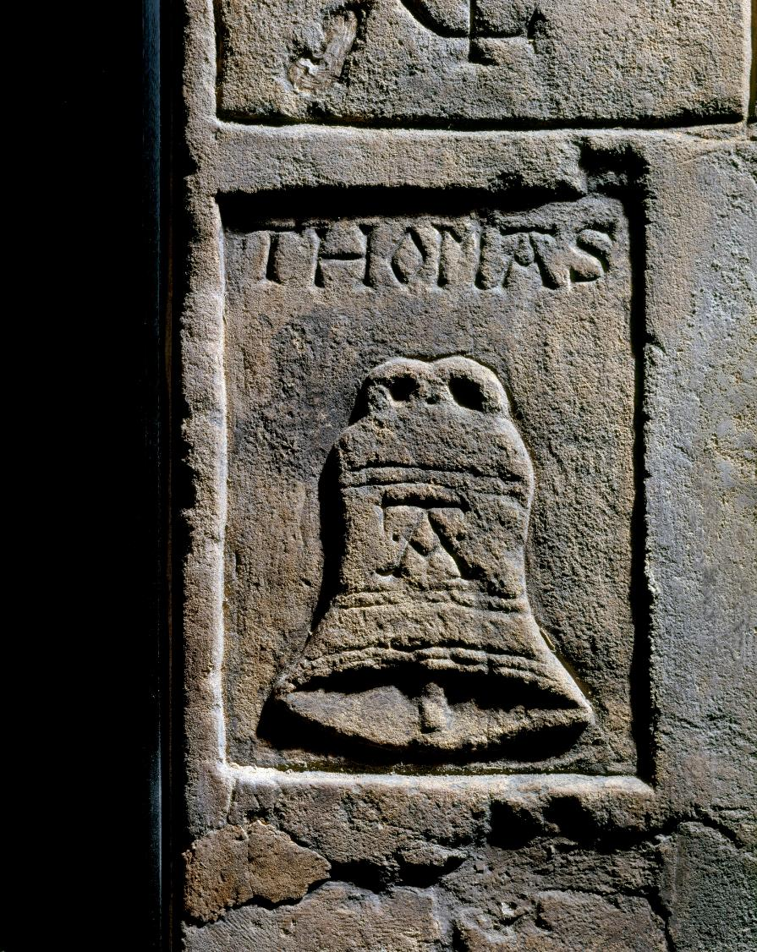
Thomas Abel carving
© Historic Royal Palaces
Notes:
Thomas Abel carving
Thomas Abel was imprisoned by Henry VIII after Henry divorced his first wife, Katherine of Aragon. Thomas Abel was Katherine's priest and remained loyal to her, after the divorce. He was eventually executed for treason. His name, Thomas, is carved above a picture of a bell with the letter A in the centre – literally 'A bell', to represent his surname Abel.

Slide 10
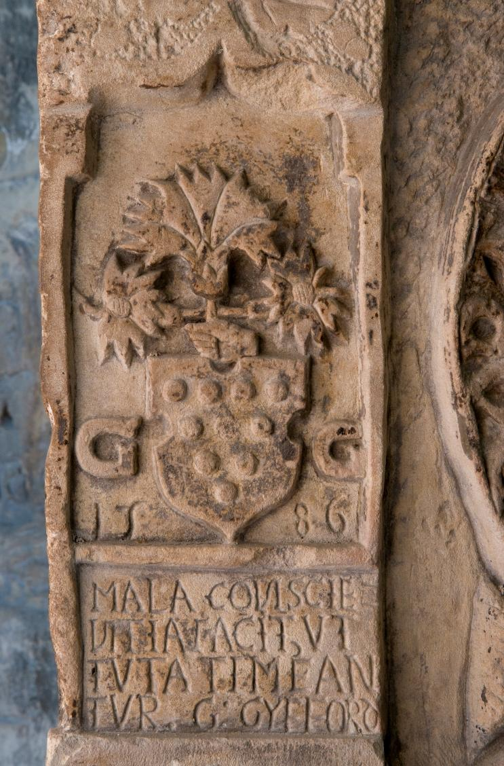
Flower carving
© Historic Royal Palaces
Notes:
Flower carving
This carving shows plants and the date 1586.

Slide 11
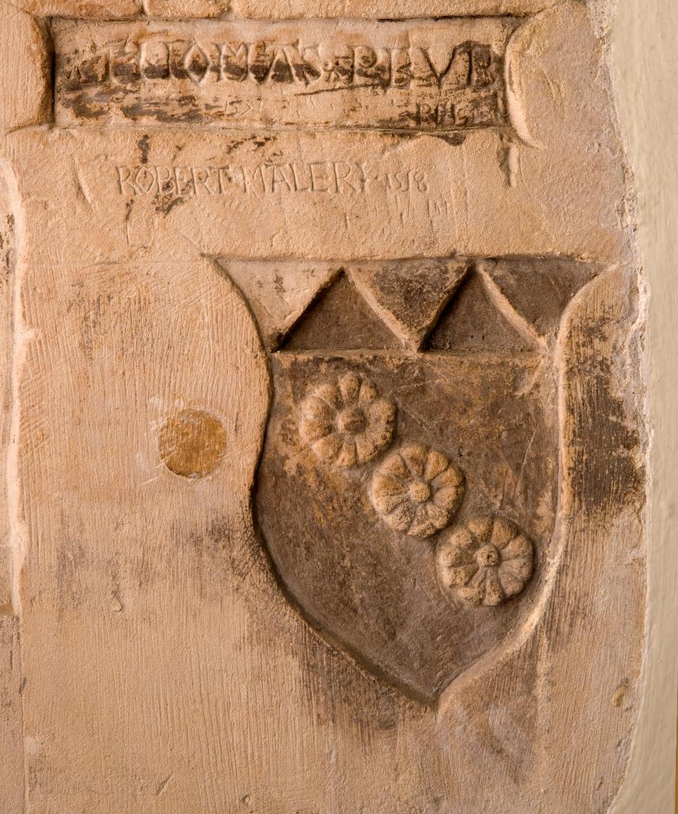
Coat of arms carving
© Historic Royal Palaces
Notes:
Coat of arms carving
This carving shows a shield with three flowers and some writing nearby.

Slide 12
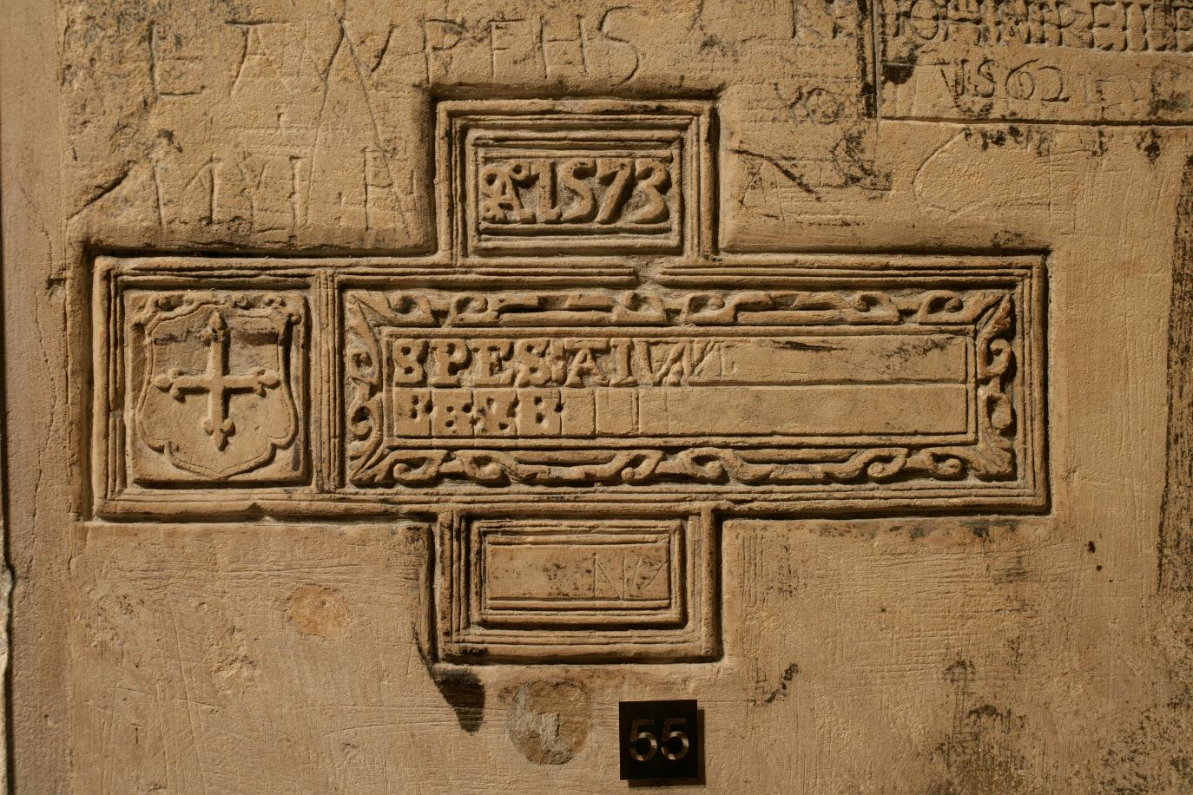
Unfinished carvings
© Historic Royal Palaces
Notes:
Unfinished carving
This carving appears to be unfinished. You can see how some of the middle parts has been divided into small sections. It gives an idea how the individual letters might have been carved.

Slide 13
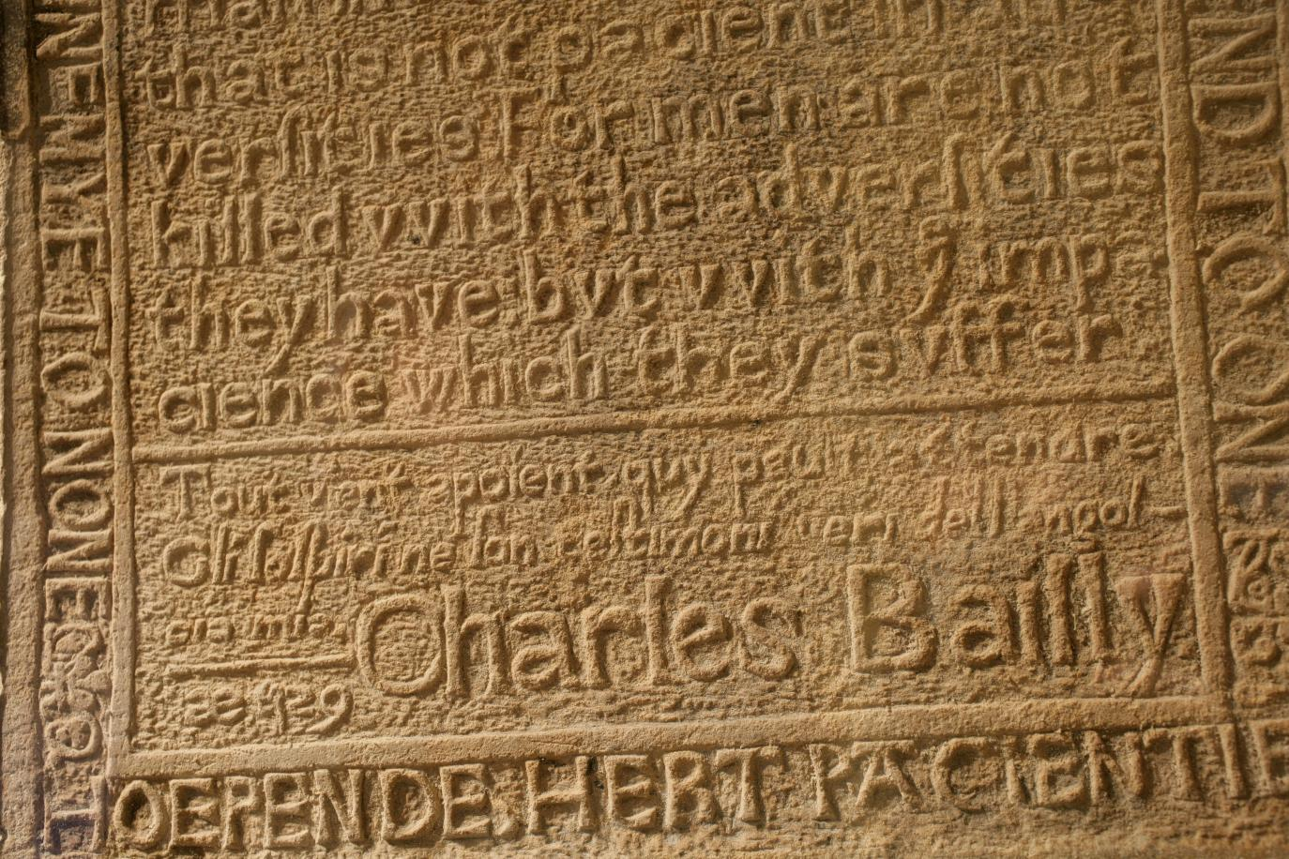
Bailly carvings
© Historic Royal Palaces
Notes:
Bailly carving
"The most unhappy man in the world is he that is not pacient in adversities; for men are not killed with the adversities they have, but with ye impacience which they suffer.“ Charles Bailly was imprisoned in 1571, after he was involved in a plot against Elizabeth I.

Slide 14
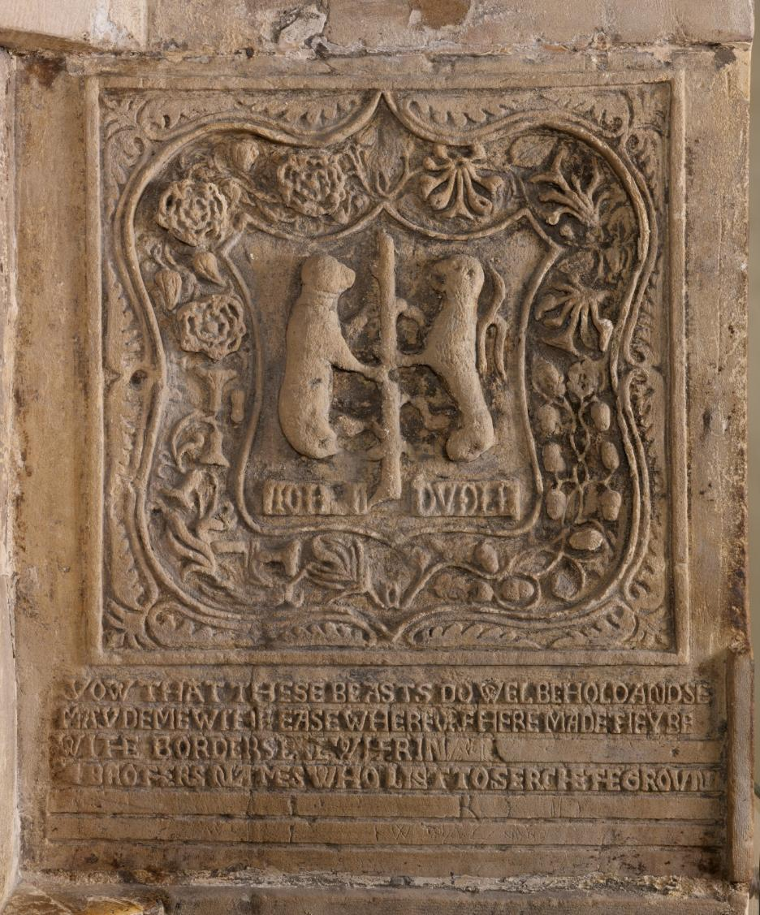
Dudley carving
© Historic Royal Palaces
Notes:
Dudley carving
This elaborate carving is linked to Lord Guildford Dudley and his brothers, who were imprisoned in this room. It is thought the different flowers in the carving represent the different brothers: roses for Ambrose; honeysuckles for Henry; oak leaves for Robert and carnations (known as gillyflowers) for Guildford. We don’t know if one of the Dudley brothers carved this or whether they may have paid an expert to do it, but it was carved by someone who was a good artist.

Slide 15
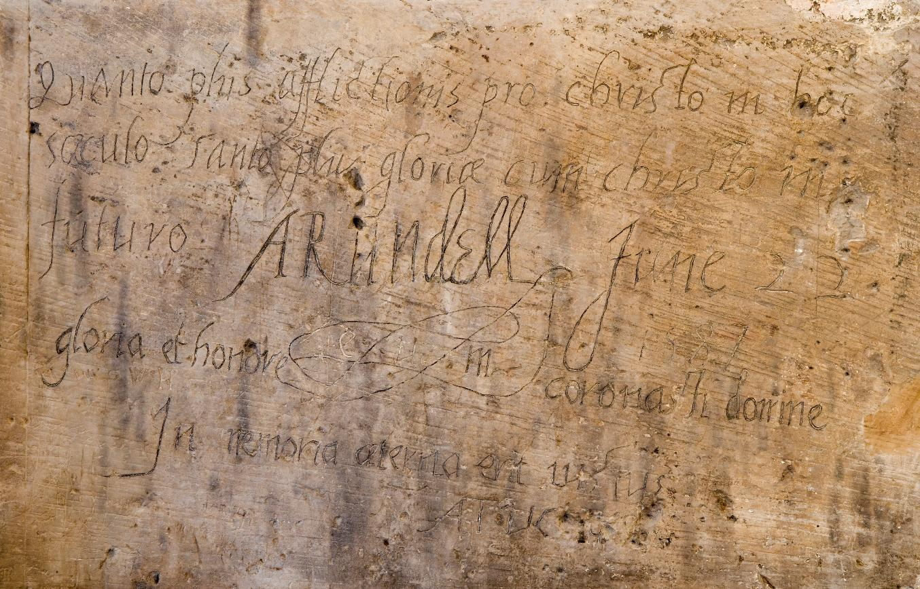

Arundel carving
© Historic Royal Palaces
Listen to a reading of this carving, in Latin and translated into English.
Notes:
Arundel carving
Elizabeth I imprisoned Philip Howard, Earl of Arundel, in the Beauchamp Tower for 10 years. He refused to give up his Catholic faith and was seen as a threat. He died in the Beauchamp Tower in 1595. Listen to the audio of the inscription, first in Latin, then translated into English.
Translation:
The more affliction we endure for Christ in this world, the more glory we shall obtain with Christ in the next.

Slide 16
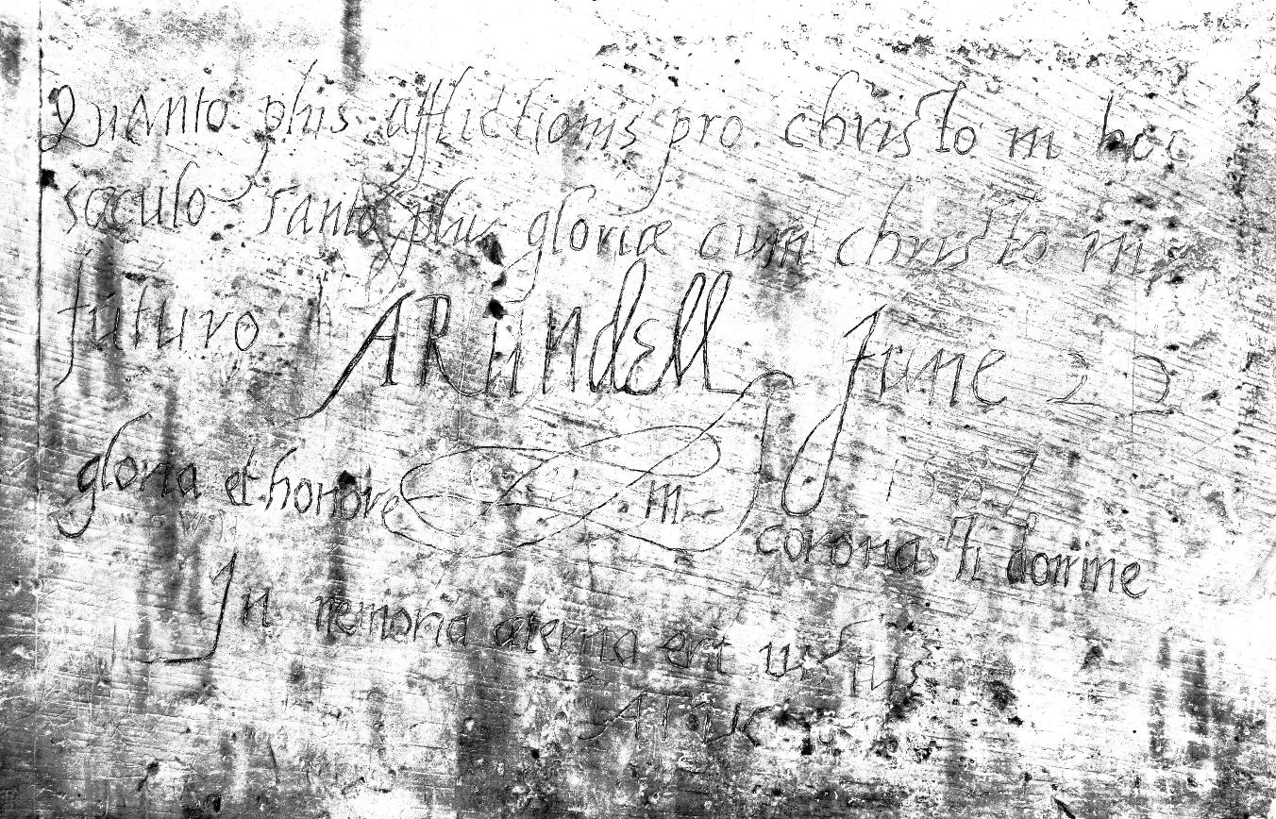
Arundel carving (black & white)
© Historic Royal Palaces
Notes:
Arundel carving
This is a black and white version of the Arundel carving which might be easier for some students to read the text.

