Slide 1




HOW TO USE - NOTES FOR TEACHERS
These resources from Historic Royal Palaces are multi-purpose.
They are ready for you to tweak and use in your lessons.
For the best experience, download and open the
file in the PowerPoint
desktop app.
Answers are found
under the slide. Click
on the notes symbol at
the bottom of the screen.
Delete text and images to make your own worksheets.
Disclaimer and Use Terms
We are the owner or the licensee of all intellectual property rights in these resources which are protected by copyright laws and treaties around the world. All such rights are reserved. These resources, and the content included within them, may be used by you for educational purposes only. This means that you may download the resources and use or share them solely in educational environments (including for home school lessons) or as part of homework. You may not share the resources other than for the above purposes and you must not use the resources, or any part of them, for any commercial purpose.

Slide 2

WHEN ARE WE?
Empire & Sea Power
1714 – 1837
War & Revolution
1603 – 1714
WWI
1914 – 1918
Maya Civilisation 2000 BCE – 1500 CE
WWII
1939 – 1945
Mughal India 1526 – 1707
Benin 900 – 1300
Cold War
1945 – 1989
Qing Dynasty 1644 – 1912
French Revolution
1789 – 1799
1100 CE
1300 CE
1500 CE
1700 CE
1900 CE
2100 CE
The Silk Roads 130 BCE – 1453 CE
Medieval c.5th century – 1450
Renaissance 1450 – 1750
Industrial Revolution 1750 – 1900
Modern
Normans
Middle Ages 1154 – 1485
Tudors
Stuarts
Georgians
Victorians
House of Windsor
Edwardians

Slide 3


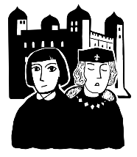
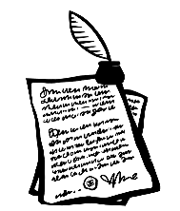
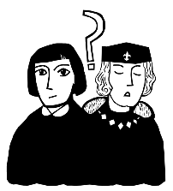



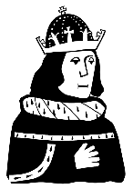

RICHARD III AND THE TWO PRINCES TIMELINE
9 April 1483
June 1483
June 1483
Mid-July 1483
Edward IV dies
Young Richard taken to the Tower of London
Boys declared illegitimate
Last reported sighting of the Princes in the Tower
May 1483
6 July 1483
1674
Reports of Edward V at the Tower
Richard of Gloucester crowned King Richard III
White Tower
bodies of two children discovered

Slide 4
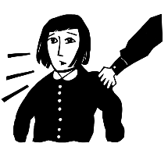
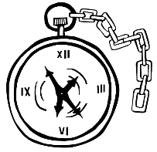
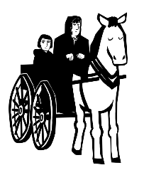

RICHARD III AND THE TWO PRINCES TIMELINES 2
RICHARD III AND THE TWO PRINCES TIMELINE
9 April 1483
29 April 1483
May 1483
June 1483
June 1483
Mid-July 1483
Edward IV dies
Richard of Gloucester intercepts Antony Woodville takes Edward
Edward V’s coronation delayed
Young Richard taken to the Tower of London
Boys declared illegitimate
Last reported sighting of the Princes in the Tower
19 April 1483
May 1483
6 July 1483
August 1485
1674
Antony Woodville and Edward V head
to London
Reports of Edward V at the Tower
Richard of Gloucester crowned King Richard III
Richard III killed at the Battle of Bosworth
White Tower
bodies of two children discovered

Slide 5

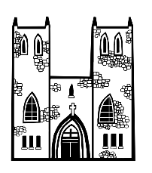

RICHARD III AND THE TWO PRINCES TIMELINES 3
RICHARD III AND THE TWO PRINCES TIMELINE
9 April 1483
29 April 1483
May 1483
June 1483
June 1483
Mid-July 1483
1491
Edward IV dies
Richard of Gloucester intercepts Antony Woodville takes Edward
Edward V’s coronation delayed
Young Richard taken to the Tower of London
Boys declared illegitimate
Last reported sighting of the Princes in the Tower
Perkin Warbeck claims to be young Richard of Shrewsbury
19 April 1483
April 1483
May 1483
June 1483
6 July 1483
August 1485
1674
Antony Woodville and Edward V head
to London
Westminster Abbey Elizabeth Woodville takes sanctuary
Reports of Edward V at the Tower
William Hastings executed at the Tower of London
Richard of Gloucester crowned King Richard III
Richard III killed at the Battle of Bosworth
White Tower
bodies of two children discovered

Slide 6

CLASSROOM TASKS
Q1
Who took sanctuary in Westminster Abbey?
Q2
Which event came first: the princes declared as illegitimate, or the execution of William Hastings?
Q3
When was the last reported sighting of the two princes?
Q4
Where were the bodies of the two children discovered in 1674?
Notes:
Classroom task answers
Elizabeth Woodville (plus her daughters and younger son, Richard of Shrewsbury, Duke of York) took sanctuary in Westminster Abbey.
William Hastings was executed before the boys were declared illegitimate.
The last reports of the princes alive was in mid-July, 1483.
The bodies were discovered in the White Tower at the Tower of London.

Slide 7


VOCABULARY LIST
illegitimate | child whose parents were not legally married to each other when they were born
intercepts | stop or catch someone before they are able to reach a particular place
sanctuary | place of safety; in the past, Christian churches were places of safety and people could not be arrested or harmed in them

