Slide 1




HOW TO USE - NOTES FOR TEACHERS
These resources from Historic Royal Palaces are multi-purpose.
They are ready for you to tweak and use in your lessons.
For the best experience, download and open the
file in the PowerPoint
desktop app.
Answers are found
under the slide. Click
on the notes symbol at
the bottom of the screen.
Delete text and images to make your own worksheets.
Disclaimer and Use Terms
We are the owner or the licensee of all intellectual property rights in these resources which are protected by copyright laws and treaties around the world. All such rights are reserved. These resources, and the content included within them, may be used by you for educational purposes only. This means that you may download the resources and use or share them solely in educational environments (including for home school lessons) or as part of homework. You may not share the resources other than for the above purposes and you must not use the resources, or any part of them, for any commercial purpose.

Slide 2

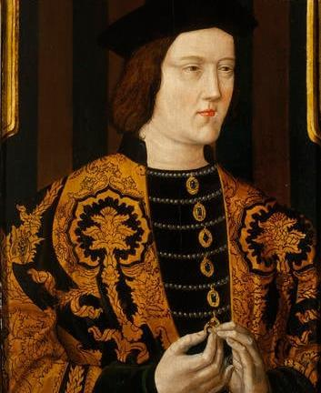
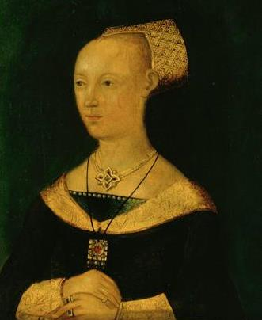

Edward IV and Elizabeth Woodville
EDWARD IV
ELIZABETH
WOODVILLE
The Yorkist King who won the crown twice in battle
The widow of a Lancastrian knight who became a Yorkist Queen
Edward IV was the eldest son of Richard, Duke of York, and Cecily Neville. He grew up fighting on the Yorkist side in the Wars of the Roses. His father was killed in 1460 at the Battle of Wakefield.
He became king after defeating the Lancastrian armies at the Battle of Towton in 1461.
He was deposed in 1470 but became king again a year later.
Edward secretly married Elizabeth Woodville in 1464, but their marriage was later
declared invalid.
He died in 1483, leaving two young sons who became known as the ‘Princes in the Tower’ after they mysteriously disappeared.
Elizabeth was born to a family of low-ranking nobles who were supporters of the Lancastrians.
She married Sir John Grey, a Lancastrian knight, and they had two children. However, he was killed in battle in 1461, fighting for the Lancastrian army.
Elizabeth later married the Yorkist Edward IV in secret, and this caused a public scandal. She was crowned Queen Consort in 1465 and used her position to increase the status and wealth of her family.
After Edward’s death, her sons were taken to the Tower of London. Elizabeth took sanctuary in Westminster Abbey with her other children. Her two sons mysteriously disappeared.
Years later, Elizabeth helped to arrange the marriage of her daughter Elizabeth of York to Henry Tudor, which ended the Wars of the Roses and started the Tudor dynasty.
Royal Collection Trust
© His Majesty King Charles III 2024
Royal Collection Trust
© His Majesty King Charles III 2024
Lived: 1442 - 1483
Lived: c.1437 - 1492
Birthplace: Rouen, France
Birthplace: Northamptonshire
Reigned: 1461-1470 & 1471-1483
Reigned: 1465-1470 & 1471-1483
Q:
Why do you think Elizabeth’s marriage to Edward caused a scandal when it became public?
What evidence is there to explain why Elizabeth was not a popular queen?
Edward was the tallest king of England, at 1.93 metres tall.
Q:
What impression do you have
of Edward from his portrait
and this biography?
Notes:
Edward IV notes: In his portrait, Edward IV appears to be a tall and imposing man, and a successful soldier. This might be based on the fact he won the throne in battle twice during a very turbulent period in English history.
Elizabeth Woodville notes: The marriage between Edward IV and Elizabeth might have caused a scandal because she came from a family of low-ranking nobles. The King was expected to marry someone from high-ranking nobility, or a foreign princess. In addition, her family and first husband were Lancastrian supporters and Edward was part of the York family.
Elizabeth might have been unpopular because she was not considered of high enough status to be Queen. She also used her position to advance her family. (This included the two sons from her previous marriage, and her brothers and sisters.)

Slide 3
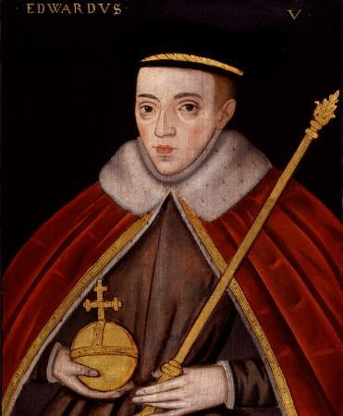
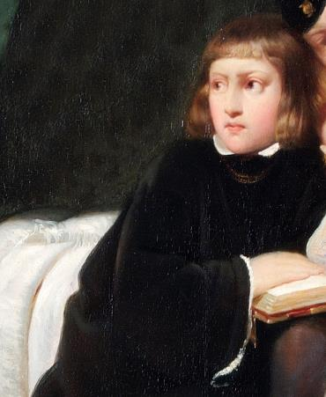


Edward V and Richard of Shrewsbury
EDWARD V
RICHARD OF
SHREWSBURY
The older of the two boys known as the Princes in the Tower
The younger of the two boys known as the Princes in the Tower
Edward V was the elder son of Edward IV and Elizabeth Woodville. He became
Prince of Wales in 1471 and grew up with his uncle Antony Woodville, Earl Rivers,
at Ludlow Castle.
Edward became king when he was 12, when his father died. His other uncle, Richard of Gloucester, was named Lord Protector. Edward and his younger brother, also called Richard, were taken to the Royal Apartments at the Tower of London, to prepare for Edward’s coronation.
However, not long before his coronation, his parents’ marriage was declared invalid. This meant he and his brother were illegitimate and he could not become king. Days later, Richard of Gloucester became King.
Edward and Richard were last seen in autumn 1483, playing in the gardens at the Tower of London. They both disappeared soon after.
The last reported sightings of the boys were in 1483 at the Tower of London, playing with their bows and arrows.
© National Portrait Gallery, London
© Historic Royal Palaces
Lived: 1470 - ?
Lived: 1473 - ?
Birthplace: London
Birthplace: Shropshire
Reigned: 1483
Richard was the younger son of Edward IV and Elizabeth Woodville. He became Duke of York in 1474 and grew up with his mother and sisters. He became the next in line to the throne at 9 years old, when his brother Edward V became king. Their uncle, also called Richard, took young Edward to the Tower of London.
The princes’ mother took young Richard with her into sanctuary at Westminster Abbey, but she was forced to give him up. He joined Edward at the Tower of London. They both disappeared soon after.
In 1674 skeletons of two children
were found at the Tower of London.
Many people believe these are the remains of the princes.
Q:
Why do you think Richard’s mother took him into sanctuary with her?
The painting is called ‘The Princes in the Tower’. How has the artist created a sense that something evil is about to happen?
Q:
Why do you think the story of the two princes still fascinates people today?
Notes:
Edward V notes: There are many reasons the story of the two princes still fascinates people today. Some people will be particularly interested since what happened to the princes is still a mystery, unlikely ever to be solved.
Richard of Shrewsbury notes:
Elizabeth may have feared that a power struggle would break out following the death of the King. She was an unpopular queen, so she was in a vulnerable position. Her elder son was out of her control but, by having control of the heir, she put herself in a stronger position.
The artist of the painting creates a sense that something evil is about to happen by setting the scene on a stone staircase, in darkness and shadows. The boys are dressed in black and have terrified expressions on their faces. There is a shadow looming above them on the staircase, perhaps that of their murderer.

Slide 4
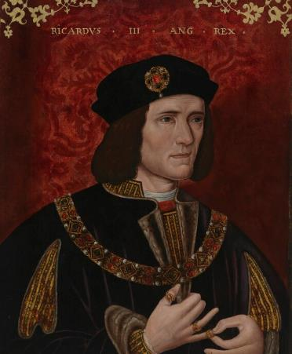
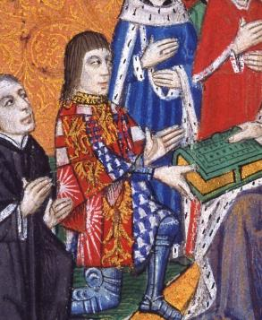
Richard III and Antony Woodville
RICHARD III
ANTONY
WOODVILLE
The last English king to die on
the battlefield
Knight courtier and uncle to the Princes in the Tower
Richard III was the youngest son of Richard, Duke of York, and Cecily Neville. His brother Edward IV became king in 1461 and Richard became the Duke of Gloucester.
Experienced military commander
by age 17.
Later put in charge of northern England.
When his brother Edward IV died, he became Lord Protector and ruled
on behalf of his 12-year-old nephew Edward V.
Placed his nephews, the two princes (the uncrowned Edward V and his 10-year-old brother Richard) in the Tower of London.
The boys were declared illegitimate and disappeared soon after.
A few weeks after the disappearance of the princes, in July 1483, Richard was crowned King Richard III. Two years later, he was killed at the Battle of Bosworth.
Q:
Why do you think the
Woodville family wanted to
hold Edward V’s coronation
as soon as possible?
Can you suggest why Richard
of Gloucester (later Richard III) saw Antony as a threat?
Q:
© National Portrait Gallery, London
Courtesy of Lambeth Palace Library
Lived: 1452 - 1485
Lived: c.1440 - 1483
Birthplace: Northamptonshire
Birthplace: Northamptonshire
Reigned: 1483 - 1485
Anthony was Elizabeth Woodville’s brother. He originally fought on the Lancastrian side in the Wars of the Roses but later became loyal to the Yorkist side. When Elizabeth
married Edward IV, Anthony became a powerful courtier.
Elizabeth and Edward IV had two sons, and the eldest, Prince Edward, was cared for by Antony at Ludlow Castle.
After King Edward IV’s death, Anthony set off for London with his nephew.
The plan was to crown young Edward quickly. However, they were intercepted by Richard, Duke of Gloucester and Richard took Edward to the Tower of London.
Anthony was suspected of planning
to become Lord Protector and
he was arrested.
He was beheaded at Pontefract Castle in 1483.
Richard III’s skeleton was discovered in a car park in 2012. It was revealed that he had scoliosis.
This was probably painful but hardly visible when he was clothed.
Q:
What impression do you get of Richard from his portrait?
Richard is often viewed as the prime suspect in the princes’ disappearance. What might he have had to gain from their deaths?
Notes:
Richard III notes:
In his portrait, Richard’s mouth is set in a hard line and turns down at the corners. His eyes are a hard steely, grey. These give the impression that he is mean and cunning. His right shoulder also appears higher than his left. In the past, this type of physical difference was sometimes associated with inner wickedness. (Research suggests that this portrait was altered after it was made to make Richard appear more wicked and unkind).
Richard may have benefited from the prince's death since, even though the boys had been declared illegitimate, they were still likely to be a focus for future plots against Richard.
Antony Woodville notes:
A coronation is the religious ceremony that gives a monarch ‘earthly and spiritual power’. Elizabeth and Anthony Woodville wanted the coronation to happen as soon as possible to secure young Edward’s position as king.
Richard was wary that Anthony wanted to become Lord Protector himself. Young Edward had been brought up by Anthony and was likely to support him. This would leave Richard with less power.

Slide 5
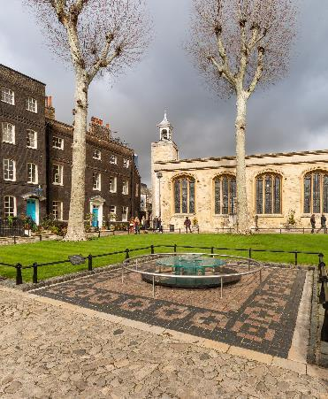
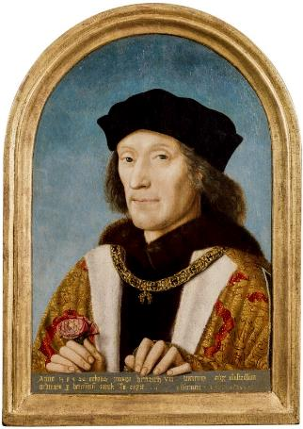

William Hastings and Henry VII
WILLIAM
HENRY VII
HASTINGS
Founder of the Tudor dynasty
Close friend and advisor to Edward IV
Henry became king after the Battle of Bosworth in 1485, in which Richard III was defeated.
He was part of the House of Lancaster but did not have a strong claim to the throne. He made his claim stronger by marrying Elizabeth, the eldest daughter of the Yorkist King Edward IV. Together, they united the two royal houses of Lancaster and York.
Strengthened the power of the monarchy.
Reduced the power of nobles.
Increased taxes.
During his reign, Henry VII Defeated two rebellions that were led by people stating they had a stronger claim to the throne than he did.
He left behind a stable country, a secure throne and a full treasury when he died.
William supported the Yorkists. He was knighted on the battlefield in 1461.
Became Baron Hastings.
Gained land and great wealth.
Loyal to Edward IV even when Edward was briefly deposed in 1470.
Greatly trusted and immensely powerful.
When Edward died, he supported Richard, Duke of Gloucester, in becoming Lord Protector for the young Edward V.
After the death of Edward IV in 1483, William Hastings attended what he thought was a normal meeting at the Tower of London. However, he was accused of plotting with the Woodville family to kill Richard. He was dragged onto Tower Green and beheaded without trial.
© Historic Royal Palaces
© National Portrait Gallery, London
Lived: c.1431 - 1483
Lived: 1457 - 1509
Birthplace: Leicestershire
Birthplace: Wales
The image shows Tower Green today, with a memorial for those that lost their lives nearby.
Reigned: 1485 - 1509
The new Tudor emblem combined the red rose of Lancaster with the white rose of York. It became
known as the Tudor Rose.
Hastings was reported to be very well-liked at court, even by his rivals.
Q:
The charges against Hastings were probably false. Why do you think he was executed?
Q:
How did Henry secure the future of the Tudor dynasty?
Do you think Henry was a popular king?
Notes:
William Hasting notes:
William may have been executed because he was a trusted friend of Edward IV. Now Edward IV was dead, Richard wanted to rule himself. But William was likely to support Edward IV’s son and not Richard. William may have protected young Edward and believed he was the rightful king. Even though William supported Richard becoming Lord Protector, Richard possibly knew William would remain loyal to the young Edward if Richard tried to become King.
Henry VII notes:
Henry married Elizabeth of York which added weight to the Tudor claim to the throne. He also planned marriages for his children to form alliances with other countries. He put down uprisings and reduced the power of the nobles.
Some people might think that Henry was popular because he restored peace and stability after the Wars of the Roses. Others might say he was unpopular because he increased taxes.

Slide 6
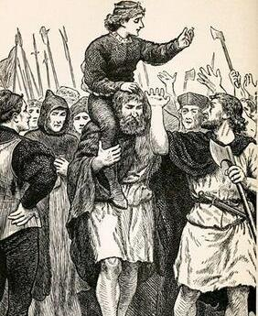
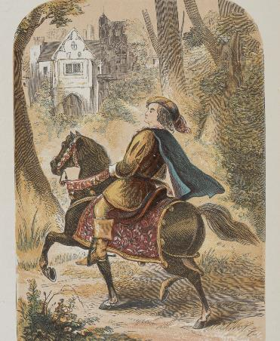

Lambert Simnel and Perkin Warbeck
LAMBERT
PERKIN
SIMNEL
WARBECK
The boy who claimed to be
King of England
The man who claimed to be one of the Princes in the Tower
Not much is known about Lambert’s early life and even his real name is not known.
In 1487, some adult rebels claimed he was Edward Plantagenet, son of George,
Duke of Clarence.
He became a figurehead for Yorkist rebellions against Henry VII. Some people thought he should be king. He was crowned King Edward VI at Dublin Cathedral.
In response, Henry VII had the real Edward Plantagenet taken from Tower of London and paraded through streets. The Yorkist rebellion still grew but the royal army defeated them at battle. The rebel leaders were executed.
Lambert was pardoned and sent to work in the royal kitchens.
Q:
Why do you think Perkin Warbeck was a greater threat to Henry VII than Lambert Simnel had been?
What does this tell you about how the two princes’ disappearance impacted
the throne?
GL Archive / Alamy Stock Photo
Courtesy of the British Library 9504.ff.7
Lived: c.1476 - 1534
Lived: c.1474 - 1499
Birthplace: Oxford
Birthplace: Tournai, France
Perkin appeared at court in Burgundy in 1491. He claimed to be Richard of Shrewsbury, the younger of the two princes who went missing in 1483.
He said he had escaped and had been in hiding in Europe. He managed to convince several rulers, including the two princes’ aunt, the Duchess of Burgundy, that he was indeed Richard.
Together, they attempted to invade England in 1497 but he was captured and imprisoned in the Tower of London. Perkin confessed he was not
Richard after all.
He was released but kept under close watch at court. He tried to escape and was returned to the Tower of London. He was executed in 1499.
After he was crowned, he was paraded through the streets of Dublin.
Whilst claiming to be Richard,
Perkin said the older prince (his ‘brother’) had been murdered but he had been spared because of his young age and innocence.
Q:
Why do you think Henry VII pardoned Lambert Simnel?
Notes:
Lambert Simnel notes:
There may have been a few reasons Lambert Simnel was pardoned.
Lambert was only a boy of about 10 years old. Henry probably knew he had been used by the adult leaders of the rebellion.
Lambert was no real threat. His claim was easy to disprove as the real Edward Plantagenet was still alive and under Henry’s control in the Tower.
Perkin Warbeck notes:
Perkin was a greater threat than Lambert Simnel because Henry could not disprove his claim by producing the real Richard, or his body.
Perkin’s story tells us that since the bodies of the princes had not been seen or found, rumours continued to circulate that they were still alive. This was a threat to Henry’s throne as there was always a chance that an imposter could be a focus for a rebellion.

Slide 7
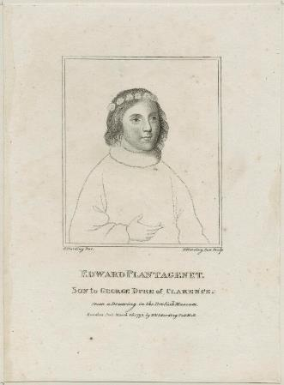

Edward Plantagenet
EDWARD
_____________
PLANTAGENET
_____________
The last male member of the Plantagenet royal family
Q:
How old was Edward when
he was imprisoned in the
Tower of London?
Why do you think Henry VII imprisoned then executed him?
© National Portrait Gallery, London
CC BY NC ND 3.0
Image credit:
Lived: 1475 - 1499
Lived: _______
Birthplace: Warwick
Birthplace: _______
Edward was the son of George,
Duke of Clarence, and a member of the House of York.
He was the nephew of Edward IV and Richard III.
In 1476 his mother Isabel
Neville died.
In 1478 his father was executed at
the Tower of London.
In 1478 Edward became the
Earl of Warwick.
Edward grew up in the household
of Thomas Grey. Thomas was Elizabeth Woodville’s son, from
her first marriage.
In 1485, Henry Tudor defeated Richard III and became
King Henry VII.
Not long after this, Edward was imprisoned in the Tower of London by Henry VII.
He tried to escape in 1499 and was executed on Tower Hill.
Q:
Notes:
Edward Plantagenet notes:
Edward was ten years old when he was imprisoned in the Tower of London.
Edward was part of the York family, and Henry VII had become king after killing Richard III in battle. Edward was a potential threat to Henry. This might explain why Henry VII imprisoned and executed him. (Edward’s father was George, Duke of Clarence, brother of Edward IV and Richard III. Although Edward’s father George had been executed for treason – which technically barred Edward from becoming king – he was still a threat to Henry and possible focus for plots against him.)

Slide 8

TEMPLATE BIOGRAPHY
____________
____________
____________
____________
Image credit:
Image credit:
Lived: _______
Lived: _______
Birthplace: _______
Birthplace: _______
Q:
Q:

Slide 9

VOCABULARY LIST
depose | remove someone from power
courtier | nobleman or noblewoman who spends a lot of time at the royal court
dynasty | series of leaders from the same family
emblem | picture of an object used to represent something else, such as membership of a group or an idea
illegitimate | child whose parents were not legally married to each other when they were born
imposter | person who pretends to be someone else
invalid | not legal
intercept | stop or catch someone before they are able to reach a particular place
Lancaster | one side of the Plantagenet royal family who fought in the Wars of the Roses; their emblem was the Red Rose
Lancastrians | supporter of the Lancaster side in the Wars of the Roses
Lord Protector | title used by someone in charge of a country, when the king or queen is unable to rule (if they are unwell or a child, for example)
military | word used in connection with an armed force such as soldiers
nobles | people of high rank in society
pardoned | officially forgiven for an offence or crime
Plantagenet | royal family who ruled England from 1154 to 1485

Slide 10
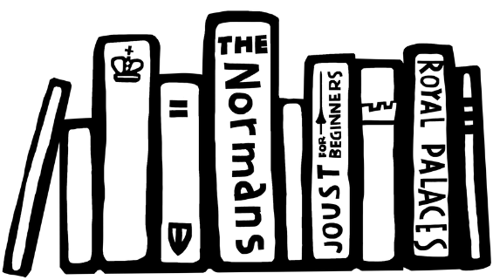

VOCABULARY LIST 2
VOCABULARY LIST
plot/plotting | secretly plan to harm someone, especially a government or ruler
power struggle | a fight for control between two or more people or groups
Queen Consort | wife of a reigning king
rebel | person who joins a rebellion
rebellion | a fight by a large group of people against the government or ruler
Royal Apartments | the king or queen’s private rooms
sanctuary | place of safety; in the past, Christian churches were places of safety and people could not be arrested or harmed in them
scandal | action or event that shocks people
scoliosis | condition where a person’s spine twists and curves to the side
Wars of the Roses | name given to battles fought in England between 1455 and 1485 between two sides of the Plantagenet royal family
wealth | large amount of money, property, land or valuable possessions
York | one side of the Plantagenet royal family who fought in the Wars of the Roses; their emblem was the White Rose
Yorkist | supporters of the York side in the Wars of the Roses

