Slide 1




HOW TO USE - NOTES FOR TEACHERS
These resources from Historic Royal Palaces are multi-purpose.
They are ready for you to tweak and use in your lessons.
For the best experience, download and open the
file in the PowerPoint
desktop app.
Answers are found
under the slide. Click
on the notes symbol at
the bottom of the screen.
Delete text and images to make your own worksheets.
Disclaimer and Use Terms
We are the owner or the licensee of all intellectual property rights in these resources which are protected by copyright laws and treaties around the world. All such rights are reserved. These resources, and the content included within them, may be used by you for educational purposes only. This means that you may download the resources and use or share them solely in educational environments (including for home school lessons) or as part of homework. You may not share the resources other than for the above purposes and you must not use the resources, or any part of them, for any commercial purpose.

Slide 2

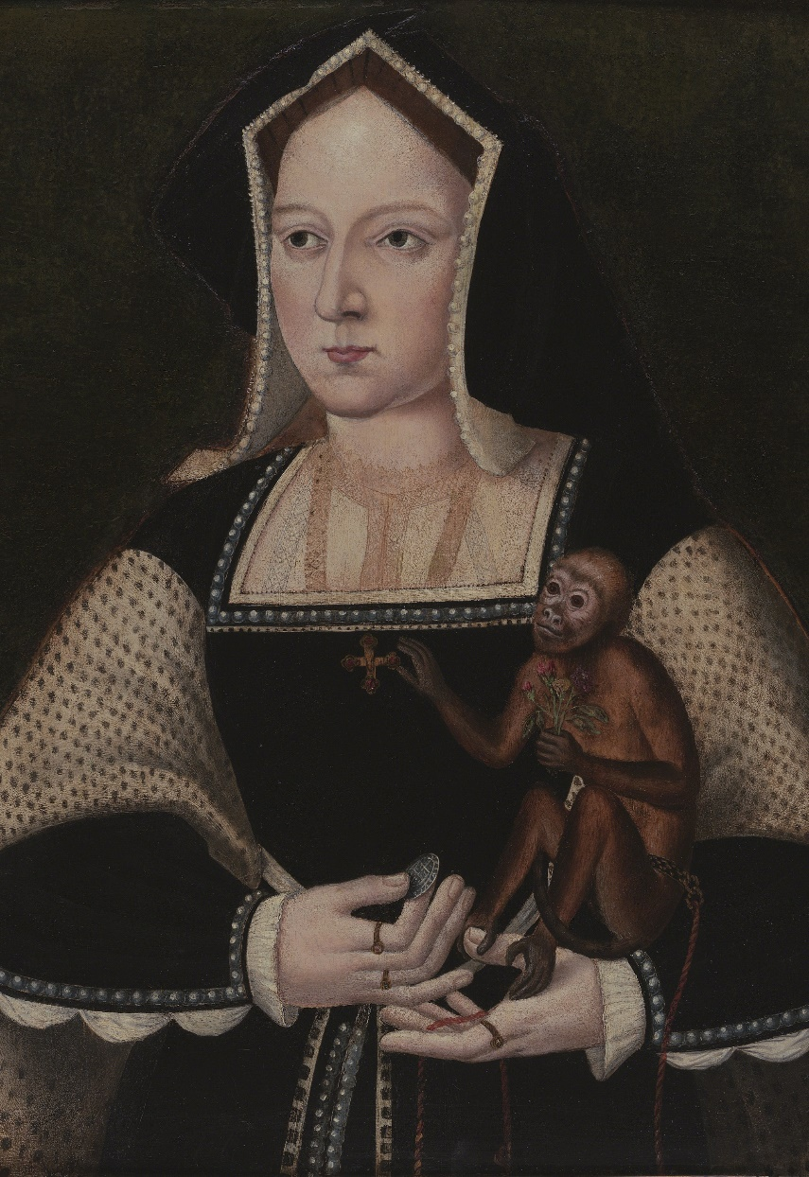

KATHERINE OF ARAGON
A Spanish princess who became a powerful and brave queen
She had one son who sadly only lived for two months, and she suffered other losses of pregnancies too. In 1516, she had a daughter, Mary.
Henry was obsessed with having a son and
wanted to remarry.
He thought that God was punishing him because he had married his brother’s widow.
Henry claimed their marriage was invalid and wanted Katherine to go quietly into a convent. She refused and gave a powerful speech in court to argue that their marriage was valid. The Pope supported her.
Eventually, Henry went against the Pope. He banished Katherine from court, and she was banned from
seeing her daughter. She remained popular
with the public until she died.
Katherine was a Spanish princess, daughter of Isabella of Castile and Ferdinand of Aragon. Her mother was a very strong and powerful Queen regnant.
Katherine came to England in 1501, aged 15 as part of a marriage alliance between England and Spain.
She brought a large entourage with her, including Catalina of Motril who might have been an enslaved Muslim woman.
She married Henry VII’s oldest son, Arthur, but he died a few months later.
In 1509, aged 23 she married Arthur’s younger brother Henry VIII.
The first 10 years of their marriage were happy.
In 1513, Katherine became regent while Henry was fighting in France. The Scottish army took this as an opportunity to invade England. Katherine rode north in full armour to address the English troops.
Alas, Sir, where have I offended you?
I take God and all the world to witness that I have been to you a true, humble and obedient wife.
Part of Katherine’s speech to
defend her marriage in 1529.
Q:
Give one example that shows Katherine was a very capable queen?
Why do you think Katherine refused to ‘go quietly’ to a convent?
At 21, became the first female ambassador in European history.
Q:
Photo © Philip Mould Ltd, London / Bridgeman Images
Reigned: 1509 - 1533
Q:
What influence might Katherine’s mother have had on her?
Lived: 1485 - 1536 | Birthplace: Madrid, Spain
Notes:
Notes:
There are a few examples that show Katherine was a very capable queen. Henry made her regent when he was away fighting. She also became the Spanish ambassador. Also, she got the Pope’s support and stood up for herself when Henry tried to send her away.
Katherine may not have wanted to ‘go quietly’ to a convent for a few reasons. Having been brought up as a Spanish princess, Katherine had a strong sense of her high status and position in the world. She was a devout Catholic so her marriage was sacred, she would have felt it could not be ended except by one partner dying. If she accepted the marriage was invalid, that would make her daughter illegitimate.
Katherine’s mother was a strong, powerful ruler and a queen in her own right. This possibly influenced Katherine to also be strong willed and brave.
Primary source:
Katherine defended her marriage in court and her speech was recorded by George Cavendish. You can view a reproduction of the account:
The Project Gutenberg eBook of The Life of Cardinal Wolsey, by George Cavendish and S.W. Singer.

Slide 3
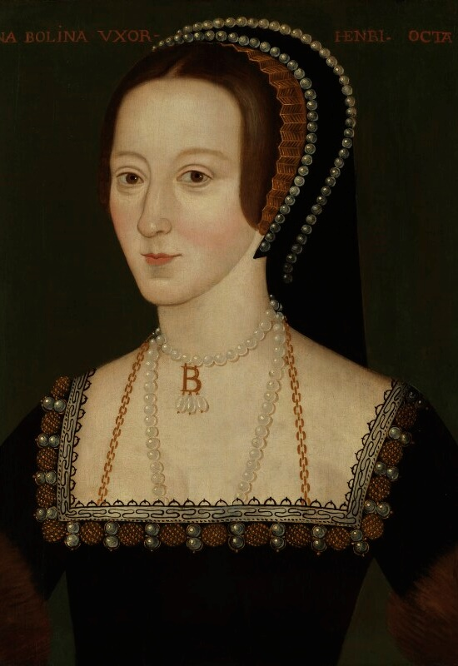
ANNE BOLEYN
Anne gave birth to a daughter, Elizabeth in 1533.
She supported, and maybe even encouraged, Henry’s religious changes.
She stayed in touch with her powerful female friends in Europe.
At the time, it was unusual for women to get involved with politics, but Anne was intelligent and determined to be involved. As a result, she made enemies at court including Thomas Cromwell. She also suffered the loss of pregnancies. Her relationship with Henry began to break down. She was eventually accused of seeing other men and plotting to kill the King.
Even though there was not any evidence, she was found guilty of treason. She was beheaded by a
swordsman in the Tower of London and buried in the Chapel. After she died, Henry tried to remove all traces of Anne, including destroying her portraits, but some still remain.
An intelligent and bold queen who got involved
with politics
Anne was born to a well-connected family. She spent her childhood at Hever Castle. Her father wanted her to have the same education as her brothers. She was sent to royal courts in the Netherlands and France around 1513 where she:
learnt languages, skills and etiquette
heard about new Protestant religious ideas
made friends with powerful European women.
She returned to England by 1522 and became a lady-in-waiting to Henry’s first wife, Katherine.
She was stylish and sophisticated and had a
captivating personality. By 1526, Henry was obsessed with Anne, however she refused him at first.
After Henry broke from the Roman Catholic Church, they got married in 1533. Henry built the Great Hall at
Hampton Court Palace for her and carved the initials H & A into the wood.
This will make me have greater desire to continue speaking French well and also spell.
Sir I beg you to excuse me if my letter is badly written.
Part of a letter Anne
wrote to her father in 1514.
Q:
Give one example that shows Anne was well educated and intelligent.
When Elizabeth I became queen, she had new portraits made of Anne.
© National Portrait Gallery, London
Reigned: 1533 - 1536
Q:
Why do you think Anne was accused of treason and executed, even thought there was not really any evidence against her?
Lived: c.1501 - 1536 | Birthplace: Norfolk
Notes:
Notes:
There are a few examples that show Anne was educated and intelligent: she was more educated than most noble girls as her father wanted her to have the same education as her brothers. She learned languages and skills in European courts. She had an interest in new religious ideas.
Anne was probably accused of treason because she was outspoken and got involved in politics, which women were not expected to do in the Tudor period. This made her powerful enemies, like Thomas Cromwell. Henry also lost interest in her when she gave birth to a daughter instead of a son. None of this was treason.
Primary Source
Anne wrote a letter to her father, in French, in 1514. At this time she was serving in the French court. You can view the original with Stanford University (46 of 430, pg 22):
https://dms-data.stanford.edu/data/manifests/Parker/xs417vg0804/manifest.json

Slide 4
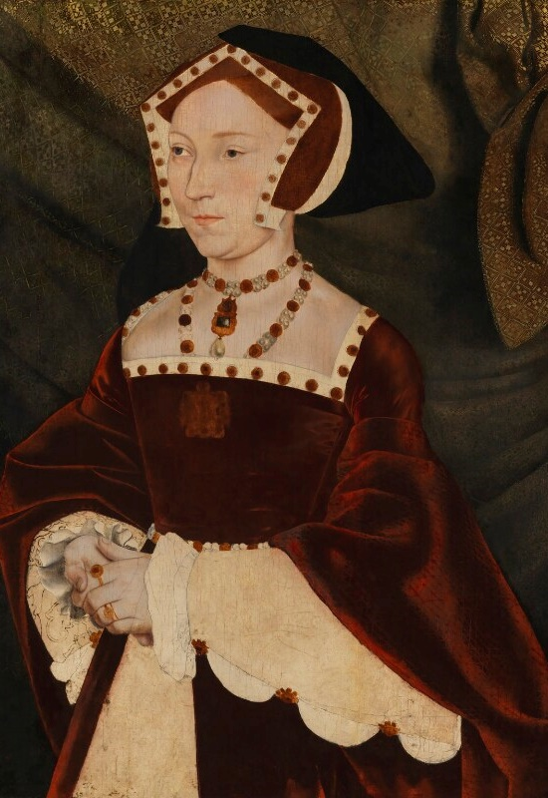
JANE SEYMOUR
A mysterious queen, who supported
Catholic monasteries
In 1536, Henry and Jane got engaged and married. This was very shortly after the execution of Anne Boleyn. As queen, Jane:
stopped fashions that Anne had introduced, such as the French style headdress
formed a close relationship with her
stepdaughter Mary
helped Mary and Henry to repair their relationship.
At one point, she begged Henry not to close the Catholic monasteries. This made Henry very angry, and he told her he did not want his wife to get involved in politics. As a warning, he reminded Jane what had happened to his previous wife.
In 1537 she gave birth to a boy, Edward, at Hampton Court Palace. Edward was Henry’s first a male heir. But it was a difficult birth and Jane became ill. Sadly, she died two weeks later.
Jane was born around 1508 at Wolf Hall. She came from a wealthy family, but they did not have much power at court. She was a devout Catholic and was
taught needlework.
She was sent to court by her family in 1529 and became a lady-in-wating to Katherine of Aragon, who she respected. She later also served Anne Boleyn.
We don’t really know a lot about Jane, details about her life and personality are a mystery today.
There are very few sources written by Jane herself.
We have to rely on what others wrote about her.
Eustace Chapuys, an ambassador, reported that Henry sent her letters and gifts, but that she politely refused these. She may have wanted to wait until Henry was ready to marry her. This might suggest she was firm and confident.
Q:
Jane is often thought of as ‘meek and mild’. Is this fair? Why/why not?
Her labour lasted three days and three nights.
Q:
Give one example that shows Jane was a capable queen?
Her motto was
‘Bound to obey and serve’.
© National Portrait Gallery, London
Reigned: 1536 - 1537
Lived: c.1508 - 1537 | Birthplace: Wiltshire
Q:
Why don't we know more about Jane?
Notes:
Notes:
Even though Jane is sometimes remembered as meek and mild, this isn’t necessarily true. We know that she refused to accept Henry’s letters and gifts until she was sure he wanted to marry her. She also spoke up about closing the monasteries, even though she was not able to change Henry’s mind. She was willing to stand up for what she believed in. We don’t have enough evidence to know more about Jane’s personality to know if she really was meek and mild.
Some examples that show Jane was a capable queen include the fact that she made a distinction between herself and Anne Boleyn regarding what she wore. Anne had introduced a French style head dress but Jane wore the English style. This was clever because Anne had become very unpopular, and Jane was trying to distance herself from the previous queen. Not only that, but she formed a close relationship with her stepdaughter, Mary and helped repair Mary’s relationship with her father.
There are a few reasons we don’t know more about Jane, but one of the biggest is that there are very few sources that were written or created by Jane so we only know what other people (like Eustace Chapuys) thought about her.

Slide 5
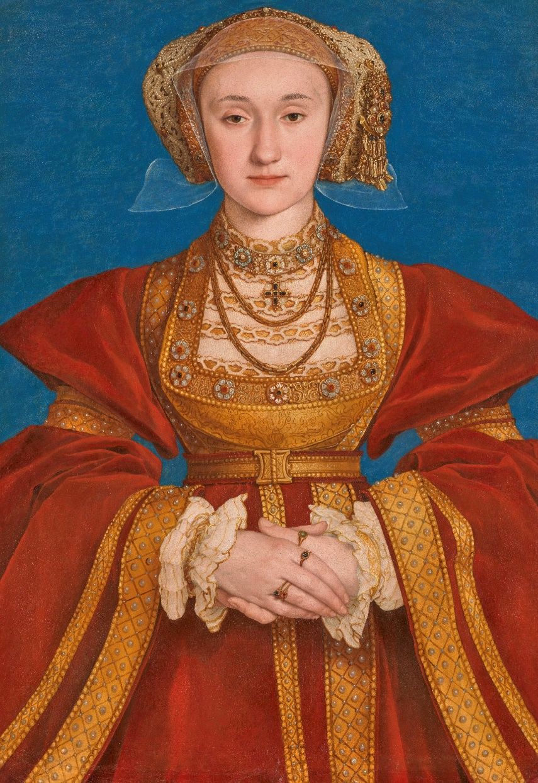
ANNE OF CLEVES
A generous and kind queen who was known for having fun
Henry wanted to get out of the marriage, but he could not do this without risking his alliance. The marriage went ahead in 1540, and their wedding was extravagant. However, they did not have a close relationship and they did not have much in common.
Anne tried to learn English to make the
relationship work
She became friends with Henry’s daughter Elizabeth and they developed a close relationship
She was generous and kind towards her servants.
After six months she agreed to end the marriage. She stayed in England, became a femme sole and was given a generous allowance and properties. She seemed to enjoy her life without the responsibility of being queen. Later, when Edward VI became king, she lost many of her properties. However, after he died, she was part of Mary I’s coronation procession and remained close to her stepdaughters.
Anne was born in Cleves in Germany and her father was a duke. Her mother was a Catholic, but Anne was probably Protestant. She liked card games and gambling. She probably did not learn English.
Henry VIII’s chief minister was Thomas Cromwell. Together, they were planning a new marriage for Henry, but they also wanted to set up an alliance in Europe. A painter was sent to Germany to paint portraits of Anne and her younger sister. Henry saw these images and thought Anne was very beautiful, he decided to marry her.
She arrived in England in 1539 aged 24.
Henry was anxious to meet her.
He greeted her in disguise which was a tradition of a romantic courtly lover.
He attempted to kiss her, but Anne did not recognise him.
Henry was disappointed by her appearance
and behaviour.
Madame la Cleve has a more joyous countenance than ever. She wears a great variety of dresses, and passes all her time in sports and recreations.
The French Ambassador writing about
Anne of Cleves
Q:
What evidence is there that Anne tried hard to be a good queen?
After she separated from Henry, Anne had a strong position at court.
(C) RMN-Grand Palais (musée du Louvre) Adrien Didierjean
Reigned: 1540
Q:
Do you think Anne was sensible in agreeing to their separation? If so, why?
Lived: 1515-1557 Birthplace: Rhineland, Germany
Notes:
Notes:
There is lots of evidence that Anne tried hard to be a good queen. She learnt English to try and make her marriage to Henry work. She became close friends with Mary and Elizabeth. She was also kind and generous towards her servants.
Many people will think Anne was sensible in agreeing to a separation as she avoided being banished from court like Katherine of Aragon was. Instead, she was rewarded with money and properties and seems to have formed a good relationship with Henry and his daughters.
Primary Source
The French Ambassador wrote about Anne of Cleves and described her as enjoying her life after the divorce. You can view a copy of the source:
Henry VIII: August 1540, 11-20 | British History Online 15 Aug., 976. Marillac to Montmorency. Letters and Papers, Foreign and Domestic, Henry VIII, Volume 15, 1540.

Slide 6
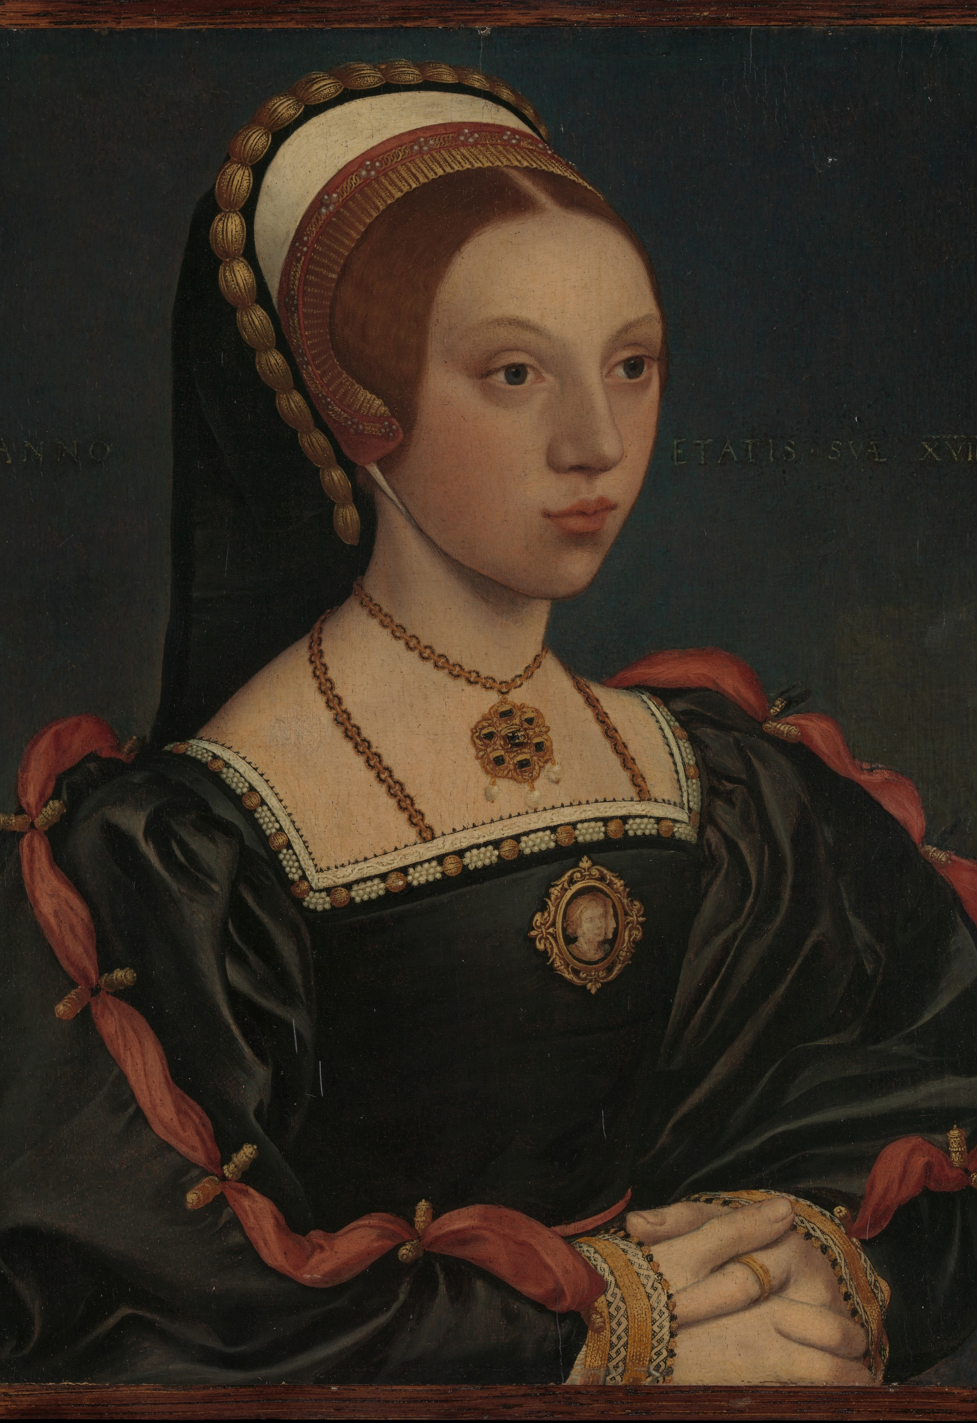
CATHERINE HOWARD
A gracious, young queen who had a sad ending
Some evidence suggests Thomas might have pressured her, so she may not have felt completely free to say no to receiving and writing letters.
Catherine was at Hampton Court Palace when Henry found out about the letters. He ordered an immediate investigation. She was put under house arrest.
Eventually, she confessed that she had had affairs. However, she may have also been pressured to say this.
Henry was angry and she was sentenced to death. In 1542, she was taken by boat to the Tower of London. She was so determined to act properly; she even practised laying her head on the execution block. She was executed three days later. She was buried in the chapel nearby.
Catherine’s father, Edmund Howard was a son of the Duke of Norfolk. Her mother, Joyce, died in 1528 and Catherine was sent to live with her step-grandmother, Agnes Tilney, the dowager Duchess of Norfolk. She had a stable life there and was taught to read, write, dance, play music and good etiquette.
In 1539, her uncle helped to get Catherine a position at court.
She became a lady-in-waiting to Anne of Cleves.
Henry was attracted to Catherine.
They got married in 1540.
Henry was almost 50 years old and Catherine was still a teenager.
There is evidence that the men around her used Catherine and her position as queen to help themselves. In 1541, she began spending time with Thomas Culpepper. They wrote each other letters that seem romantic.
It makes my heart die to think I cannot be always in your company.
Yours as long as life endures.
One of Catherine’s letters to Thomas Culpepper.
Q:
Give one example that shows Catherine had little control over her life.
She was around 20 years old
when she was executed.
The Met CC0
Reigned: 1540 - 1541
Q:
Experts are unsure if this image is of Catherine. There are very few images of her that survive today. Why might this be?
Lived: c.1521 - 1542 | Birthplace: London
Notes:
Notes:
Catherine had little control over her life: she was sent to live with her grandmother. She was sent to court. She had little choice about marrying Henry VIII. She was not able to defend herself against accusations of treason. The men around her used Catherine and her position to help themselves.
There are a few reasons that might explain why there are so few portraits of Catherine around today. Firstly, she was only queen for a short time so this might not have been enough to have a portrait made. Also, Henry often destroyed all documents and portraits related to his former wives, so he may have ordered any portraits of her to be demolished.
Primary Source
Some of Catherine’s letters to Thomas Culpepper survive today. You can view them with the National Archives: - The National Archives

Slide 7
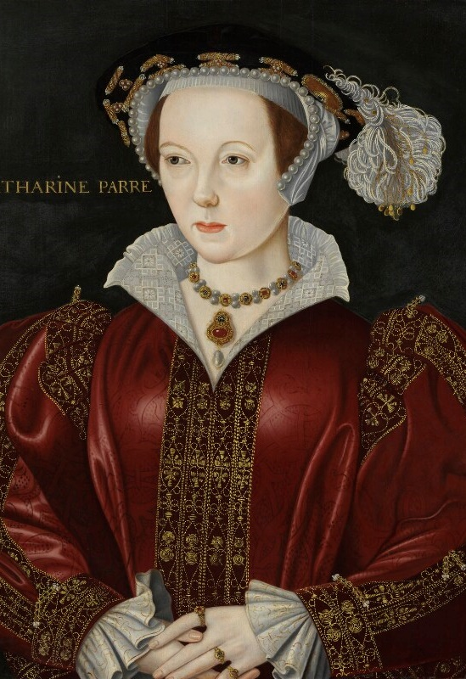
KATHERINE PARR
An intelligent queen who inspired other women
Katherine was a loving stepmother to Henry’s three children and became very close to Elizabeth
in particular.
She supported other women to learn, write
and paint.
She became regent while Henry fought in
France in 1544 and did very well in this role.
She had disagreements with Henry about religion. His ministers tried to turn him against her. This could have ended badly for Katherine, but she told Henry she had only argued with him to learn from him, and he forgave her.
Katherine was loyal to Henry until he died in 1547. Then, she married Thomas Seymour and gave birth to their daughter, Mary, in 1548. Katherine died a few days after.
Katherine’s father was a courtier, Sir Thomas Parr, and her mother was Maud, a lady-in-waiting to Katherine of Aragon. She was very clever, fluent in French, Latin and Italian and liked music and dancing.
Her first marriage was to Sir Edward Burgh.
He died and she became a widow.
Her second marriage was to Lord Latimer.
He was about twenty years older than her and in poor health.
Katherine took care of him until he died.
She was a strong supporter of the English Reformation. She met and fell in love with Thomas Seymour, Jane Seymour’s brother. But Henry VIII proposed to her, and they got married at Hampton Court Palace in 1543. In the Tudor period, marriages were usually about money and power, not love.
I am bound to serve you and revere you with a daughter’s love.
Part of a letter from Elizabeth to Katherine.
Q:
Why do you think Katherine accepted Henry’s marriage proposal, even though there is evidence she was already in love with
Thomas Seymour?
The first English queen to write and publish her own books.
© National Portrait Gallery, London
Reigned: 1543 - 1547
Q:
What evidence is there that Katherine was good at connecting with people?
Lived: 1512 - 1548 | Birthplace: London
Notes:
Notes:
Katherine may have agreed to marry Henry because she felt it was her duty to accept him, or God’s will. Perhaps she was concerned what he would do if she refused. There is no evidence that Katherine was an ambitious woman who wanted the power and status of being queen.
There is lots of evidence Katherine was good at connecting with people. She cared for her second husband when he was ill. She also managed to connect with all three of Henry’s children, despite them having different religions and a troubled past with each other and Henry himself. She was also able to convince Henry to trust her again after his ministers tried to turn him against her.
Primary Source
Katherine became a loving step-mother to Elizabeth. Elizabeth visited Katherine whilst she was regent at Hampton Court Palace. You can view part of the letter she wrote to her stepmother with Bridgeman Images: Image of Autograph letter from Princess Elizabeth to Katherine Parr, in which

Slide 8
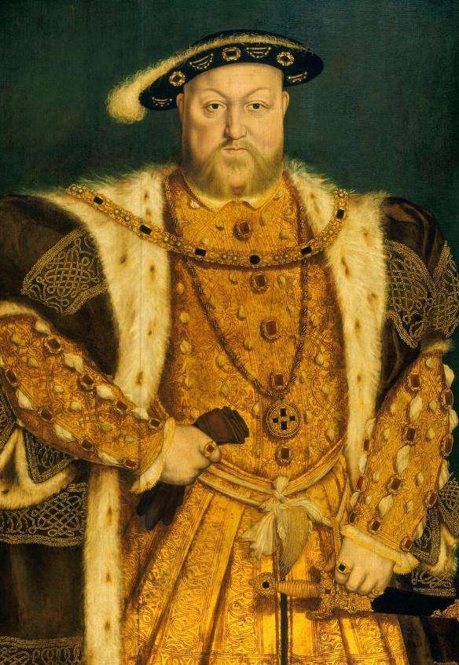
HENRY VIII
The King who married six times and created
the Church of England
Henry VIII was the second son of Henry VII. His
elder brother, Arthur, died in 1502. Henry VIII became king aged 17 after his father died.
Wrote music and poetry.
Graceful dancer and excellent sportsman.
Married his brother’s widow, Katherine of Aragon.
In 1516, their daughter Mary was born.
During his time as king, he had two big challenges: having a male heir and getting the Pope’s permission for a divorce.
Henry and Katherine did not have a son to become heir. Henry thought God was punishing him for marrying his brother’s widow. He asked the Pope to declare that their marriage had been invalid, but the Pope refused. So, Henry broke away from the Roman Catholic Church.
Married his second wife Anne Boleyn in 1533.
Created a separate Church of England.
Made himself the Supreme Head of the
Church of England.
In 1534, got Parliament’s support to make changes to the way the Church was run, and this started the English Reformation.
Henry and his chief minister, Thomas Cromwell, closed hundreds of monasteries, and took land and treasure. Henry used this wealth for developing England’s navy and building projects at
Hampton Court Palace.
He and Anne had one child, Elizabeth, but not long after he accused Anne of treason, and she was executed. Around this time, he had an accident whilst jousting where he was knocked unconscious for
a few hours.
His third wife, Jane Seymour, gave birth to his only son Edward at Hampton Court Palace. After she died, he married three more times, and executed another of his wives, Catherine Howard. When Henry died, he was buried with Jane Seymour in the Chapel at Windsor Castle.
Q:
Henry was very popular when he first became king. Why do you think that was?
© Royal Collection Enterprises Ltd 2025 | Royal Collection Trust
Q:
Why was Henry determined to end his marriage to Katherine of Aragon?
Reigned: 1507 – 1547
Q:
How does the artist convey Henry’s power in the portrait?
Lived: 1491 - 1547 | Birthplace: London
Notes:
Notes:
Henry might have been a popular because he was tall, young, sporty and cultured. Some people thought this would be a new era, with a new young king and his wife.
Henry wanted to end his marriage because he wanted a son to inherit the throne. The Wars of the Roses was still in living memory. Henry might have feared that leaving the throne to a woman might result in a civil war and the end of the Tudor dynasty.
In his portrait, Henry stands in a dominant pose. His expensive, fashionable clothes, encrusted with jewels, emphasise both his immense wealth and his physical size. One hand rests on his sword, which adds to the impression of a powerful, masculine, ruler.

Slide 9

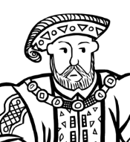
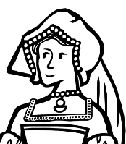
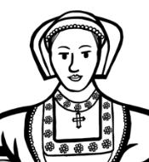
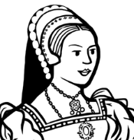
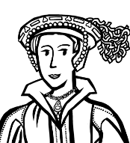


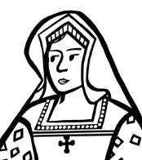
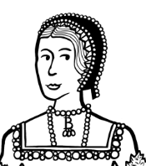
TIMELINE
SIX TUDOR QUEENS TIMELINE
Anne Boleyn is executed
Jane Seymour marries Henry
Henry dies
Katherine Parr marries Thomas Seymour
Anne of Cleves arrives in England
Catherine Howard arrives at court
Katherine of Aragon arrives in England
Katherine of Aragon marries Henry VIII
Katherine of Aragon gives birth to Mary
Jane Seymour arrives at court
Catherine Howard is accused of treason
Katherine Parr marries Henry
1501
1509
1516
1529
1536
1539
1541
1543
1547
1506
1513
1522
1533
1537
1540
1542
1544
Katherine of Aragon becomes the first female ambassador
Katherine of Aragon acts as regent
Anne Boleyn goes to Netherlands and France
Anne Boleyn returns to England and arrives at court
Anne Boleyn marries Henry and gives birth to Elizabeth
Jane Seymour gives birth to Edward and dies shortly after
Anne of Cleves marries Henry but the marriage is annulled
Catherine Howard marries Henry
Catherine Howard
is executed
Katherine Parr
acts as regent
Notes:
Key events from the lives of the six queens

Slide 10


CLASSROOM TASKS
1
Create a timeline of each Tudor queen’s life using the information in their biographies.
You could combine all six queens onto one timeline and use a different colour for each of them.
2
Read the biographies of the six Tudor Queens. What similarities and differences can you find in their lives?
3
Looks closely at the portraits of the six Tudor Queens. What similarities and differences can you find in how they are portrayed and what clothing they wore?
4
Which of the six queens do you think had the most choice and control over their lives?
You could plot this along a line.
No control
Lots of control
5
Think of one word to describe each queen. Can you come up with an alternative to the ‘Divorced, beheaded, died, divorced, beheaded, survived’ rhyme?

Slide 11
BLANK TIMELINE
SIX TUDOR QUEENS
Notes:
Blank for classroom use

Slide 12

VOCABULARY LIST 1
affair | romantic relationship between two people, one or both of whom are married to someone else
alliance | agreement between people or countries to help each other
allowance | set amount of money to spend
ambassador | the official representative of a foreign ruler at the royal court
Catholic | member of the Roman Catholic Church - a type of Christianity that follows the teachings of the Pope
chief minister | the king or queen’s main advisor who has a lot of power
Church of England | the Christian church in England based on the Protestant faith, established by King Henry VIII, with the king or queen as its head
convent | buildings where religious communities of women called nuns live and worship
courtier | nobleman or noblewoman who spends a lot of time at the royal court
divorce | the legal ending of a marriage
courtly lover | knight who performed noble deeds for the woman he loved
English Reformation | name given to ending the Pope's control of the English Church and the religious changes that followed
entourage | a group of people attending or surrounding an important person
etiquette | the rules for polite behaviour in society that people were expected to follow
femme sole | a single woman who can act independently
government | group of people that have the authority to rule a country

Slide 13

VOCABULARY LIST 2
VOCABULARY LIST
heir | person who will become the next king or queen
house arrest | kept as a prisoner in a house, castle or palace rather than a prison
illegitimate | child whose parents were not legally married to each other when they were born
invalid | not legal
jousting | sport developed in the Middle Ages as training for soldiers who fought on horseback
lady-in-waiting | one of the queen’s companions who is there to do as the queen wishes
monasteries | buildings where religious communities of men called monks live and worship
minister | someone with a lot of power and responsibility in government
navy | ships built and maintained to defend a country
nobleman/woman | person of high rank in society
Parliament | the group of people elected to make and change laws in a country; in the past only very rich and powerful people were Members of Parliament
peacemaker | someone who tries to stop people from arguing or fighting
plot/plotting | secretly plan to harm someone, especially a government or ruler
Pope | the head of the Roman Catholic Church
Protestant | A type of Christianity that believes people do not need officials (such as the Pope or Bishops) to communicate with God

Slide 14


VOCABULARY LIST 3
VOCABULARY LIST
regent | person who rules when the king or queen is unable to
regnant | a queen who rules in her own right, not because she is the wife of a king
Roman Catholic Church | Christian religion with the Pope as its head
Supreme Head | the highest in rank
treason | the crime of acting against your own country, especially by trying to kill the king or queen, or overthrow the government
wealthy | having a large amount of money, property, land and valuable possessions
widow | woman whose husband has died

