Slide 1




HOW TO USE - NOTES FOR TEACHERS
These resources from Historic Royal Palaces are multi-purpose.
They are ready for you to tweak and use in your lessons.
For the best experience, download and open the
file in the PowerPoint
desktop app.
Answers are found
under the slide. Click
on the notes symbol at
the bottom of the screen.
Delete text and images to make your own worksheets.
Disclaimer and Use Terms
We are the owner or the licensee of all intellectual property rights in these resources which are protected by copyright laws and treaties around the world. All such rights are reserved. These resources, and the content included within them, may be used by you for educational purposes only. This means that you may download the resources and use or share them solely in educational environments (including for home school lessons) or as part of homework. You may not share the resources other than for the above purposes and you must not use the resources, or any part of them, for any commercial purpose.

Slide 2

WHEN ARE WE?
Empire & Sea Power
1714 – 1837
War & Revolution
1603 – 1714
WWI
1914 – 1918
Maya Civilisation 2000 BCE – 1500 CE
WWII
1939 – 1945
Mughal India 1526 – 1707
Benin 900 – 1300
Cold War
1945 – 1989
Qing Dynasty 1644 – 1912
French Revolution
1789 – 1799
1100 CE
1300 CE
1500 CE
1700 CE
1900 CE
2100 CE
The Silk Roads 130 BCE – 1453 CE
Medieval c.5th century – 1450
Renaissance 1450 – 1750
Industrial Revolution 1750 – 1900
Modern
Normans
Middle Ages 1154 – 1485
Tudors
Stuarts
Georgians
Victorians
House of Windsor
Edwardians

Slide 3


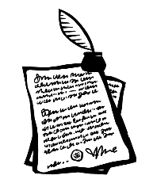

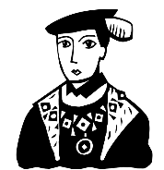


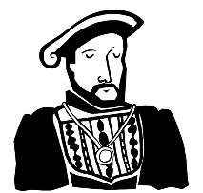
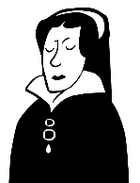
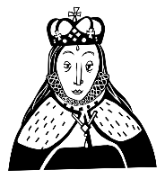
TUDOR RELIGIOUS ROLLER COASTER TIMELINE
1536
1547
1553
1559
Closure of monasteries begins
Edward VI is King. Plans to make the country Protestant
Lady Jane Grey is Queen for nine days
Elizabethan Religious Settlement passed by Parliament
1534
1553
1558
Henry VIII declares himself Head of the Church of England
Mary I is Queen. Plans to bring back the Catholic faith
Elizabeth I is Queen. Plans for religious compromise

Slide 4
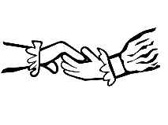

TUDOR RELIGIOUS ROLLER COASTER TIMELINE 2
TUDOR RELIGIOUS ROLLER COASTER TIMELINE
1533
1536
1547
1553
1559
Henry VIII marries Anne Boleyn
Closure of monasteries begins
Edward VI is King. Plans to make the country Protestant
Lady Jane Grey is Queen for nine days
Elizabethan Religious Settlement passed by Parliament
1534
1549
1553
1558
Henry VIII declares himself Head of the Church of England
Book of Common Prayer published
Mary I is Queen. Plans to bring back the Catholic faith
Elizabeth I is Queen. Plans for religious compromise

Slide 5


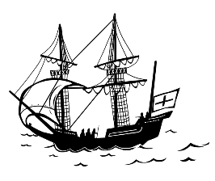

TUDOR RELIGIOUS ROLLER COASTER TIMELINE 3
TUDOR RELIGIOUS ROLLER COASTER TIMELINE
1533
1536
1547
1553
1554
1559
1603
Henry VIII marries Anne Boleyn
Closure of monasteries begins
Edward VI is King. Plans to make the country Protestant
Lady Jane Grey is Queen for nine days
Thomas Wyatt’s Protestant rebellion fails
Elizabethan Religious Settlement passed by Parliament
Elizabeth dies and Tudor dynasty ends
1534
1539
1549
1553
1558
1588
Henry VIII declares himself Head of the Church of England
First authorised translation of Bible in English published
Book of Common Prayer published
Mary I is Queen. Plans to bring back the Catholic faith
Elizabeth I is Queen. Plans for religious compromise
English navy defeats Catholic Philip of Spain’s invasion

Slide 6

CLASSROOM TASKS
Q1
In what year did Henry VIII announce himself as Head of the Church of England?
Q2
Which was published first – the Book of Common Prayer or the first authorised translation of the Bible?
Q3
Which Queen tried to restore the Catholic faith to England?
Q4
What important settlement was passed by Parliament in 1559?
Notes:
Classroom task answers
Henry announced himself as the Head of the Church of England in 1531.
The translation of the Bible was published first in 1539, followed by the Book of Common Prayer in 1549.
Mary I tried to restore the Catholic faith.
The Elizabethan Religious Settlement was passed in 1559. (This was intended as an inclusive compromise to help heal religious divisions. It established the Church of England based on the Protestant religion, with the monarch as its Head. But it also kept some Catholic rituals.

Slide 7
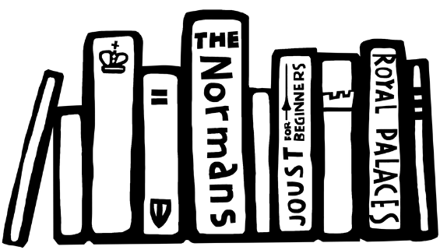

VOCABULARY LIST
authorised | officially approved
Catholic | member of the Roman Catholic Church, a type of Christianity that follows the teachings of the Pope
Church of England | the Christian church in England based on the Protestant faith, established by King Henry VIII
dynasty | series of leaders from the same family
Elizabethan Religious Settlement | laws passed by Parliament in 1559 which made the Church of England the country’s official religion
Monasteries | building or buildings where religious communities of men called monks live and worship
Protestant | A type of Christianity that believes people do not need officials like the Pope to communicate with God
rebellion | a fight by a large group of people against the government or ruler

