Slide 1




HOW TO USE - NOTES FOR TEACHERS
These resources from Historic Royal Palaces are multi-purpose.
They are ready for you to tweak and use in your lessons.
For the best experience, download and open the
file in the PowerPoint
desktop app.
Answers are found
under the slide. Click
on the notes symbol at
the bottom of the screen.
Delete text and images to make your own worksheets.
Disclaimer and Use Terms
We are the owner or the licensee of all intellectual property rights in these resources which are protected by copyright laws and treaties around the world. All such rights are reserved. These resources, and the content included within them, may be used by you for educational purposes only. This means that you may download the resources and use or share them solely in educational environments (including for home school lessons) or as part of homework. You may not share the resources other than for the above purposes and you must not use the resources, or any part of them, for any commercial purpose.

Slide 2

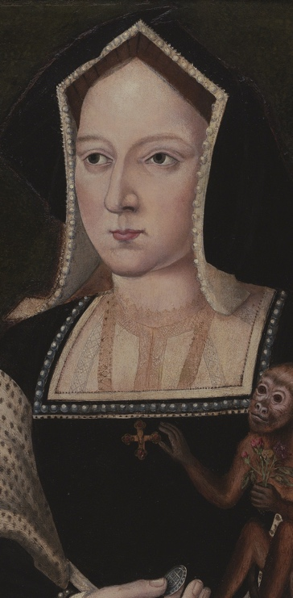
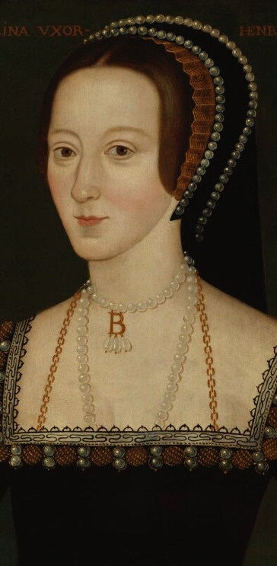
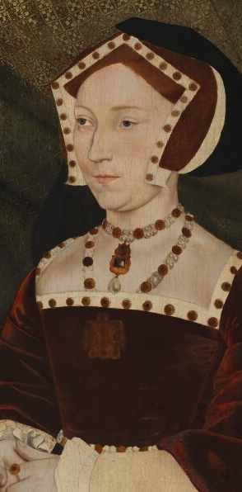
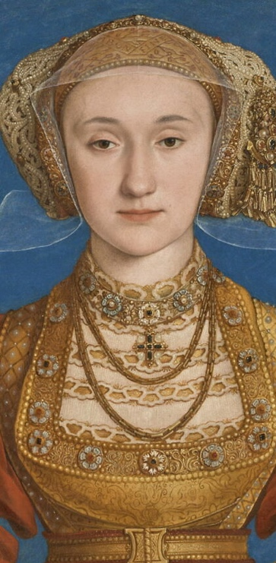
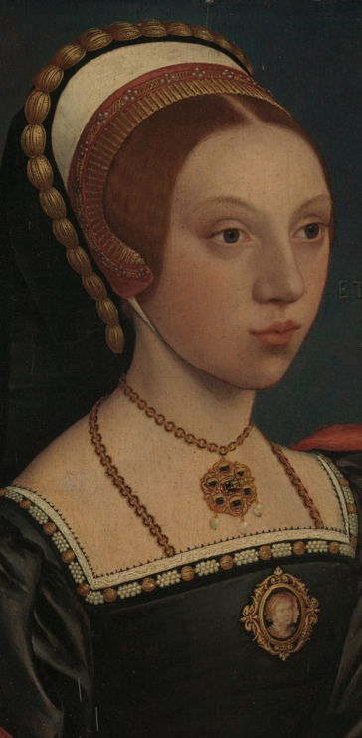
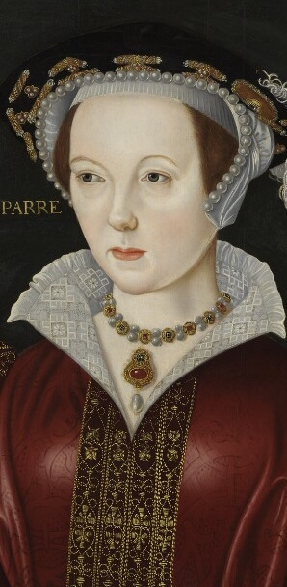
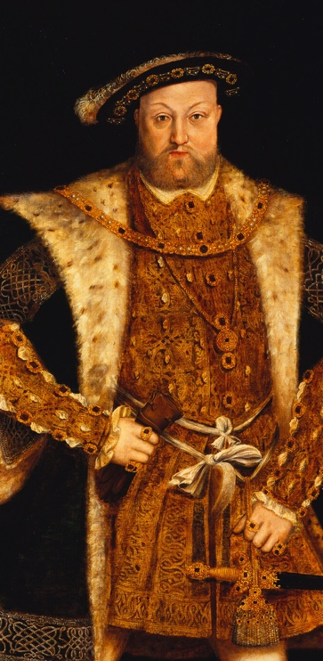
Fact sheet with portraits
KATHERINE
OF ARAGON
ANNE
BOLEYN
JANE
SEYMOUR
ANNE
OF CLEVES
CATHERINE
HOWARD
KATHERINE
PARR
KING
HENRY VIII
1485-1536
c1501-36
1509-37
1515-57
c1521-42
1512-48
1491-1547
Henry’s first wife, they were married 24 years before they separated. They had one child Mary, the future Mary I.
Henry’s second wife. They were married 3 years before Anne was executed. They had one child Elizabeth, the future Elizabeth I.
Henry’s third wife, they were married 1 year before Jane died. They had one child Edward, the future Edward VI.
Henry’s fourth wife, they were married a few months before they divorced.
Henry’s fifth wife, they were married less than two years before she was executed.
Henry’s sixth wife, they were married four years before Henry died.
King of England for 38 years in the Tudor period.
Believed education was important for girls
Ruled as regent and kept the country running
Loved reading and writing
One of the first female authors to publish a book in England
Created a new protestant Church in England
Married six times and had three children (Mary, Elizabeth and Edward)
Spent time at Hampton Court Palace and the Tower of London
Became an independent woman (which was unusual in the Tudor period)
Had her own castles and her own money
Enjoyed her life hunting and gambling
Got on very well with her servants, step-children and Catherine Howard
Grew up with 10 brothers and sisters, living with her grandmother
Had very good etiquette (manners)
Sadly, did not have much control over her life
Was around 20 when she was executed
A Spanish princess, her mother was a powerful queen
One of the first female ambassadors
Ruled as regent and inspired an army
Stood up for herself and her daughter
Worked as a Lady-in-waiting
Tried to protect Catholics and monasteries
There are not many historic sources from Jane herself
Jane’s personality is a mystery
Educated in the Netherlands and France
Interested in new religious ideas (Protestantism)
Intelligent and outspoken
Had powerful female friends in Europe
SIX TUDOR QUEENS & HENRY VIII
Notes:
Image licenses
Katherine of Aragon © Philip Mould Ltd, London/Bridgeman Images.
Anne Boleyn © National Portrait Gallery, London
Jane Seymour © National Portrait Gallery, London
Anne of Cleves, © 2023 Grand Palais Rmn (Louvre Museum) / Adrien Didierjean
Katherine Parr © National Portrait Gallery, London
Catherine Howard Portrait of a Young Woman The Met CC0
King Henry VIII © Royal Collection Enterprises Ltd 2025 | Royal Collection Trust
Please note: No one knows exactly what Catherine Howard looked like. Some historians think this portrait may be of her, but we can’t be sure.

Slide 3
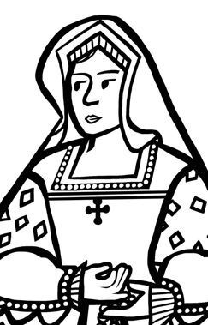
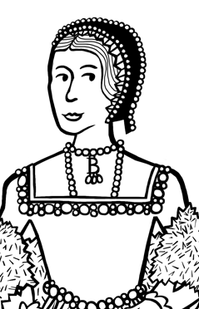
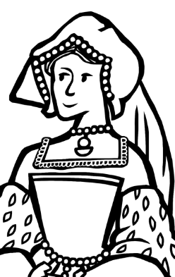
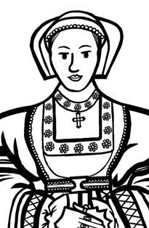
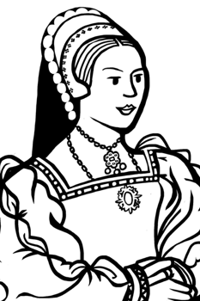
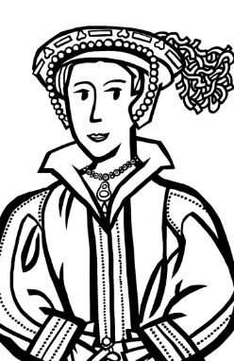
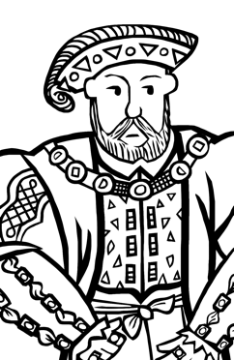
Fact sheet with illustrations
KATHERINE
OF ARAGON
ANNE
BOLEYN
JANE
SEYMOUR
ANNE
OF CLEVES
CATHERINE
HOWARD
KATHERINE
PARR
KING
HENRY VIII
1485-1536
c1501-36
1509-37
1515-57
c1521-42
1512-48
1491-1547
Henry’s first wife, they were married 24 years before they separated. They had one child Mary, the future Mary I.
Henry’s second wife. They were married 3 years before Anne was executed. They had one child Elizabeth, the future Elizabeth I.
Henry’s third wife, they were married 1 year before Jane died. They had one child Edward, the future Edward VI.
Henry’s fourth wife, they were married a few months before they divorced.
Henry’s fifth wife, they were married less than two years before she was executed.
Henry’s sixth wife, they were married four years before Henry died.
King of England for 38 years in the Tudor period.
Believed education was important for girls
Ruled as regent and kept the country running
Loved reading and writing
One of the first female authors to publish a book in England
Created a new protestant Church in England
Married six times and had three children (Mary, Elizabeth and Edward)
Spent time at Hampton Court Palace and the Tower of London
Became an independent woman (which was unusual in the Tudor period)
Had her own castles and her own money
Enjoyed her life hunting and gambling
Got on very well with her servants, step-children and Catherine Howard
Grew up with 10 brothers and sisters, living with her grandmother
Had very good etiquette (manners)
Sadly, did not have much control over her life
Was around 20 when she was executed
A Spanish princess, her mother was a powerful queen
One of the first female ambassadors
Ruled as regent and inspired an army
Stood up for herself and her daughter
Worked as a Lady-in-waiting
Tried to protect Catholics and monasteries
There are not many historic sources from Jane herself
Jane’s personality is a mystery
Educated in the Netherlands and France
Interested in new religious ideas (Protestantism)
Intelligent and outspoken
Had powerful female friends in Europe
SIX TUDOR QUEENS & HENRY VIII

Slide 4



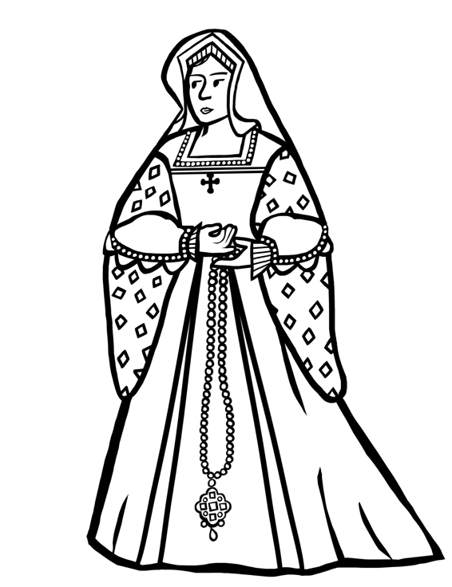

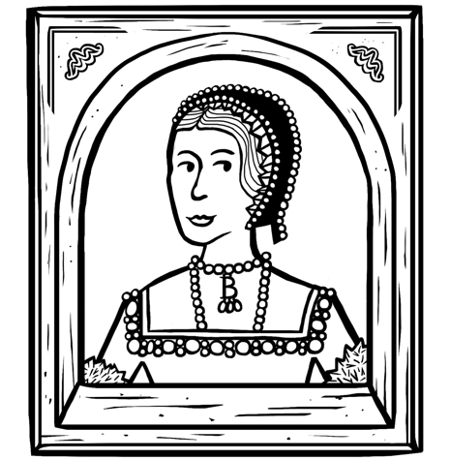
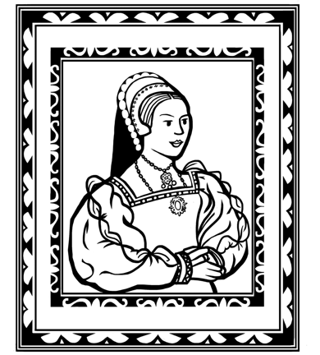
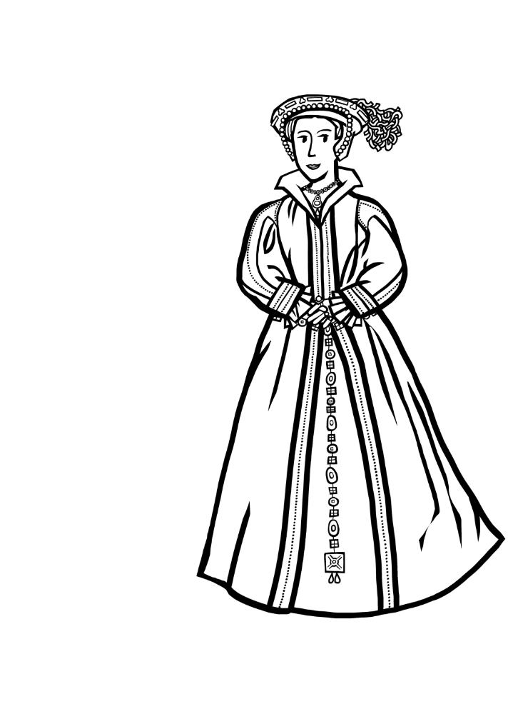

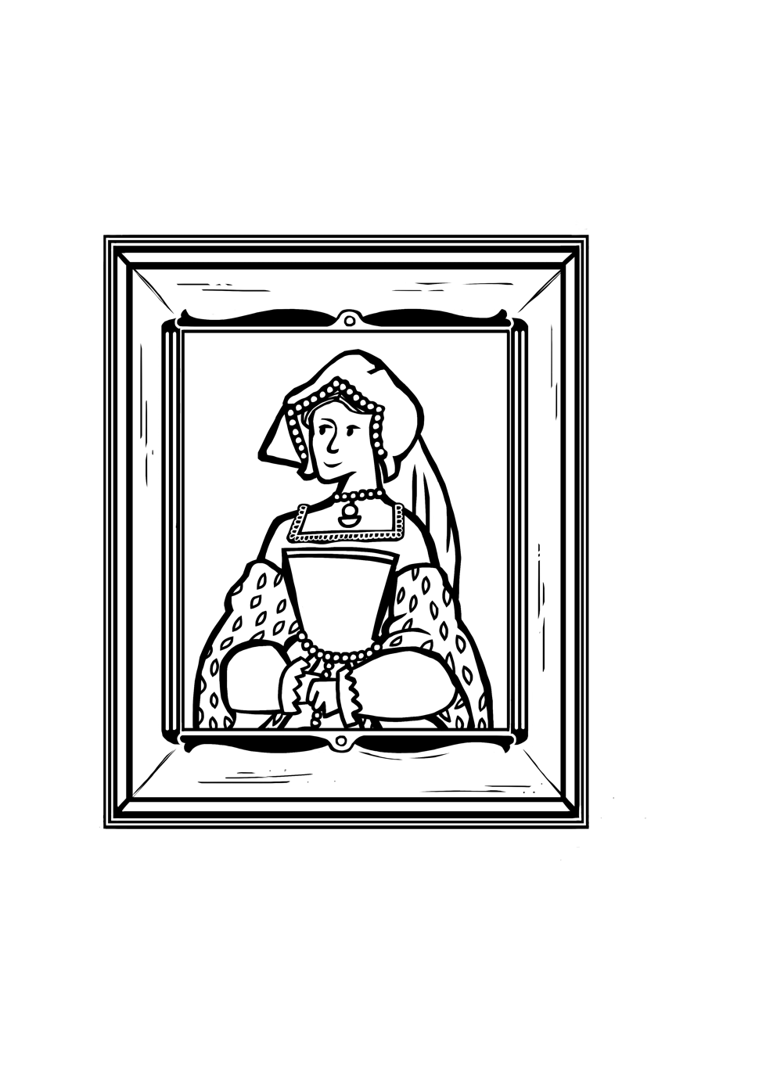
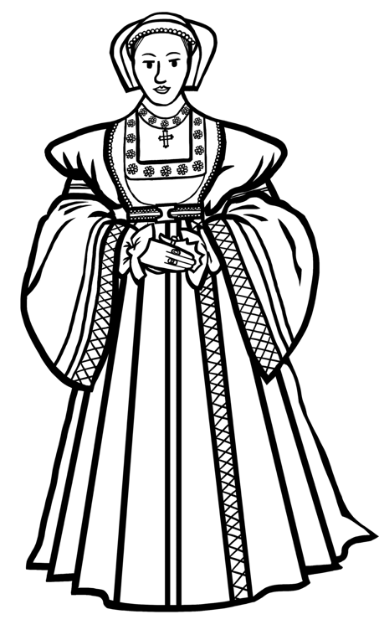

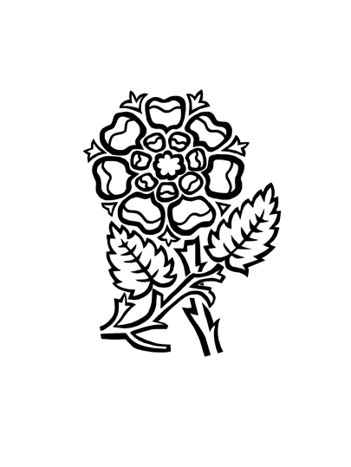


Colouring sheet
CATHERINE HOWARD
ANNE BOLEYN
KATHERINE PARR
KATHERINE OF ARAGON
HENRY VIII
JANE SEYMOUR
ANNE OF CLEVES

Slide 5



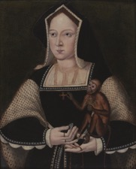
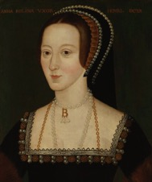
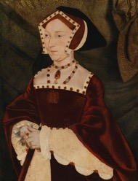

Question sheet 1
SIX TUDOR
QUEENS
KATHERINE
OF ARAGON
ANNE BOLEYN
JANE
SEYMOUR
1485-1536
c1501-36
1509-37
Where was she from?
Where did she travel to?
What did she work as?
What might she have done in her role as ambassador?
What new religion was she interested in?
What did she try to protect?
What might she have done in her role as regent?
What might she have been outspoken about?
Why don’t we know more about Jane?
Choose one word to describe Katherine of Aragon
Choose one word to describe Anne Boleyn
Choose one word to describe Jane Seymour
Notes:
Image licenses
Katherine of Aragon © Philip Mould Ltd, London/Bridgeman Images.
Anne Boleyn © National Portrait Gallery, London
Jane Seymour © National Portrait Gallery, London
Answers
Katherine of Aragon
She was from Spain.
In her role as ambassador she would have helped represent her parents, the Spanish Queen and King in England.
In her role as regent she commanded troops into battle.
Anne Boleyn
She visited the Netherlands and France.
She was interested in the new religion Protestantism.
She was outspoken about religion and politics.
Jane Seymour
She worked as a Lady-in-waiting.
She tried to protect Catholic people and monasteries.
There are not many historic sources about Jane so we don’t know very much about her.

Slide 6



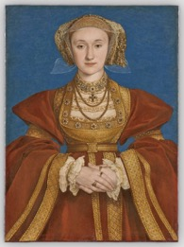
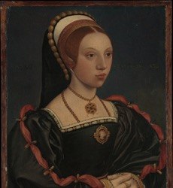
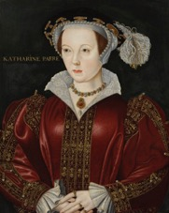
Question sheet 2
SIX TUDOR
QUEENS
ANNE
OF CLEVES
CATHERINE HOWARD
KATHERINE PARR
1515-57
c1521-42
1512-48
What did she enjoy doing?
Who looked after her when she was growing up?
Why might she have thought education was important for girls?
Who did she get on well with?
What might ‘good manners’ have meant in the Tudor period?
What hobbies did she have?
In what ways was she independent?
Why don’t we know more about Catherine as an adult?
What achievements did she have?
Choose one word to describe Anne of Cleves
Choose one word to describe Catherine Howard
Choose one word to describe Katherine Parr
Notes:
Image licenses
Anne of Cleves, © 2023 Grand Palais Rmn (Louvre Museum) / Adrien Didierjean
Katherine Parr © National Portrait Gallery, London
Catherine Howard Portrait of a Young Woman The Met CC0
Please note: No one knows exactly what Catherine Howard looked like. Some historians think this portrait may be of her, but we can’t be sure.
Answers
Anne of Cleves
She enjoyed hunting and gambling.
She got on well with her servants, stepchildren and Catherine Howard.
She was independent because she had her own castles and money, which was rare in the Tudor period.
Anne Boleyn
She visited the Netherlands and France.
She was interested in the new religion Protestantism.
She was outspoken about religion and politics.
Jane Seymour
She worked as a Lady-in-waiting.
She tried to protect Catholic people and monasteries.
There are not many historic sources about Jane so we don’t know very much about her.

Slide 7

Activity sheet
TUDOR WOMEN
DRAWING
ACTIVITY
Which of the queens had a good education?
The six Tudor queens wore different styles of headdresses.
Look carefully at portraits of the queens. Can you spot what makes each headdress different?
Choose one headdress and draw it. Show its shape, colours, and decorations.
Which of the queens had links to other countries?
Do you think all women in Tudor times lived like these queens?
Why or why not? What might be different about their lives?
MAKE IT MEMORABLE
The six Tudor queens are sometimes remembered by a rhyme: Divorced, beheaded, died, divorced, beheaded, survived.
But we think there might be a better way to remember them! Can you come up with a new saying to remember the six Tudor queens?

Slide 8






Research activity
ONE TUDOR QUEEN
| Choose one queen to find out more about
Did she do anything important or special?
What difficulties or problems might she have had in the Tudor period?
How was her life different from life today?
How was her life similar to life today?

Slide 9


Vocabulary
VOCABULARY
ambassadors | Important people sent by a king or queen to speak for them in another country.
Catholics | Christians who follow the teachings of the Pope in Rome.
etiquette | The rules for being polite and well-mannered in society.
.
executed | When someone is killed as a punishment after being found guilty in a trial.
lady-in-waiting | A woman who helps and spends time with a queen or princess.
monasteries | Buildings where monks live, work, and pray together.
Protestantism | A type of Christianity that teaches people can talk to God directly, without needing the Pope or bishops.
regent | A person who rules a country when the king or queen is too young or unable to do so.
sources | Things from the past that help us learn about history, like letters, diaries, paintings, or old objects.

