Slide 1




HOW TO USE - NOTES FOR TEACHERS
These resources from Historic Royal Palaces are multi-purpose.
They are ready for you to tweak and use in your lessons.
For the best experience, download and open the
file in the PowerPoint
desktop app.
Answers are found
under the slide. Click
on the notes symbol at
the bottom of the screen.
Delete text and images to make your own worksheets.
Disclaimer and Use Terms
We are the owner or the licensee of all intellectual property rights in these resources which are protected by copyright laws and treaties around the world. All such rights are reserved. These resources, and the content included within them, may be used by you for educational purposes only. This means that you may download the resources and use or share them solely in educational environments (including for home school lessons) or as part of homework. You may not share the resources other than for the above purposes and you must not use the resources, or any part of them, for any commercial purpose.

Slide 2








KENSINGTON PALACE TIMELINE
168
1819
Today
William III and
Mary II transform Nottingham House into Kensington Palace
Queen Victoria born in palace
Royal Family members still live in private apartments
1704
1899
Queen Anne starts to improve gardens and builds Orangery
State Apartments opened to public

Slide 3
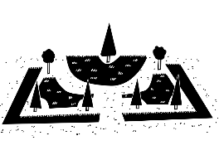



KENSINGTON PALACE TIMELINE 2
KENSINGTON PALACE TIMELINE
168
1722
c. 1727
1819
Today
William III and
Mary II transform Nottingham House into Kensington Palace
William Kent decorates State Apartments
Queen Caroline starts projects to redesign gardens
Queen Victoria born in palace
Royal Family members still live in private apartments
1704
1724
1899
1940
Queen Anne starts to improve gardens and builds Orangery
Peter the ‘Wild Boy’ Mehmet and Mustafa painted on King’s Grand Staircase
State Apartments opened to public
Damaged by bombs during London Blitz

Slide 4

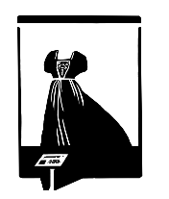


KENSINGTON PALACE TIMELINE 3
KENSINGTON PALACE TIMELINE
168
1722
c. 1727
1819
1841
1911
Today
William III and
Mary II transform Nottingham House into Kensington Palace
William Kent decorates State Apartments
Queen Caroline starts projects to redesign gardens
Queen Victoria born in palace
Kensington Gardens open to public
London Museum opens in State Apartments
Royal Family members still live in private apartments
1704
1724
1760
1837-97
1899
1940
Queen Anne starts to improve gardens and builds Orangery
Peter the ‘Wild Boy’ Mehmet and Mustafa painted on King’s Grand Staircase
George II dies in palace
State Apartments used to store furniture and paintings
State Apartments opened to public
Damaged by bombs during London Blitz

Slide 5

CLASSROOM TASKS
Q1
What was the name of the mansion that William and Mary transformed into Kensington Palace?
Q2
Which two Queens are responsible for developing the gardens?
Q3
For how many years have Kensington Gardens been open to the public?
Q4
In what year did the London Museum open in the State Apartments?
Notes:
Classroom task answers
William and Mary transformed Nottingham House into Kensington Palace.
Queen Anne and Queen Caroline are the Queens responsible for transforming the gardens.
Kensington Palace Gardens have been open to the public for 172 years (in 2023).
The London Museum opened in 1911 (Collection moved to new site in 1976).

Slide 6
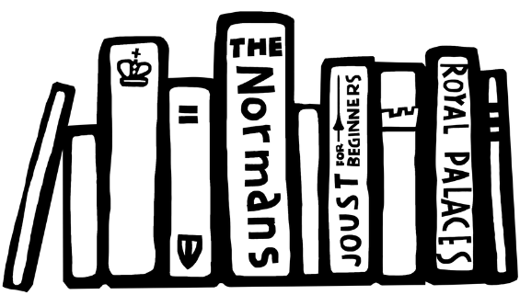

VOCABULARY LIST
Blitz | bombs that fell on Britain in WWII
Orangery | brick building with large windows used for growing exotic fruits and plants
State Apartments | grand public rooms where official visitors are hosted

