Slide 1




HOW TO USE - NOTES FOR TEACHERS
These resources from Historic Royal Palaces are multi-purpose.
They are ready for you to tweak and use in your lessons.
For the best experience, download and open the
file in the PowerPoint
desktop app.
Answers are found
under the slide. Click
on the notes symbol at
the bottom of the screen.
Delete text and images to make your own worksheets.
Disclaimer and Use Terms
We are the owner or the licensee of all intellectual property rights in these resources which are protected by copyright laws and treaties around the world. All such rights are reserved. These resources, and the content included within them, may be used by you for educational purposes only. This means that you may download the resources and use or share them solely in educational environments (including for home school lessons) or as part of homework. You may not share the resources other than for the above purposes and you must not use the resources, or any part of them, for any commercial purpose.

Slide 2

WHEN ARE WE?
Empire & Sea Power
1714 – 1837
War & Revolution
1603 – 1714
WWI
1914 – 1918
Maya Civilisation 2000 BCE – 1500 CE
WWII
1939 – 1945
Mughal India 1526 – 1707
Benin 900 – 1300
Cold War
1945 – 1989
Qing Dynasty 1644 – 1912
French Revolution
1789 – 1799
1100 CE
1300 CE
1500 CE
1700 CE
1900 CE
2100 CE
The Silk Roads 130 BCE – 1453 CE
Medieval c.5th century – 1450
Renaissance 1450 – 1750
Industrial Revolution 1750 – 1900
Modern
Normans
Middle Ages 1154 – 1485
Tudors
Stuarts
Georgians
Victorians
House of Windsor
Edwardians

Slide 3

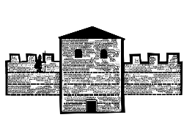

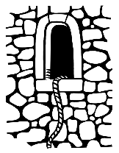




NORMAN TOWER OF LONDON TIMELINE
About AD 200
October 1066
1101
Stone walls built Roman Londinium
Battle of Hastings
Ranulf Flambard first prisoner to escape
c.1070s
c.1100
White Tower building begins
White Tower completed

Slide 4




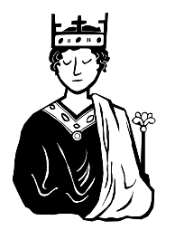
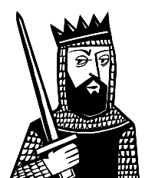
NORMAN TOWER OF LONDON TIMELINE 2
NORMAN TOWER OF LONDON TIMELINE
About AD 200
October 1066
1068
1075
1100
1101
Stone walls built Roman Londinium
Battle of Hastings
Matilda is crowned as Queen
Edward’s wife Edith dies
William II dies. Henry I is King
Ranulf Flambard first prisoner to escape
January 1066
25 December 1066
c.1070s
1087
c.1100
Edward the Confessor dies. Harold Godwinson is King
William I is King
White Tower building begins
William I dies. William II is King
White Tower completed

Slide 5
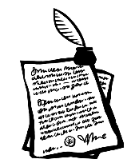

NORMAN TOWER OF LONDON TIMELINE 3
NORMAN TOWER OF LONDON TIMELINE
About AD 200
October 1066
1068
1075
1085
1100
1101
Stone walls built Roman Londinium
Battle of Hastings
Matilda is crowned as Queen
Edward’s wife Edith dies
William I begins survey
‘Domesday Book’
William II dies. Henry I is King
Ranulf Flambard first prisoner to escape
January 1066
25 December 1066
c.1071
c.1070s
1087
c.1100
Edward the Confessor dies. Harold Godwinson is King
William I is King
William of Poitiers writes about Norman Conquest
White Tower building begins
William I dies. William II is King
White Tower completed

Slide 6

CLASSROOM TASKS
Q1
Who was the first prisoner to escape from the Tower?
Q2
When was William I crowned King?
Q3
Roughly how many years after the Battle of Hastings did William I start his survey (recording the property and land in his kingdom)?
Q4
Roughly how long did it take to build the White Tower?
Notes:
Classroom task answers
Ranulf Flambard was the first prisoner to escape from the Tower. (He had been an unpopular tax collector for William I. He was imprisoned by Henry I to make himself popular with his new subjects.)
William I was crowned King on 25th December (Christmas Day) 1066.
William I started the survey in 1085, nineteen years after the Battle of Hastings.
It took roughly 30 years to build the White Tower.

