Slide 1




HOW TO USE - NOTES FOR TEACHERS
These resources from Historic Royal Palaces are multi-purpose.
They are ready for you to tweak and use in your lessons.
For the best experience, download and open the
file in the PowerPoint
desktop app.
Answers are found
under the slide. Click
on the notes symbol at
the bottom of the screen.
Delete text and images to make your own worksheets.
Disclaimer and Use Terms
We are the owner or the licensee of all intellectual property rights in these resources which are protected by copyright laws and treaties around the world. All such rights are reserved. These resources, and the content included within them, may be used by you for educational purposes only. This means that you may download the resources and use or share them solely in educational environments (including for home school lessons) or as part of homework. You may not share the resources other than for the above purposes and you must not use the resources, or any part of them, for any commercial purpose.

Slide 2



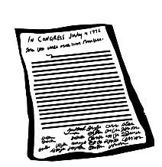
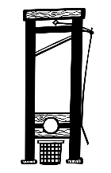






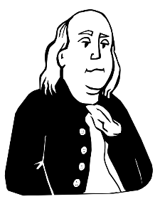



HILLSBOROUGH CASTLE | 1600-1790
1609
1641–52
1660
1689–91
1776
1789
The Plantation of Ulster
English Civil War & Irish Confederate War
Restoration of Charles II
Williamite War in Ireland
American Declaration of Independence
The French Revolution
GLOBAL events
LOCAL events
1573
1611
1650s
1690
1742
1750s
1771
Moyses Hill arrives in Ireland
Moyses Hill acquires land and settles in Ulster
Hillsborough Fort built
William III camps at Hillsborough Fort before Battle of the Boyne
Wills Hill begins work to improve Hillsborough village
Wills Hill builds Hillsborough Castle
Benjamin Franklin visits Hillsborough Castle
Not to scale

Slide 3














HILLSBOROUGH CASTLE | 1791–1934
1798
1801
1807
1845
1914–18
1921
1922
The United Irishmen Rebellion
The Act of Union
The Slave Trade Bill
The Irish Famine
World War I
The Partition of Ireland
Role of Governor of Northern Ireland created
GLOBAL events
LOCAL events
1800
1815
1837
1844
1867
1925
1934
2nd Marquess of Downshire opposes Act of Union
Lord Arthur Hill serves at the Battle of Waterloo
Earl of Hillsborough marries Lady Caroline Frances
Ballroom added to Hillsborough Castle
Lady Alice marries Lord Kenlis
Hillsborough Castle is sold to the British Government
A fire breaks out at Hillsborough Castle
Not to scale

Slide 4

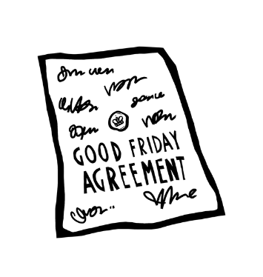





HILLSBOROUGH CASTLE | 1935–2022
1939
1960s
1998
2022
World War II begins
Start of ‘The Troubles’
Good Friday Agreement signed
Queen Elizabeth II dies
GLOBAL events
LOCAL events
1940s
1953
1972
1985
1998
2005
2019
The Royal Family spend more time at Hillsborough Castle
Elizabeth II visits Hillsborough Castle after her Coronation
Direct rule begins and role of Governor is abolished
Anglo-Irish Agreement signed at Hillsborough Castle
Peace Process talks take place at Hillsborough Castle
Elizabeth II and Mary McAleese meet at Hillsborough Castle
Hillsborough Castle opens to the public
Not to scale

