Slide 1



HOW TO USE - NOTES FOR TEACHERS
These resources from Historic Royal Palaces are multi-purpose.
They are ready for you to tweak and use in your lessons.
For the best experience, download and open the
file in the PowerPoint
desktop app.
Delete text and images to make your own worksheets.
Disclaimer and Use Terms
We are the owner or the licensee of all intellectual property rights in these resources which are protected by copyright laws and treaties around the world. All such rights are reserved. These resources, and the content included within them, may be used by you for educational purposes only. This means that you may download the resources and use or share them solely in educational environments (including for home school lessons) or as part of homework. You may not share the resources other than for the above purposes and you must not use the resources, or any part of them, for any commercial purpose.

Slide 2
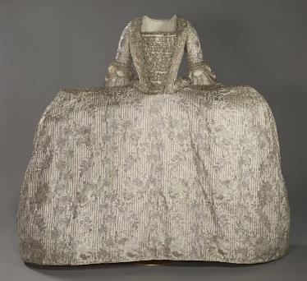
Mantua Fact Sheet
What is a mantua?
How did the mantua keep its shape?
Dresses that were worn at court in the 1700s.
They have:
a tight-fitting top (called a bodice)
a decorated front piece (called a stomacher)
a long back part (called a train) that hung over a skirt (petticoat).
These dresses were made from expensive silk and decorated with detailed stitching. They showed how rich and important someone was and followed strict court fashion rules.
​
The petticoat was held out by a special frame called a hoop, made stiff with whalebone.
People wore hoops under their dresses at court and in everyday fashion until around the 1780s.
Over time, the shape of the hoop changed. It could be:
square (called an "English hoop")
fan-shaped (called a "French hoop")
bell-shaped.
Where did the silk come from?
What was it like wearing it?
© Historic Royal Palaces/ Image captured by Google
The best silk came from Lyon in France and Spitalfields in East London.
At court, people were told to wear fabric made in Britain. Queens like Caroline and Charlotte often chose British-made cloth. But many people at court cared more about style than supporting their country. They still bought fancy French fabrics without thinking twice.
​
At court, the dress was very wide at the front, sometimes up to two metres!
Women had to turn sideways just to get through a door. It was also tiring to wear. To look graceful, women took lessons from a dance teacher. They learned how to:
dance
curtsy
walk backwards
move their arms and hands nicely
use a fan in a stylish way.
The hoop under the dress could add a few extra kilos, making it even heavier to wear.
The Rockingham Mantua c. 1760-5
The Rockingham Mantua is a very fancy dress that shows how rich and important the person
wearing it was.
Made from shiny French silk with silver thread and flower patterns.
Decorated with silver lace.
Took 14 meters of fabric to make and would cost over £10,000 today!
It was probably worn by Mary, the Marchioness of Rockingham, who was married to a British Prime Minister named Charles Watson-Wentworth.
In 1787 Jane Austen’s sister-in-law, Eliza, complained:
‘how such a meagre creature as I am, can support so much fatigue … for I only stood from two to four in the Drawing Room, and of course loaded with a great hoop of no inconsiderable weight.’

Slide 3
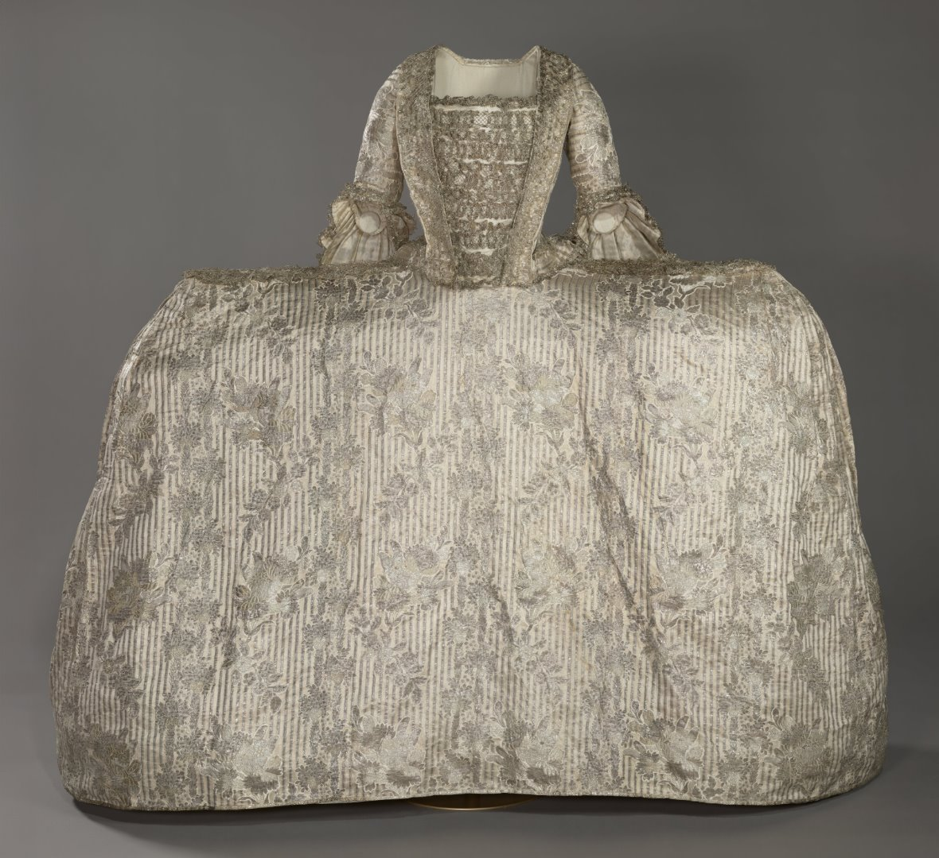
Rockingham Mantua Front
© Historic Royal Palaces/ Image captured by Google
Notes:
Explore the mantua in very high resolution: Silver Mantua — Google Arts & Culture

Slide 4
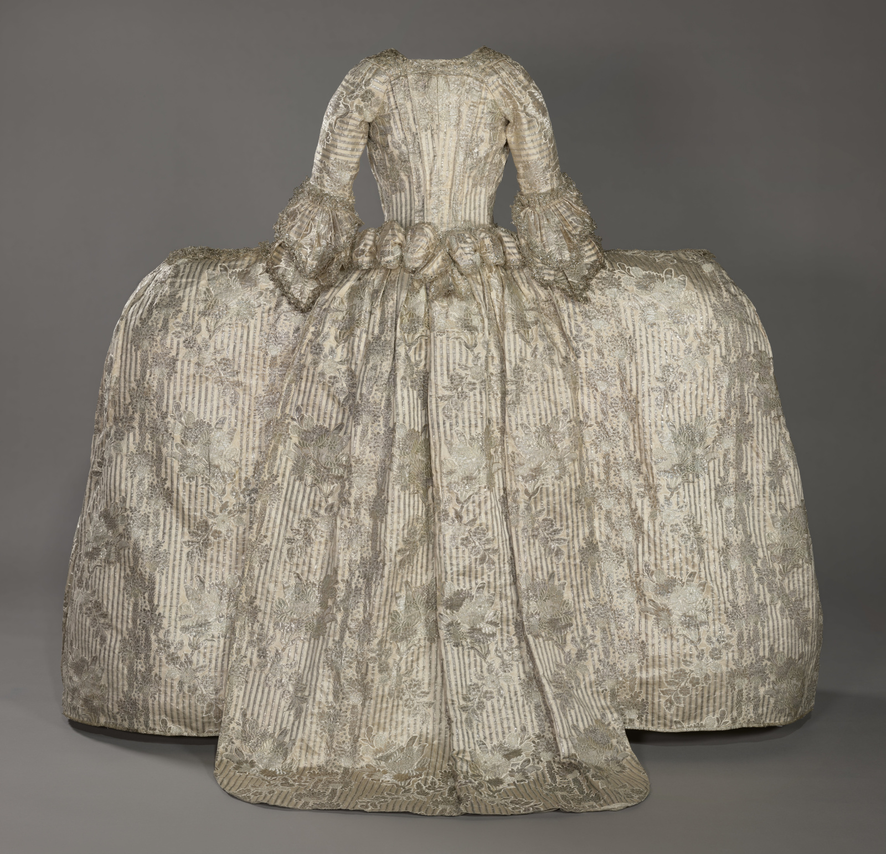
Rockingham Mantua back
© Historic Royal Palaces/ Image captured by Google
Notes:
Explore the mantua in very high resolution: Silver Mantua — Google Arts & Culture

