Slide 1
HAMPTON COURT PALACE

Slide 2
Visual Story
Hampton Court Palace – Georgian Route

Slide 3
Welcome to hampton court palace

Slide 4
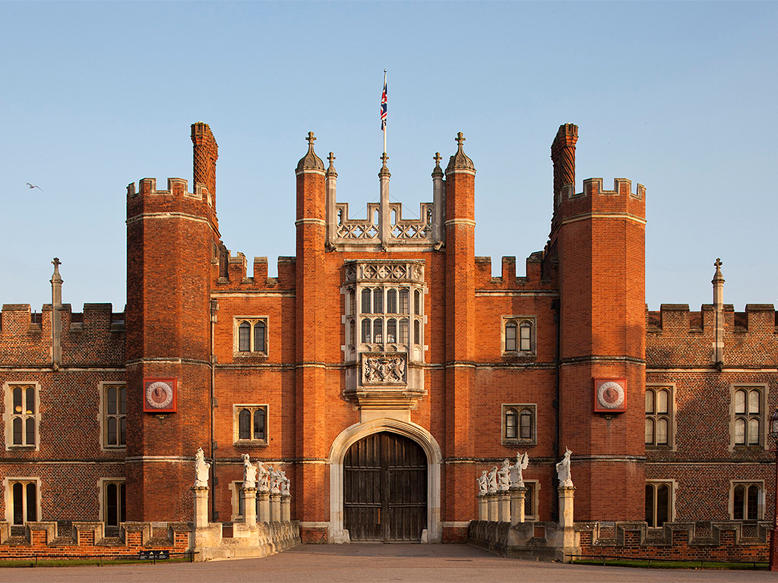
This is Hampton Court Palace. Come and look inside.

Slide 5
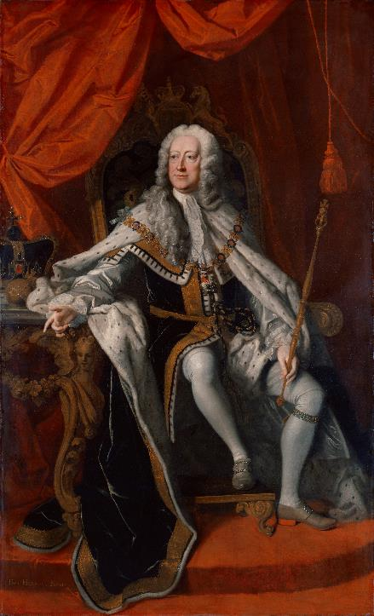
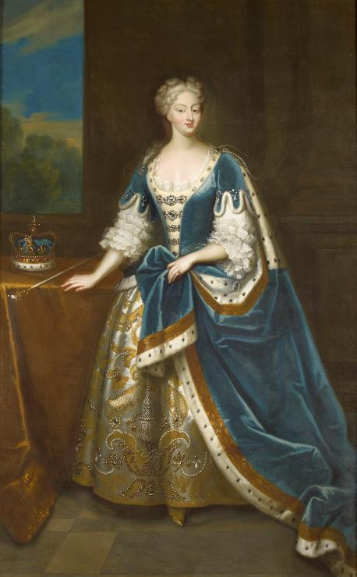
George II and Queen Caroline lived at Hampton Court Palace 300 years ago.
© Royal Collection Enterprises Limited 2025 | Royal Collection Trust
© National Portrait Gallery

Slide 6
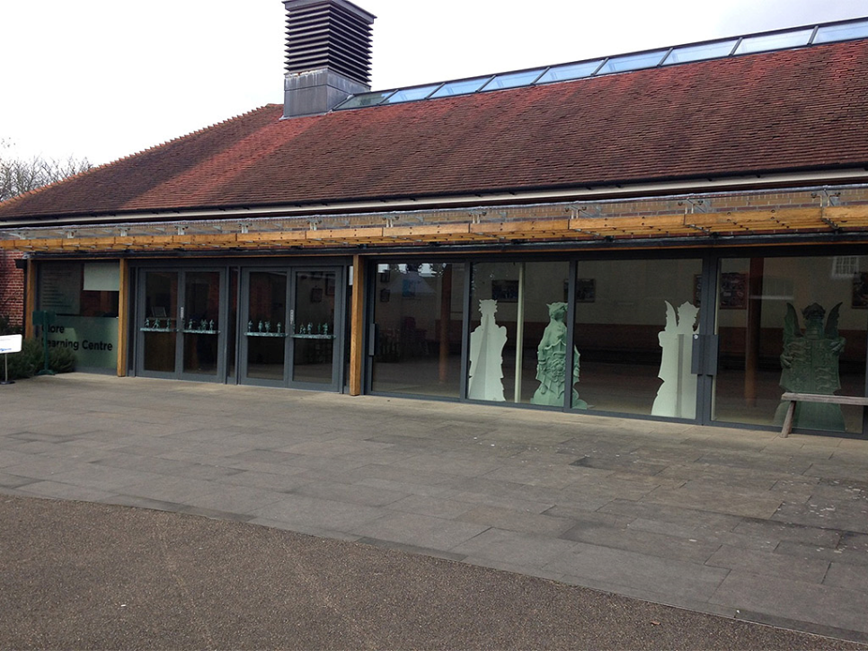
When you arrive, you will first come to this building.

Slide 7
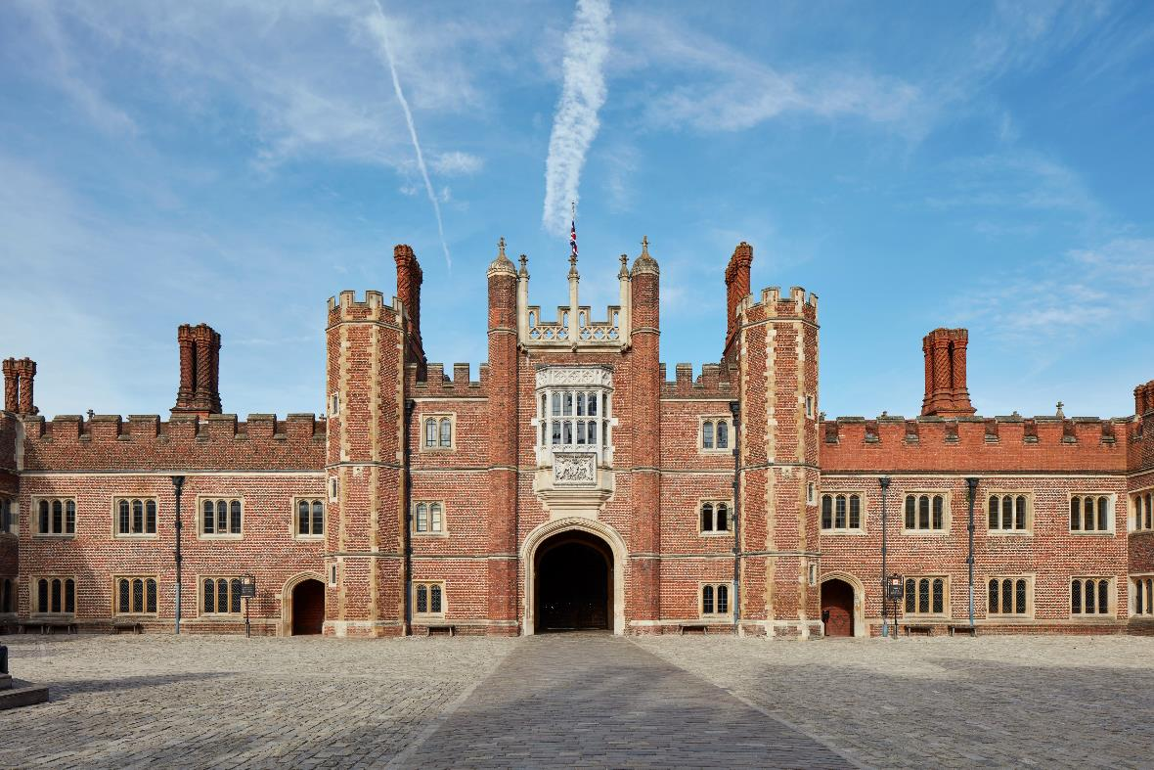
You will then go into the Palace and walk through this big place.

Slide 8
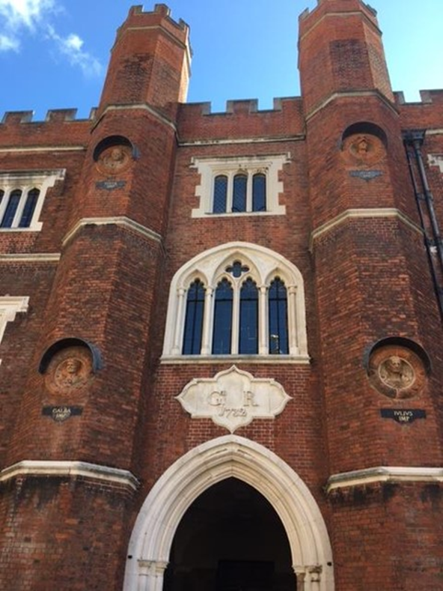
You will see the sign for the Georgian Rooms.

Slide 9
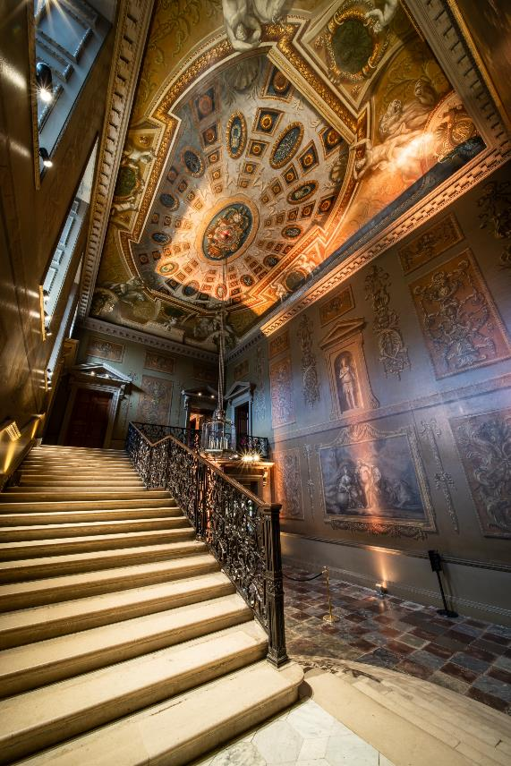
You will stand below this staircase and listen to music.

Slide 10
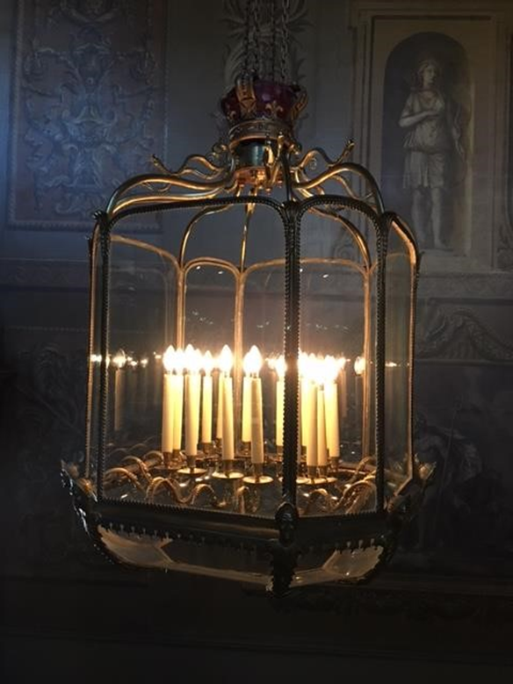
You can look up and see this object.

Slide 11
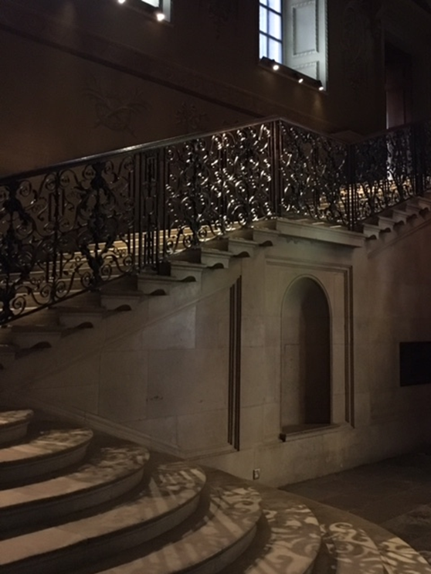
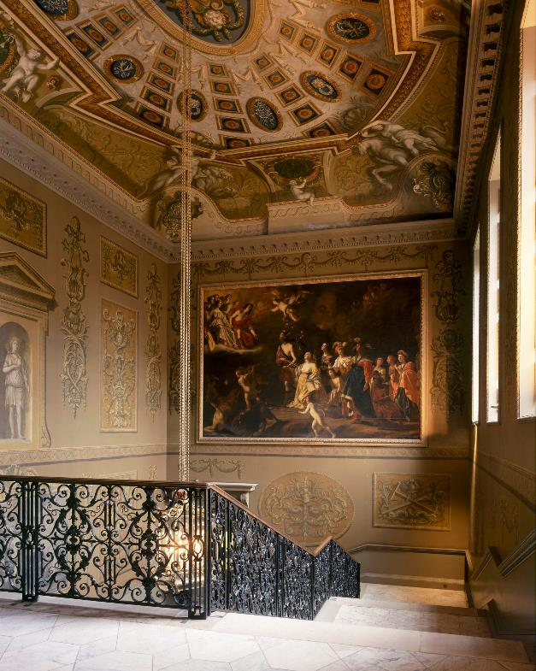
You can hold onto this handrail to climb the stairs.

Slide 12
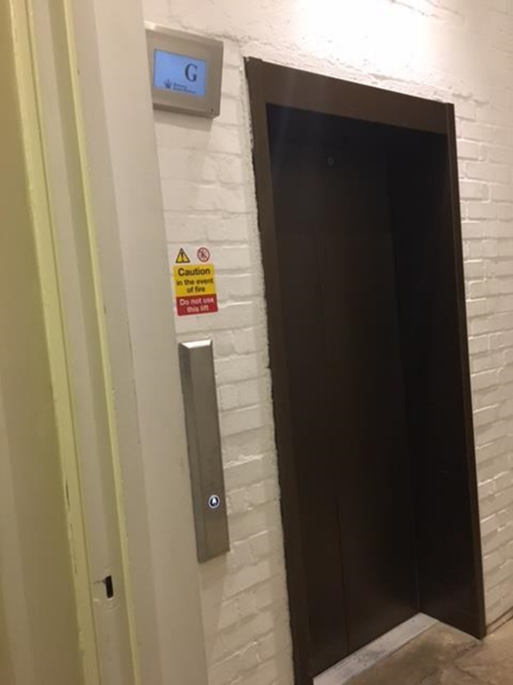
There is a lift you can use to go to the First Floor.

Slide 13
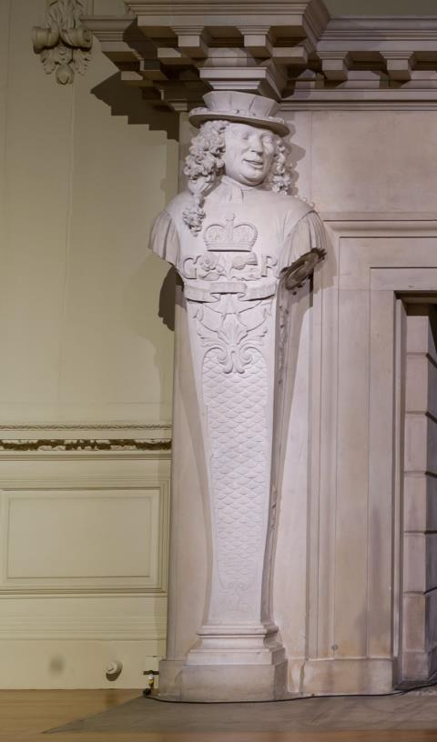
You will see this sculpture in the Guard Chamber.

Slide 14
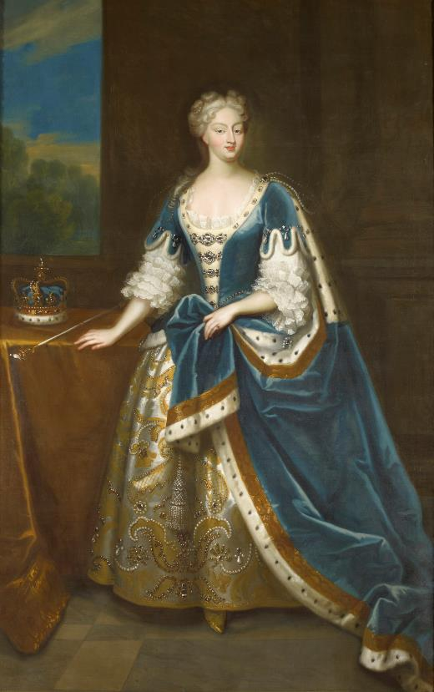
You can look at this portrait in the Presence Chamber.
© Royal Collection Enterprises Limited 2025 | Royal Collection Trust

Slide 15
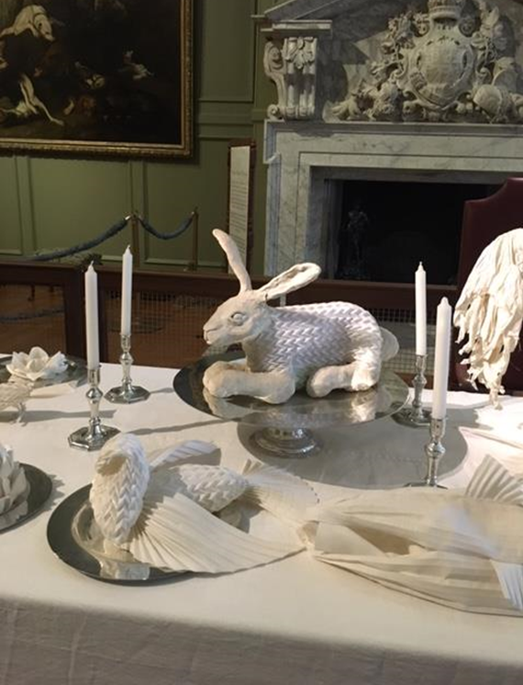
You will see this table in the Public Dining Room.

Slide 16
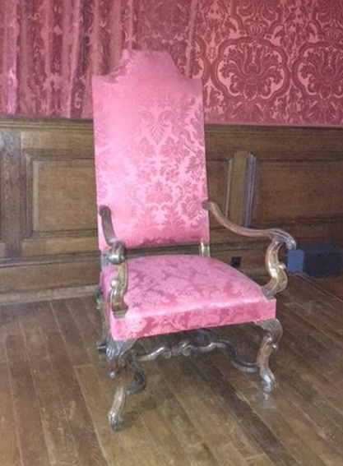
Look for this special chair in the Queen's Privy Chamber.

Slide 17
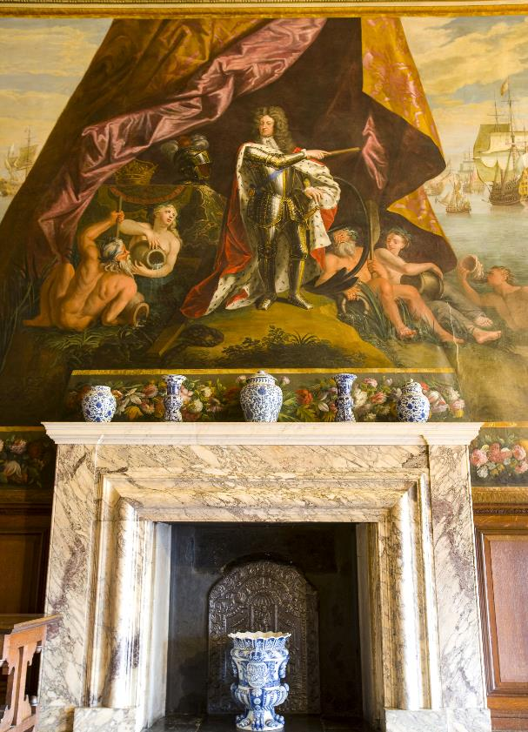
You will see this mural in the Queen's Drawing Room.

Slide 18
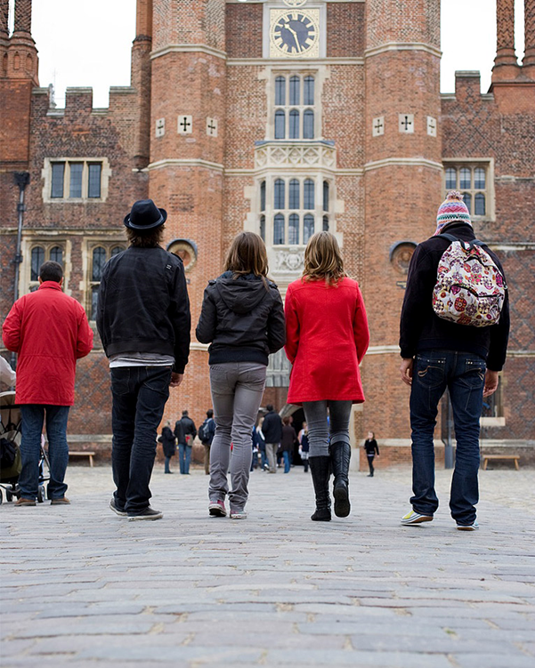
Hampton Court Palace is busy.

Slide 19
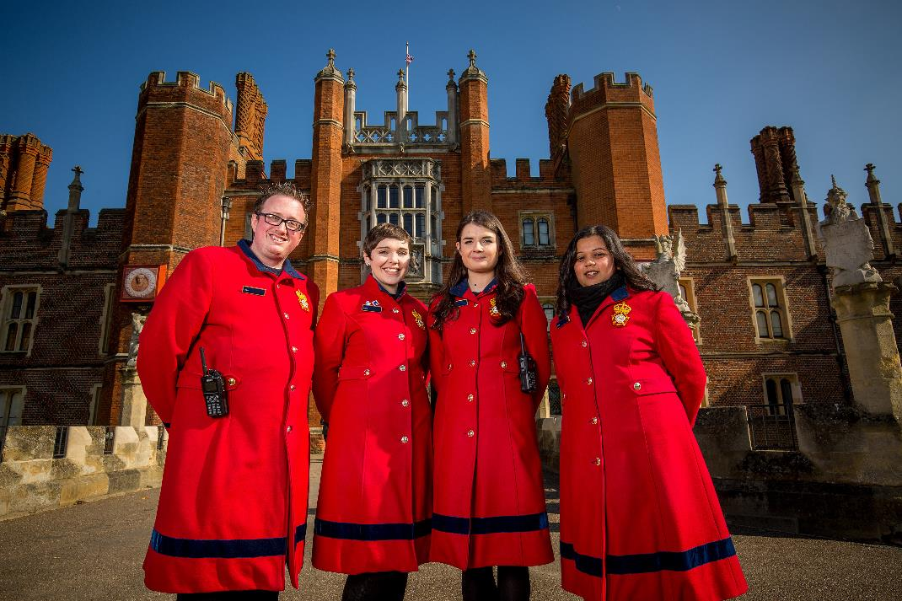
There are staff called Warders who can help you when you are exploring the Palace.

Slide 20
We hope you enjoy your visit.

