Slide 1



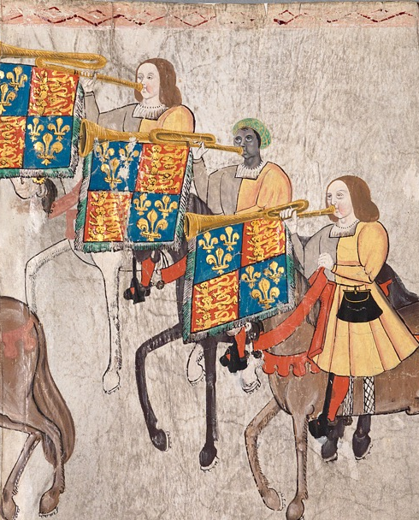


WATCH-ALONG GUIDE
BEFORE WATCHING
KEY THEMES
WIDER HISTORICAL THEMES
John Blanke is a significant individual because he was a skilled musician who played the trumpet for King Henry VIII. He is especially important because he is
the only Black person from Tudor England whose name and image we know today.
Entertainment was a big part of Tudor life, and musicians like John Blanke played an important role in royal events and celebrations.
This video can help explore diversity in Tudor England. The Tudor period was a time of exploration, and people from different parts of the world, including Africa and Asia, lived and worked in England. Black people held many different jobs during this time, including important roles like John’s.
It is also important to note that slavery was not a legal status in England during the Tudor period.
Society | During the Tudor period, there was lots of exploration and travel,
which led to a more diverse population
in England.
In the video, John says, “There aren’t many Black people at Tudor court. But many people from Asia and Africa have travelled to England.”
Respected musician
Someone who is admired for being very good at playing music.
Tournament roll
A long, illustrated document made on animal skin that shows and describes a special event. In the video, we see the Westminster Tournament Roll, which shows a celebration held in 1511.
JOHN
BLANKE
SOURCES USED IN THE VIDEO
Tournament roll | This important image shows John playing the trumpet while riding a horse. This is the only image we have of John from when he was alive.
Documents | A letter from John to the King asking for a pay rise shows that John was confident and knew he was highly skilled.

Slide 2
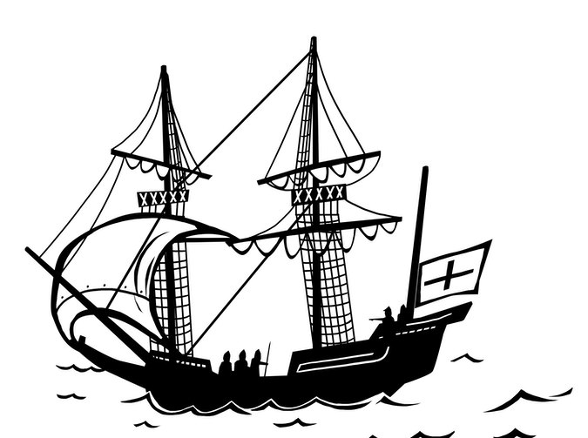
WHILE WATCHING
00:17
00:47
2:10
3:19
4:17
END
MEETING JOHN BLANKE
MISSING PIECE
OF HISTORY
IDENTIFYING JOHN BLANKE
DIVERSITY IN TUDOR ENGLAND
THE TRUMPET
REMEMBERING JOHN BLANKE
How does this object help tell John Blanke’s story?
The trumpet was a very important instrument in royal ceremonies. It made a loud, powerful sound, and people who played it— like John —were seen as important and skilled.
How many pictures are there of musicians alive today?
Musicians today will have lots of photographs of them! But there is only one known image of John Blanke. He is the only Black Tudor whose name and image we know. This picture is a rare piece of evidence about his life.
Why might we know so little about people from the past?
We don’t have all the evidence from history because some documents, images, and stories are lost over time. We know much more about kings and queens than about people like John Blanke.
Can you find something on John’s clothes that shows he worked for King Henry VIII?
The letters “HR” on John’s tunic stand for “Henry Rex” (King Henry). Even today, the King or Queen of England uses the letter “R” to show they are the ruler.
Remind students that people from many different parts of the world lived in Tudor England and worked in a variety of jobs— including important ones like John’s.
Why should we remember John Blanke today?
John’s story shows us that Black people lived and worked in Tudor England. His job as a royal trumpeter proves that people from different backgrounds could hold important and respected roles.
AFTER WATCHING
HOW DO WE KNOW?
KNOWLEDGE SUMMARY
Introduce the idea of a historical source—something historians use to study the past. Explain that evidence is the information we get from these sources to understand and explain history.
A supporting PowerPoint presentation is available to help students study the sources shown in the video, including the Westminster Tournament Roll and
John Blanke’s letter asking for a pay rise.
These activities help students explore how sources shape what we know about historical figures.
John Blanke is a significant individual.
Tudor England was more diverse than many people realise. People from Africa, Asia and other parts of the world lived and worked in England.
John Blanke is the only known Black Tudor with both an image and a
recorded name.
He was a respected musician who played the trumpet for King Henry VIII and performed at special events, including the Westminster Tournament of 1511.
Image credit: College of Arms MS Westminster Tournament Roll, 1511, membrane 28. Reproduced by permission of the Kings, Heralds and Pursuivants of Arms.

