Slide 1
HAMPTON COURT PALACE

Slide 2
Visual Story
Hampton Court Palace – Tudor Kitchens

Slide 3
Welcome to Hampton Court Palace

Slide 4
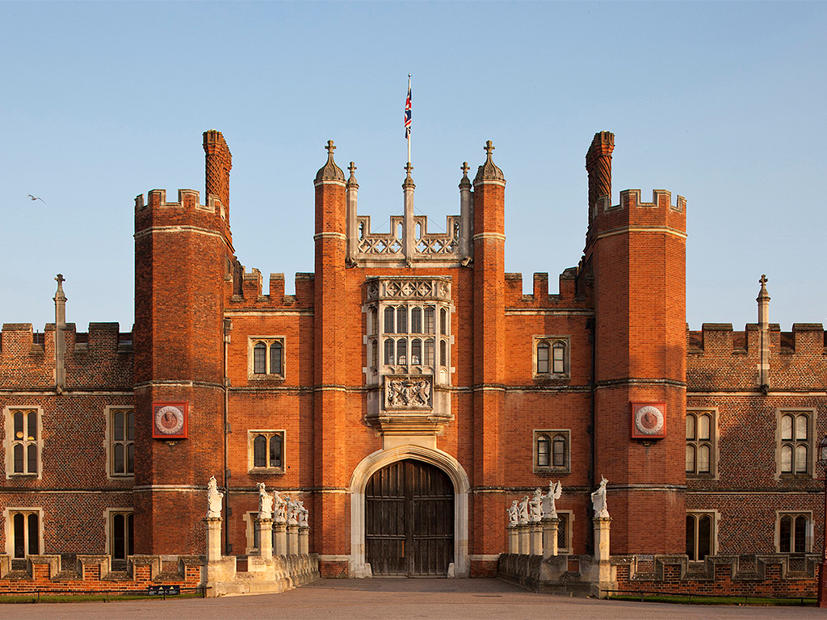
This is Hampton Court Palace. Come and look inside.

Slide 5
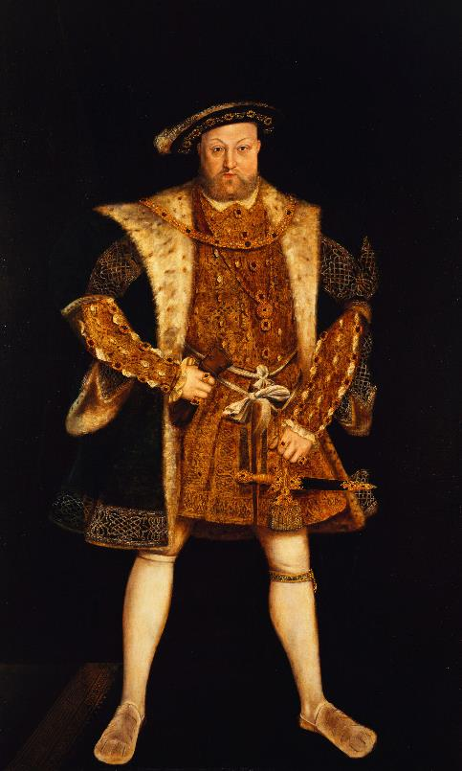
Henry VIII lived at Hampton Court Palace 500 years ago.
© Royal Collection Enterprises Limited 2025 | Royal Collection Trust

Slide 6
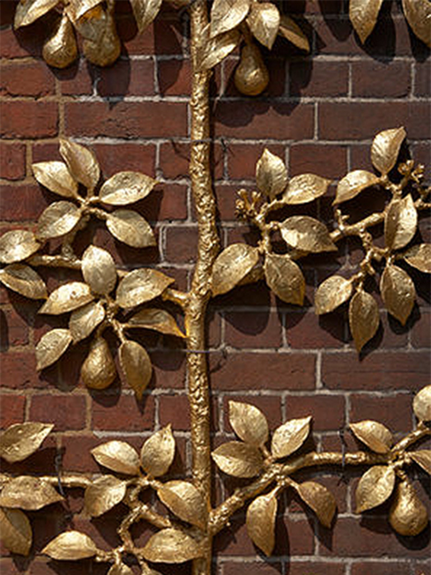
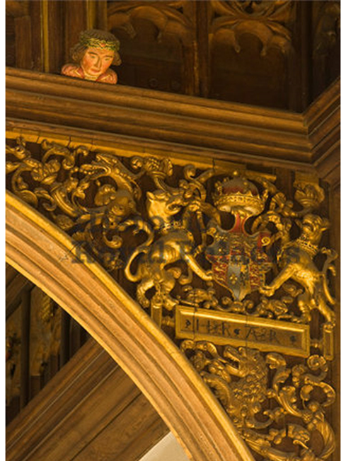
Many things at Hampton Court Palace are a gold colour.

Slide 7
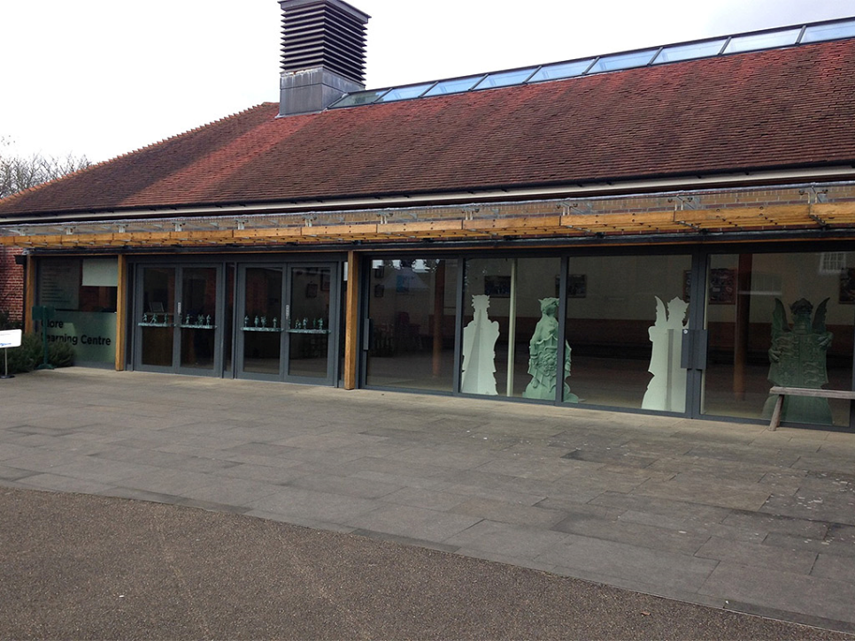
When you arrive, you will first come to this building.

Slide 8
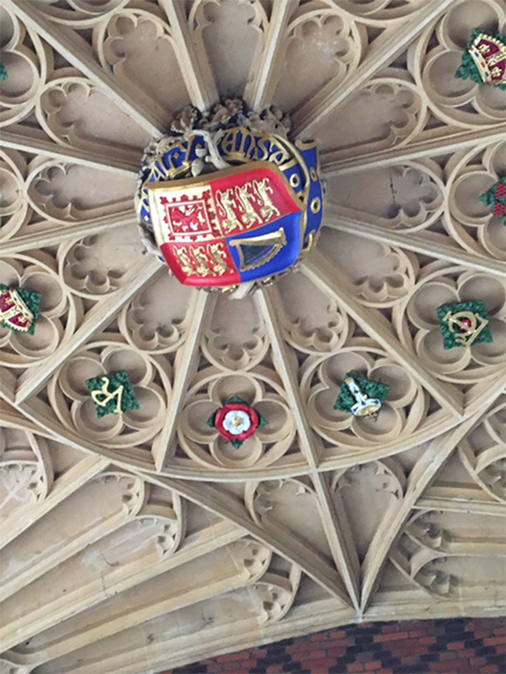
At Hampton Court Palace, you can look up to see this.

Slide 9
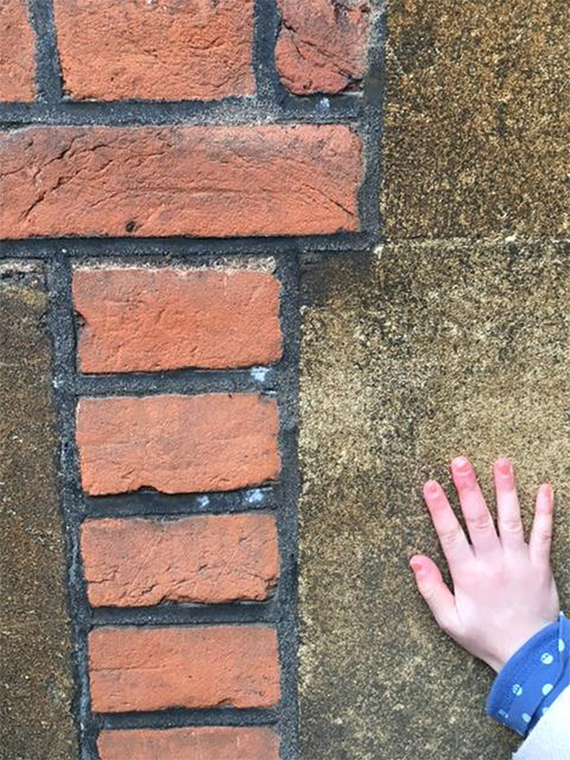
You can also feel the brickwork.

Slide 10
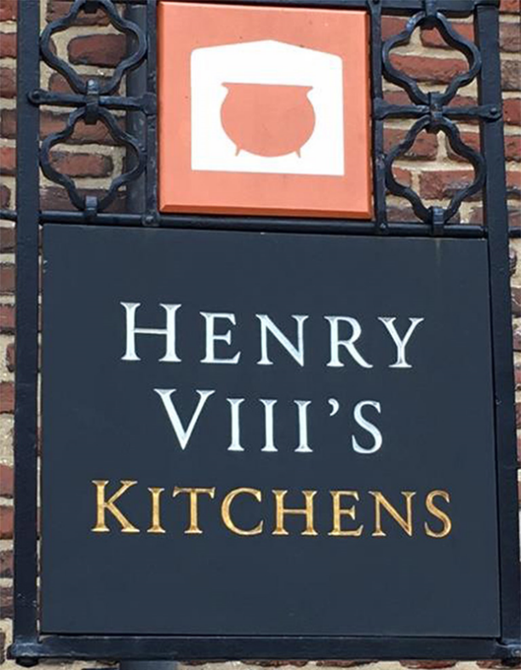
You will see the sign for the Tudor Kitchens.

Slide 11
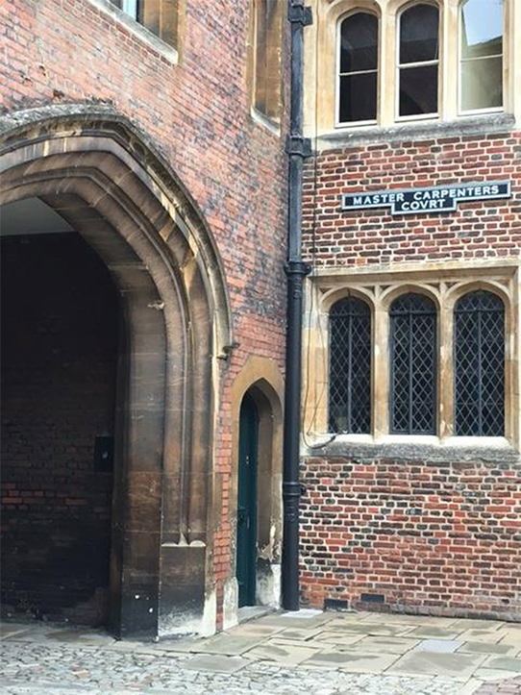
You can stand under this archway and listen to a sound.

Slide 12
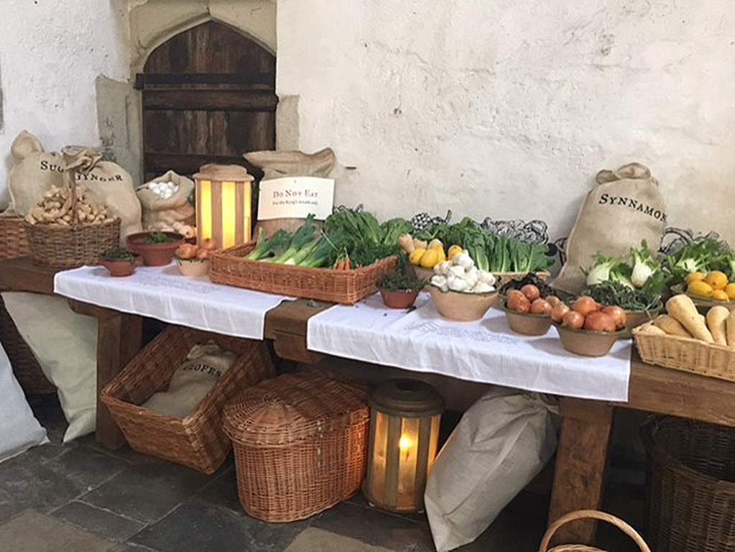
You can look inside the Tudor Kitchens.

Slide 13
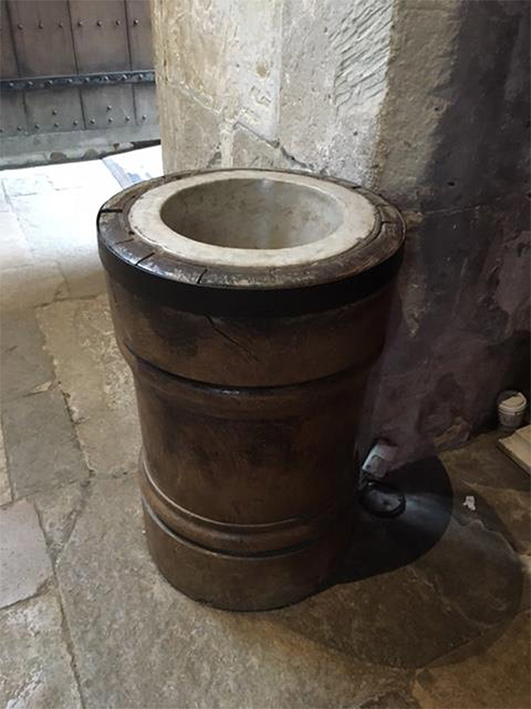
Look out for this big object in the Great Kitchen.

Slide 14
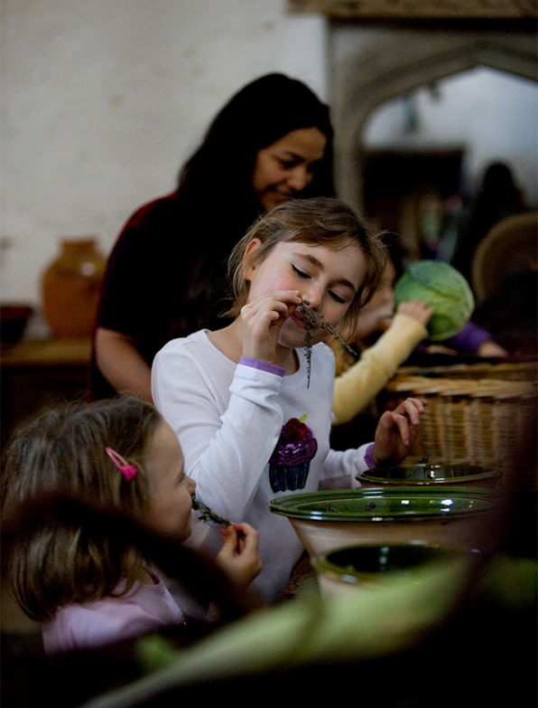
You can touch vegetables and smell some herbs.

Slide 15
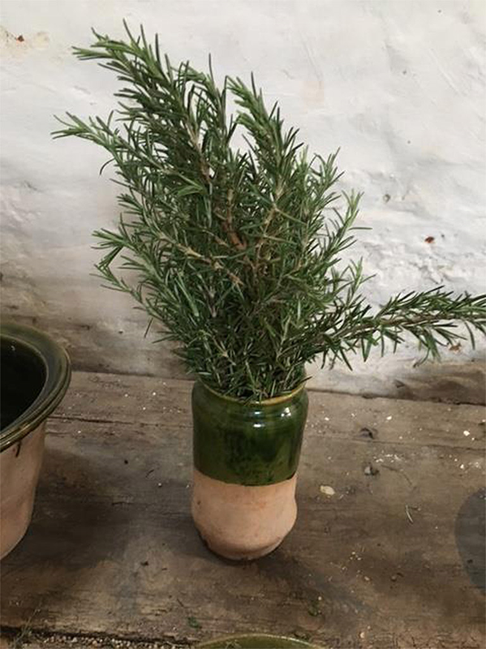
This is one of the herbs you can smell.

Slide 16
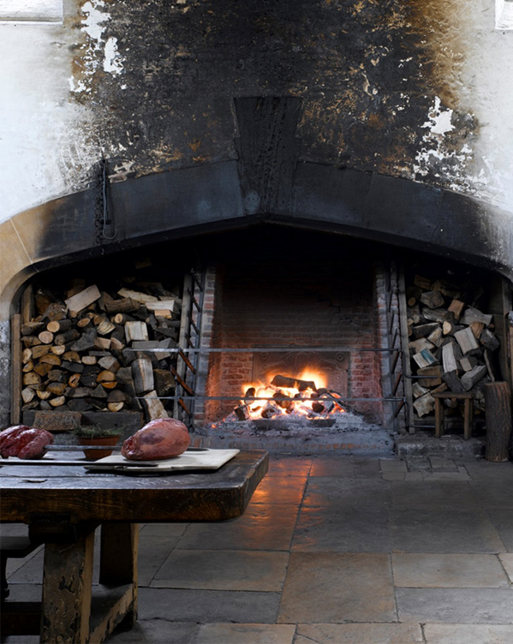
You will see and smell the Great Fire.

Slide 17
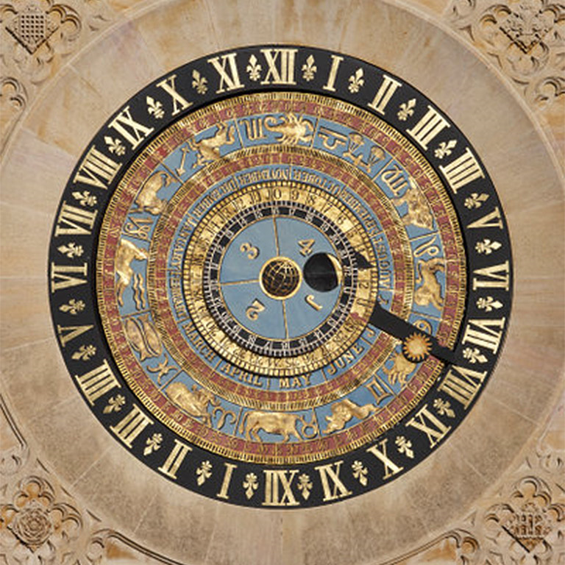
You might see this special object at Hampton Court Palace.

Slide 18
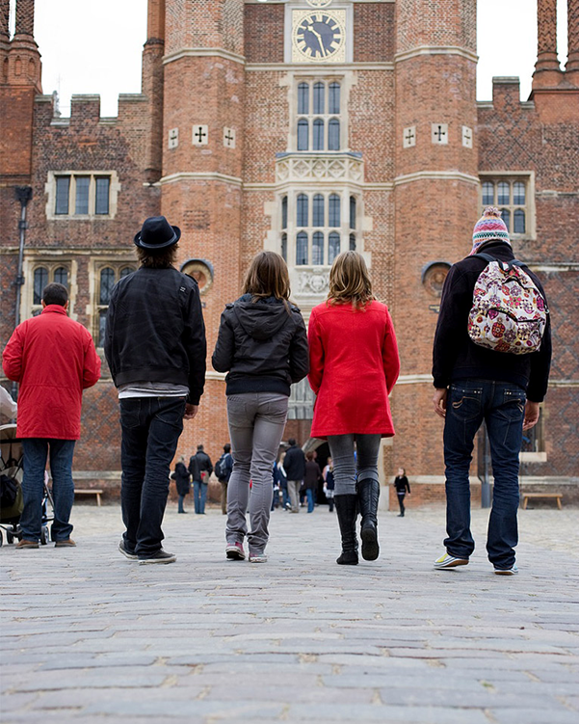
Hampton Court Palace is busy.

Slide 19
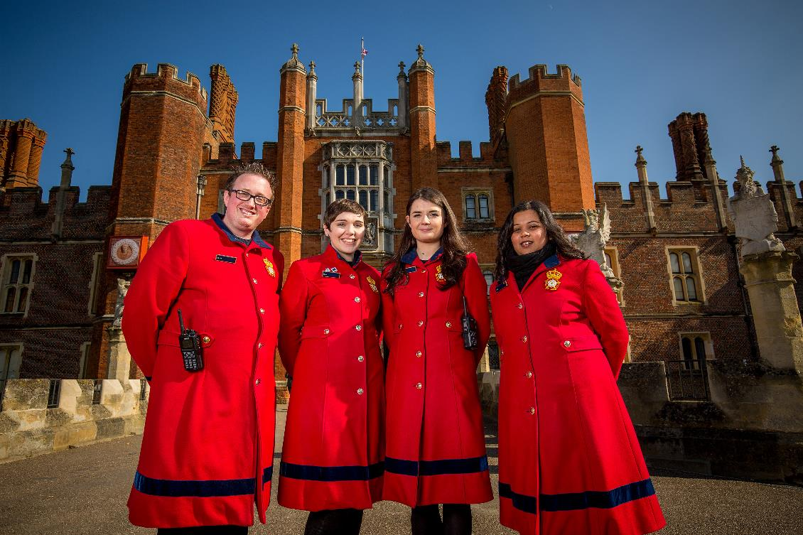
There are staff called Warders who can help you when you are exploring the Palace.

Slide 20
We hope you enjoy your visit.

