Slide 1




HOW TO USE - NOTES FOR TEACHERS
These resources from Historic Royal Palaces are multi-purpose.
They are ready for you to tweak and use in your lessons.
For the best experience, download and open the
file in the PowerPoint
desktop app.
Answers are found
under the slide. Click
on the notes symbol at
the bottom of the screen.
Delete text and images to make your own worksheets.
Disclaimer and Use Terms
We are the owner or the licensee of all intellectual property rights in these resources which are protected by copyright laws and treaties around the world. All such rights are reserved. These resources, and the content included within them, may be used by you for educational purposes only. This means that you may download the resources and use or share them solely in educational environments (including for home school lessons) or as part of homework. You may not share the resources other than for the above purposes and you must not use the resources, or any part of them, for any commercial purpose.

Slide 2




YORK AND LANCASTER FAMILY TREE PART 1
YORK & LANCASTER
FAMILY TREE
KEY
r. reigned
monarch
married
line of descent
EDWARD III
1312-77 (r. 1327-77)
JOHN OF GAUNT
LIONEL
1338-68
1340-99

Slide 3






YORK AND LANCASTER FAMILY TREE PART 2
YORK & LANCASTER
FAMILY TREE
KEY
r. reigned
monarch
married
line of descent
EDWARD III
1312-77 (r. 1327-77)
JOHN
OF GAUNT
LIONEL
1338-68
1340-99
RICHARD
DUKE OF YORK
HENRY V
YORK
1386-1422 (r. 1413-22)
LANCASTER
1411-60
ELIZABETH WOODVILLE
EDWARD IV
GEORGE
DUKE OF CLARENCE
RICHARD III
HENRY VI
MARGARET
OF ANJOU
1442-83
(r. 1461-70 & 1471-83)
1452-85 (r. 1483-85)
1421-71
(r. 1422-61 & 1470-71)
1437-92
(r. 1464-70 & 1471-83)
1449-78
1430-82
(r. 1445-61 & 1470-71)
EDWARD
DUKE OF WARWICK
EDWARD OF MIDDLEHAM
1475-99
1474-84
EDWARD OF WESTMINSTER
1453-71

Slide 4




YORK AND LANCASTER FAMILY TREE PART 3
YORK & LANCASTER
FAMILY TREE
KEY
r. reigned
monarch
married
line of descent
EDWARD III
1312-77 (r. 1327-77)
JOHN
OF GAUNT
LIONEL
1338-68
1340-99
RICHARD
DUKE OF YORK
HENRY V
YORK
1386-1422 (r. 1413-22)
LANCASTER
1411-60
ELIZABETH WOODVILLE
EDWARD IV
GEORGE
DUKE OF CLARENCE
RICHARD III
HENRY VI
MARGARET
OF ANJOU
1442-83
(r. 1461-70 & 1471-83)
1452-85 (r. 1483-85)
1421-71
(r. 1422-61 & 1470-71)
1437-92
(r. 1464-70 & 1471-83)
1449-78
1430-82
(r. 1445-61 & 1470-71)
EDWARD
DUKE OF WARWICK
EDWARD OF MIDDLEHAM
1475-99
1474-84
EDWARD OF WESTMINSTER
1453-71
EDWARD V
RICHARD OF SHREWSBURY
ELIZABETHOF YORK
HENRY VII
1470-?
(r. 1483)
1457-1509
(r. 1485-1509)
1473-?
1466-1503
(r. 1486-1503)

Slide 5


YORK AND LANCASTER FAMILY TREE EXTRA DETAILS
What happened before?
YORK & LANCASTER
FAMILY TREE
Edward III inherited the throne from his father, Edward II, who was deposed and murdered.
EDWARD III
1312-77 (r. 1327-77)
JOHN
OF GAUNT
LIONEL
1338-68
1340-99
Henry V’s wife was Catherine of Valois. After his death she married Owen Tudor. They were Henry VII’s grandparents.
RICHARD
DUKE OF YORK
HENRY V
1386-1422 (r. 1413-22)
1411-60
ELIZABETH WOODVILLE
EDWARD IV
GEORGE
DUKE OF CLARENCE
RICHARD III
HENRY VI
MARGARET
OF ANJOU
1442-83
(r. 1461-70 & 1471-83)
1452-85 (r. 1483-85)
1421-71
(r. 1422-61 & 1470-71)
1437-92
(r. 1464-70 & 1471-83)
1449-78
1430-82
(r. 1445-61 & 1470-71)
EDWARD
DUKE OF WARWICK
EDWARD OF MIDDLEHAM
1475-99
1474-84
EDWARD OF WESTMINSTER
What happened after?
1453-71
Henry VII and Elizabeth of York united the Lancastrians and the Yorkists and founded the Tudor dynasty.
EDWARD V
RICHARD OF SHREWSBURY
ELIZABETHOF YORK
HENRY VII
1470-?
(r. 1483)
1457-1509
(r. 1485-1509)
1473-?
1466-1503
(r. 1486-1503)

Slide 6

CLASSROOM TASKS
Q1
Was Henry V a Yorkist or a Lancastrian King?
Q2
In what year did Henry VI inherit the throne?
Q3
How old was Edward IV when he first became King?
Q4
How were Edward V, Edward Duke of Warwick and Edward of Middleham related?
Notes:
Classroom task Answers
Henry V was a Yorkist King.
Henry VI inherited the throne in 1421.
Edward was nineteen when he first became King.
They were cousins because their fathers were brothers.

Slide 7
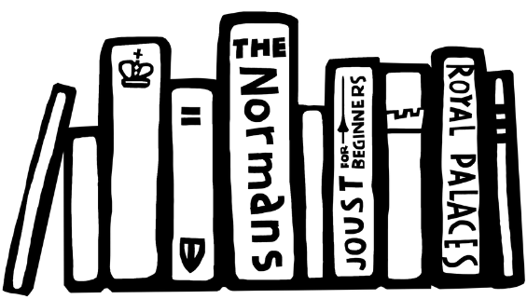
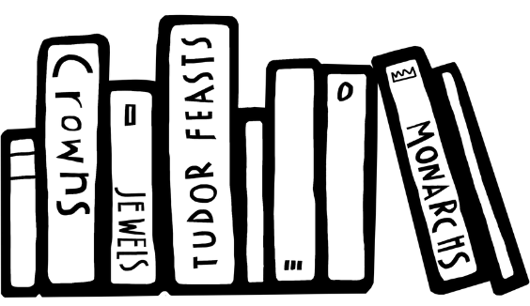
VOCABULARY LIST
depose | remove someone from power
dynasty | series of leaders from the same family
inherited | given something such as money or a title after the death of the person who owned or held them before
Lancastrians | supporter of the Lancaster side in the Wars of the Roses
Yorkists | supporters of the York side in the Wars of the Roses
Wars of the Roses | battles fought in England between 1455 and 1485 between Yorkists and Lancastrians

Slide 8

IMAGES
Edward III | © National Portrait Gallery, London
Elizabeth Woodville | Royal Collection Trust / © His Majesty King Charles III 2024
Edward IV | Royal Collection Trust / © His Majesty King Charles III 2024
George Duke of Clarence | Philip Mould & Company, London
Richard III | © National Portrait Gallery, London
Henry VI | Courtesy of the British Library Royal 15 E. VI
Margaret of Anjou | Courtesy of the British Library Royal 15 E. VI
Edward V | © National Portrait Gallery, London
Richard of Shrewsbury | © Historic Royal Palaces
Elizabeth of York | © National Portrait Gallery, London
Henry VII | © National Portrait Gallery, London

