Slide 1
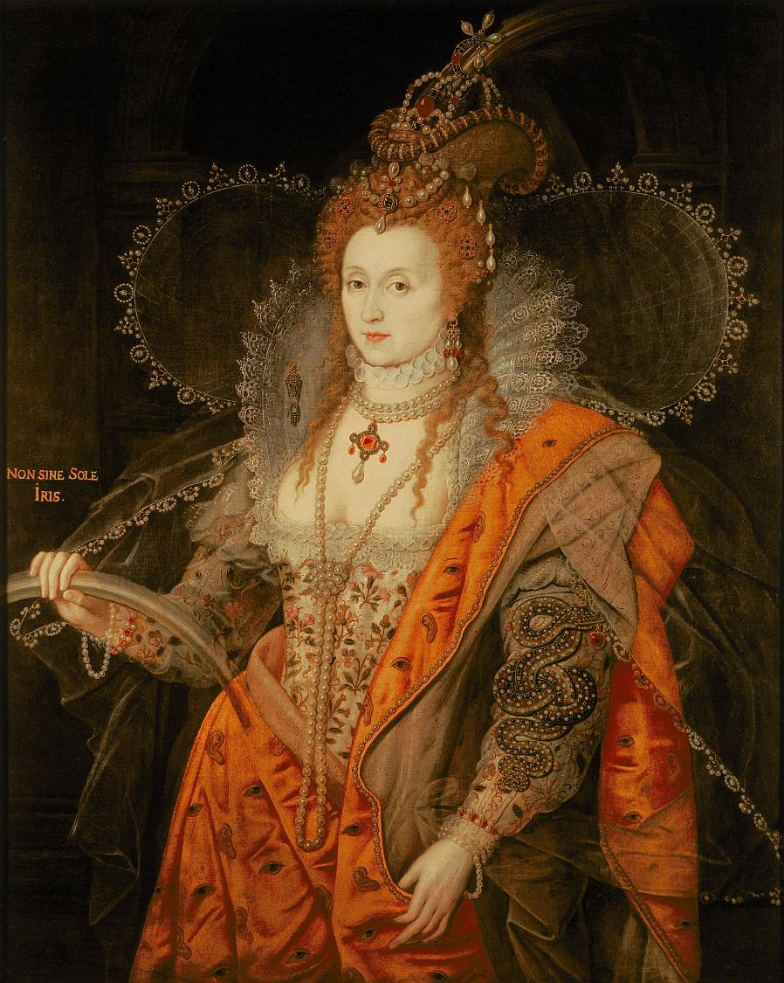

The Rainbow Portrait
Find more details and full image credits in the ‘Notes’ section below the slide.
Credit: Hatfield House, Hertfordshire, UK/Bridgeman Images.
Notes:
Disclaimer and Use Terms
We are the owner or the licensee of all intellectual property rights in these resources which are protected by copyright laws and treaties around the world. All such rights are reserved. These resources, and the content included within them, may be used by you for educational purposes only. This means that you may download the resources and use or share them solely in educational environments (including for home school lessons) or as part of homework. You may not share the resources other than for the above purposes and you must not use the resources, or any part of them, for any commercial purpose.
The Rainbow Portrait of Elizabeth I uses her clothing to illustrate her power and position. She uses symbols incorporated into her clothing to communicate different ideas:
The portrait shows that she is vibrant, youthful, goddess-like, other worldly and totally in control
Snake represents knowledge and intelligence and the and the heart shaped jewel in it’s mouth represents mercy.
The eyes and ears painted on the orange taffeta mantel show that Elizabeth I is omnipresent - she sees and hears everything.
The wings in this painting symbolise Elizabeth’s heavenly knowledge and divine power – she believed she ruled England because God had put her there.
The pearls represent purity
Image of Queen Elizabeth I, 'The Rainbow Portrait', c.1600 (oil on panel) by Oliver, Isaac (c.1565-1617)

Slide 2
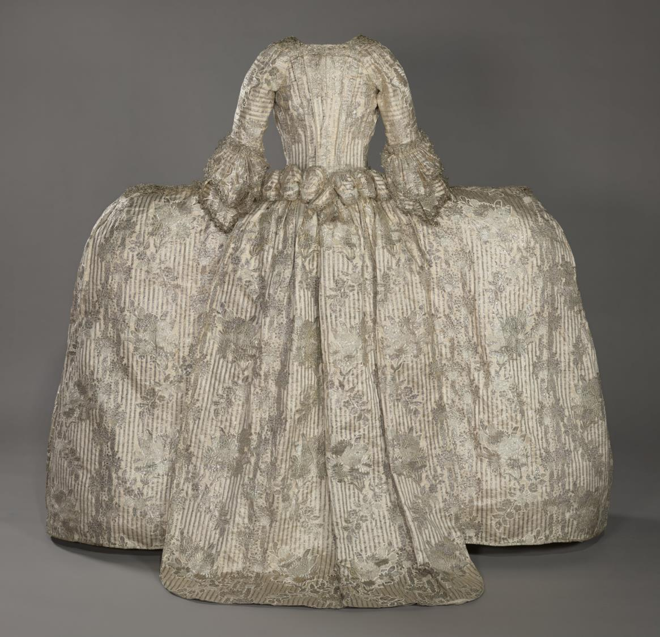
The Rockingham Mantua
Credit: Historic Royal Palaces
Notes:
The Rockingham Mantua
The Rockingham Mantua is a perfect example of court dress, showcasing wealth and status. It was likely worn by Mary, Marchioness of Rockingham, wife of British Prime Minister Charles Watson-Wentworth. It is:
Made of French silk satin brocaded with silver thread, featuring floral design.
Trimmed with silver lace
Made using 14 meters of fabric, it would cost over £10,000 today.
Likely worn by Mary, Marchioness of Rockingham, wife of British Prime Minister Charles Watson-Wentworth.

Slide 3
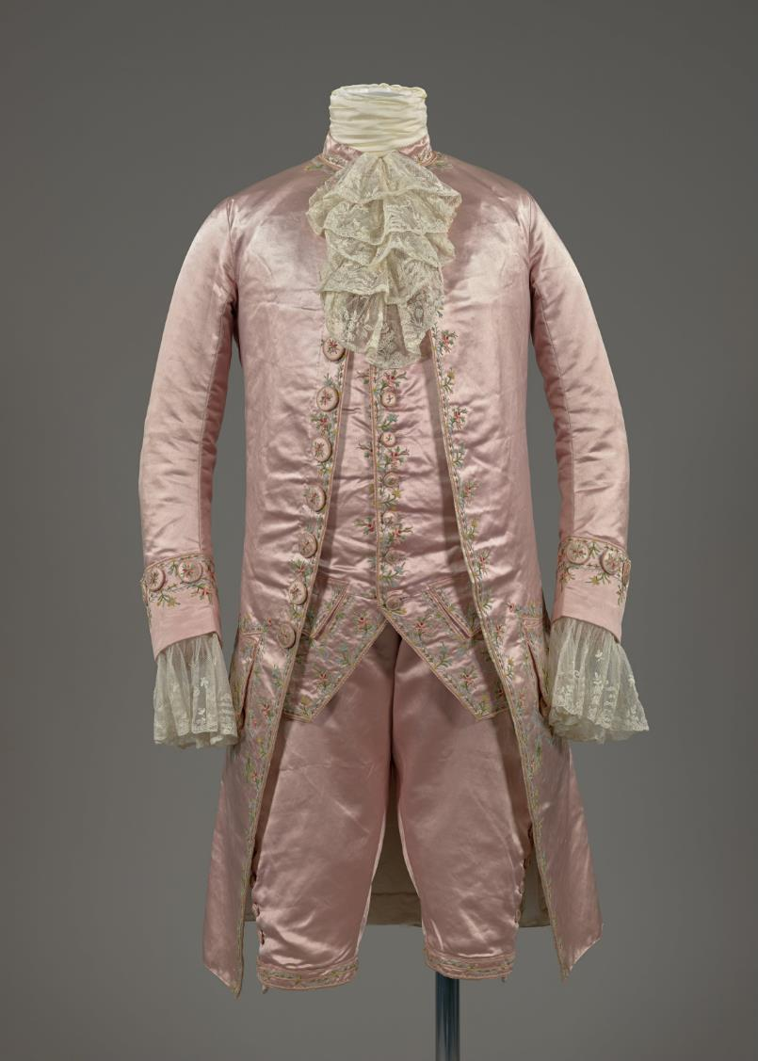
18th Century Court Suit
Credit: Historic Royal Palaces/Image captured by Google
Notes:
18th century court suit c. 1780
from the 1700s to present day, dressing to attend a royal court has always required you to dress your best. This richly embroidered 18th-century court suit, made entirely by hand, showcases the extravagant and colourful fashion worn by wealthy men at royal court. Such garments took months to make and were so expensive that courtiers sometimes mortgaged their homes to afford them. Though once essential for social advancement, this elaborate style fell out of general fashion by the century’s end, remaining mostly as formal court dress.

Slide 4
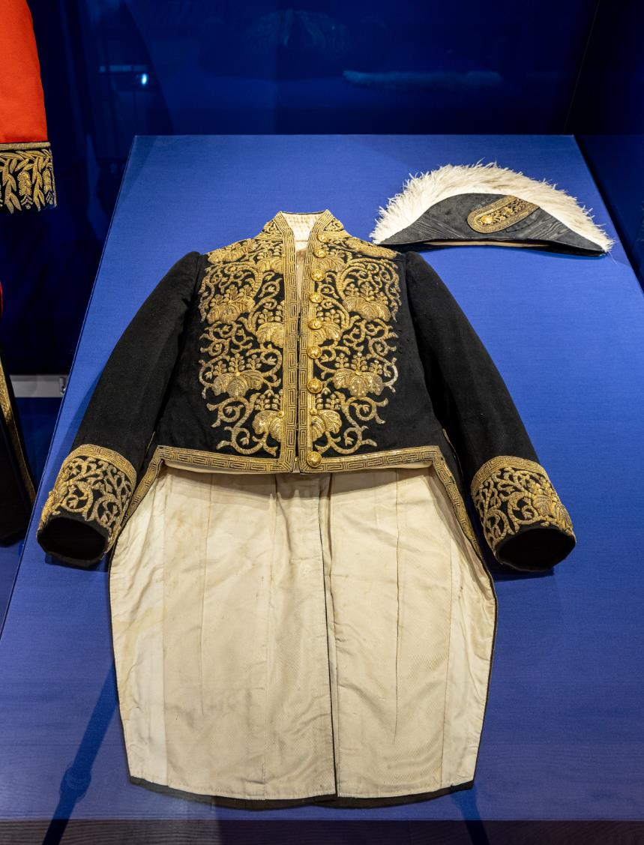
Japanese Court Suit c. early 1900s
Credit: Historic Royal Palaces
Notes:
Japanese Court Suit c. early 1900s
This Japanese court suit, taireifuku, is made from a dark woollen cloth with a white silk lining. It has metal buttons and is embellished with gold raised-work embroidery. It is probably from the early 20th century

Slide 5
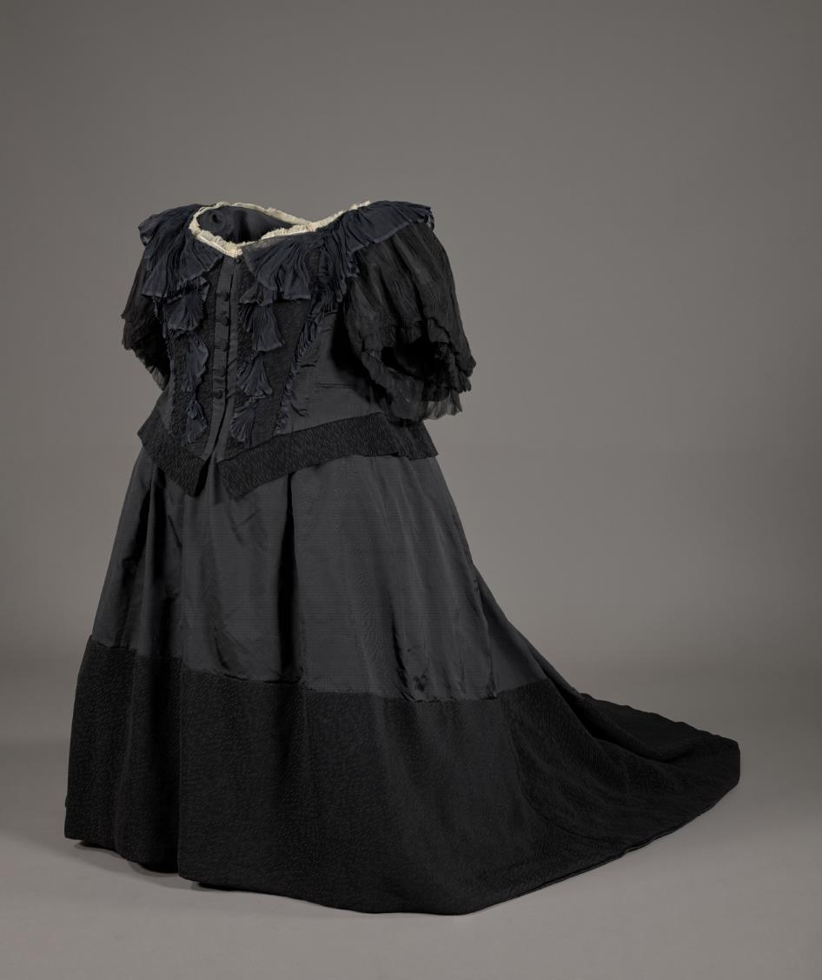
Dress worn by Queen Victoria, designed by Martha Dudley1898
Credit: Historic Royal Palaces/Image captured by Google
Notes:
Dress worn by Queen Victoria, designed by Martha Dudley1898
Queen Victoria wore black mourning clothes from Prince Albert’s death in 1861 until her own, reflecting her deep grief and shaping a distinct, recognisable public image. This particular dress, made of satin and crepe with lightweight chiffon sleeves for summer wear, combines rich textures to create a sense of majesty. Accompanied by a note and royal seal verifying its origin from Osborne House, it’s an example of the royal garments often gifted to loyal household staff and preserved with documented provenance.

Slide 6
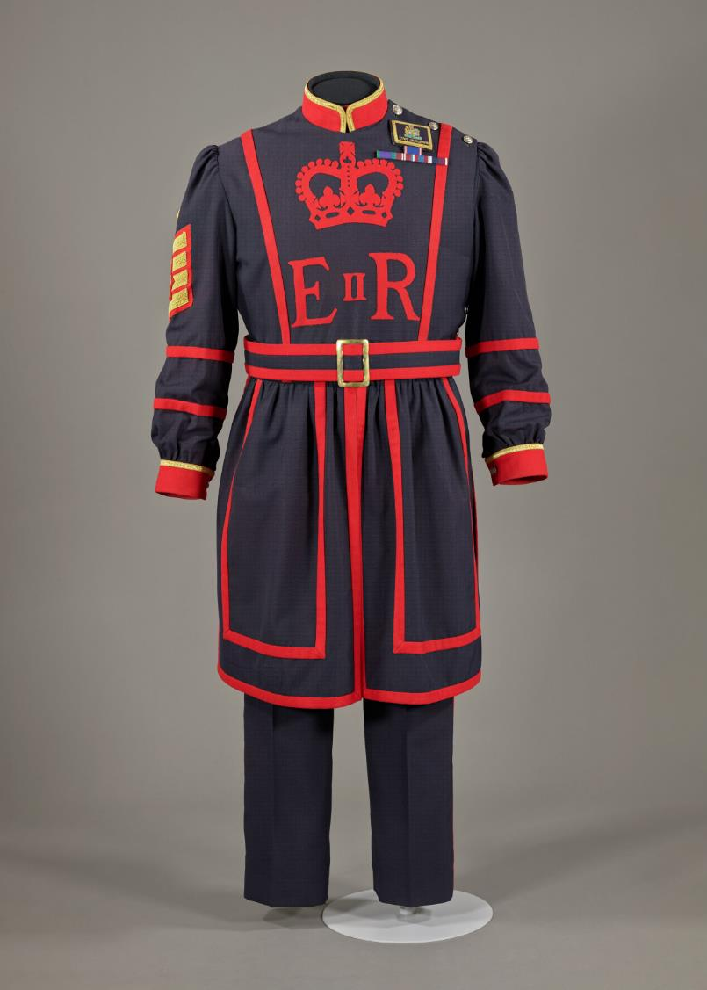
Yeoman Warder uniform
Credit: Historic Royal Palaces/Image captured by Google
Notes:
Yeoman Warder uniform
Uniforms are both practical items and a way to create a sense of belonging, convey status and identity within an official workplace. Uniforms in royal settings follow particularly strict codes, based upon protocols which can be hundreds of years old.
The Yeoman Warders trace their origins back to the reign of Henry VII in the late 15th century when they were established as a royal bodyguard but are a separate entity from the Yeoman of the Guard corps of Royal Bodyguards of the British monarch, although the uniform is are very similar, the latter wearing also a cross belt from the left shoulder, used originally to support a short firearm.

Slide 7
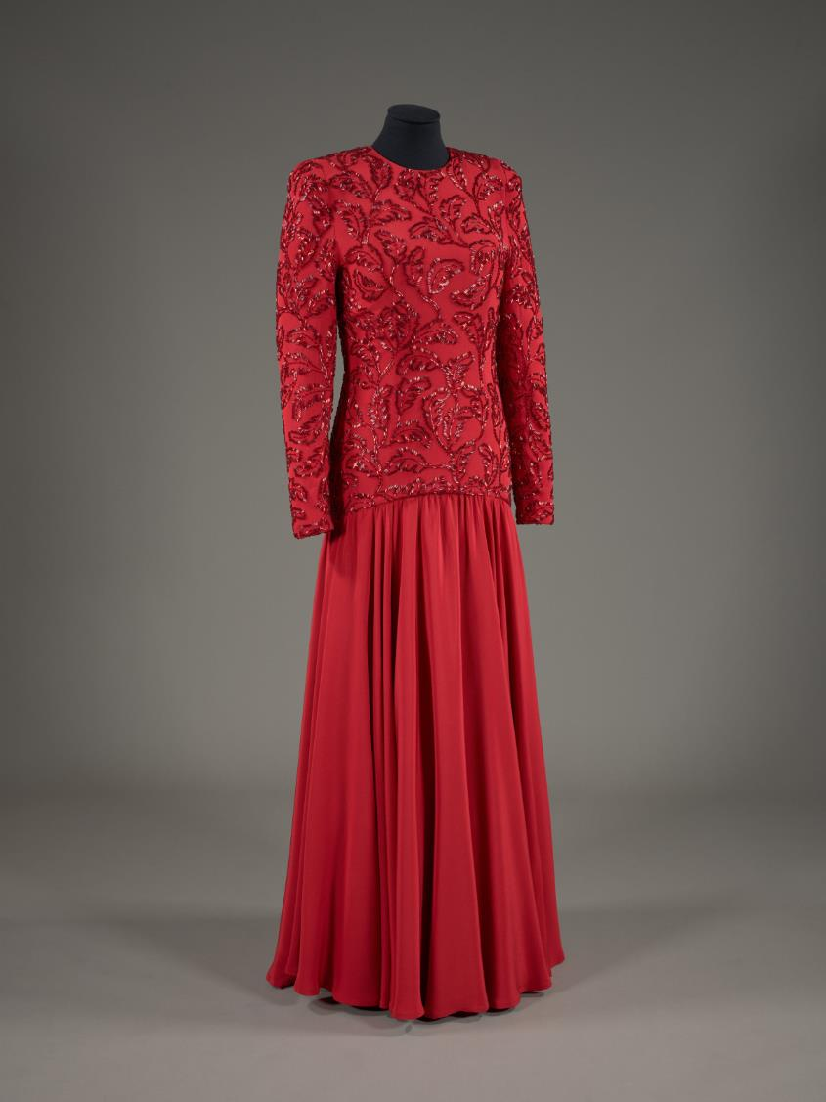
Evening dress worn by Diana, Princess of Wales, designed by Bruce Oldfield 1987
Credit: Historic Royal Palaces/Image captured by Google
Notes:
Evening dress worn by Diana, Princess of Wales, designed by Bruce Oldfield 1987
This silk evening gown with beaded embroidery was worn by Diana, Princess of Wales during a 1986 state visit to Saudi Arabia, designed with long sleeves and a high neckline to respect local customs. Created by British designer Bruce Oldfield, a favourite of Diana’s, the gown reflects 1980s fashion with its wide shoulders and dropped waist. In 1997, Diana sold this dress at a charity auction in New York, raising millions for HIV/AIDS and cancer causes.

Slide 8
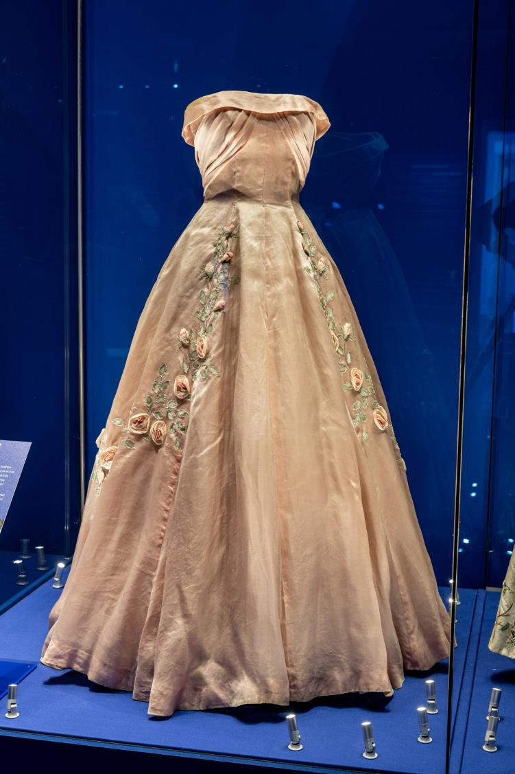
Debutante dress, designed by Worth1958
Credit: Historic Royal Palaces
Notes:
Debutante dress, designed by Worth1958
This debutante dress was worn by Georgina Grattan-Bellew during the 1958 season—the final year debutantes were presented at court. Designed by Worth London, it represents both the glamour and social expectations of upper-class women in post-war Britain. The end of the debutante tradition marked a broader cultural shift toward a more egalitarian society, as women increasingly sought education and careers over traditional roles.

