Slide 1
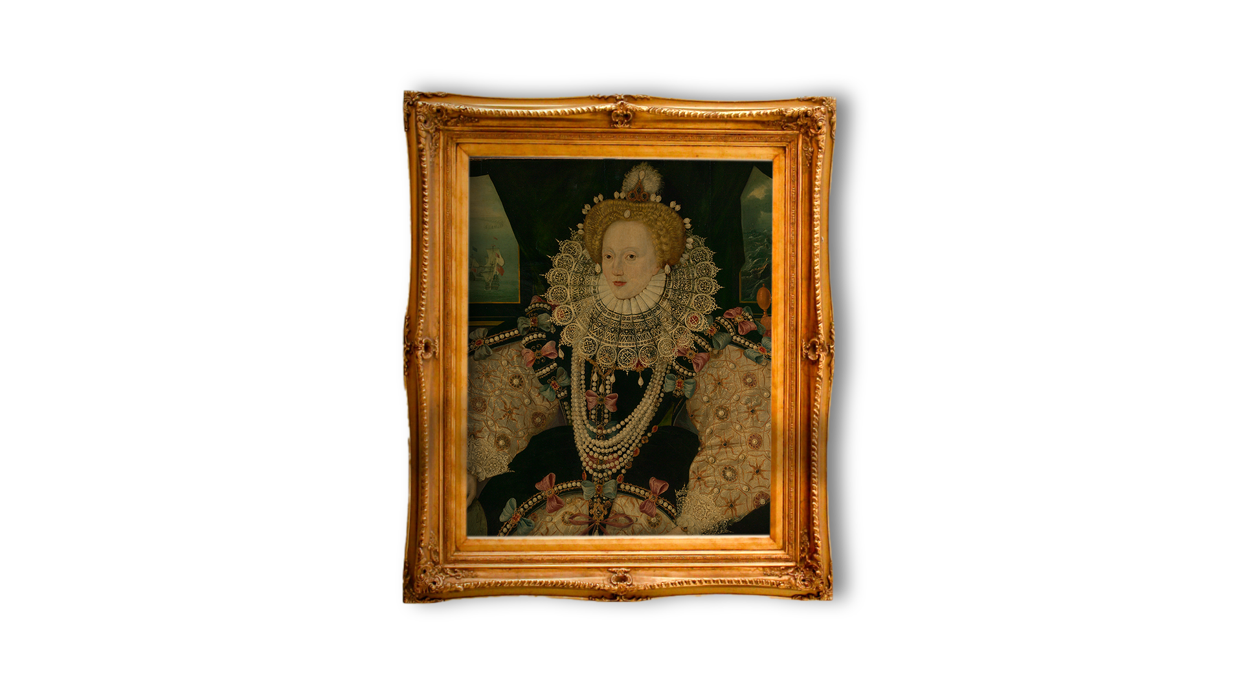

Queen Elizabeth I – source task
Queen Elizabeth I
– Source Task –
Notes:
Image Credit:
Elizabeth I Elizabeth 1, 1533 – 1603 (the Armada Portrait) © National Maritime Museum, Greenwich, London

Slide 2


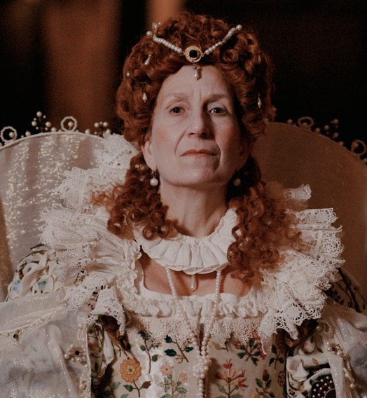
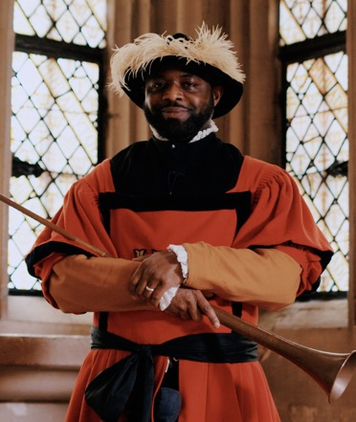
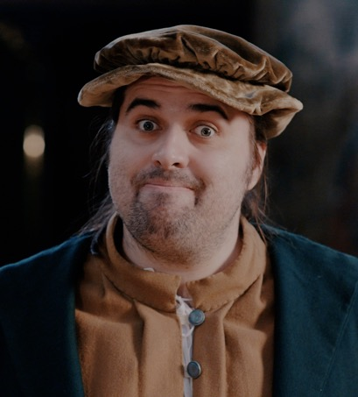
Have you watched me tell my story?
Have you watched me tell my story?
John Blanke
Will Somer
Elizabeth I
Notes:
Watch the videos: https://youtube.com/playlist?list=PLmQztN3936tL1ZgIHlfwlsKaRAqEDNQf1&feature=shared

Slide 3


Vocabulary
history | Learning about people, places and events from a long time ago to understand what life was like in the past.
source | Items from the past that help us learn about what happened. These might be portraits or documents.
evidence | Clues that help us understand and explain what life was like in the past.
portrait | A picture or artwork of a person. It can be a painting, a photograph or even a sculpture.
monarch | A king or queen who leads a country and makes important decisions.
dynasty | A family of kings and queens. When one monarch dies, their child usually becomes the next ruler.
court | The household of the monarch, including people who live and work with the king or queen, like their family and helpers.
crown | Something that a king or queen wears on their head to show they have power.
fleet | A group of ships, especially ones used in battles or by the navy.
Notes:
Teacher notes:
These terms are used in the video and this source task. It would be useful for students to be aware of them. However students do not need to memorise or discuss all of them.

Slide 4

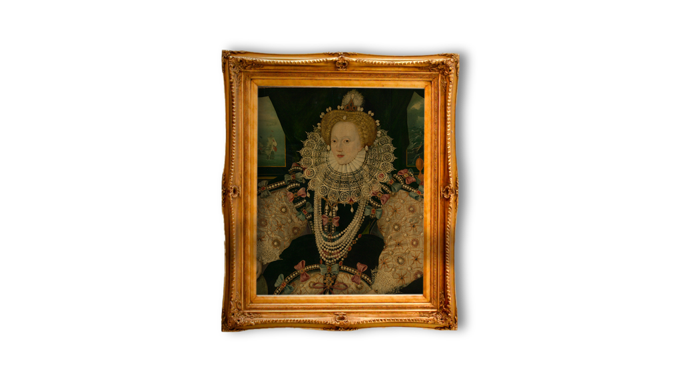

When did Elizabeth I live?
When did
Elizabeth I live?
Elizabeth was born almost 500 years ago!
TUDOR PERIOD
Henry VII
Henry VIII
Edward VI
Mary I
Elizabeth I
Further into the past
Now
Notes:
Teacher notes:
The purpose of this slide is for children to understand that this period of history is a long time in the past which is why life is so different to what they know.
Ask children to find 'now'. Explain this is where we are today.
Move finger back to the end of the bright blue section. This is how far the oldest people alive today can remember. The Tudors are further in the past than that.
Say the word Tudor and explain this was the family who ruled over England and who we will learn more about.
Queen Elizabeth I was born in 1533.

Slide 5


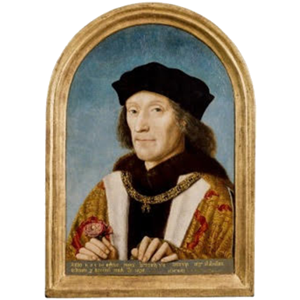


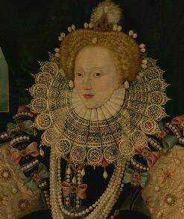
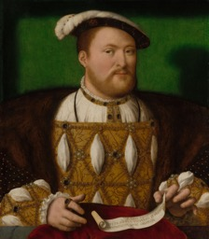
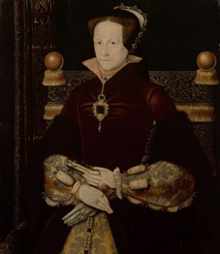
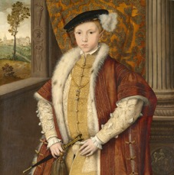
Tudor Dynasty timeline
Timeline of the Tudor Dynasty
Henry VII
Henry VIII
Edward VI
Mary I
Elizabeth I
Notes:
Teacher notes:
This sequence is designed to help children understand how the crown was passed from parent to child then from sibling to sibling. The information below is designed to help tell the story of the period and link to the video children have viewed.
Henry VII was the first Tudor monarch. He won the crown at the Battle of Bosworth Field.
Henry VIII became king when his father died. He reigned for almost 40 years. He felt strongly that he needed a son to become king after he died. He did not think a daughter as queen would be as strong. He changed the country’s religion to the Church of England as the Pope wouldn’t let him divorce his first wife. Every Tudor monarch that followed was his child.
Edward VI was his only son. It was normal for sons to become king even if they had an older sister. He died with no children and tried to make sure the new Church of England was successful.
After Edward’s death, his sister Mary became Queen (Lady Jane Grey was named Edward’s heir but people were unhappy Mary was not made Queen).
Mary I tried to make England a Catholic country again and married King Philip of Spain (a Catholic king). She imprisoned her sister Elizabeth and harshly punished many protestants.
Elizabeth I was the final Tudor Queen and chose never to marry. She often said she was married to her country. She returned England to a protestant country which has stayed the same ever since. In her reign, explorers visited the Americas and attacked ships from other countries. Theatre became very popular and writers like William Shakespeare entertained at court.
Image Credit:
Henry VII © National Portrait Gallery, London
Henry VIII © Royal Collection Enterprises Limited 2025 | Royal Collection Trust
Edward VI © Royal Collection Enterprises Limited 2025 | Royal Collection Trust
Mary I © Royal Collection Enterprises Limited 2025 | Royal Collection Trust
Elizabeth I Elizabeth 1, 1533 – 1603 (the Armada Portrait) © National Maritime Museum, Greenwich, London

Slide 6

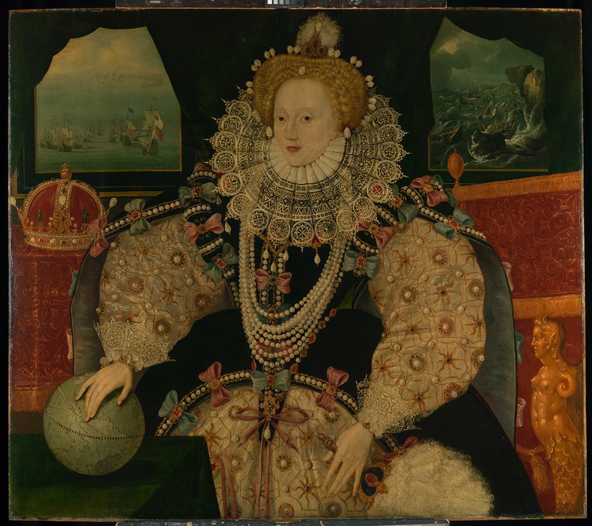
Do you remember this source?
Do you
remember
this source?
Notes:
About this source:
This portrait of Elizabeth I was made to commemorate England's victory after the Spanish Armada. During this battle Elizabeth gave a powerful speech to encourage her troops.
The portrait was designed to show off Elizabeth's power as a female ruler. Elizabeth is seen with her hand on the globe. She wears several pearl necklaces, with pearls in her wig and pearl earrings. There are also pearls sewn into her clothing.
Learn more about the Armada Portrait with Royal Museums Greenwich
Armada Portrait of Elizabeth I: See for free at the Queen's House
Symbolism in portraits of Queen Elizabeth I | Royal Museums Greenwich

Slide 7


How does this source help tell Elizabeth I’s story?
How does this
source help tell
Elizabeth I’s
story?
Notes:
Task:
Ask the students to look closely at this source.
Questions to ask:
Can you find something that shows Elizabeth I was the monarch?
There is a crown on the left-hand side.
Can you find something that shows her clothes were expensive?
There are lots of pearls on her clothing, and in her hair!
Themes to explore:
Before cameras were invented, very rich people could afford to have a portrait of them to be made. This is one reason we know more about kings and queens than poorer people. Paintings would take a long time to create. They would often include lots of ‘messages’ for people to pick up on.
This was a time of exploration and discovery. Elizabeth encouraged many people to go on long ship journeys to new parts of the world. These voyages brought lots of new items to England, including silk and pearls. Some people in England benefitted a lot from these voyages.
However, the English often treated the people they met on their journeys extremely badly. The experiences of the indigenous peoples are important for us to remember and consider.
Image Credit:
Elizabeth I Elizabeth 1, 1533 – 1603 (the Armada Portrait) © National Maritime Museum, Greenwich, London

Slide 8

Source close-up
How does this
source help tell
Elizabeth I’s story?
Notes:
Task:
Look at the four sections of the portrait. Ask the students to describe what they can see in that part of the painting. Ask how each part helps to tell Queen Elizabeth I's story?
(answers on the next slide)

Slide 9

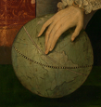
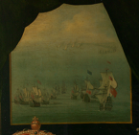
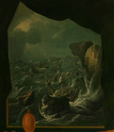
Look closer
Look closer at this source…
The Tudor crown is a symbol of Elizabeth’s royal power.
The globe shows England’s exploration of the world.
The English fleet looks calm and powerful.
The Spanish fleet is in trouble.
Notes:
Each section of the painting helps tell us about Elizabeth I's story and remind us why she is a significant individual.
The crown
Elizabeth was queen for 44 years. At the time she was the longest reigning monarch. During this time she made important decisions about the church and running of the nation. The crown is placed close to her. She was a powerful female ruler. She never married, instead she often said she was married to her country.
The globe
During her time as queen, England began to explore more of the world and make contact with the Americas and Asia. This brough new people and goods to England. The English often mistreated the indigenous people they met on these voyages. Here, Elizabeth is pointing at the Americas on the map.
Spanish Armada
Spain tried to invade England due to religious conflicts. Elizabeth gave a powerful and famous speech to the England troops. They defeated the Spanish. The victory meant the English church remained independent and not influenced by the Catholic church in Rome. On the left, we see English ships in calm water, looking powerful. On the right we see the Spanish ships struggling in the waves and against the cliffs. Elizabeth faces towards the calm scene and away from the chaos.

Slide 10
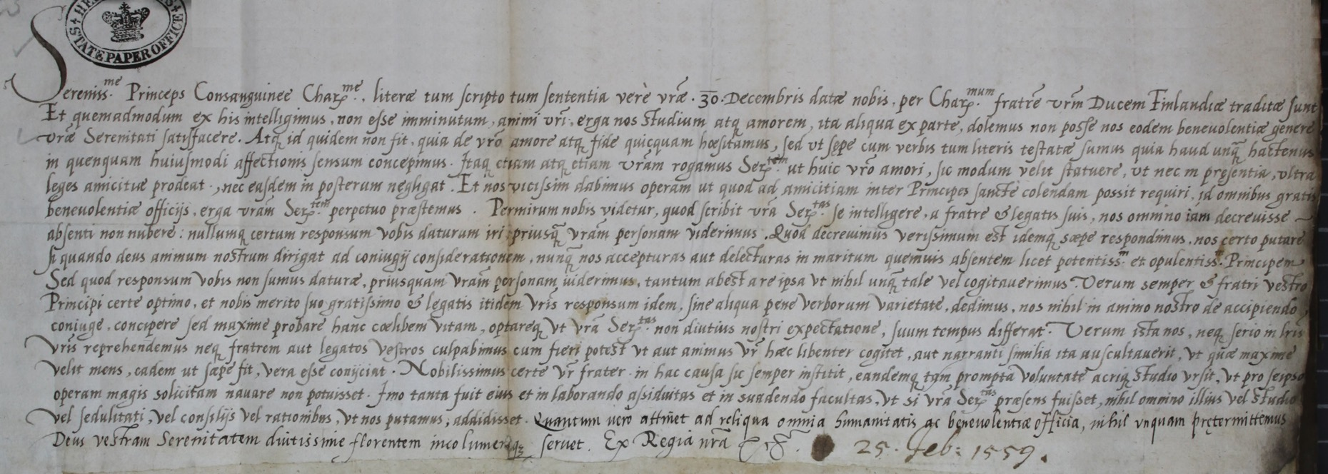
Other sources
Other sources about Elizabeth I
Notes:
Teacher notes:
This is an original letter written (or dictated) by Queen Elizabeth I to King Eric XIV of Sweden in 1560. He was one of many suitors and he had requested to visit her in England.
She wrote that she could not share his feelings and that he should not come to England. In addition, she wrote, “that we do not conceive in our heart to take a husband but highly commend the single life” which shows she was proudly living as a Queen with no desire or need to have a husband.
Learn more about this source with National Archives
https://www.nationalarchives.gov.uk/education/resources/elizabeth-monarchy/elizabeth-i-to-king-eric-xiv-of-sweden/
Image Credit:
The National Archives

