Slide 1




HOW TO USE - NOTES FOR TEACHERS
These resources from Historic Royal Palaces are multi-purpose.
They are ready for you to tweak and use in your lessons.
For the best experience, download and open the
file in the PowerPoint
desktop app.
Answers are found
under the slide. Click
on the notes symbol at
the bottom of the screen.
Delete text and images to make your own worksheets.
Disclaimer and Use Terms
We are the owner or the licensee of all intellectual property rights in these resources which are protected by copyright laws and treaties around the world. All such rights are reserved. These resources, and the content included within them, may be used by you for educational purposes only. This means that you may download the resources and use or share them solely in educational environments (including for home school lessons) or as part of homework. You may not share the resources other than for the above purposes and you must not use the resources, or any part of them, for any commercial purpose.

Slide 2

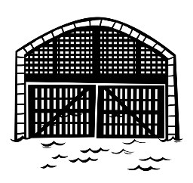
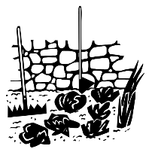
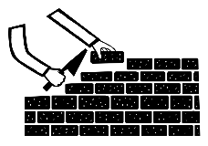

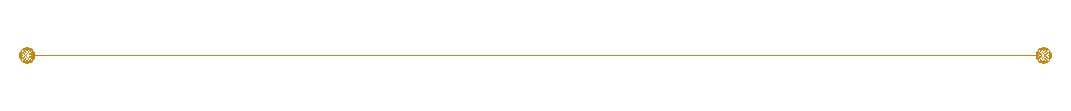

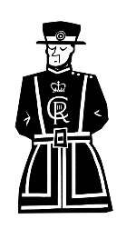

TOWER OF LONDON TIMELINE
c.1070s
1270s
1939-1945
White Tower building begins
Water Gate (Traitor’s Gate) is built
WWII – the moat is used to grow vegetables
1485
1554
First Yeoman of the Guard or ‘Beefeaters’
Lady Jane Grey executed

Slide 3
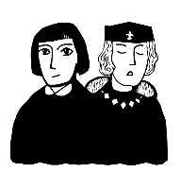



TOWER OF LONDON TIMELINE 2
TOWER OF LONDON TIMELINE
c.1070s
1270s
1483
1939-1945
White Tower building begins
Water Gate (Traitor’s Gate) is built
The Princes in the Tower disappear
WWII – the moat is used to grow vegetables
1252
1485
1554
1671
1913
A polar bear lives at the Tower as part of the menagerie
First Yeoman of the Guard or ‘Beefeaters’
Lady Jane Grey executed
Colonel Blood tries to steal the Crown Jewels
Suffragette Leonora Cohen smashes a display case

Slide 4
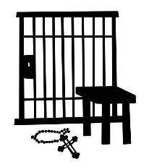
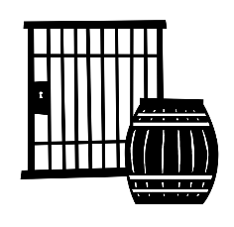


TOWER OF LONDON TIMELINE 3
TOWER OF LONDON TIMELINE
c.1070s
1270s
1483
1534
1605
1696
1939-1945
White Tower building begins
Water Gate (Traitor’s Gate) is built
The Princes in the Tower disappear
Sir Thomas More imprisoned
Guy Fawkes imprisoned
Isaac Newton is Warden of the Mint
WWII – the moat is used to grow vegetables
1252
1381
1485
1554
1671
1913
A polar bear lives at the Tower as part of the menagerie
Peasant Revolt reaches the Tower
First Yeoman of the Guard or ‘Beefeaters’
Lady Jane Grey executed
Colonel Blood tries to steal the Crown Jewels
Suffragette Leonora Cohen smashes a display case

Slide 5

CLASSROOM TASKS
Q1
What was the moat used for during the Second World War?
Q2
Can you put these events in date order?
an attempt to steal the Crown Jewels
the disappearance of the Princes in the Tower
the execution of Lady Jane Grey
Q3
Who smashed a display case?
Q4
How long ago were the Yeoman Warders, or Beefeaters, founded?
Notes:
Classroom task answers
The moat was used to grow vegetables.
The Princes disappeared in 1483. Lady Jane Grey was executed in 1554. Colonel Blood tried to steal the Crown Jewels in 1671.
The Suffragette Leonora Cohen smashed a display case.
In 2024, the Yeoman Warders were founded 539 years ago.

Slide 6
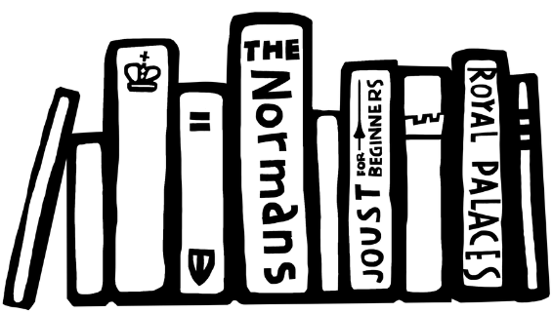

VOCABULARY LIST
armoury | a place where weapons are kept
menagerie | a place where wild animals are kept
Mint | a place where coins are made
Suffragette | a member of the Women’s Social and Political Union who fought for the right of women to vote in elections
treason | crime of betraying your country, government, King or Queen
Yeoman of the Guard | a member of the King or Queen’s bodyguard

