Slide 1




HOW TO USE - NOTES FOR TEACHERS
These resources from Historic Royal Palaces are multi-purpose.
They are ready for you to tweak and use in your lessons.
For the best experience, download and open the
file in the PowerPoint
desktop app.
Answers are found
under the slide. Click
on the notes symbol at
the bottom of the screen.
Delete text and images to make your own worksheets.
Disclaimer and Use Terms
We are the owner or the licensee of all intellectual property rights in these resources which are protected by copyright laws and treaties around the world. All such rights are reserved. These resources, and the content included within them, may be used by you for educational purposes only. This means that you may download the resources and use or share them solely in educational environments (including for home school lessons) or as part of homework. You may not share the resources other than for the above purposes and you must not use the resources, or any part of them, for any commercial purpose.

Slide 2
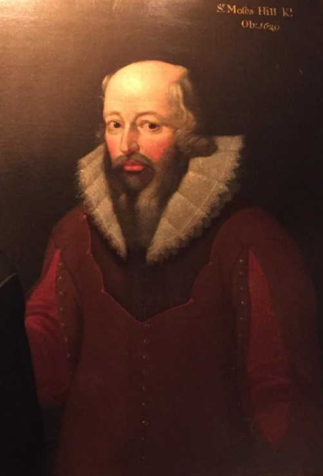

SIR MOYSES HILL
A key person in the Plantation of Ulster
Moyses had an important role in the Plantation of Ulster. He personally profited from land confiscated from Catholics. The Hill family became very rich and influential as a result.
He came to Ireland with the English army in 1573.
Became governor of Olderfleet Castle in Larne.
Given land in Larne and Carrickfergus.
Became Sheriff of Carrickfergus in 1591 and later became Mayor.
Received a Knighthood in 1603.
Moyses was elected to the Irish Parliament as MP for County Antrim in 1613. This was the Hill family’s first step into politics.
He was given the tile Provost Marshall of Ulster which meant he was now head of the Military Police. He was formally pardoned by King James I in 1617.
This meant he was forgiven in advance for any
murders of innocent people that he might commit, as part of his role.
Moyses settled in Ulster and bought land in County Antrim and in County Down. He created a large estate that included the village then known as Cromlyn, owned by the Magennis clan.
Cromlyn was later renamed Hillsborough after his family. Hillsborough Castle was built there in the
mid-1700s.
‘An implacable persecutor of the Catholics and an ever-willing instrument in carrying out the detestable policy of King James I’
Father Donatus Mooney
writing about Moyses Hill
during his lifetime.
Q:
What clues are there in the portrait that it was painted after Moyses Hill’s death?
The only portrait we have of him was painted after his death.
Q:
The Hill family motto is: “Through God and the Sword I have obtained”. Do you think this is a good description of Moyses Hill’s life?
© Historic Royal Palaces
Q:
Do you think Father Donatus Mooney’s description is reliable?
Lived: 1553 - 1629 | Birthplace: Devon
Notes:
Sir Moyses Hill notes:
The date in the top right corner (just visible) is 1629, the year he died.
Moyses Hill became wealthy through military force and the belief – by English Protestants – that God was on their side. Re. The family motto.
It was clearly in Moyses personal interest/gain to persecute members of the indigenous Catholic population and confiscate their land. Father Mooney was also writing at the time Moyses was alive which makes him a more reliable source, however, as he is a Catholic Priest we need to be aware that he would only be presenting one side of the narrative.

Slide 3

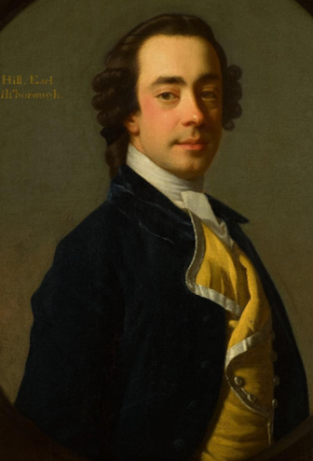
WILLS HILL
1st Marquess of Downshire
Politician, patron of the arts and developer of Hillsborough
Wills was the second son of Trevor Hill, 1st Viscount of Hillsborough, and his wife, Mary. Wills Hill’s nickname was the Black Earl.
Went to Winchester School in England but was often at Hillsborough.
Married Lady Margaretta Fitzgerald in 1747.
They had five children, but two of them didn’t survive childhood.
Began his political career aged 23. Wrote a ‘Proposal for Uniting the Kingdoms of Great Britain and Ireland’ in 1751. Appointed Privy Councillor and Comptroller of the household of King George II in 1754. Known as a powerful speaker in parliament. In 1768 he became the first Secretary of State for the British Colonies in North America.
In 1744, he started to develop Hillsborough into a modern Georgian town.
He was responsible for building many key features , including the Castle.
He rebuilt the church and created a pleasure garden in the grounds of the old fort.
He became the Earl of Hillsborough, and later the first Marquess of Downshire.
Loved music, opera and theatre.
Featured in newspaper’s gossip columns.
Described as charming and easy going but so strong he could knock a man down with a single blow.
Owned several properties and estates in England.
His favourite luxury food was turtle.
Q:
Looking at his portrait, how would you describe Wills Hill?
© Historic Royal Palaces
Q:
Is there any evidence in the biography that makes you have a different view of him?
Lived: 1718 - 1793 | Birthplace: Gloucestershire
Notes:
Wills Hills notes:
In his portrait, Wills Hill is portrayed as looking noble, wise, thoughtful, kindly and/or fatherly.
Wills Hill regularly appeared in gossip columns and had a reputation for being able to knock someone down in a fight.

Slide 4
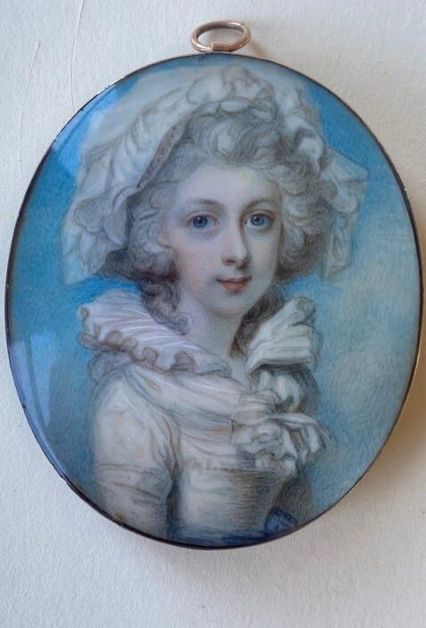
MARY SANDYS
Marchioness of Downshire and Baroness Sandys
Mary was a wealthy heiress, who married Arthur Hill in 1786. She became an important political hostess and head of a powerful family.
Arthur became the 2nd Marquess of Downshire in 1793 but died in 1801.
She became head of the family with seven
young children.
Mary was responsible for managing her own estates and her eldest son’s.
Mary was a close friend of the Prince of Wales who later became King George IV. She hosted dinners and held balls in London.
At the time, women could not vote or be elected to power, but she was very involved in political campaigns. She even bribed people to vote the way
she wanted them to.
‘I got all the wives to promise that their husbands would vote on the right side’
Mary writing about her political campaigning in a letter.
Hated travelling between London and Hillsborough because she had
a fear of the sea.
Q:
How is Mary portrayed in the portrait?
These miniatures were gifted to Historic Royal Palaces by the trustees of the Sandys Trust (Registered Charity Number 1168357)
Q:
What evidence is there to suggest that Mary had roles and responsibilities beyond being a mother?
Lived: 1764 - 1836 | Birthplace: Berkshire
Notes:
Mary Sandys notes
In her portrait, Mary is portrayed as a wide-eyed young woman. People might think she looks quite weak and vulnerable.
There is evidence that Mary was a capable woman, who managed her own estates and those of her eldest son, until he turned 21. She also exerted political power through her wealth and influence and enjoyed hosting dinner parties and balls.

Slide 5
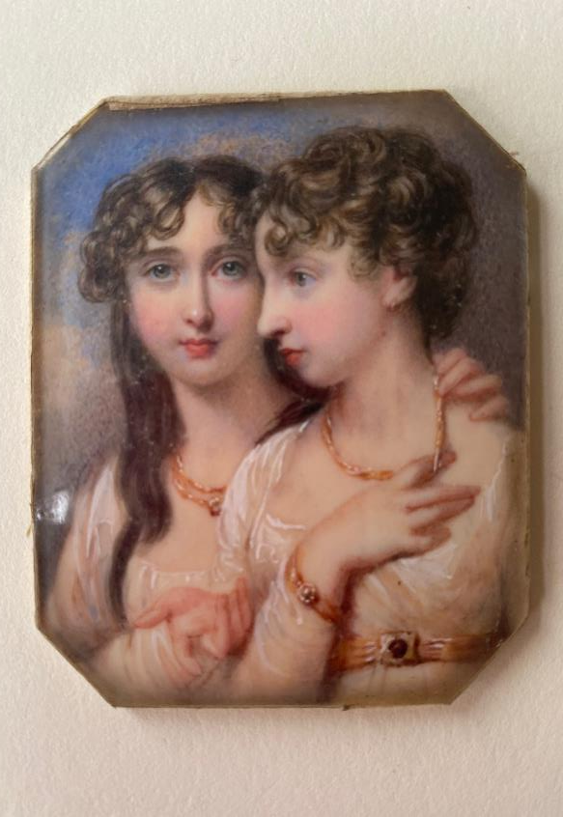
CHARLOTTE AND MARY HILL
Sisters who kept a diary about their busy social lives
Charlotte and Mary were the daughters of the 2nd Marquess of Downshire and his wife Mary Sandys.
They did not go to boarding school like their
five brothers.
Taught at home by a governess and tutors.
They studied French, music, singing, dancing
and drawing.
After their father died, their mother relied on them to support her with running the estates and her busy social life in London.
They wrote a joint diary from their late teens recording their lives and they took it in turns to write entries. They recorded everyday details, from what they ate for breakfast, to information about events such as The Battle of Waterloo.
Their brother Arthur fought as part of this battle.
They also took it in turns to assist their mother, alternating every week. They went with her on social visits, replied to her business and personal letters and helped run the household. They called it being ‘mama’s secretary’ or ‘lady-in-waiting’.
Eventually, their brother took over running the Hill family estates, but their mother still had her own estates to manage. Interestingly, their mother went to her son for business advice but to her daughters for help with day-to-day running of her estates. Neither of the sisters ever married.
‘’Told him certainly not, we had other fish to fry’
The sisters reply to a man who said girls spend all their time thinking about what to wear.
Q:
What did the sisters mean by ‘we had other fish to fry’?
Q:
From the evidence in the biography, how was the education for wealthy girls and boys different at this time?
26 volumes of the sisters’ diaries have survived.
These miniatures were gifted to Historic Royal Palaces by the trustees of the Sandys Trust (Registered Charity Number 1168357)
Q:
There is an impression of young women at the time of being only interested in going to balls and trying to find a husband. Do you think Charlotte and Mary fit this stereotype?
Charlotte 1794 - 1821 | Birthplace: unknown
Mary 1796 - 1830 | Birthplace: unknown
Notes:
Charlotte and Mary notes;
By the statement ‘we had other fish to fry’ the sisters meant they were far too busy with more important things to spend too long thinking about what to wear.
Boys were educated ‘publicly’ at boarding schools. Girls were educated ‘privately’ at home by governesses and tutors. (Girls were taught subjects and skills people thought would help them become ‘accomplished’ young women and wives.)
There is evidence to show that Charlotte and Mary led very busy lives with many responsibilities. They acted as their mother’s private secretary and helped to run the various households the family lived in.

Slide 6
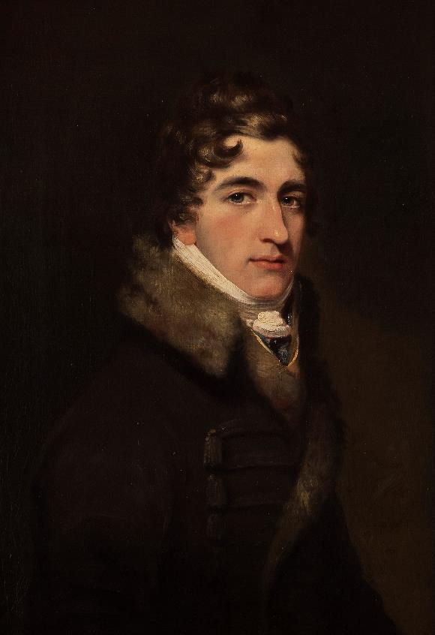

ARTHUR HILL
3rd Marquess of Downshire
A well-respected Irish landlord
Did not spend money bribing people to vote the way he wanted (like his mother had done).
Supported parliamentary reform but did not want a political job.
He cared about the poor economic and social conditions of many people in Ireland. He disapproved of other Irish landlords who didn’t spend much time on their estates in Ireland and instead lived in England. He visited tenants and personally answered their letters. He also invited all the local children to a party every year at Hillsborough Castle.
When he died many tenants attended his funeral.
Arthur Hill became Marquess of Downshire aged 12, after his father died.
Went to Eton College and Oxford University.
His mother managed his estates until he ‘came of age’ at 21.
Arthur made Hillsborough Castle his main home soon after his 21st birthday. He had inherited estates in Ireland but also huge debts from his parents and grandfather. He was described as a serious and sensible young man, and successfully paid off his debts. Arthur also wanted to improve the living conditions of his tenants.
Married Lady Maria Windsor in 1811 and they had five children.
Lived a relatively simple life.
Q:
How do you think Arthur’s portrait reflects his personality and lifestyle?
Was a strong supporter of Irish language and helped to preserve Irish poetry and folk songs.
Q:
From the biography, why do you think he was a well-respected landlord?
Three of his brothers
were also called Arthur.
Reproduced by permission of the Provost and Fellows of Eton College
Q:
Do you think Arthur could have done
more to improve social and economic conditions in Ireland if he had become more active in politics?
Lived: 1788 - 1845 | Birthplace: London
Notes:
Arthur Hill notes:
In his portrait, Arthur is dressed plainly and simply, which reflects his relatively simple lifestyle for such a wealthy man. He stares directly at the viewer which gives an impression of honesty.
There is evidence to show that he cared about his tenants and tried to improve their living conditions. He also took a personal interest in them, answering their letters and holding parties for their children.
There are different ways to reflect on Arthur’s decision not to take a political job.
On one hand, Arthur’s legacy would have been greater if he had taken on a national political role and campaigned on issues that affected the whole of Ireland.
However, on the other he achieved more by staying in Ireland and focussing his efforts on directly improving the lives of his tenants.

Slide 7
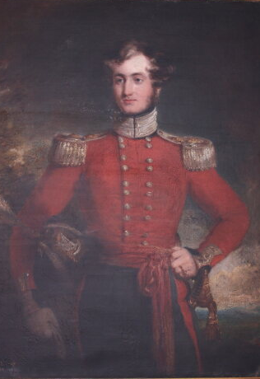
ARTHUR HILL
4th Marquess of Downshire
A caring landlord who led a colourful life
Arthur was born at Hillsborough Castle and was known as Lord Hillsborough. When his father died, he became the 4th Marquess of Downshire.
Spent early childhood with a private tutor
at Hillsborough.
Sent to boarding school aged 10.
Was often in trouble for bad behaviour and disappointing classwork.
Struggled with mathematics.
Letters home show that he was homesick for Hillsborough.
He was said to have a good heart but also a fierce temper. He was involved in several fights including one at Oxford University in which a friend of his died. However, he was also known for two heroic acts in which he saved people from drowning.
Became an officer in local militia.
From 1836 until 1845 he was Member of Parliament for County Down.
Married Caroline Frances Stapleton Cotton in 1837.
They had a famous wedding party at
Hillsborough Fort for over 3,000 tenants.
They had four children.
In 1845, during the Great Famine, Arthur donated lots of money to help his tenants. He stayed in Ireland throughout most of the famine to help them.
13 people are said to have died after his wedding party from eating and drinking too much.
Q:
How is Arthur portrayed in his portrait?
His nickname was
The Big Marquess.
Q:
Do you agree that Arthur’s life could be described as ‘colourful’?
Kind permission from the Northern Ireland Office.
Q:
What evidence is there that Arthur cared about his tenants?
Lived: 1812 - 1868 | Birthplace: Hillsborough
Notes:
Arthur Hill notes:
In his portrait, Arthur is portrayed as a dashing young army officer in his red uniform with gold trim. He has a helmet under his right arm and a sword in a holder hanging from his left wrist.
Arthur’s character could be described as ‘colourful’ because he was frequently in trouble at school and got into fights. He saved two men from drowning. Also, several people are said to have died after his wedding party from over-indulgence.
Arthur donated large sums of money to help his tenants during the Great Famine and stayed in Ireland to try to help them further.

Slide 8
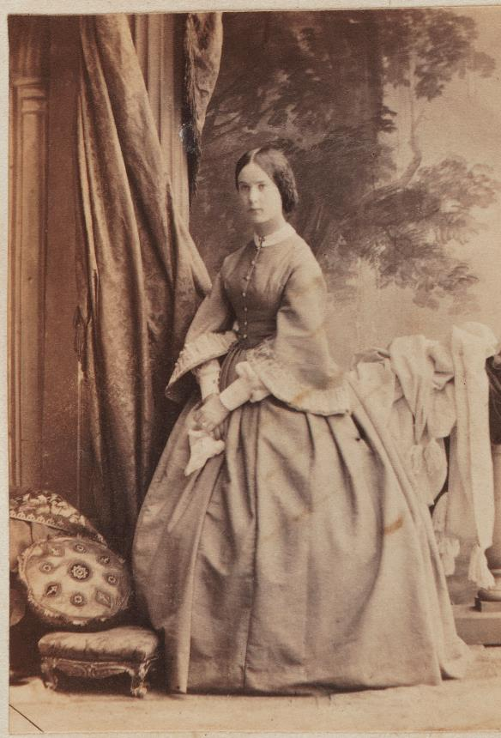
ALICE HILL
Fashionable socialite who was well-loved in Hillsborough
Alice was the daughter of Arthur, the 4th Marquess of Downshire, and Caroline. She had two younger brothers who were both called Arthur.
Grew up at Hillsborough Castle and at family homes in London and Berkshire.
At 7 years old, she opened a ball with her father.
At 12, she was in charge of decorating the Christmas tree at Hillsborough Castle.
At 17, she was presented by her mother to Queen Victoria, marking her entry into society.
She was involved in a scandal in 1860 when the family were on holiday on their yacht in the Mediterranean. According to newspaper reports, her father found the ship’s captain on his knees about to kiss Alice’s hand. Her father threw the Captain overboard, and he drowned.
She married Thomas Taylour at Hillsborough in 1867, he later became the Earl of Bective.
They had large celebrations throughout the village including sports competitions and fireworks.
The ornamental temple in the gardens at Hillsborough Castle is known as Lady Alice’s
Temple. The temple is said to be a wedding gift from her brothers.
The married couple visited Hillsborough Castle often. They had two daughters. When she died, aged 85, Queen Mary (wife of King George V) sent a sympathy telegram describing her as ‘an old friend’.
Alice supported the campaign for women to have the vote.
Q:
What evidence is there in the biography that Alice had a very privileged life?
© National Portrait Gallery, London
Q:
Is there anything to suggest Alice used her privileged position to change society?
Lived: 1842 - 1928 | Birthplace: London
Notes:
Alice Hill notes:
There is plenty of evidence that Alice had a privileged life, including that Alice’s family owned several homes and a yacht. She attended balls as a child and was presented to the Queen. She married another member of the aristocracy in a large celebration and went on to live in a large house with royalty as friends.
She supported the cause of women’s suffrage and giving women the right to vote. Many other wealthy women disagreed with this, they believed that men were best at making important decisions.

Slide 9
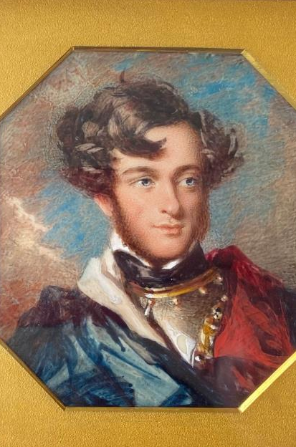
GEORGE HILL
A younger son who became a landlord and farmer
George was the youngest brother of Arthur, the 3rd Marquess of Downshire. He was born three months after his father died. He was named after King George III who was his godfather.
Since he was the younger brother, he did not inherit the family estates.
Joined the army aged 16 and was promoted
to Captain.
Fell in love with Cassandra Knight, niece of the famous writer, Jane Austen.
His mother did not approve but eventually gave them enough money to marry.
Cassandra died a few days after giving birth to their 4th child.
George later married Cassandra’s sister, Louisa.
When his mother died, George inherited money from her. This allowed him to buy land in Donegal. This area was remote and had extreme poverty.
George built roads and bridges and opened a hotel to attract tourists. He also wanted to change the way people farmed there.
In Ireland, families had shared land for farming, but George thought this caused arguments and slowed things down. One of his decisions was to split the land into individual plots, which was unpopular with local people. However, it may have protected them from worst effects of the Great Famine. The population of these areas did not decrease as much as it did in other parts of Ireland.
His second marriage took place
in Denmark where it was legal to marry his first wife’s sister.
As a boy, he used his pocket money to buy a pig, fatten it up and sell it to the butcher.
Q:
How is George portrayed in his portrait?
These miniatures were gifted to Historic Royal Palaces by the trustees of the Sandys Trust (Registered Charity Number 1168357)
Q:
What do you think are the advantages and disadvantages of shared farming?
Lived: 1801 - 1879 | Birthplace: unknown
Notes:
George Hill notes:
In his portrait, George is portrayed as a young soldier. Students might say that he looks handsome and cheerful.
One of George’s unpopular decisions about farming was to move away from the shared farming that had been used for centuries in Ireland. He divided the land into individual plots.
Shared farming
Advantages: People working together could create a strong sense of community and shared responsibility. They could share tools and help each other if someone was sick and couldn’t work.
Disadvantages: It might cause arguments. People might be accused of not doing their fair share of the work, or of taking more than their fair share of the crops.

Slide 10

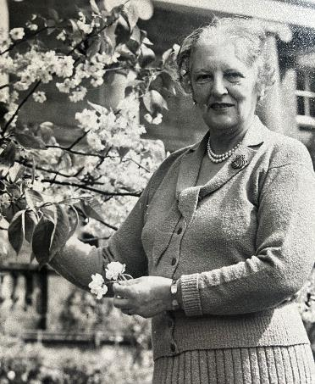
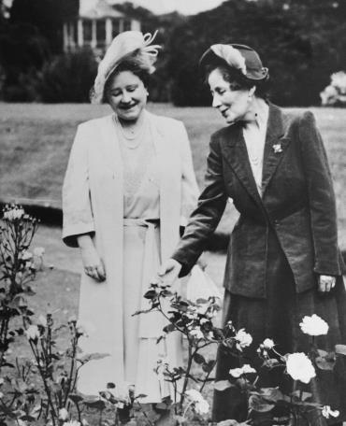
LADY PEGGY WAKEHURST AND LADY ROSE GRANVILLE
LADY PEGGY
LADY ROSE
WAKEHURST
GRANVILLE
Campaigner for mental health
‘First lady’ of Northern Ireland and Queen Elizabeth II’s aunt
Born Margaret Tennant but known as Peggy. She married John Loder in 1920 and they had four children. He later became
Lord Wakehurst.
John also became the 3rd Governor of Northern Ireland between 1952-64. They moved to Hillsborough Castle which was then known as Government House.
Lady Wakehurst visited a hospital for mental health patients and was shocked by the conditions there. In 1959, she started an independent charity called the Northern Ireland Association for Mental Health, now known as Inspire. The Headquarters for the charity was in Belfast and had a members’ club called Beacon House.
Lady Wakehurst was also a founding member of the National Schizophrenia Fellowship. She was its President from
1984 to 1986.
During the First World War the young Lady Rose helped run a convalescence hospital for soldiers at Glamis Castle, her family home.
In 1916, she married William Leveson-Gower and they had two children. Later, William became Earl of Granville, and Rose became Lady Granville.
Rose’s sister Elizabeth married into the royal family. Rose’s niece would become
Queen Elizabeth II.
Lady Rose’s husband became the 2nd Governor of Northern Ireland from 1945-52. Together, they moved to Hillsborough Castle, then called Government House. As wife of the Governor, Lady Rose had unofficial responsibilities, including opening public buildings such as schools and hospitals. She often hosted important dinner parties and met with visitors at
Government House. In 1946, she welcomed her niece, Princess Elizabeth, during the princess's first official visit to Northern Ireland.
Loder Archive, Historic Royal Palace
Loder Archive, Historic Royal Palace
Lived: 1899 - 1994
Lived: 1890 - 1967
Birthplace Peebleshire, Scotland
Birthplace: Angus, Scotland
Lady Rose also designed the rose garden at Hillsborough Castle, which is now called the Granville Garden. This image shows Lady Rose (right) and her sister Queen Elizabeth (left).
‘I want a name suggesting light.’
Lady Wakehurst talking about what to call the members’ club for her charity.
Q:
How do you think it would have felt to have your family home converted to a hospital during a war?
Q:
Lady Wakehurst had difficulty convincing others to improve mental health care in Northern Ireland. Why do you think that was?
Notes:
Lady Wakehurst notes:
Lady Wakehurst may have faced difficulties changing mental health care because at the time people had less understanding of mental illness, and ways of supporting people who are suffering from it, than we do today. It was a topic that was often not openly talked about. Some people thought that, as the Governor’s wife, she was meddling in matters that were no concern of hers, and that she had no understanding of.
Lady Rose Granville notes
Answers might convey the upheaval of having your family home turned into a hospital. It would have been distressing to see sick and injured soldiers' day to day. Lady Rose became a nurse, a role she had no previous experience of. It would’ve been a complete change to everyone’s lives.

Slide 11
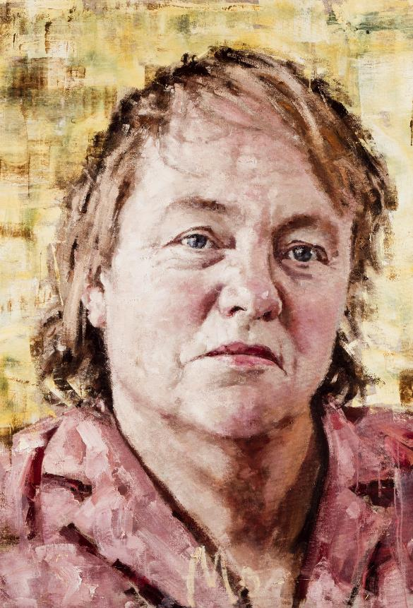
MO MOWLAM
Secretary of State for Northern Ireland and a pivotal
player in the Northern Ireland Peace Process
Born Marjorie Mowlam but was always known as Mo. Mo’s father was an Assistant Postmaster and her mother was a telephonist.
Went to Durham University.
Rowed for her college and joined the Labour Party.
Mo worked for a Labour MP for a while and then moved to the United States to study. She lectured at universities in America and Britain. She was elected to Parliament in 1987 and became Labour spokesperson on Northern Ireland later that year. She married Jonathan Norton, a banker, in 1995, and had two stepchildren.
She became Secretary of State for Northern Ireland and played a key role in negotiating the 1998
Good Friday Agreement. This was a major step in the Northern Ireland Peace Process.
When staying at Hillsborough Castle, she held concerts and open days, opening the estate to all people in Northern Ireland. She particularly liked the gardens and often took walks on the estate.
Mo was diagnosed with a brain tumour in 1997. She lost her hair due to treatment. She frequently removed her wig during meetings to be more comfortable.
She passed away in 2005. She requested that some of her ashes be scattered in the gardens at
Hillsborough Castle.
She sometimes flooded the bathroom at Hillsborough Castle by getting distracted by her work and forgetting that she had begun to run a bath.
Q:
From the evidence in the biography, do you think her portrait reflects her personality?
© National Portrait Gallery, London
Q:
Mo Mowlam was a very popular politician. Can you suggest why that was?
Lived: 1949 - 2005 |Birthplace: Hertfordshire
Notes:
Mo Mowlam notes
There is evidence in the biography that Mo Mowlam had a very strong, down-to-earth personality and wasn’t vain about her personal appearance. Some people may think the portrait reflects this. If you look closely, the name ‘Mo’ is painted at the bottom of the painting, this is how she liked to be known instead of the formal title ‘Secretary of State’.
Mo Mowlam had not come from a wealthy, privileged family so many voters could relate to her, and liked her forthright, down-to-earth personality. Mo must have been intelligent and hardworking to have achieved so much. These reasons suggest why she was a popular politician.

Slide 12
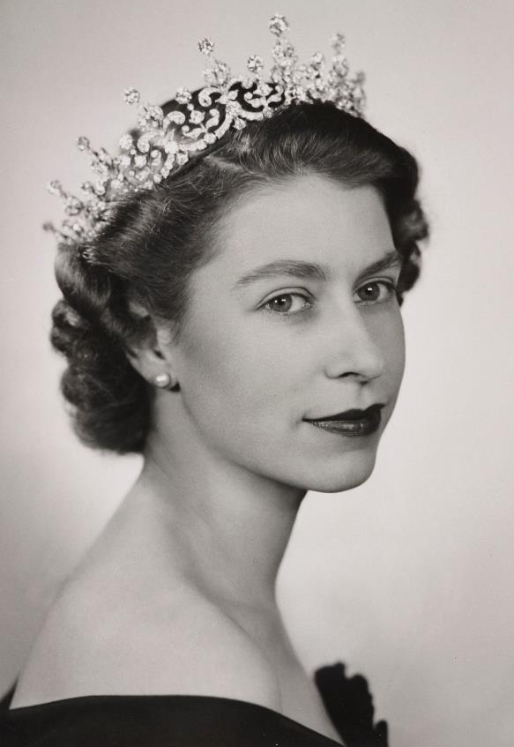
ELIZABETH II
The longest reigning monarch in British History
Elizabeth was born in Mayfair, London. Her father was the Duke of York, who was the second son of George V. Her mother was Lady Elizabeth Bowes-Lyon. She had one younger sister, Margaret.
Described as a sensible and well-behaved child.
Loved dogs and horses.
Her uncle, Edward VIII, abdicated in 1936. As a result, Elizabeth’s father became king, and she became first in line to the throne. She married Philip Mountbatten in 1947, and they had 4 children.
Elizabeth became queen in 1952 when her father died. Her coronation was the first to be broadcast on live television.
She made 25 official visits to Northern Ireland over her lifetime and often stayed at Hillsborough Castle.
On her first official visit in 1946, she was welcomed by her aunt and uncle, Lady Rose and Earl William of Granville. Her uncle, William was the Governor of Northern Ireland at the time.
A month after her Coronation the Queen enjoyed a formal banquet at Hillsborough Castle.
In 2005, a very significant and symbolic meeting took place. Elizabeth II met the President of Ireland, Mary McAleese, at Hillsborough Castle. This was the first meeting of the two Heads of State on the island of Ireland since the Partition of Ireland in 1921.
Hillsborough was granted Royal Status by Queen Elizabeth II in 2021, becoming Royal Hillsborough.
Q:
Why was Elizabeth not expected to become queen as a young child?
When the Queen ate in the
Dining Room at Hillsborough Castle
she liked to sit looking out onto
the rose garden.
Q:
Who welcomed her on her first official visit to Hillsborough Castle?
Royal Collection Trust / © His Majesty King Charles III 2024
Reigned: 1926 - 2022
Q:
What was significant about the meeting between Queen Elizabeth II and Mary McAleese at Hillsborough Castle in 2005?
Lived: 1926 - 2022 |Birthplace: London
Notes:
Elizabeth II notes
Elizabeth was not expected to become queen because she was not next in line to the throne. Her uncle, Edward, was the oldest son of George V and was next in line to the throne. It was expected that he would have children and they would be his heirs. However, Edward abdicated. This meant his younger brother became King instead and Elizabeth became next in line to the throne.
The Queen’s first visit to Hillsborough Castle was hosted by her aunt and uncle. Lady Rose Granville was her mother’s sister, and the Earl of Granville was Governor of Northern Ireland at the time.
The meeting between Queen Elizabeth and Mary McAleese was significant because it was the first time that the Heads of State of the UK and Ireland had met on the Island of Ireland since Partition in 1921. The meeting was seen as a symbolic reconciliation between the two states.

Slide 13


TEMPLATE WORKSHEET
________________
________________
________________
________________
Image credit:
Image credit:
Lived: _______
Lived: _______
Birthplace: _______
Birthplace: _______
Q:
Q:

Slide 14
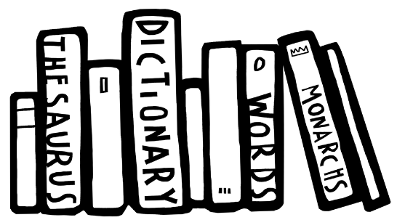
VOCABULARY LIST
abdicate | give up the position of being king or queen
colony | group of people from one country who build a settlement in another land
comptroller | royal household official in charge of finances
convalescence hospital | place to stay while you recover from surgery, illness or an injury
economic | word used in connection with goods and services, such as food and clean water
elected | person chosen (to be a leader, for example) by other people voting for them
estate | large area of land, often with a big house and several smaller ones, owned by one person, family or organisation
famine | when large numbers of people cannot get enough food for a long period of time; people in a famine may die from starvation or disease
Georgian | time from 1714 to 1830 when Britain and Ireland were ruled by George I-George IV
Good Friday Agreement | deal agreed on how Northern Ireland should be governed; it ended 30 years of violent conflict in Northern Ireland
government | group of people that have the authority to rule a country
Governor of Northern Ireland | the king or queen’s official representative in Northern Ireland; the position was created in 1922 and ended in 1973
Great Famine | terrible famine in Ireland between 1845-49 when the potato crop, that many people depended on, was destroyed by a disease
Head of State | chief public representative of a country, such as the king, queen or president
indigenous | first people to live in a place
inherit | given something such as money or a title after the death of the person who owned or held them before

Slide 15
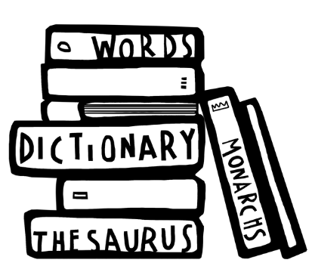
VOCABULARY LIST 2
VOCABULARY LIST
Knighthood | title awarded to a man for services to the king or queen; he can then use the title ‘Sir’ before his name
landlord | the owner of land or houses that another person pays rent (money) to
Marquess | senior nobleman, above an Earl in rank but below a Duke
military | word used in connection with an armed force such as soldiers
militia | military force whose job is to help the regular army in an emergency
MP | short for Member of Parliament
ornamental | used as a decoration
Parliament | the group of people elected to make and change laws in a country
parliamentary reform | changes to improve the voting system for Members of Parliament to make it fairer
patron | someone who gives financial or other support to a person or organisation
Plantation of Ulster | colonies in Northern Ireland set up by Protestant settlers from England and Scotland, encouraged by King James I
pleasure garden | large park or garden that is open to the public for enjoyment, leisure activities and entertainment
poverty | not having enough money for basic needs such as food, clothing and housing
Privy Councillor | member of the Privy Council, a group of advisors to the king or queen
Provost Marshall | head of the military police
Roman Catholic Church | Christian religion with the Pope as its head

Slide 16
VOCABULARY LIST 3
VOCABULARY LIST
scandal | action or event that shocks people
Secretary of State | senior minister in charge of a government department
Sheriff | someone who represents the king or queen in a county
socialite | someone who is well-known in fashionable society and goes to a lot of parties and social events
telephonist | person who operates telephone connections in a large building such as a hotel or office block
tenant | person who pays rent (money) to live in a house, or to farm on land, owned by someone else
wealthy | a large amount of money, property, land or valuable possessions

