Slide 1
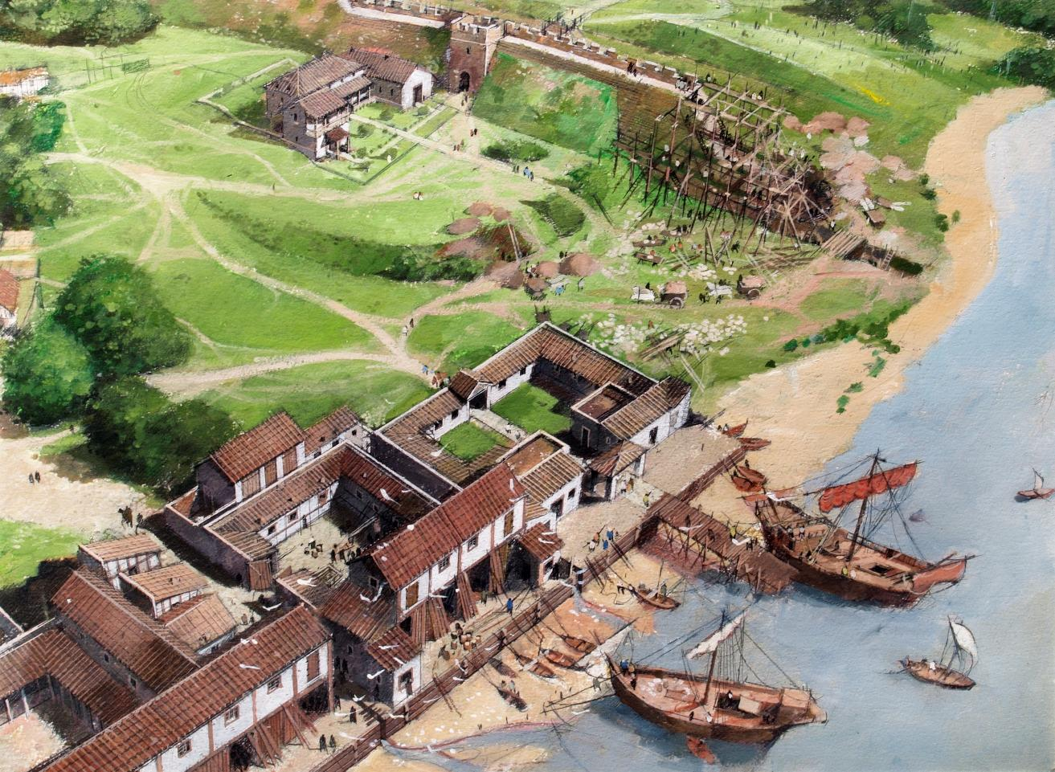

Hampton Court Palace
© Historic Royal Palaces
Find more details and full image credits in the ‘Notes’ section below the slide.
Notes:
Disclaimer and Use Terms
We are the owner or the licensee of all intellectual property rights in these resources which are protected by copyright laws and treaties around the world. All such rights are reserved. These resources, and the content included within them, may be used by you for educational purposes only. This means that you may download the resources and use or share them solely in educational environments (including for home school lessons) or as part of homework. You may not share the resources other than for the above purposes and you must not use the resources, or any part of them, for any commercial purpose.
Painting of The Tower of London as it is thought to have looked in 200AD | Painting by Ivan Lapper

Slide 2
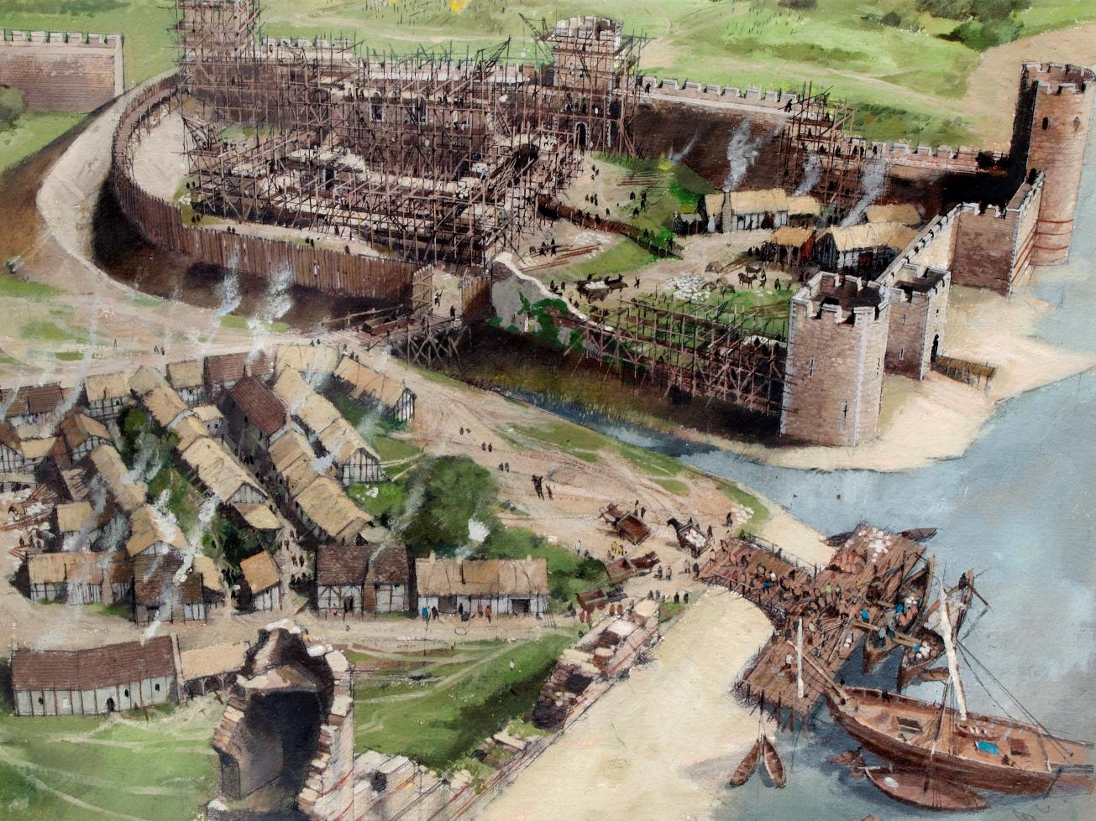
The Great Hall
© Historic Royal Palaces
© Historic Royal Palaces
Notes:
Painting of The Tower of London as it is thought to have looked in 1080 during the Norman era | Painting by Ivan Lapper

Slide 3
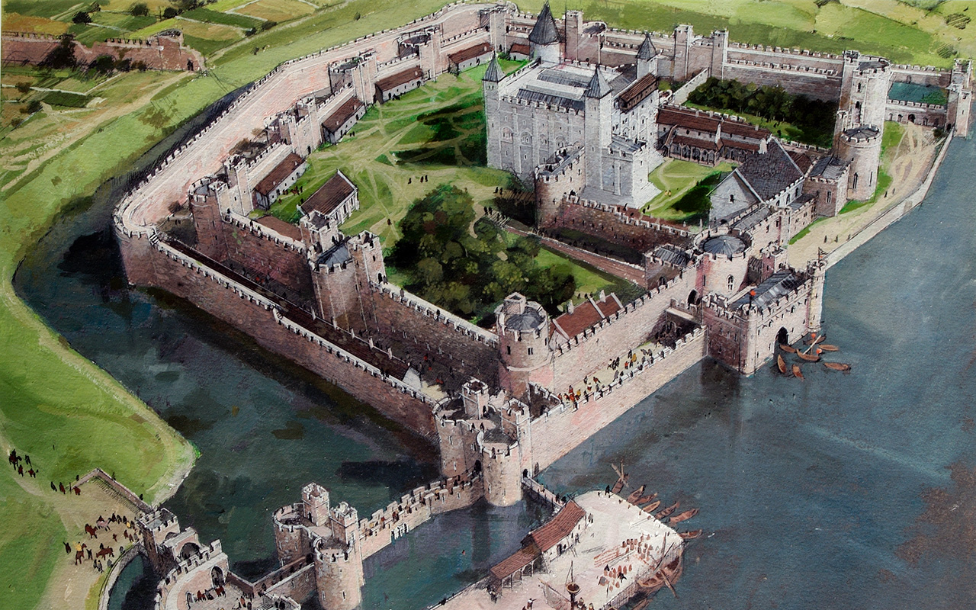
Falcon
© Historic Royal Palaces
Notes:
Painting of The Tower of London as it is thought to have looked in 1300 during the Medieval era | Painting by Ivan Lapper

Slide 4
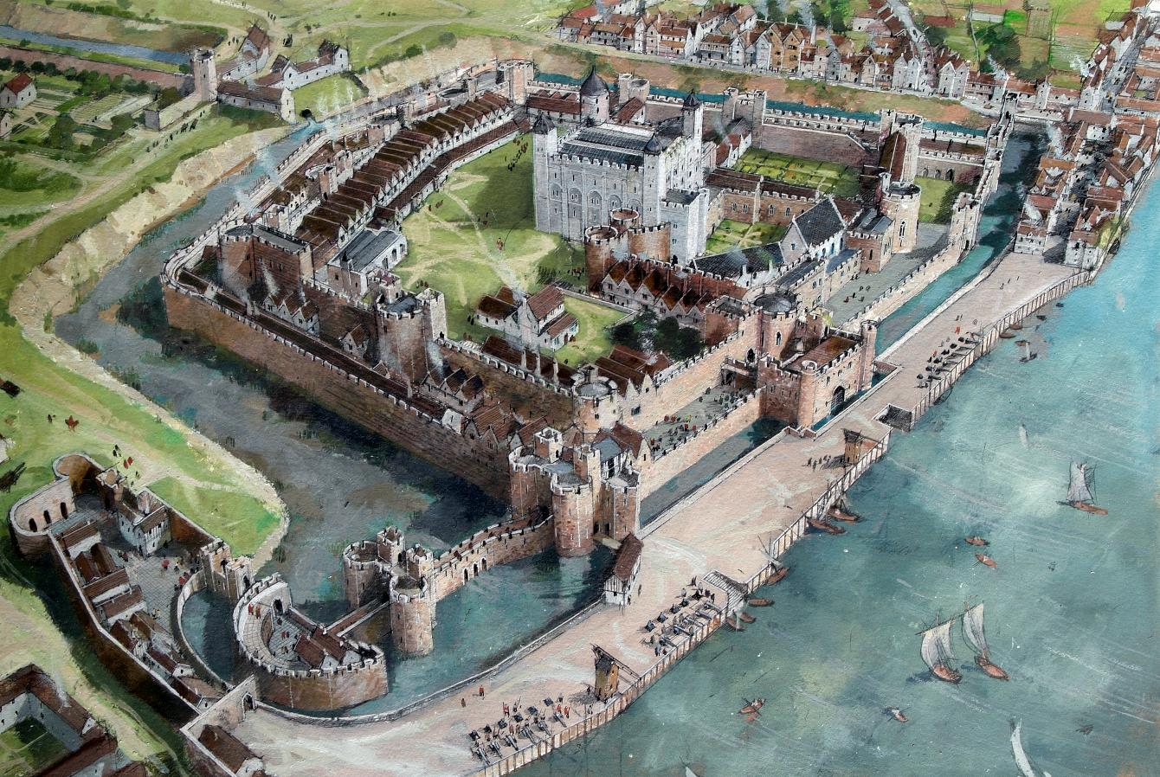
Anne Boleyn Symbol
© Historic Royal Palaces
Notes:
Painting of The Tower of London as it is thought to have looked in 1547 during the Tudor era | Painting by Ivan Lapper

Slide 5
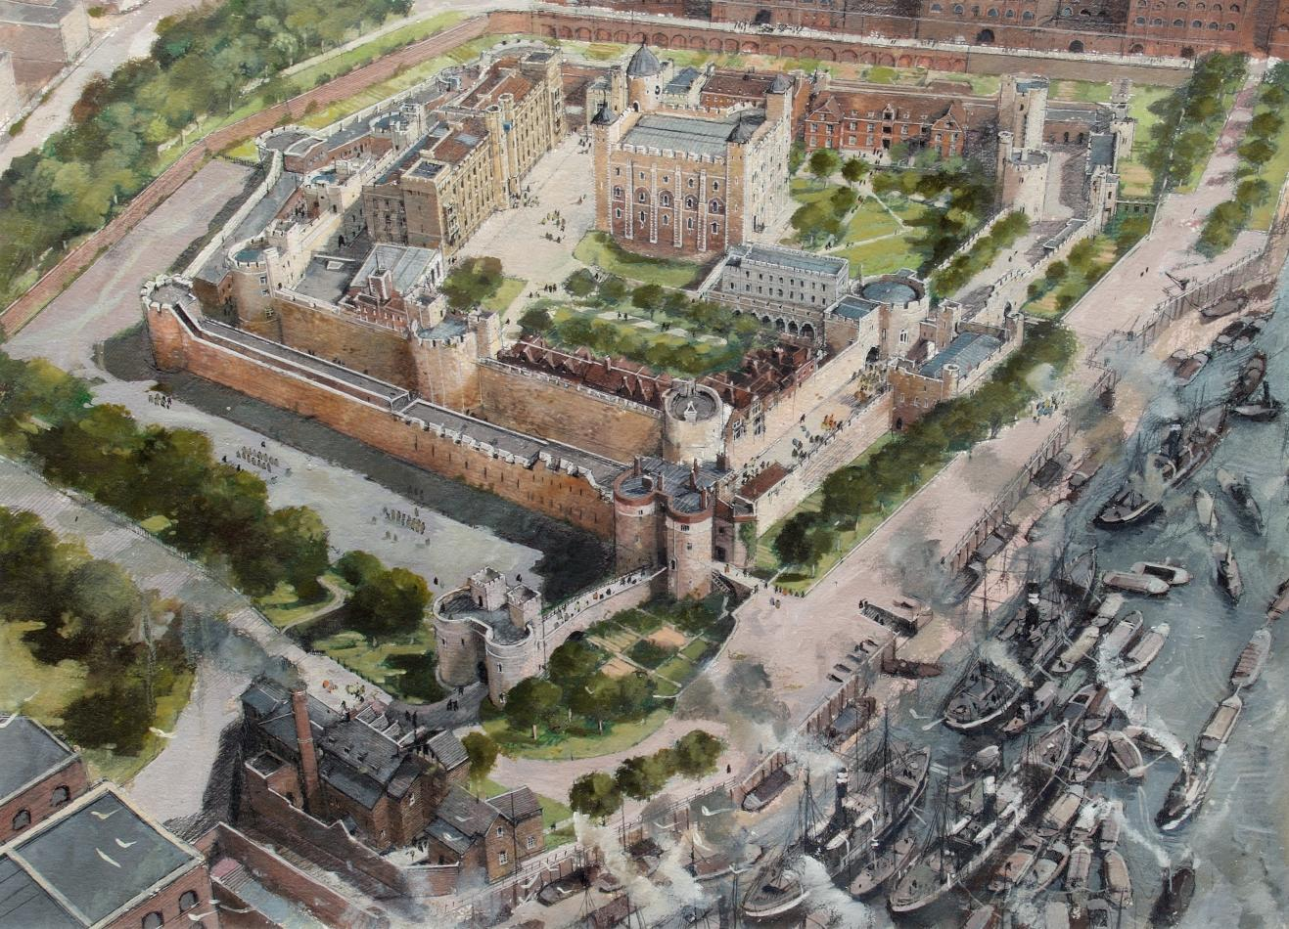
Wolsey Closet
© Historic Royal Palaces
Notes:
Painting of The Tower of London as it is thought to have looked in 1890 during the Victorian era | Painting by Ivan Lapper

Slide 6
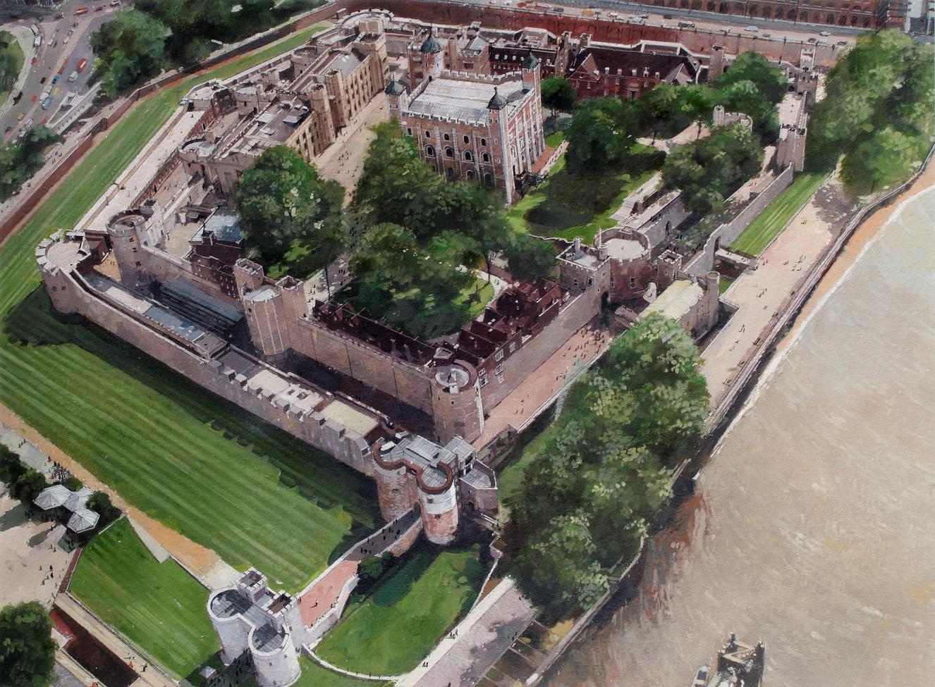
Henry dining in private
© Historic Royal Palaces
Notes:
Painting of The Tower of London as it looked in the year 2000 | Painting by Ivan Lapper

