Slide 1
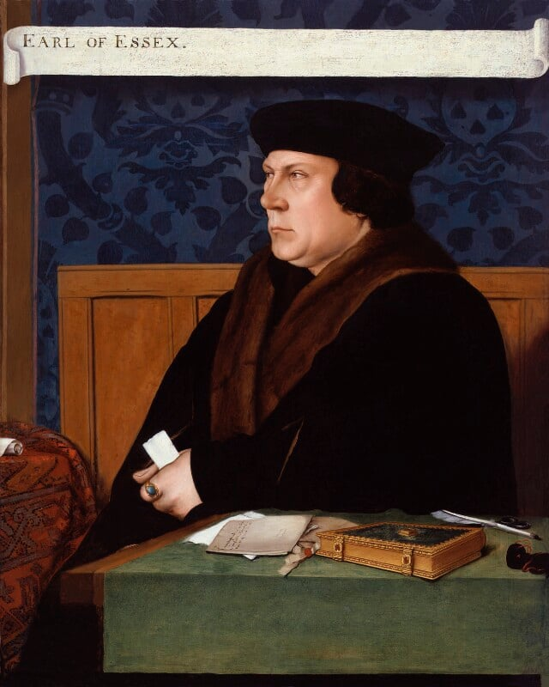

Thomas Cromwell, Earl of Essex – National Portrait Gallery
© National Portrait Gallery - CC BY-NC-ND 3.0 - Attribution-NonCommercial-NoDerivs 3.0 Unported
Find more details and full image credits in the ‘Notes’ section below the slide.
Notes:
Disclaimer and Use Terms
We are the owner or the licensee of all intellectual property rights in these resources which are protected by copyright laws and treaties around the world. All such rights are reserved. These resources, and the content included within them, may be used by you for educational purposes only. This means that you may download the resources and use or share them solely in educational environments (including for home school lessons) or as part of homework. You may not share the resources other than for the above purposes and you must not use the resources, or any part of them, for any commercial purpose.
Thomas Cromwell, Earl of Essex – National Portrait Gallery - CC BY-NC-ND 3.0 - Attribution-NonCommercial-NoDerivs 3.0 Unported

Slide 2
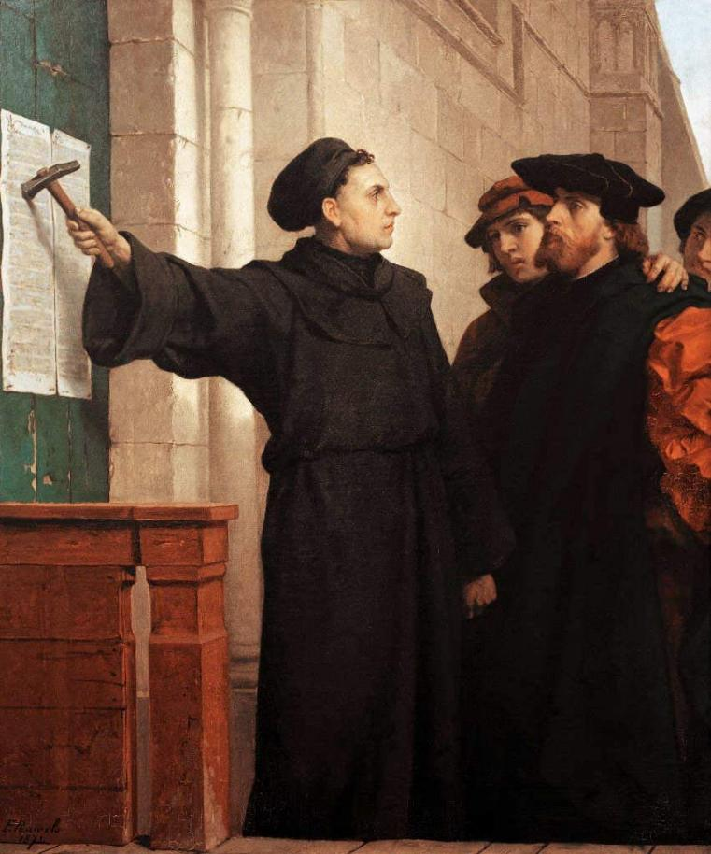
The moment when Martin Luther nailed his Ninety-five Theses to the door of the Castle Church in Wittenberg, Germany, in 1517
© Ferdinand Pauwels (1830–1904),
Notes:
The moment when Martin Luther nailed his Ninety-five Theses to the door of the Castle Church in Wittenberg, Germany, in 1517 - © Ferdinand Pauwels (1830–1904), Eisenach, Wartburg-Stiftung CC PDM 1.0 Public Domain Mark 1.0 Universal

Slide 3
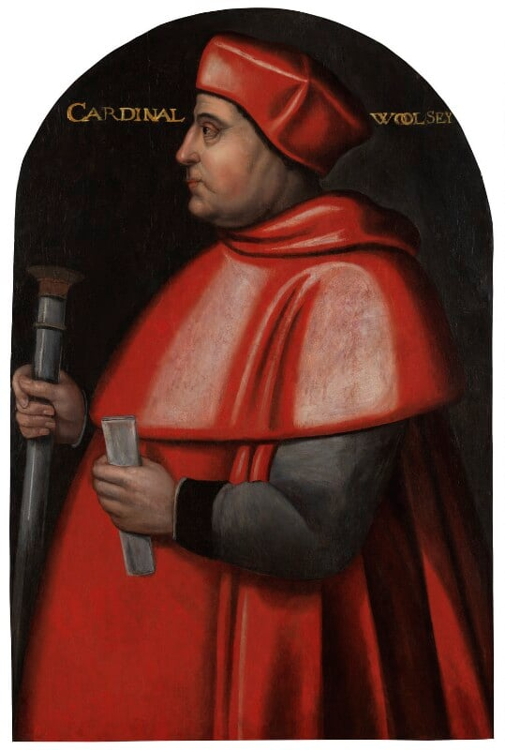
Cardinal Thomas Wolsey – National Portrait Gallery
© National Portrait Gallery - CC BY-NC-ND 3.0 - Attribution-NonCommercial-NoDerivs 3.0 Unported
Notes:
Cardinal Thomas Wolsey – National Portrait Gallery - CC BY-NC-ND 3.0 - Attribution-NonCommercial-NoDerivs 3.0 Unported

Slide 4
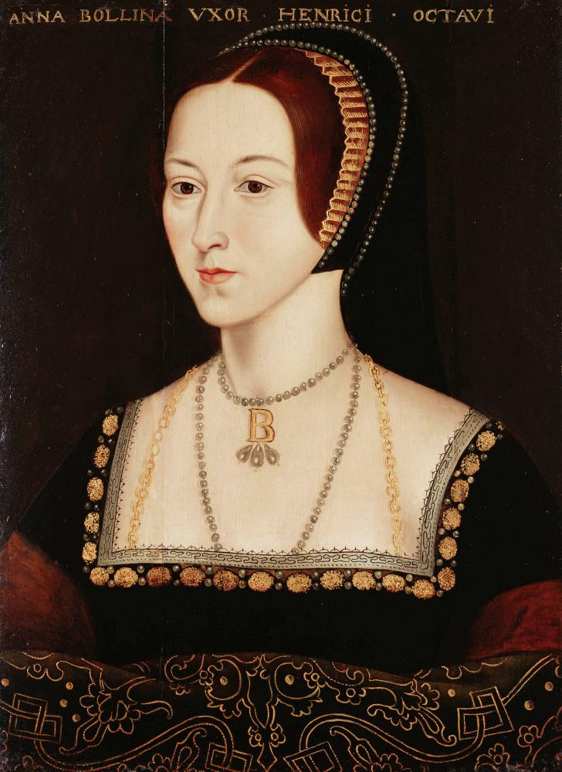
Anne Boleyn -© Royal Collection Enterprises Ltd 2026 | Royal Collection Trust
© Royal Collection Trust
Notes:
Anne Boleyn -© Royal Collection Enterprises Ltd 2026 | Royal Collection Trust

Slide 5
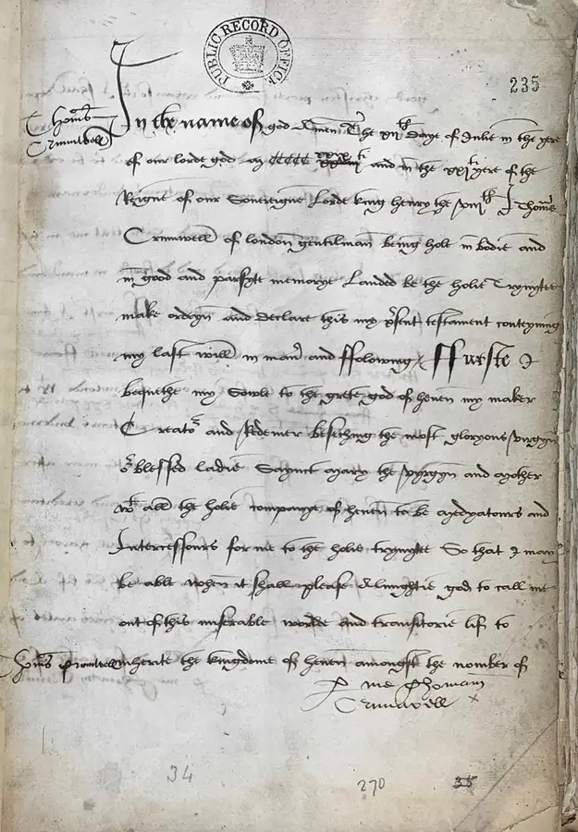
Excerpt from Thomas Cromwell’s will, originally written on 12 July 1529
© The National Archives
Notes:
Excerpt from Thomas Cromwell’s will, originally written on 12 July 1529 - Credit: The National Archives

Slide 6
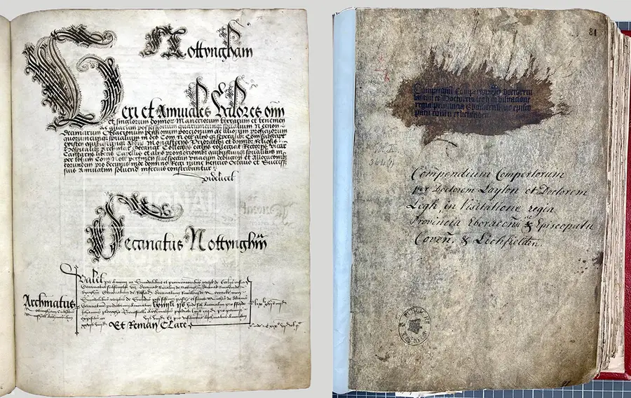
Excerpt from Thomas Cromwell’s Notes
© The National Archives
Notes:
Excerpt from Thomas Cromwell’s Notes- Credit: The National Archives

Slide 7
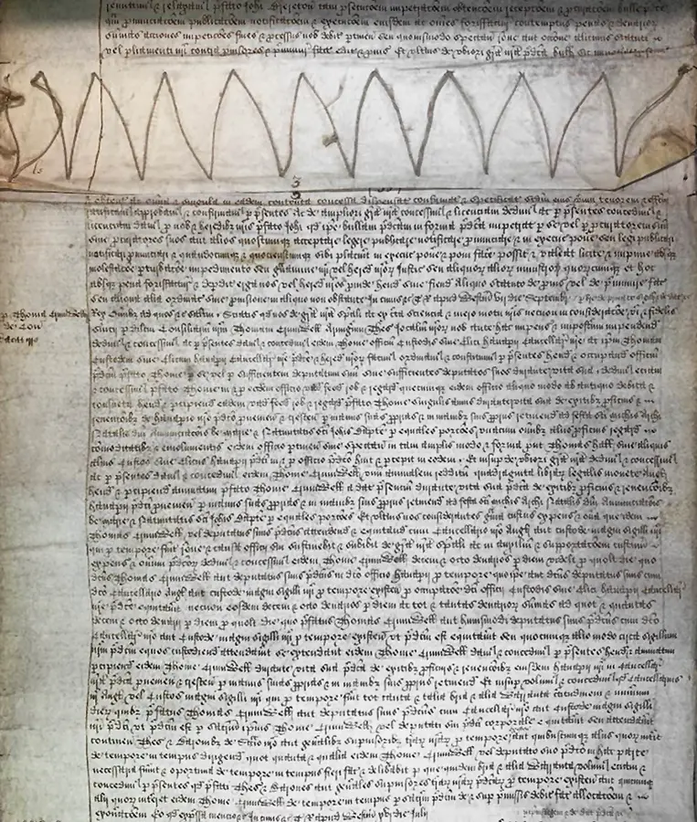
Patent roll showing the letter appointing Cromwell to royal service, 3 July 1532
© The National Archives
Notes:
Patent roll showing the letter appointing Cromwell to royal service, 3 July 1532- Credit: The National Archives

Slide 8
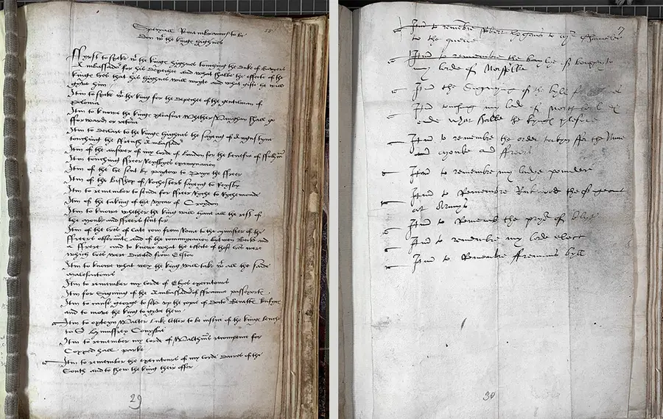
Thomas Cromwell’s notebook from the 1530s
© The National Archives
Notes:
Thomas Cromwell’s notebook from the 1530s- Credit: The National Archives

Slide 9
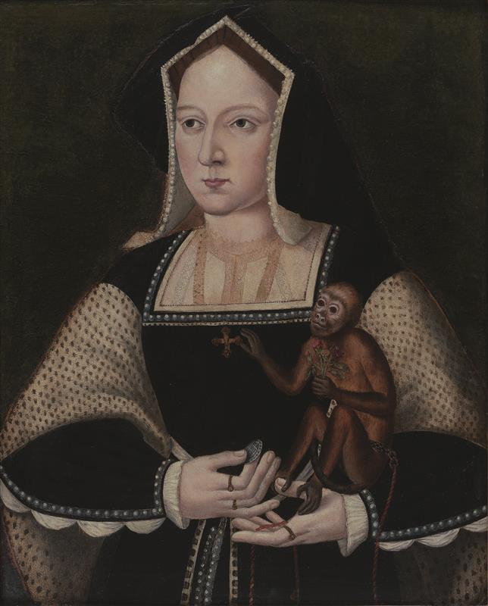
Katherine of Aragon Portrait - Photo © Philip Mould Ltd, London / Bridgeman Images
© © Philip Mould Ltd, London / Bridgeman Images
Notes:
Katherine of Aragon - Photo © Philip Mould Ltd, London / Bridgeman Images

Slide 10
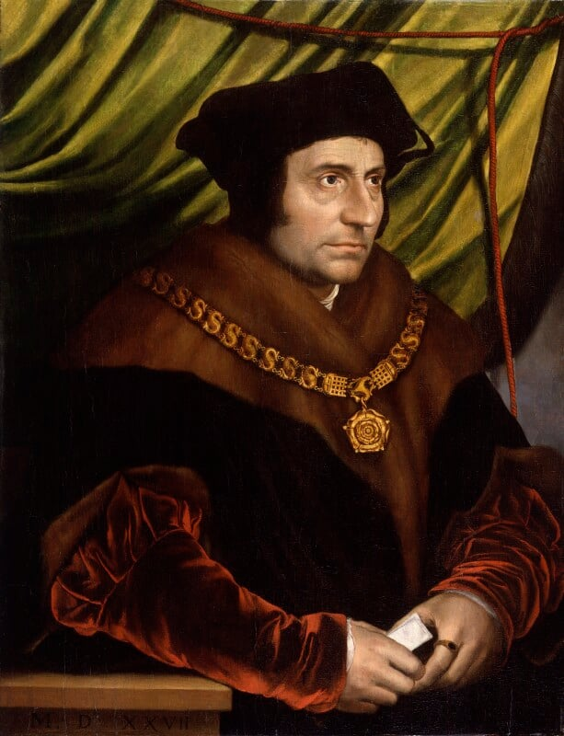
Sir Thomas More – National Portrait Gallery
© National Portrait Gallery - CC BY-NC-ND 3.0 - Attribution-NonCommercial-NoDerivs 3.0 Unported
Notes:
Sir Thomas More – National Portrait Gallery - CC BY-NC-ND 3.0 - Attribution-NonCommercial-NoDerivs 3.0 Unported

Slide 11
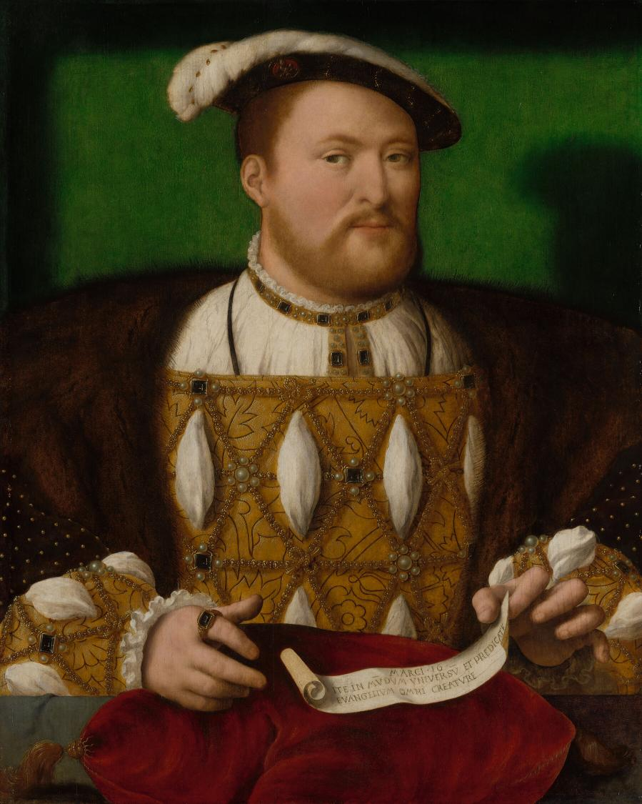
Henry VIII -© Royal Collection Enterprises Ltd 2026 | Royal Collection Trust
© Royal Collection Trust
Notes:
Henry VIII -© Royal Collection Enterprises Ltd 2026 | Royal Collection Trust

Slide 12
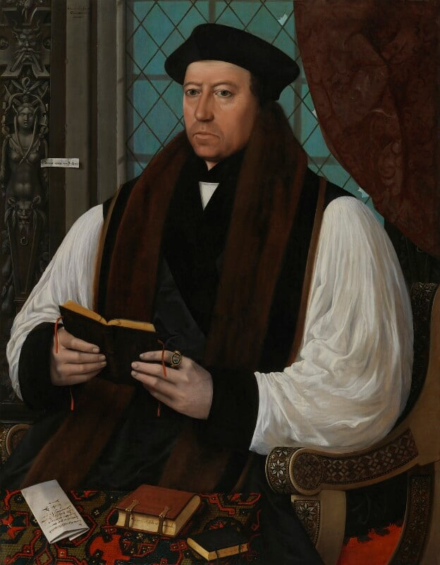
Sir Thomas Cranmer – National Portrait Gallery
© National Portrait Gallery - CC BY-NC-ND 3.0 - Attribution-NonCommercial-NoDerivs 3.0 Unported
Notes:
Sir Thomas Cranmer – National Portrait Gallery - CC BY-NC-ND 3.0 - Attribution-NonCommercial-NoDerivs 3.0 Unported

Slide 13
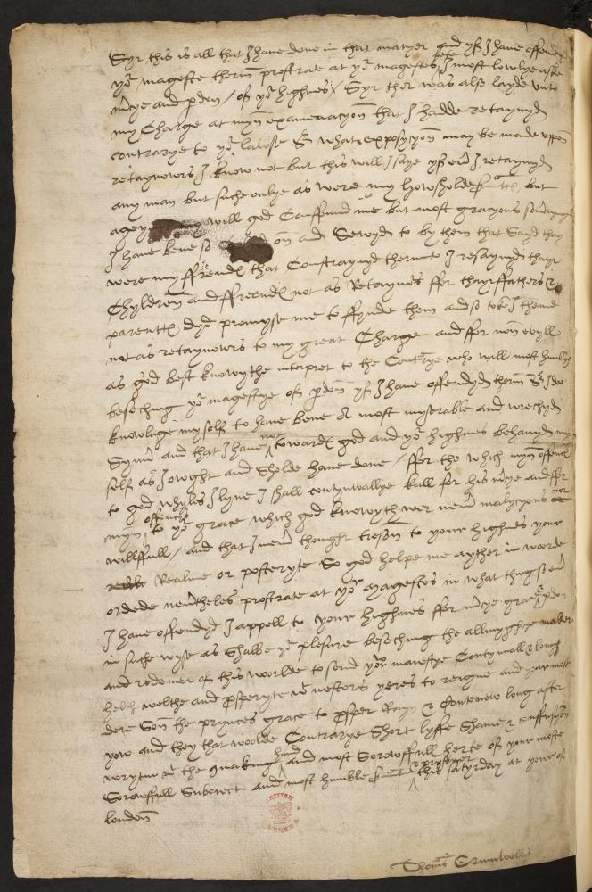
Thomas Cromwell’s notes - Courtesy of the British Library Shelfmark: Cotton Titus B. I
© The British Library
Notes:
Thomas Cromwell’s notes - Courtesy of the British Library Shelfmark: Cotton Titus B. I

Slide 14
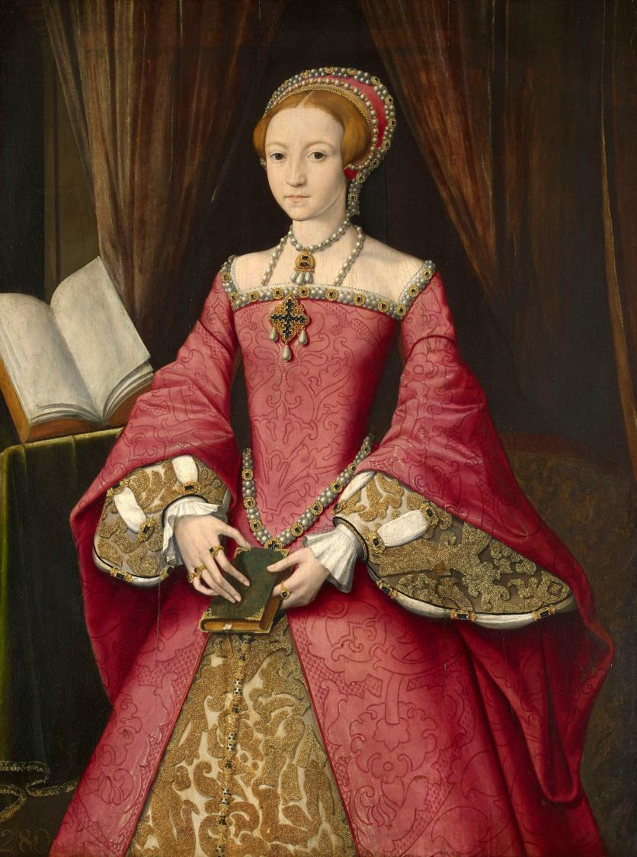
Elizabeth aged 13-© Royal Collection Enterprises Ltd 2026 | Royal Collection Trust
© Royal Collection Trust
Notes:
Elizabeth aged 13-© Royal Collection Enterprises Ltd 2026 | Royal Collection Trust

Slide 15
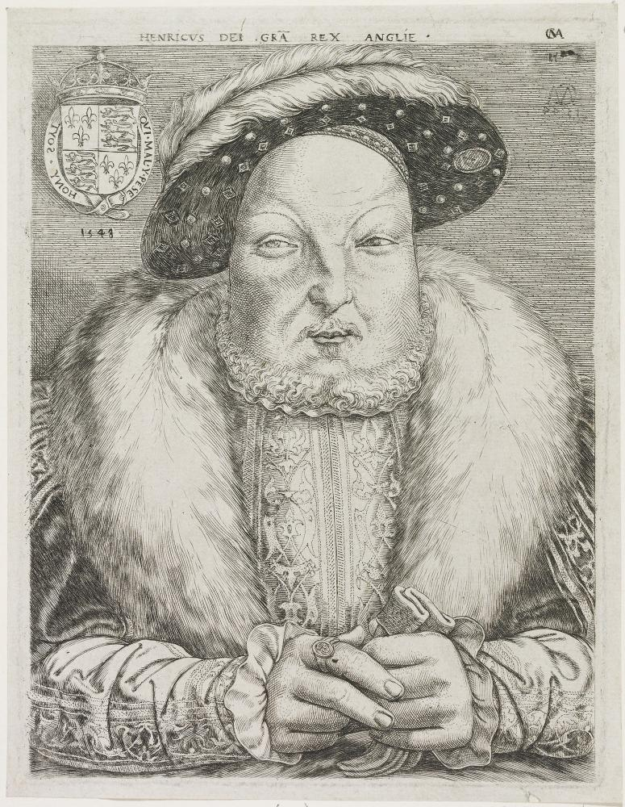
Henry VIII - © Royal Collection Enterprises Ltd 2026 | Royal Collection Trust
© Royal Collection Trust
Notes:
Henry VIII - © Royal Collection Enterprises Ltd 2026 | Royal Collection Trust

